Slide 1



SMART INDIA HACKATHON 2026
TITLE PAGE
  Problem Statement ID – 26073
  Problem Statement Title- AI/ML-Based Intelligent Anomaly Detection for Automatic Weather Stations (AWS)
  Theme- Disaster Management
  PS Category- Software
  Team ID- DIS05
  Team Name - PralayDisha

Slide 2




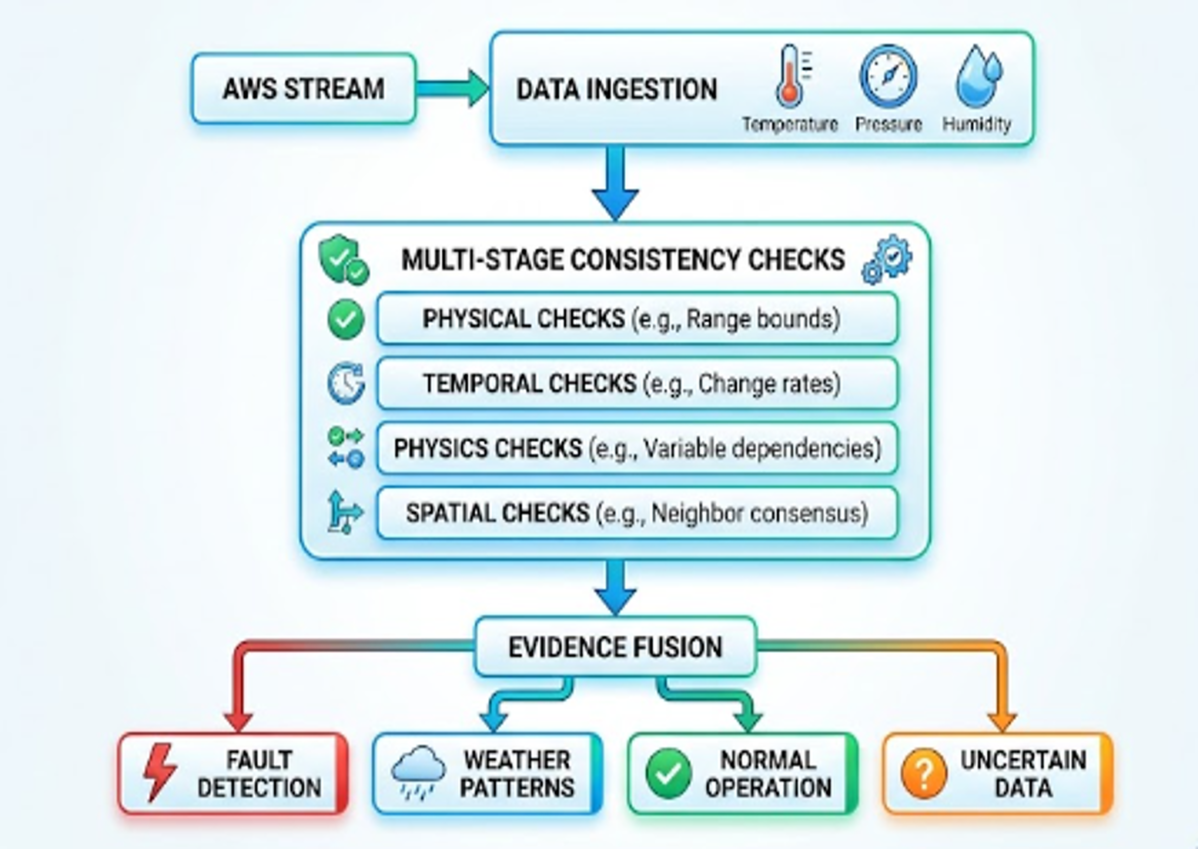
SkyGuard AI: Real-Time Anomaly Detection for AWS
PralayDisha
Problem
Our Idea
Every reading gets a verdict
AWS readings can be corrupted by sensor faults, drift, power and communication failures.
Simple threshold checks can flag genuine extreme weather as bad data.
With many stations, manual checking is slow and unreliable
SkyGuard AI is a real-time, explainable quality-control layer for Automatic Weather Stations. Using only temperature, pressure and humidity, it answers one question for every reading.
SENSOR FAULT
Abnormal reading → fault type + alert
WEATHER EVENT
Sensors + nearby stations agree → keep
NORMAL
Consistent across time and sensors
Is this a faulty sensor or genuine weather?
UNCERTAIN
Low confidence → human review
Proposed Solution
Innovation / Uniqueness
Collect T, P, RH from AWS.
Check physical, temporal and spatial patterns.
Combine evidence to identify fault vs weather.
Report verdict, fault type, confidence and alert.
Dashboard and alerts show station health, anomaly timeline and maintenance actions.
Fault vs. weather: uses multiple evidence sources before rejecting a reading.
Root Cause diagnosis: spike, stuck value, drift, noise, dropout, cross-sensor mismatch.
Explainable: confidence score and SHAP reasons for every alert.
Predictive sensor health: detects slow drift before failure
Only T, P, RH needed: no extra sensors or hardware
Unique: We determine whether the abnormality comes from the sensor or from the weather.
2
Notes:
2

Slide 3
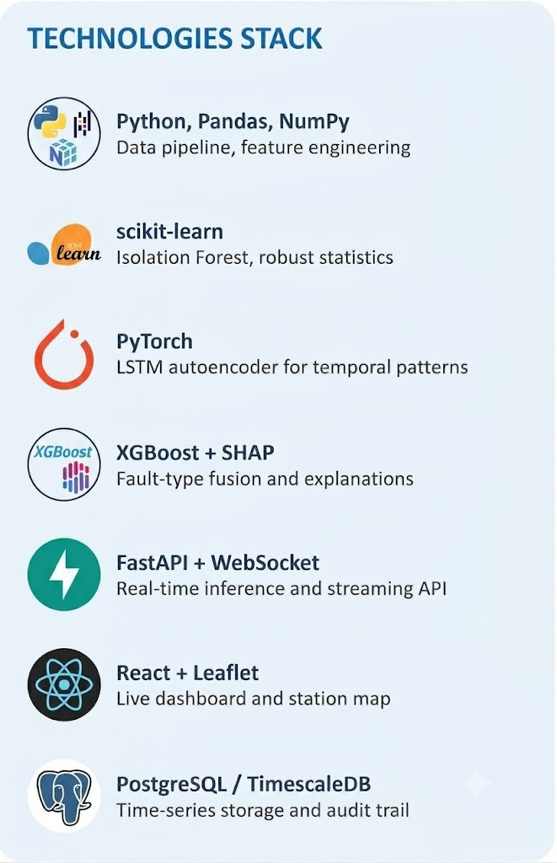





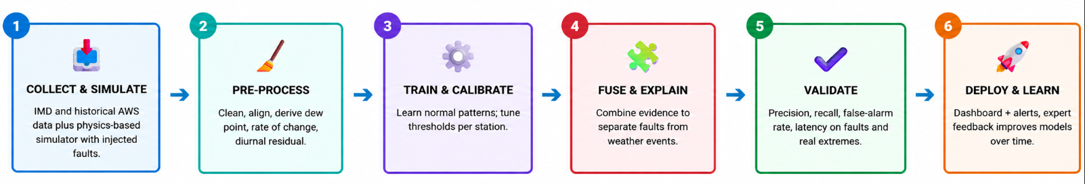

TECHNICAL APPROACH
PralayDisha
SYSTEM ARCHITECTURE
AWS Network
Stations report
Temperature
Pressure
Humidity
Ingestion and Cleaning
Validate and time-align
Fill gaps, drop duplicates
Derive dew point, rate of change, diurnal residual
Detection Engine (4 layers)
Fusion and Diagnosis
Evidence Fusion
XG Boost classifier
→ Verdict + Fault Type
→ Confidence + Explanation
Action Layer
Live dashboard
Alerts
Maintenance tickets
API to IMD QC
L1 Physical & Rule QC
Range, step-change, flatline
L2 Temporal ML
Isolation Forest + LSTM-AE
L3 Multivariate physics
Dew point ≤ temperature
T-P-RH consistency
L4 Spatial Buddy Check
Compare with nearby AWS stations
IMPLEMENTATION METHODOLOGY
3
Notes:
3

Slide 4




FEASIBILITY AND VIABILITY
PralayDisha
Technical Feasibility
Operational Viability
Mature open-source ML: Isolation Forest, LSTM autoencoder and XGBoost are well documented tools.
Only 3 inputs: Temperature, pressure and humidity are already reported by every AWS so no new hardware.
Real-time capable: Lightweight per-station inference can run on standard servers.
Physics reduces label dependency: Dew-point and T/P/RH consistency help when fault labels are scarce.
Drop-in QC layer: Sits between the AWS data and downstream products with minimal workflow changes.
Transparent alerts: fault type, confidence and evidence for every flag.
Human in the loop: Uncertain cases go to experts for review.
Targeted maintenance: Sensor-health trends help prioritize station visits.
Economic Feasibility
Challenges and Mitigation
No proprietary license dependency: Uses an open-source software stack.
Software-only upgrade: Uses on the existing AWS network with no new sensors.
Fewer unnecessary visits: Early fault detection helps prioritize maintenance.
Scalable deployment: Processing can scale with the number of stations.
RISK
MITIGATION
Few labelled real faults
Fault injection + physics-based simulation, learn normal patterns
Real extremes look like faults
Spatial buddy check and physical plausibility before verdict
Stations with few neighbours
Fall back to temporal + multivariate layers, lower confidence
Seasonal model drift
Seasonal baselines + periodic recalibration + expert feedback
4
Notes:
4

Slide 5
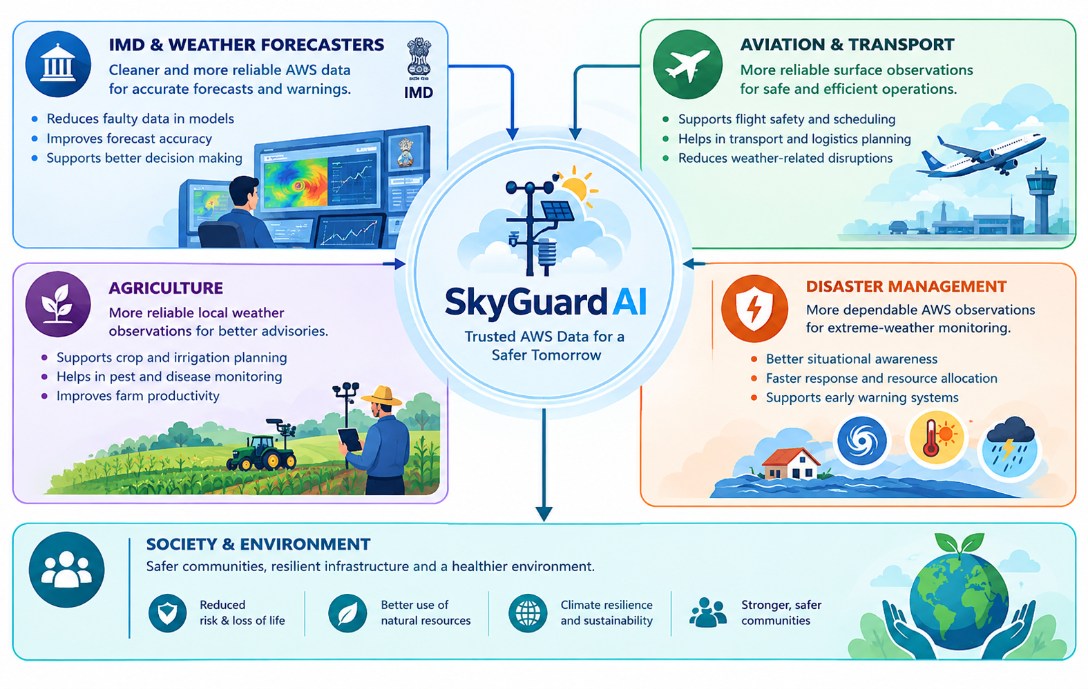






IMPACT AND BENEFITS
PralayDisha
KEY IMPACTS: WHO GAINS
BENEFITS
Trusted data: Faulty readings are flagged before reaching downstream forecasts and advisories.
Fewer false alarms: Genuine heatwaves and squalls are preserved, not rejected.
Faster maintenance: Fault type and sensor-health trends help prioritize station visits.
Explainable decisions: Confidence and evidence show why a reading was flagged.
Real-time operation: Designed for continuous anomaly detection as readings arrive.
IMPACT AND SCALABILITY
Pilot
Single AWS station
Regional
State AWS cluster
National
Full IMD AWS network
Beyond
Rainfall, wind, other sensor networks
5
Notes:
5

Slide 6
RESEARCH AND REFERENCES
PralayDisha
SUPPORTING RESEARCH PAPERS
DATA SOURCES
Liu, Ting & Zhou (2008): Isolation Forest. IEEE ICDM → LINK
Malhotra et al. (2016): LSTM Encoder-Decoder for Multi-Sensor Anomaly Detection. ICML Workshop → LINK
Lundberg & Lee (2017): A Unified Approach to Interpreting Model Predictions (SHAP). NeurIPS → LINK
Chandola, Banerjee & Kumar (2009): Anomaly Detection: A Survey. ACM Computing Surveys → LINK
Estévez et al. (2011): Validation procedures for AWS meteorological data. J. Hydrology → LINK
India Meteorological Department: AWS observation network and data portal (mausam.imd.gov.in) → LINK
ERA5 reanalysis, Copernicus CDS: climatological baselines (Hersbach et al., 2020) → LINK
In-house physics-based AWS simulator: labelled fault injection (spike, stuck, drift, noise, dropout) and real-extreme scenarios
Live AWS feed: pipeline accepts streaming T, P, RH observations from IMD when authorized
TECHNICAL DOCUMENTATION AND STANDARDS
RESEARCH AND TECHNOLOGY CONTEXT
WMO-No. 8: Guide to Instruments and Methods of Observation (measurement and QC practice) → LINK
Lawrence (2005), BAMS: relative humidity to dew-point relation (Magnus form) for physical consistency checks
Library docs: scikit-learn, PyTorch, XGBoost, SHAP, FastAPI
Physics-informed QC: physical limits remove impossible values
Spatial buddy check: separates a local fault from regional weather
Unsupervised + ensemble ML: supports detection of previously unseen anomalies
Explainable AI: shows why a reading was flagged
6
Notes:
6

