Slide 1

Presented by
R Sri Vignesh Reddy (2500032436)
D. Saishashank (2500032397)
Gnana (2500032614)

Slide 2
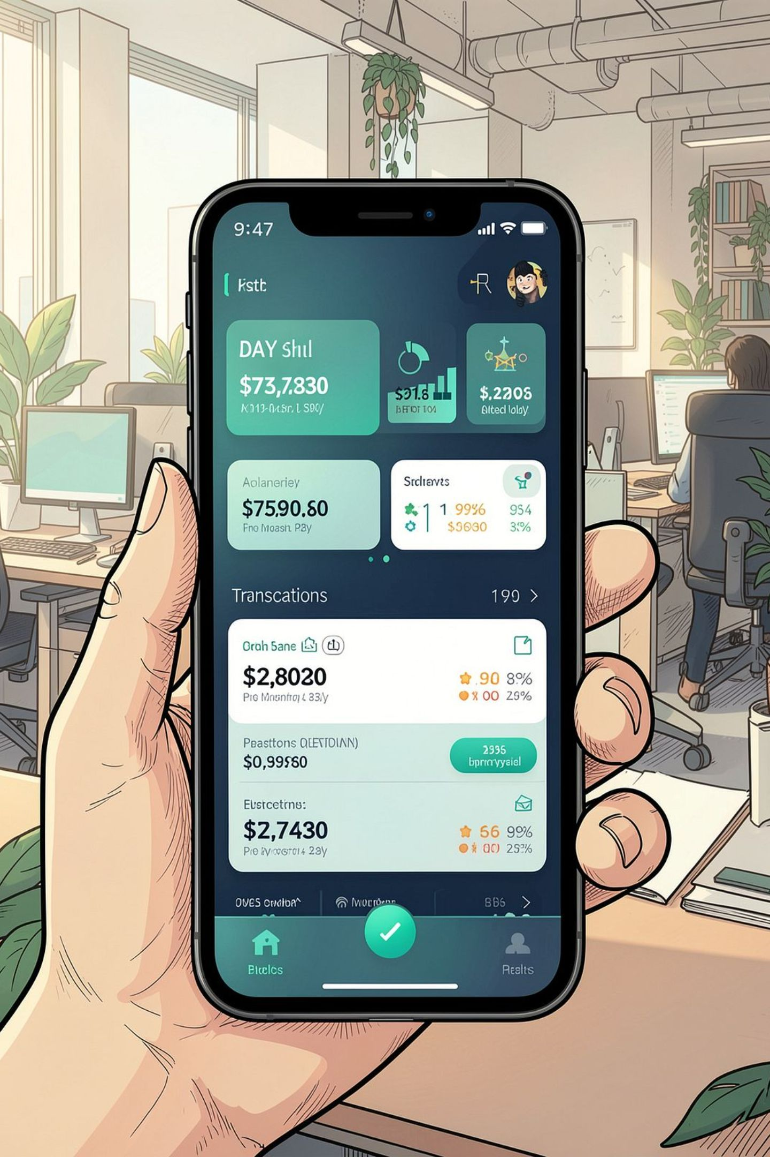
The Digital Banking Revolution: From ATMs to AI
How online banking evolved from physical terminals to intelligent, always-on financial platforms — delivering convenience, control, and security to customers everywhere.

Slide 3
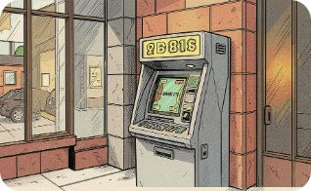
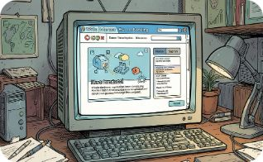

The Dawn of Virtual Banking
Early Beginnings
First Virtual Bank
Always‑On Access
1980s: Telebanking and ATM networks started shifting routine banking tasks out of branches.
1995: Security First Network Bank launched — an early milestone for purely online banking services.
Shift from branch reliance to 24/7 electronic access enabled by web and mobile platforms.

Slide 4
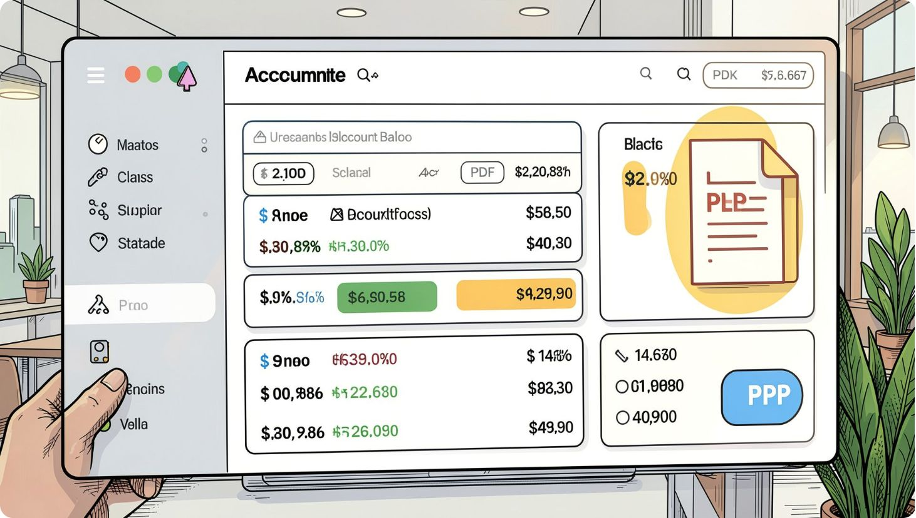

Core Features: Banking at Your Fingertips
What users expect
Account management: real-time balances, downloadable statements and easy reconciliation
Fund transfers: instant transfers between linked accounts, interbank rails like IMPS/RTGS
Bill payments: one-off and automated recurring payments with reminders and confirmation receipts
Design cues: use primary theme color #26A688 for CTAs and confirmation states.

Slide 5
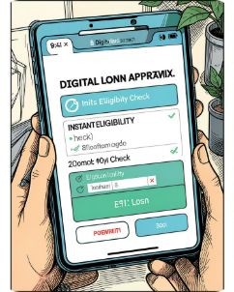
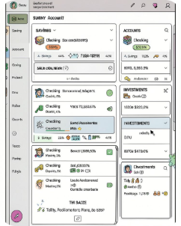
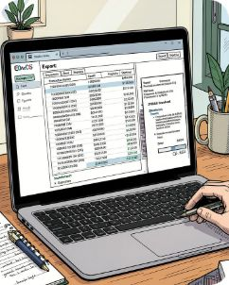
Advanced Financial Services
Loan Requests
Multi‑Account Oversight
Transaction History
Digital eligibility checks, soft credit pulls, and fast approvals reduce friction for borrowers.
Consolidated view for savings, checking and investment portfolios with quick-switch account controls.
Detailed, exportable transaction logs and statements for budgeting, taxes and record‑keeping.

Slide 6
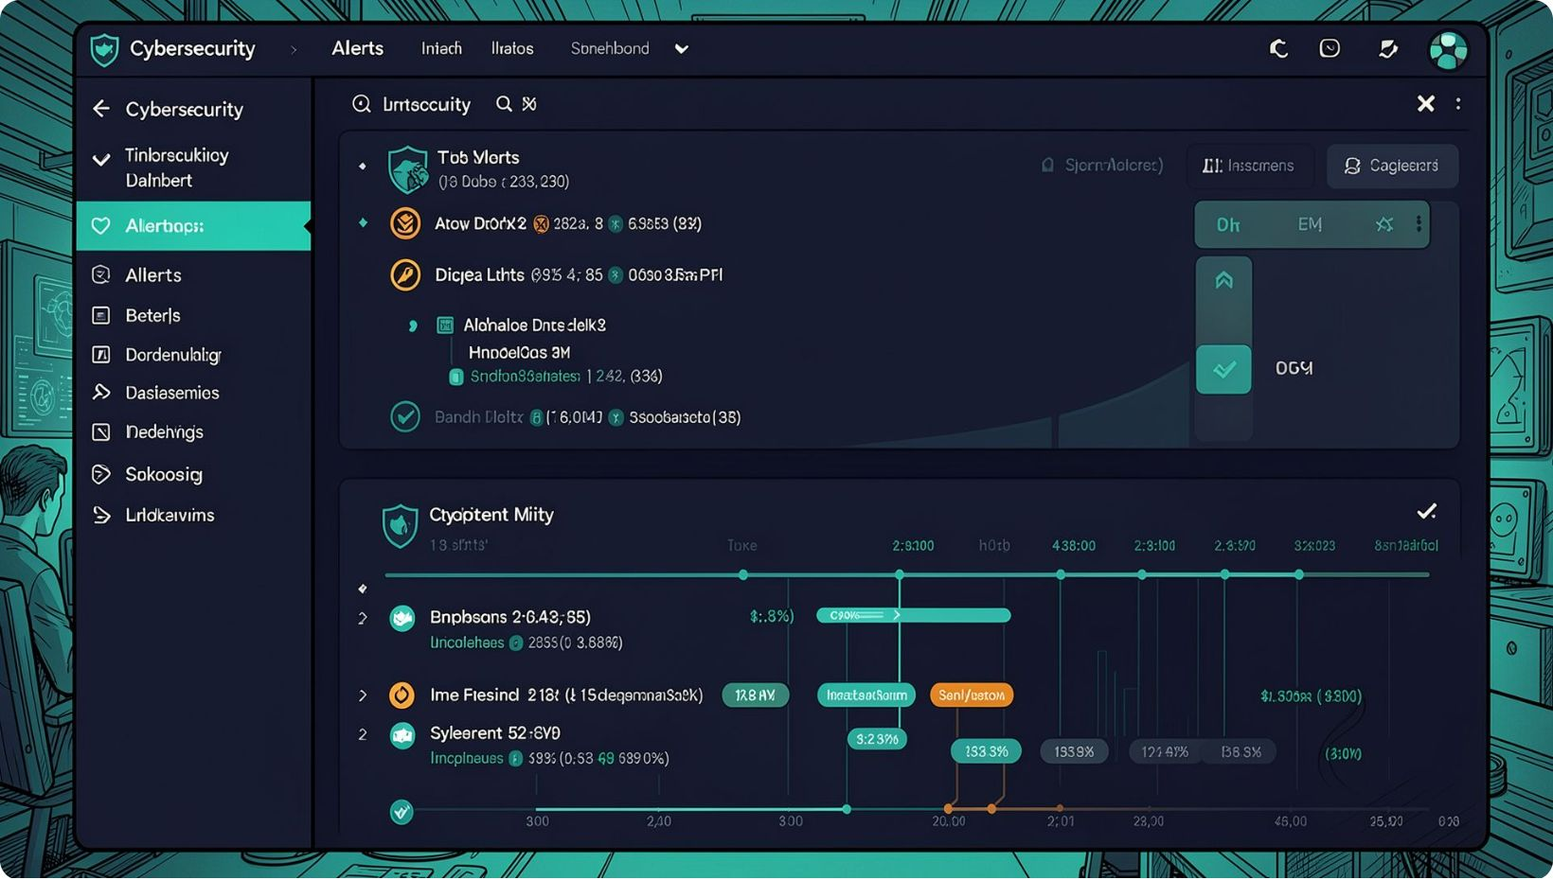
The Security Imperative
Protecting user funds and data is non-negotiable. Threats include phishing, pharming, identity theft and account takeover. Security must be layered, transparent, and user-friendly.
Encryption: SSL/TLS for data-in-transit, strong cryptographic standards for data-at-rest
Infrastructure: hardened servers, firewalls, and segmented networks
Monitoring: real-time threat detection and incident response

Slide 7
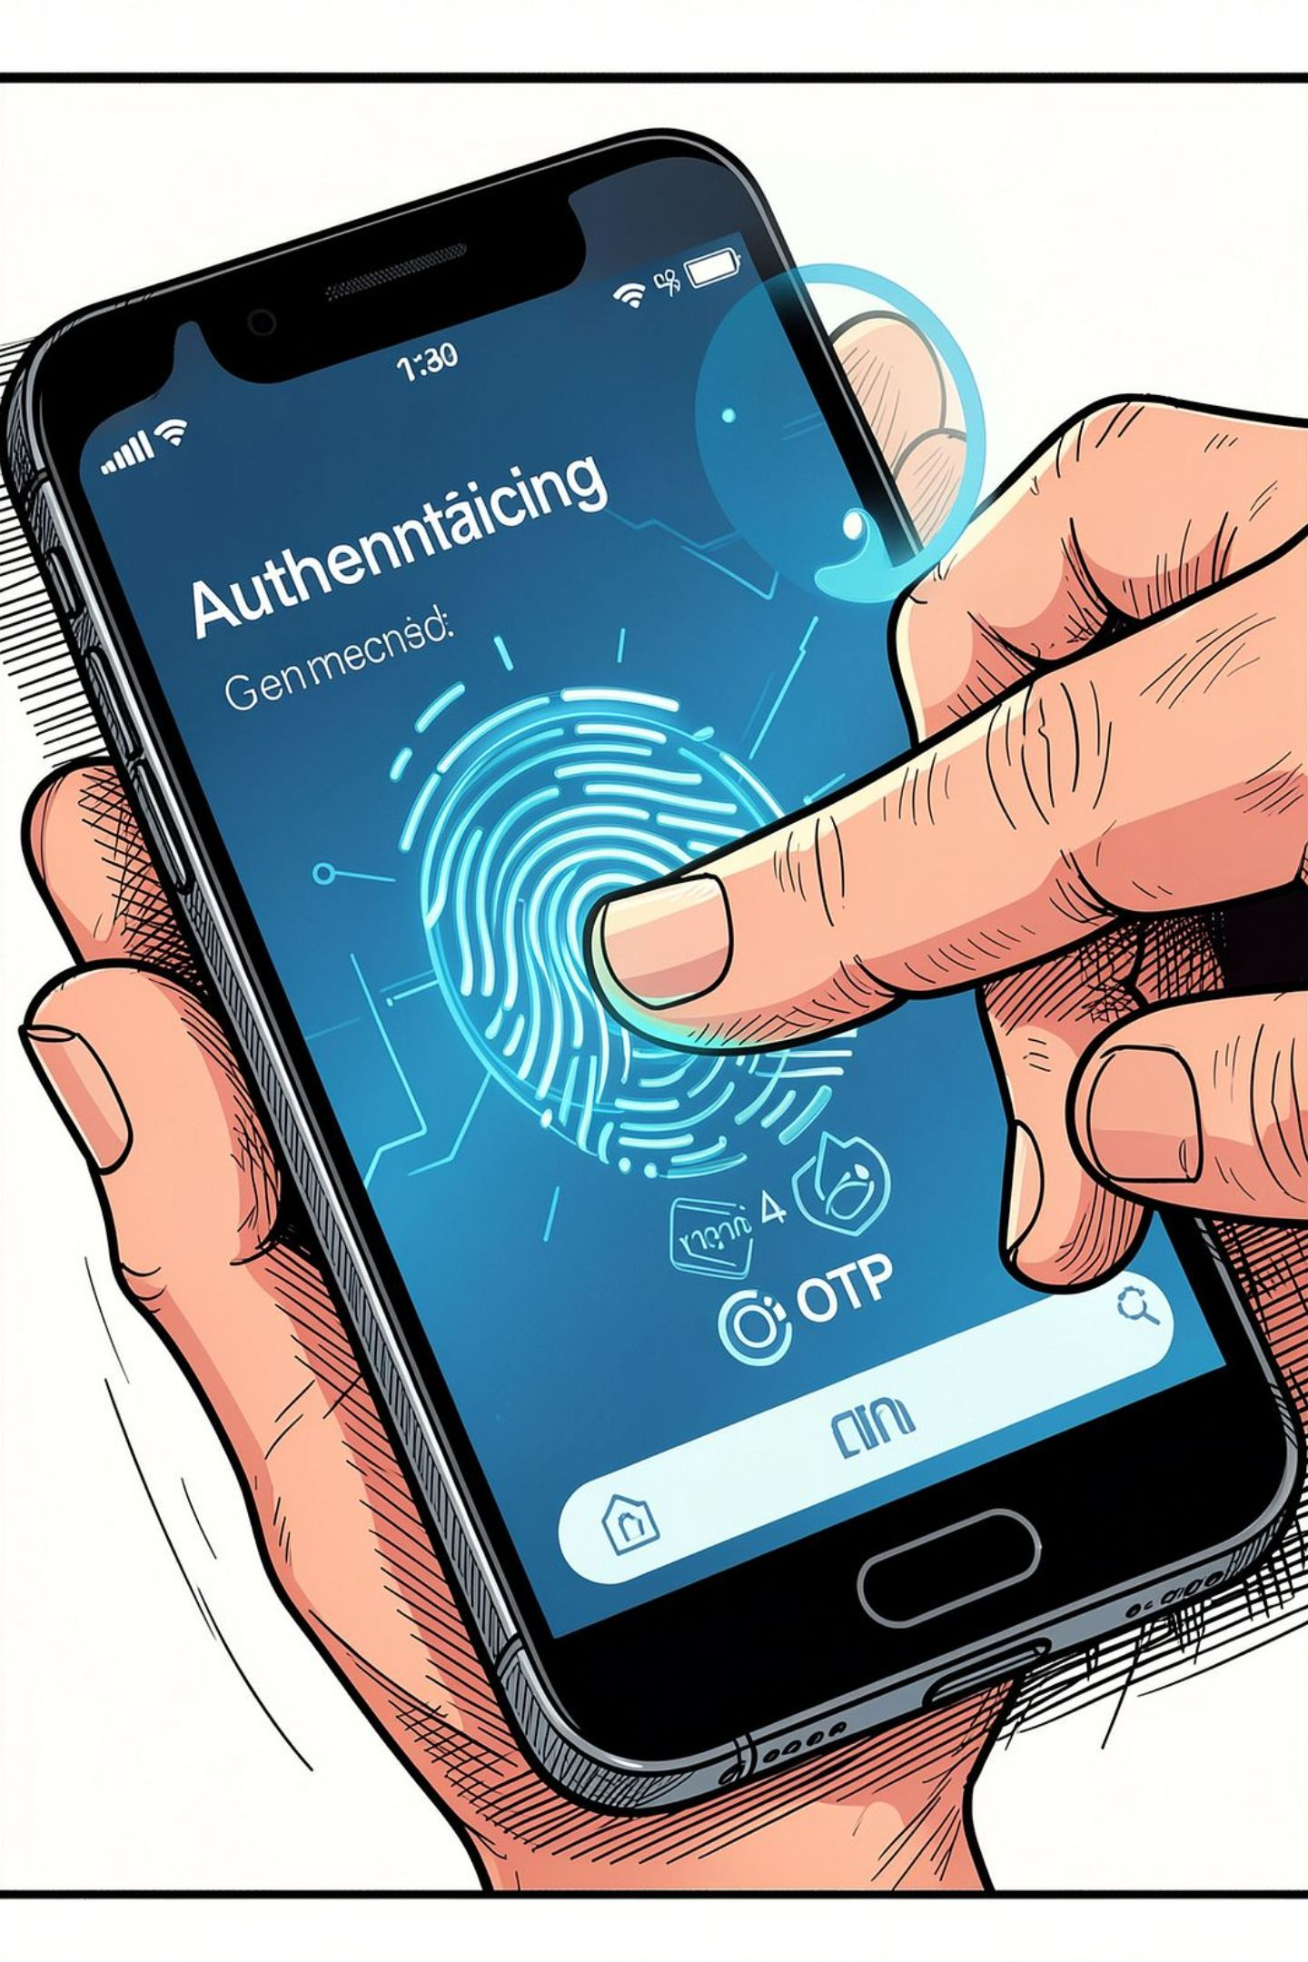
Multi‑Factor Authentication (MFA)
Knowledge
Possession
Strong passwords, PINs, and device‑bound passcodes. Encourage unique, complex credentials and periodic rotation.
One-time passwords (SMS/APP), hardware tokens, and device fingerprinting for trusted devices.
Inherence
Biometrics: fingerprint, face recognition and behavioural signals to reduce friction while increasing assurance.
Combine factors adaptively — step-up authentication for high‑risk actions like large transfers or new payee additions.

Slide 8

Fintech Integration & Emerging Tech
AI / ML: Real‑time fraud detection, personalised offers, credit decisioning and cash‑flow forecasting.
Blockchain: Immutable ledgers for high‑value settlements and audit trails.
Biometrics: Passive authentication and continuous trust signals for frictionless user experiences.

Slide 9
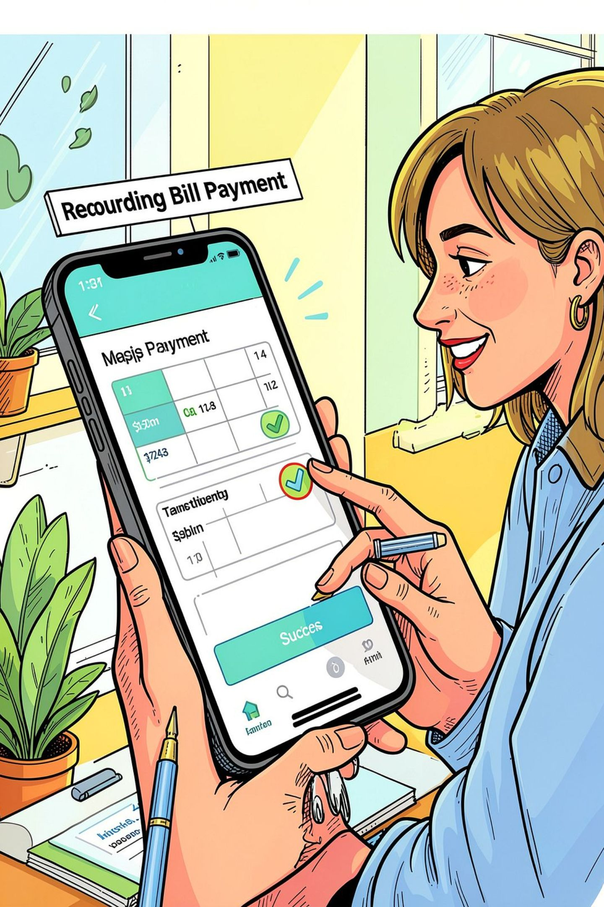




Best Practices for the Digital User
Password Hygiene
Use unique passphrases, a password manager, and enable MFA for every account.
Vigilance
Review account activity regularly and set alerts for unusual transactions.
Education
Learn to recognise phishing and social engineering; never share OTPs or credentials.
Tip: Enable transaction limits and add beneficiary whitelists for additional protection.

Slide 10
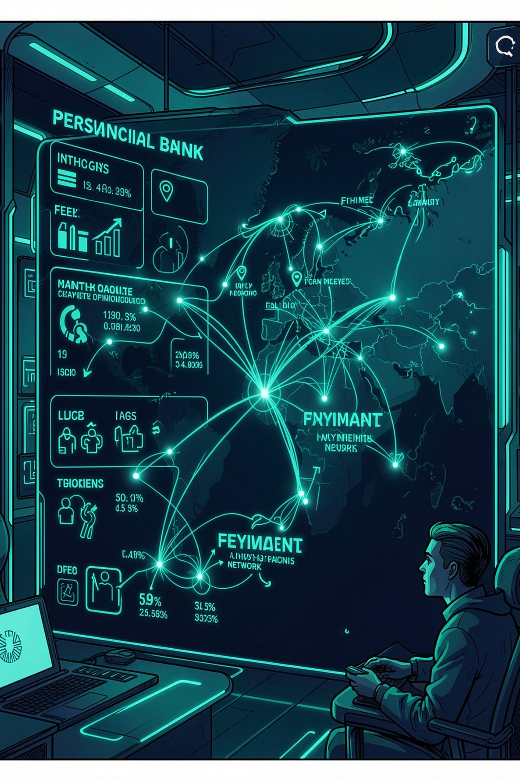
The Future of Banking
Expect hyper-personalised financial advice, immediate interbank settlement, and seamless global connectivity. Banks will blend AI-driven guidance with strong privacy-preserving security to create deeply personalised yet safe services.
Hyper-personalisation: tailored budgets, saving nudges and investment suggestions
Instant payments: real‑time rails and immediate settlements
Global reach: integrated cross-border payments with transparent FX and fees

Slide 11

Conclusion: A Secure Future
Banking is now a service you use — anytime, anywhere. Success depends on continuous innovation paired with robust security: encryption, adaptive MFA, and user education. The goal is to empower customers with control, clarity and confidence.
Next Steps for Teams
Final Thought
Innovation + vigilance = trust. Design systems that make secure banking effortless.
Prioritise secure UX: reduce friction while increasing assurance
Invest in AI for fraud detection and personalization
Educate customers and build transparent security controls

