Slide 1
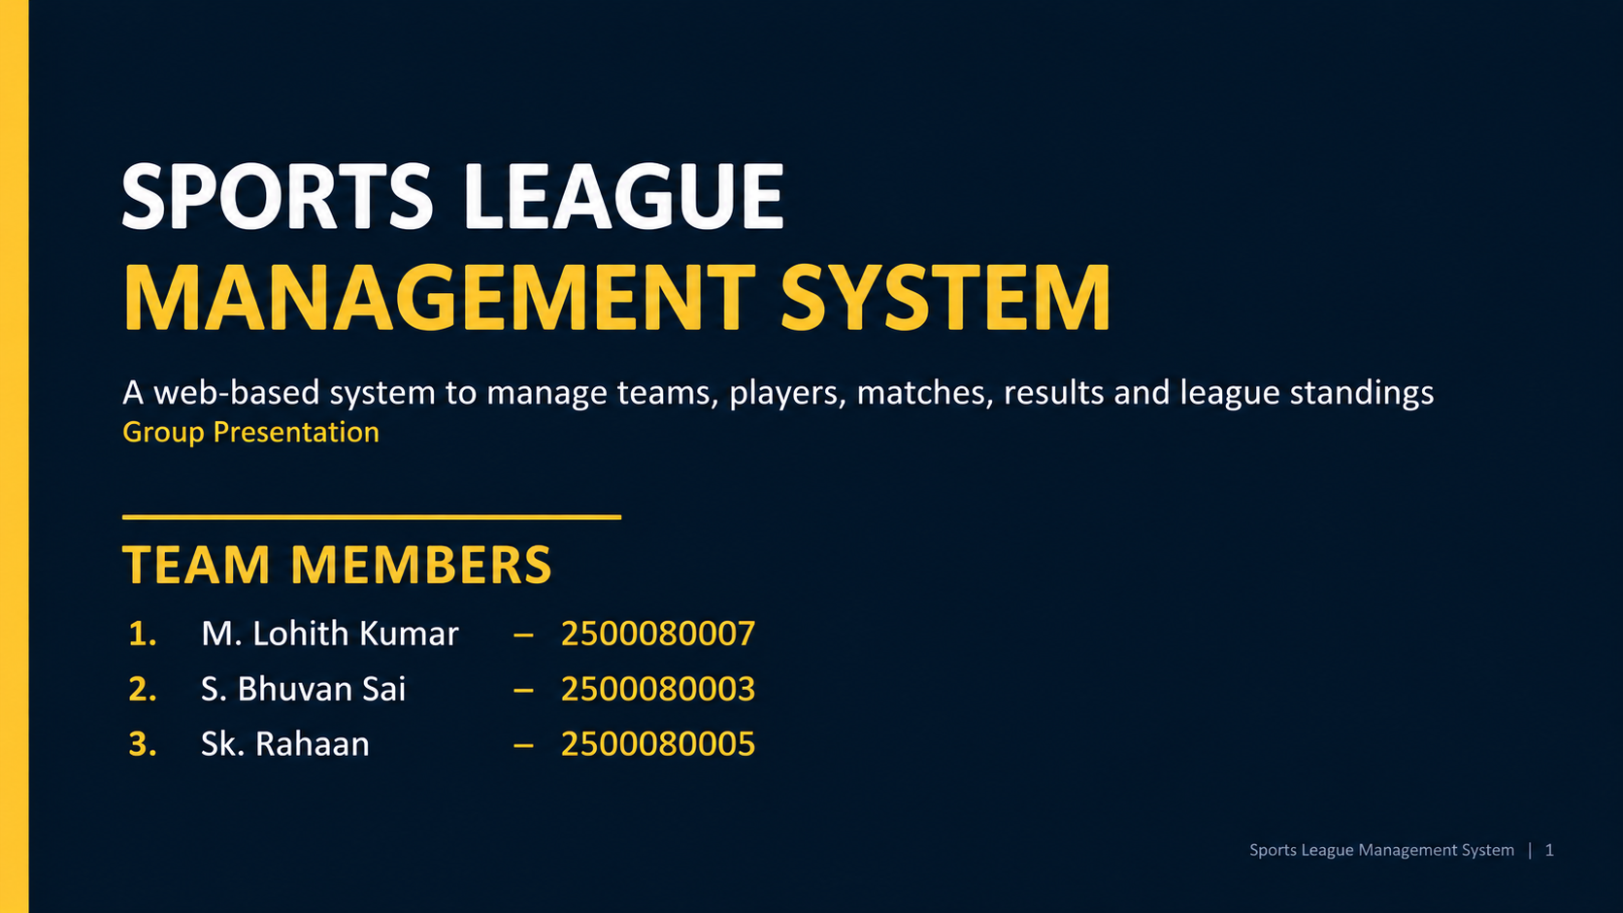
1. Project Introduction
• Sports League Management System is a simple web application for managing a sports league.
• It brings teams, players, matches, results and standings into one platform.
• The home page provides navigation to login, signup and league features.
• The system supports separate Admin and User dashboards.
Sports League Management System | 2

Slide 2
2. Problem Statement
• Managing league information manually can be difficult and time-consuming.
• Team, player, match and result information may be scattered across different records.
• Users need an easy way to view league information.
• Administrators need a simple way to add and manage league data.
Sports League Management System | 3

Slide 3
3. Objectives
• Create a simple and user-friendly sports league website.
• Provide Admin and User access.
• Manage teams and player information.
• Schedule matches and record match results.
• Automatically calculate and display league standings.
• Store application data using browser Local Storage.
Sports League Management System | 4

Slide 4
4. Technologies Used
• HTML – Used to create the structure of all web pages.
• CSS – Used for layouts, backgrounds, cards, tables, forms and responsive design.
• JavaScript – Used for login, signup, data handling and dynamic page content.
• Local Storage – Used to store users, teams, players, matches and results in the browser.
• VS Code – Used for development and testing.
Sports League Management System | 5

Slide 5
5. Main Modules
Home
Project introduction and navigation
Authentication
Signup and role-based login
Admin
Manage league information
User
View league information
Teams
Add and view teams
Players
Add and view players
Matches
Schedule and view matches
Results
Add and view match results
Standings
Calculate and display points table
Sports League Management System | 6

Slide 6
6. System Flow
Home
Signup / Login
Role Check
Admin Dashboard
User Dashboard
Admin → Teams / Players / Matches / Results
User → View Teams / Players / Matches / Results / Standings
Sports League Management System | 7

Slide 7
7. Login & Signup
• Signup page collects Name, Email and Password.
• New user details are stored in Local Storage.
• Login allows the user to select User or Admin role.
• Admin login checks the configured admin credentials.
• User login checks the stored user list.
• After successful login, the user is redirected to the correct dashboard.
Sports League Management System | 8

Slide 8
8. Admin Module
• Admin Dashboard provides management options for Teams, Players, Matches and Results.
• Admin can add new teams.
• Admin can add player details such as name, team and age.
• Admin can schedule matches with teams, date and venue.
• Admin can enter match scores and calculate the winner.
• Admin can view the current league standings.
Sports League Management System | 9

Slide 9
9. User Module
• User Dashboard provides view-only access to league information.
• Users can view teams and players.
• Users can view upcoming matches.
• Users can view match results.
• Users can view the league standings.
Sports League Management System | 10

Slide 10
10. Data Management
• The project uses browser Local Storage instead of a separate database.
• User accounts are stored under the users data.
• Teams, players, matches and results are stored as browser data.
• JavaScript reads the stored data and dynamically updates tables.
• This makes the project lightweight and easy to demonstrate.
Sports League Management System | 11

Slide 11
11. League Standings
• The standings page creates a table for each team.
• It tracks Played, Won, Lost, Draw and Points.
• A win gives 3 points.
• A draw gives 1 point to each team.
• Teams are sorted by points to display the league ranking.
Sports League Management System | 12

Slide 12
12. User Interface
• Sports-themed interface with cricket images and dark backgrounds.
• Navigation bar is provided across the main pages.
• Cards are used for features and dashboard options.
• Forms are used for login, signup and admin data entry.
• Tables are used to display teams, players, matches, results and standings.
• CSS Grid and Flexbox are used for layout and responsive design.
Sports League Management System | 13

Slide 13
13. Advantages
• Simple and easy to use.
• Centralized league information.
• Separate Admin and User functionality.
• Dynamic data display using JavaScript.
• No external database is required for this prototype.
• Responsive layout for different screen sizes.
Sports League Management System | 14

Slide 14
14. Future Enhancements
• Connect the application to a real database.
• Add secure authentication with encrypted passwords.
• Add edit and delete operations for league records.
• Add team logos and detailed player profiles.
• Add automatic match scheduling.
• Add live scores, notifications and advanced statistics.
Sports League Management System | 15

Slide 15
CONCLUSION
The Sports League Management System provides a simple web-based solution for managing league information.
It demonstrates HTML, CSS, JavaScript and Local Storage through a practical project.
Thank You
Sports League Management System | 17

