Slide 1
♫ BeatFlow
MUSIC STREAMING APP
SDC Project Review – 1
HTML • CSS • JavaScript • Local Storage

Slide 2
1. Problem Statement
• Users need one simple platform to discover, play and organize music.
• Searching music from different sources is inconvenient and time-consuming.
• Users expect playlists, search, reviews, recommendations and offline access.
• BeatFlow provides these core music-management features in a single web interface.

Slide 3
2. Project Objectives
Easy Access
Personalization
Role-Based System
Allow users to quickly search and discover songs by track, artist, album or genre.
Support playlists, reviews, ratings, recommendations and offline-track management.
Provide separate User and Admin modules with JavaScript-based navigation.
Responsive UI
Frontend Storage
Build the interface using CSS Flexbox/Grid for a clean and usable layout.
Use Local Storage for signup, login and project data as required for Review–1.

Slide 4
3. Technologies Used
HTML
CSS
JavaScript
Local Storage
Creates the structure of landing page, forms, dashboards, music cards and admin screens.
Handles the BeatFlow dark theme, responsive layout, Grid/Flexbox, buttons and cards.
Implements authentication, role redirection, search, playback, playlists and admin actions.
Stores registered users and frontend application data directly in the browser.
• No backend framework or database is used in the current SDC Review–1 version.

Slide 5
4. Application Flow / Architecture
1
Landing Page
2
Signup / Login
3
Role Check
4
User / Admin Dashboard
5
Features + Local Storage
• JavaScript controls validation, role-based redirection and dynamic UI updates.
• Local Storage acts as the browser-side data store for this frontend-only project.

Slide 6
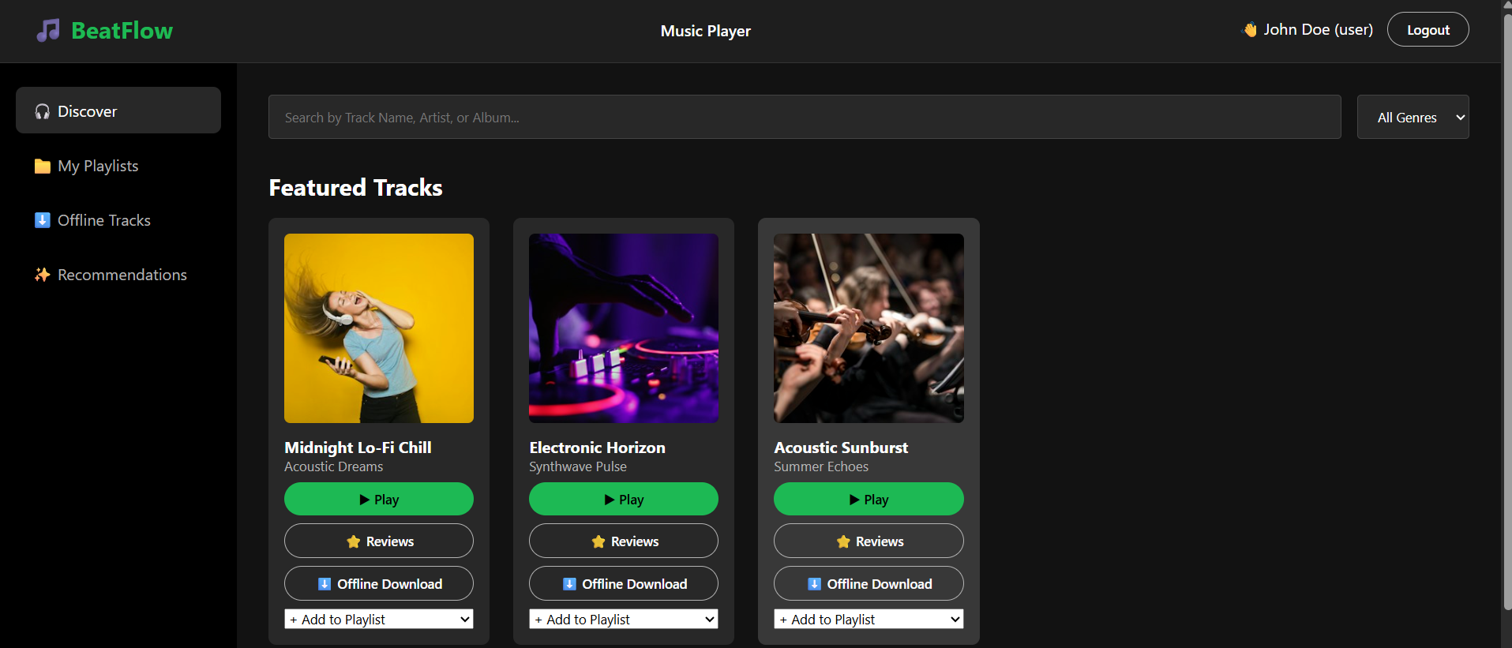
5. User Module
Discover music, play tracks and manage personal music features
• Search tracks, artists or albums
• Filter by genre
• Play featured tracks
• Reviews & offline downloads
• Add songs to playlists
• Recommendations section

Slide 7
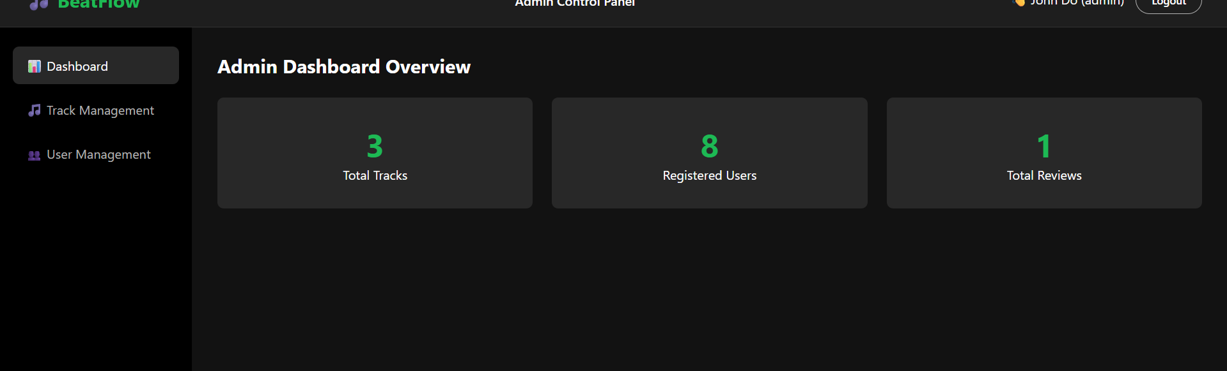
6. Admin Module
Manage application content and registered users
Dashboard
Shows total tracks, registered users and total reviews.
Track Management
Admin can manage the music catalog and track information.
User Management
Admin can view users and delete normal user accounts while protected accounts remain safe.

Slide 8
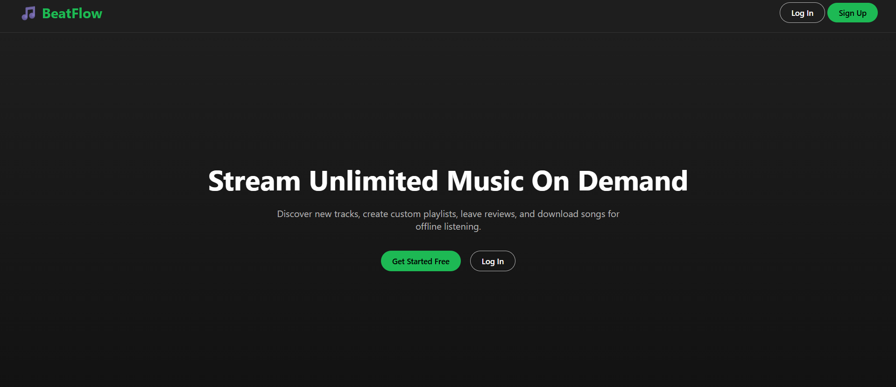
7. Signup, Login & Local Storage
• Signup saves user details in browser Local Storage.
• Login validates the entered credentials using JavaScript.
• Role information decides whether the user goes to User or Admin dashboard.
• Logout clears the active session and returns to the landing/login flow.
• For a real production app, secure server-side authentication would be required.

Slide 9
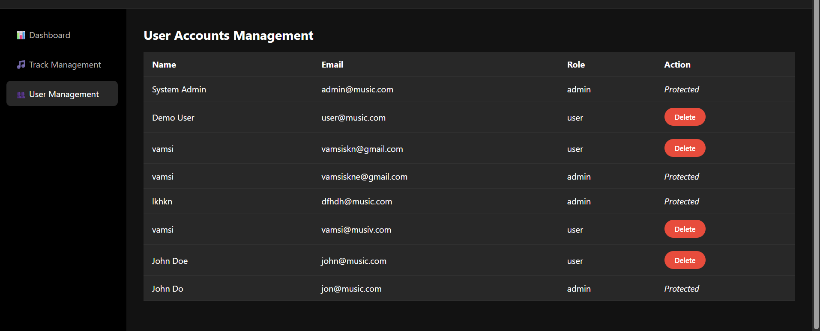
8. Major Functionalities Implemented
• Admin dashboard overview
• User account management
• Protected admin accounts
• Track discovery and playback UI
• Playlist and offline-track options
• Review/rating interface
• Responsive navigation and module-wise redirection

Slide 10
9. Conclusion & Future Scope
Current Result
Future Scope
BeatFlow successfully demonstrates a frontend Music Streaming App with separate Admin and User modules, Local Storage authentication, JavaScript navigation, music discovery, playlists, reviews and management screens.
Add a secure backend and database, real cloud music streaming, advanced recommendation algorithms, true offline downloads, stronger authentication and deployment-ready media storage.
GitHub: github.com/vamsi54-bit/Academics
Thank You

