Slide 1

English for Chemical Engineering and Technology
化学工程与工艺专业英语
Word Formation of English for CET
化工专业英语构词
Guanghua Ye
Department of Chemical Engineering, East China University of Science and Technology
guanghuaye@ecust.edu.cn

Slide 2
Vocabulary practice / 词汇练习
fine chemical | 精细化学品 | antibiotic | 抗生素 | carbonate | 碳酸盐
viscosity | 粘度 | pesticide | 杀虫剂 | emulsion | 乳液
additive | 添加剂 | potassium | 钾 | resin | 树脂
polyurethane | 聚氨酯 | phosphorus | 磷 | silica | 二氧化硅
formaldehyde | 甲醛 | pharmaceutical | 药物 | sodium | 钠
urea | 尿素 | formulation | 配方 | nylon | 尼龙
alkali | 碱 | polymerization | 聚合 | polyethylene | 聚乙烯
ammonia | 氨 | acetate | 醋酸盐 | nitric | 含氮的
sulphuric | 硫的 | inorganic | 无机的 | fertilizer | 肥料

Slide 3
Vocabulary practice / 词汇练习
nitrogen | 氮 | rhodium | 铑 | antiknock | 抗爆的
thermodynamics | 热力学 | tower | 塔 | alkylation | 烷基化
protein | 蛋白质 | azeotrope | 恒沸物 | butene | 丁烯
molybdenum | 钼 | nitration | 硝化 | methane | 甲烷
cobalt | 钴 | cyanide | 氰化物 | ethylene | 乙烯
zinc | 锌 | still | 蒸馏 | propylene | 丙烯
nickel | 镍 | hydrocracking | 加氢裂化 | ethane | 乙烷
shift reaction | 变换反应 | isomerization | 异构化 | benzene | 苯
platinum | 铂 | asphalt | 沥青 | ethylbenzene | 乙苯

Slide 4
Vocabulary practice / 词汇练习
Dye | 染料 | gasoline | 汽油
ethanol | 乙醇 | patent | 专利
toluene | 甲苯 | lubricating oil | 润滑油
xylene | 二甲苯 | distillation | 精馏
catalyst | 催化剂 | octane number | 辛烷值
biochemical | 生物化学的 | carbon | 碳

Slide 5
The Elements and Inorganic Compounds
元素和无机化合物

Slide 6
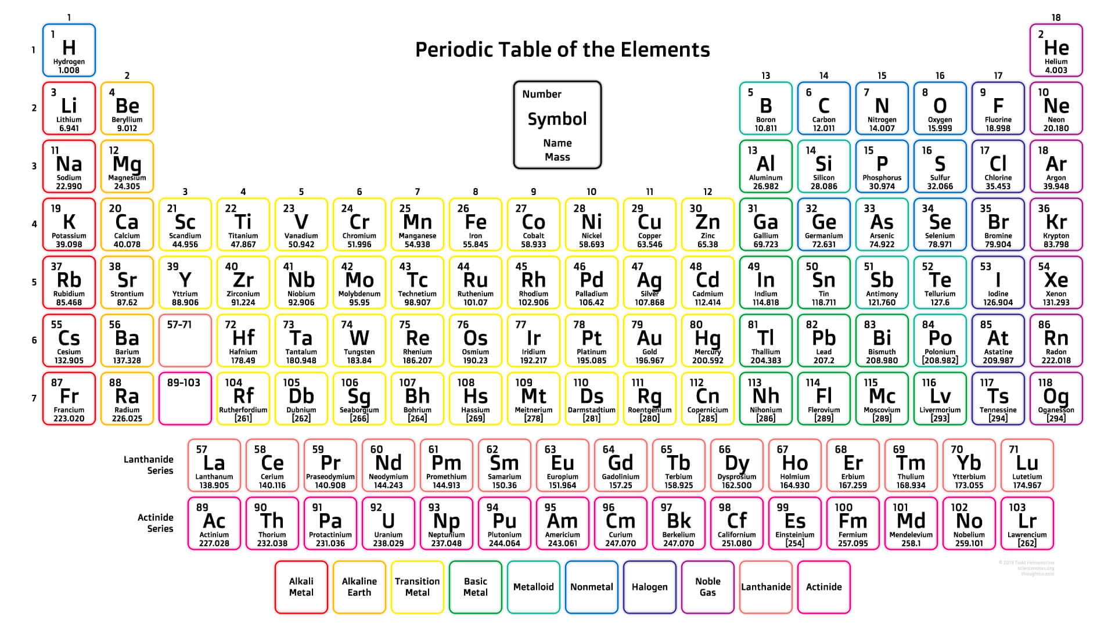
IUPAC Periodic Table of the Elements
化学元素周期表
Notes:
International Union of Pure and Applied Chemistry
Inorganic chemistry organic chemistry physical chemistry analytical chemistry

Slide 7
Chemical Elements / 化学元素
氟 fluorine 氯 chlorine 溴 bromine 碘 iodine
氧 oxygen 氢 hydrogen 氮 nitrogen
碳 carbon 硅 silicon 硼 boron 氩 argon
硫 sulfur 磷 phosphorus 砷 arsenic
锂 lithium 钠 sodium 钾 potassium 镁 magnesium
铝 aluminium 钙 calcium 钛 titanium 铬 chromium
钯 palladium 镉 cadmium 铀 uranium 镭 radium
铁 iron 钴 cobalt 铜 copper 镍 nickel
锰 manganese 锌 zinc 锡 tin 铅 lead

Slide 8
Inorganic chemical compound / 无机化合物
一、Binary compounds / 二元化合物
词尾 －ide －化物
chlorine chloride hydrogen chloride
oxygen oxide zinc oxide
fluorine fluoride hydrogen fluoride
sulfur sulfide sodium sulfide
iodine iodide potassium iodide
二、Hydrogen acids / 无氧酸（水溶液呈酸性的二元化合物）：
－(o)ic acid 酸
hydrochloric acid
hydrofluoric acid
hydrobromic acid

Slide 9
Inorganic chemical compound / 无机化合物
三、Oxygen acids and salts / 含氧酸及其盐
nitrogen nitric acid nitrate silver nitrate
sulfur sulfuric acid sulfate copper sulfate
phosphorus phosphoric acid phosphate
Chlorine chloric acid chlorate
词尾：－(o)ic acid 酸
－ate 由词尾为ic的酸所成的盐类或酯类
四、Hydroxides / 氢氧化物
hydro- + oxide 氢+氧化物
sodium hydroxide
aluminum hydroxide

Slide 10
Organic Compounds
有机化合物

Slide 11
Organic compounds and suffix / 有机物及其词尾
有机物种类 词尾 示例
烷烃：alkanes -ane 甲烷：methane
烯烃：alkenes -ene 乙烯：ethylene
炔烃：alkynes -yne 丙炔：propyne
苯：benzenes -benzene 乙苯：ethylbenzene
醇：alcohols -ol 丁醇：butanol
醚：ethers -ether 二甲醚：dimethyl ether
醛：aldehydes -al 甲醛：methanal
酮：ketones -one 丙酮：propanone
酸：acids -(o)ic acid 乙酸：ethanoic acid
酯：esters -ate 乙酸甲酯：methyl ethanoate
酸酐：anhydrides -ic anhydride 马来酸酐：maleic anhydride
胺：amines -amine 乙醇胺：ethanolamine

Slide 12
Groups with different carbon chain lengths
不同碳链基团名称
链烃名称 alkane alkene alkyne
甲基：methyl methane
乙基：ethyl ethane ethene ethyne
丙基：propyl propane propene propyne
丁基：butyl butane butene butyne
戊基：pentyl pentane pentene
己基：hexyl hexane hexene
庚基：heptyl heptane
辛基：octyl octane
壬基：nonyl nonane
癸基：decyl decane
十二烷基：dodecyl

Slide 13
Organic groups / 有机基团名称
词根 有机基团 词根 有机基团
alkyl 烷基 aryl 芳基
hydroxyl 羟基 carboxyl 羧基
carbonyl 羰基 vinyl 乙烯基
acetyl 乙酰基 phenyl 苯基
amino 氨基 sulfo 磺基
nitro 硝基 chloro 氯代
fluoro 氟代 thio 硫代
-yl －基

Slide 14
Configurations for organic compounds
有机物构型名称
词根 构型 示例
n- 正构的 n-butane
iso- 异，同 iso-butane
cycl(o)- 环（合） cyclohexane
o-，ortho- 邻（位） o-xylene
p-，para- 对（位） p-xylene
m-，meta- 间（位） m-xylene
per- 过，高 peroxide
cis- 顺（式） cis-butenedioic acid
trans- 反（式） trans-butenedioic acid

Slide 15
Prefixes for numbers / 常用数目词头
数目 词根 数目 词根 数目 词根
1 mono- 11 undaca- 21 henicosa-
2 di- 12 dodeca- 22 docosa-
3 tri- 13 trideca- 23 tricosa-
4 tetra- 14 tetradeca- 30 triconta-
5 penta- 15 petadeca- 31 hentriaconta-
6 hexa- 16 hexadeca- 40 tetraconta-
7 hepta- 17 heptadeca- 50 petaconta-
8 octa- 18 octadeca- 60 hexaconta-
9 nona- 19 nonadeca- 70 heptaconta-
10 deca- 20 eicosa- 100 hecta-

Slide 16
IUPAC Name and Common Name
IUPAC名称和通用名称
IUPAC Name Common Name 中文名称
alkane paraffin 烷烃
cycloalkane cycloparaffin/ naphthene 环烷烃
alkene olefin 烯烃
ethyne acetylene 乙炔
ethene ethylene 乙烯
propene propylene 丙烯
methylbenzene toluene 甲苯
dimethylbenzene xylene 二甲苯
phenylethene styrene 苯乙烯

Slide 17
IUPAC Name and Common Name
IUPAC名称和通用名称
IUPAC Name Common Name 中文名称
methanol methyl alcohol 甲醇
ethanol ethyl alcohol 乙醇
2-methyl-1-propanol isobutyl alcohol 异丁醇
methanal formaldehyde 甲醛
ethanal acetaldehyde 乙醛
propanone acetone 丙酮
methanoic acid formic acid 甲酸
ethanoic acid acetic acid 乙酸
octadecanoic acid stearic acid 硬脂酸
amino ethane ethylamine 乙胺

Slide 18
Word-Building in ST English
科技英语的构词

Slide 19
Compound words / 合成词
1. 名词＋名词 octane number； elimination reaction
2. 形容词＋名词 biological degradation； pilot plant
3. 动名词＋名词 alkylating reaction ； antibonding orbital
4. 过去分词＋名词 saturated hydrocarbon； branched chain
5. 名词＋动名词 oxygen-containing；
6. 名词＋过去分词 hand-made；
7. 名词＋形容词 snow-white；paper-thin
8. 形容词＋形容词 red-hot ； dark-blue

Slide 20
Prefix / 前缀
in- 表示 (1)向……内，进入，向……，
（2)不，非，负
inclusion 包含 inactive 不活泼的
indicator 指示剂 incomplete 不完全的
induce 诱导，感应 inorganic 无机的
inlet 入口 infusible 难熔的
internal 内（部）的 incompressible 不可压缩的

Slide 21
Prefix / 前缀
in- 用于b, m, p前变为 im-
immature 未成熟的 impurity 杂质
immersion 沉浸 impart 传递
in- 用于l 前变为 il-
illimitable 无限的 illogic 不合逻辑的
in- 用于r 前变为 ir-
irrational 不合理的 irreversible 不可逆的

Slide 22
Prefix / 前缀
equi- 等同 equivalent equilibrium
fore- 前，先于 forecast foreword
hemi- 半 hemisphere hemi-cellulose
semi- 半 semiconductor semi-automatic
hypo- 低，次 hypochlorite hypophosphite
multi- 多 multiply multiphase
over- 超过，过分 overload overflow
per- 高，过 peroxide perchloride

Slide 23
Prefix / 前缀
poly- 多，聚 polyatomic polytechnic
post- 在后，补充 post-graduate post-doctor
pre- 在前，预先 prearrange prepare
re- 再次，重复 repair refract review
sub- 次于，在下，低 subway subsonic subheading
super- 超 supermarket supersaturate
ultra- 超 ultra-violet ultra-sonic wave
under- 不足 underexposure undercharge

Slide 24
Prefix / 前缀
auto- 自己，自 automobile autocatalysis
electro- 电 electrophilic electronegative
hetero- 异，杂 heterogeneous heterocycle
homo- 同 homogeneous homocycle
hydro- 水或氢 hydrolysis hydrogenation
phono- 声，音 phonograph
photo- 光 photochemistry photograph

Slide 25
Suffix / 后缀
-age storage package passage
-ence difference reference conference
-ant reactant refrigerant surfactant
-ent solvent substituent detergent
-ance importance substance abundance
-ancy constancy dependancy vacancy
-ency efficiency tendency transparency
-cide pesticide germicide bactericide

Slide 26
Suffix / 后缀
-ics electronics kinetics physics
-ism mechanism atomism stereoisomerism
-ness hardness thickness illness
-ization polarization polymerization crystallization
-sion conversion corrosion diversion
-tion oxidation precipitation determination
-ist hemist scientist chemist
-or operator donor indicator
-er worker isomer monomer
-ty density safety ability

Slide 27
Suffix / 后缀
-al industrial essential experimental
-ar molecular solar linear
-ble reversible remarkable resemble
-ed colored U-shaped dissolved
-fold three-fold
-ful useful careful successful
-ic dynamic asymmetric electrophilic
-less useless colorless stainless
-ous homogeneous heterogeneous simultaneous
-tive cumulative electronegative extractive
-y dusty windy cloudy

Slide 28
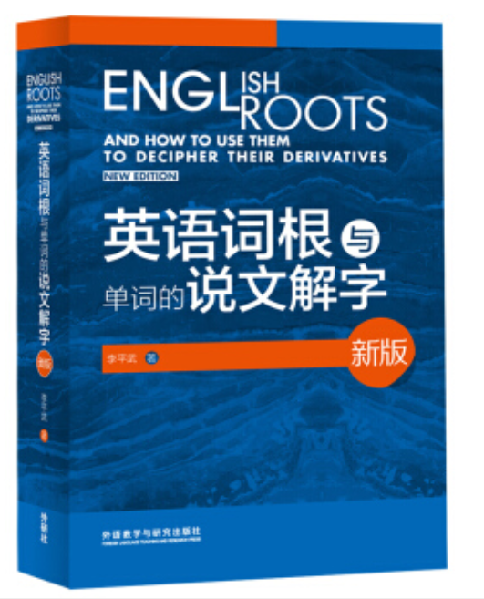
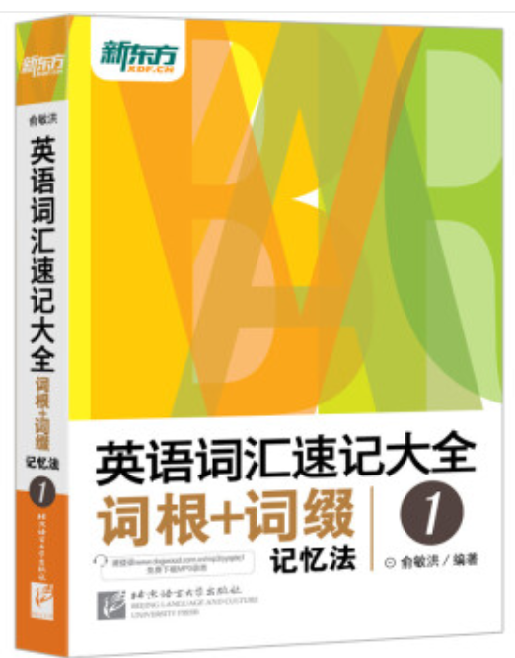
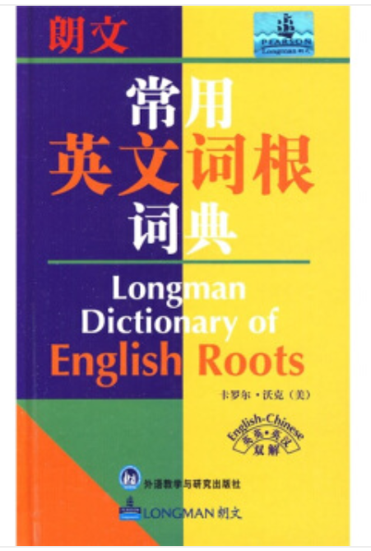
Suffix / 后缀
-ate generate indicate evaporate
-en harden shorten strengthen
-fy simplify purify classify gasify
-ize modernize polymerize aromatize
-yze catalyze hydrolyze electrolyze

Slide 29
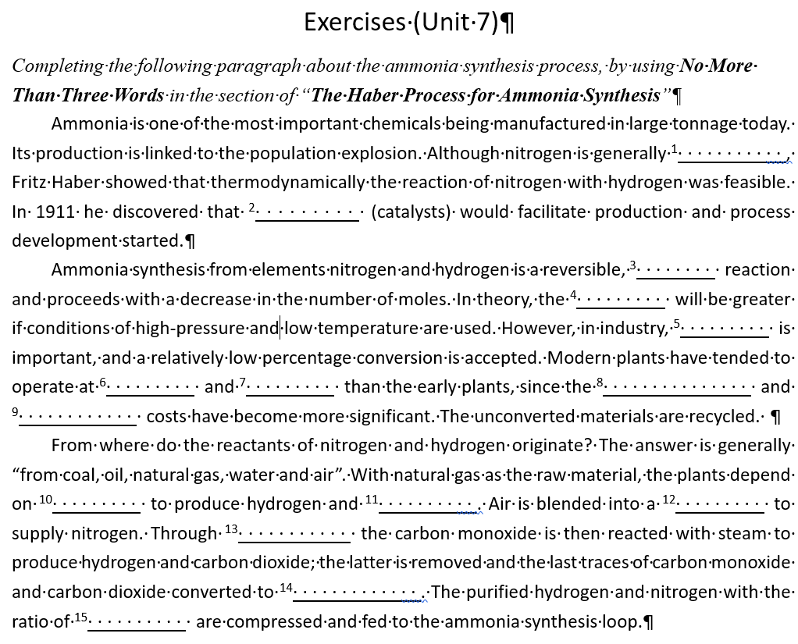
Assignment / 作业

Slide 30
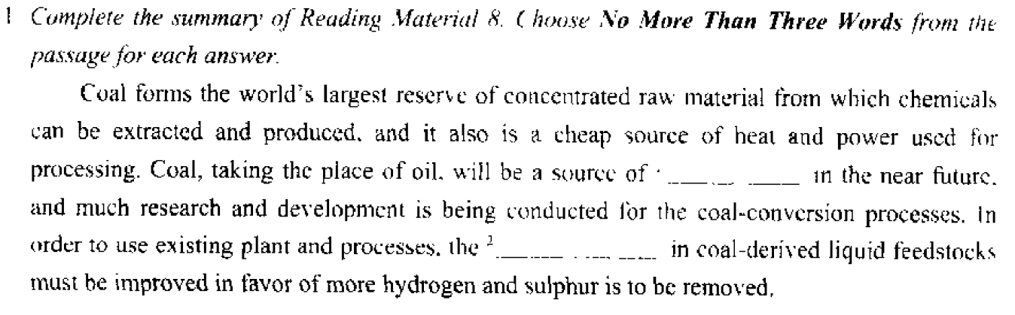
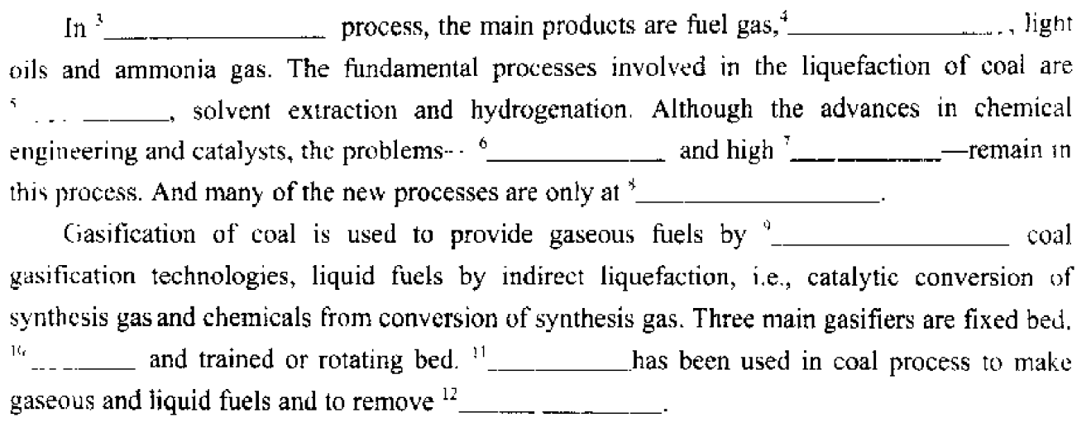
Assignment / 作业

