Slide 1
Real world example of group by
xml_files1.gz
xml_files2.gz
pipeline
unzipping(decompressing)
extract
create a table(data frame)
then write a json file
Bigquery
stage(dataset)
Bigquery
production(dataset)

Slide 2
mesinfoid
node- 1
node -2
node -3
init time
23-08-2025 T012530 UTC
select max(mesinfo_id), max(init),..........,any_value(job_id) as job_id from table group by mesinfoid, init

Slide 3
insert into final table from
(select max(mesinfo_id), max(init),..........,any_value(job_id) as job_id from table group by mesinfoid, init,file_name)
mesinfoid | init_time | job_id | process_id | file_name
node1 | 23-08-2025 T01253 | 23 | 123456 | file1
node2 | 23-08-2025 T01253 | 23 | 123456 | file1
node1 | 23-08-2025 T01215 | 23 | 123456 | file1
node1 | 23-08-2025 T01253 | 23 | 123456 | file2
node2 | 23-08-2025 T01253 | 23 | 123456 | file2
node2 | 23-08-2025 T01253 | 23 | 123456 | file2

Slide 4
Module
A module is a file containing Python definitions and statements.
A module is a file containing group of variables, methods, function and classes etc.
They are executed only the first time the module name is encountered in an import statement.
Assume that you are building a very large project, it will be very difficult to manage all logic within one single file so If you want to separate your similar logic to a separate file, you can use module.
Type of Modules:-
User-defined Modules
Built-in Modules
Ex:- array, math, numpy, sys,pandas, datetime

Slide 5
How to use Module
import statement is used to import modules.
Syntax:-
import module_name
import module_name as alias_name
from module_name import
from module_name import f_name as alias_f_name
from module_name import *
function_name1, function_name2,……, function_nameN

Slide 6
from module_name import *
This imports all names except those beginning with an underscore (_).
Ex:- from cal import *
How to access Methods, Functions, Variable and Classes ?
You can access the functions directly by it’s name.
Ex:-
add(10, 20)
sub(20, 10)

Slide 7
Package
Packages are a way of structuring Python’s module namespace by using “dotted module names”.
A package can have one or more modules which means, a package is collection of modules and packages.
A package can contain packages.
Package is nothing but a Directory/Folder

Slide 8
Creating Package
Package is nothing but a Directory/Folder which MUST contain a special file called __init__.py.
__init__.py file can be empty, it indicates that the directory it contains is a Python package, so it can be imported the same way a module can be imported.

Slide 9
SMS
Admin
dashboard.py
service.py
product.py
logout.py
__init__.py
User
profile.py
request.py
logout.py
__init__.py
Tech
profile.py
work.py
logout.py
__init__.py
geekyshows.py
__init__.py

Slide 10
How to use Package
Syntax:- from packageName.moduleName import fun_name
Syntax:- from packageName.subPackageName.moduleName import fun_name
Ex:- from Admin.service import admin_service
Ex:- from Admin.Common.footer import admin_common_footer
How to Access Variable, Function, Method, Class etc.
Syntax:- functionName()
Ex:-
admin_service( )
admin_common_footer( )

Slide 11
__all__
if a package’s __init__.py code defines a list named __all__, it is taken to be the list of module names that should be imported when from package import * is encountered.
__all__ = [‘dashboard’, ‘service’, ‘product’]

Slide 12
Package Ex
Folder structure:
-pipeline
transformer
nokia
__init__.py
xml_reader.py
xml_transformer.py
samsung
huawei
process_reader.py
transformer_factory.py
sources
utils
__init__.py
from transform.nokia.xml_transformer import table
__all__ = [table]
transformer_factory
from transformer.nokia import table
or
from transformer.nokia.xml_transformer import table

Slide 13
Abstract Class
A class derived from ABC class which belongs to abc module, is known as abstract class in Python.
ABC Class is known as Meta Class which means a class that defines the behavior of other classes. So we can say, Meta Class ABC defines that the class which is derived from it becomes an abstract class.
Abstract Class can have abstract method and concrete methods.
Abstract Class needs to be extended and its method implemented.
PVM can not create objects of an abstract class.
Ex:-
from abc import ABC, abstractmethod
Class Father(ABC):

Slide 14
Rules:
PVM can not create objects of an abstract class.
It is not necessary to declare all methods abstract in a abstract class.
Abstract Class can have abstract method and concrete methods.
If there is any abstract method in a class, that class must be abstract.
The abstract methods of an abstract class must be defined in its child class/subclass.
If you are inheriting any abstract class that have abstract method, you must either provide the implementation of the method or make this class abstract.

Slide 15
Abstract Method
from abc import ABC, abstractmethod
class Father(ABC):
@abstractmethod
def disp(self):
print('disp class')
def show(self):
print("Concrete Method")
class Child(Father) :
def __init__(self):
self.name = 'Raju'
def disp(self):
print('pass')
a = Child()
print(a.disp())

Slide 16
When use Interface
We use interface when all the features need to be implemented differently for different objects.
Defence Force
Gun =
Area =
Army
Gun = AK 41
Area = Land
Air Force
Gun = AK 42
Area = Sky
Navy
Gun = AK 43
Area = Sea

Slide 17
Date and Time
Following modules are used to work with date, time, and duration.
time
datetime

Slide 18
Time Modules
time ( ) Function – This function return the time in seconds since the epoch as a floating point number. The specific date of the epoch and the handling of leap seconds is platform dependent.
ctime ( ) Function – This function is used to get current date and time. When we pass epoch time in seconds to the function, it returns corresponding date and time in string format. When we do not pass epoch time, it returns current date and time in string format.

Slide 19
datetime Module
import time
from datetime import datetime, timedelta
reminder_time = datetime.now() + timedelta(seconds=5)
print(f"Reminder set for {reminder_time.strftime('%H:%M:%S')}")
while datetime.now() < reminder_time:
time.sleep(100)
print("Time to drink water!")

Slide 20
Formatting Date and Time
strftime() Method – This method is used to format the content of datetime, date and time class object. strftime represents string format to time. This method convert the object into a specified format and returns the formatted string.
Ex:-
dt = datetime.today()
newdt = dt.strftime(“%B, %d, %Y”)
Format Code

Slide 21
Format Code
Format Code | Meaning | Example
%a | Weekday in short name | Sun, Mon,…., Sat
%A | Weekday in full name | Sunday, Monday,…, Saturday
%d | Day of month with 0 padded | 01, 02,….,30, 31
%b | Month in short Name | Jan, Feb, ……, Dec
%B | Month in full Name | January,….., December
%m | Month in number with 0 padded | 01, 02, …., 12
%y | Year in short with 0 padded, without century | 00, 01, 02,…., 99
%Y | Year in Full with century | 0001, 0002, ….., 9999

Slide 22
Format Code
Format Code | Meaning | Example
%H | Hours with 0 padded (24 hours clock) | 00, 01, 02,……, 23
%I | Hours with 0 padded (12 hours clock) | 01, 02,…., 12
%p | AM/PM | AM, PM
%M | Minute with 0 padded | 00, 01, ….., 59
%S | Second with 0 padded | 00, 01, ….., 59
%f | Microsecond with 0 padded | 000000,……, 999999
%Z | Time zone name | (empty), UTC, CST, EST
%j | Day number of year with 0 padded | 001, 002,……, 366
%U | Week number of the year, Sunday as the first day of week with 0 padded | 00, 01, ……., 53

Slide 23
Format Code
Format Code | Meaning | Example
%c | Locale’s appropriate date and time representation | Tue Jan 30 21:30:00 2019
%x | Locale’s appropriate date representation | 08/16/88 (None); 08/16/1988 (en_US); 16.08.1988 (de_DE)
%X | Locale’s appropriate time representation | 21:30:00 (en_US); 21:30:00 (de_DE)
%% | A literal ‘%’ character | %
https://docs.python.org/3.7/library/datetime.html#strftime-and-strptime-behavior

Slide 24





Multitasking
Executing multiple task at the same time.

Slide 25
Type of Multitasking
Process based Multitasking
Thread based Multitasking

Slide 26
Process Based Multitasking
Executing multiple task at the same time where each task is a separate independent program(process), is called process based multitasking. It is suitable for Operating System level.

Slide 27
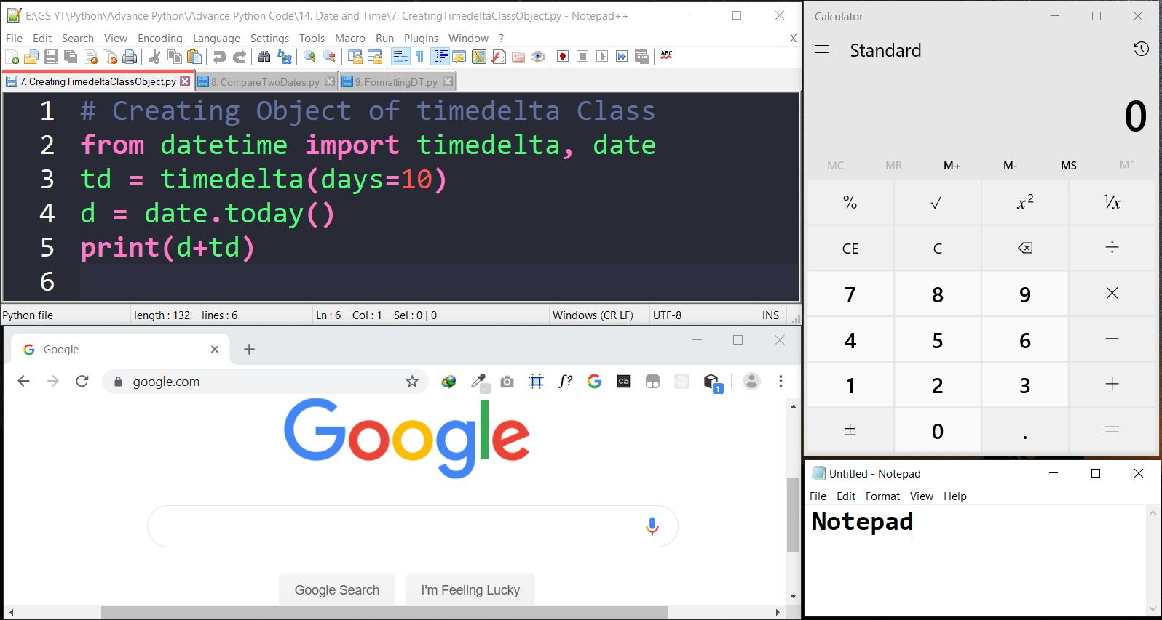

Slide 28
Thread Based Multitasking
Executing multiple task at the same time where each task is a separate independent part of the same program(process), is called Thread based multitasking and each independent part is called Thread. It is suitable for Programmatic level.
Ex: - MS Word

Slide 29
Thread
Thread is a separate flow of execution. Every thread has a task.

Slide 30


Flying Thread
CallAuntyMay Thread
Watching MJ Thread
Doc Thread

Slide 31
Multithreading
Using Multiple Threads in program or process
The main important application areas of multi threading are:
Multimedia Graphic
Animations
Video Games
Web Servers
Application Servers

Slide 32





Slide 33




Multitasking using a Multiple Thread
When multiple tasks are executed at a time, then it is called Multi-tasking. For this purpose we need more than one thread and when we use more than one thread, it is called multi threading.

Slide 34
Main Thread
When we start any Python Program, one thread begins running immediately, which is called Main Thread of that program created by PVM.
The main thread is created automatically when your program is started.
import threading
t = threading.current_thread().getName()
print(t)

Slide 35
Thread Class’s Methods
start ( ) – Once a thread is created it should be started by calling start() Method.
run( ) – Every thread will run this method when thread is started. We can override this method and write our own code as body of the method. A thread will terminate automatically when it comes out of the run( ) Method.
join ( ) – This method is used to wait till the thread completely executes the run ( ) method.

Slide 36
import threading
import time
def download_file(file_name, delay):
print(f"📥 Starting download: {file_name}")
time.sleep(delay) # simulate time taken to download
print(f"✅ Finished download: {file_name}")
# Create threads
t1 = threading.Thread(target=download_file, args=("file1.mp4", 3))
t2 = threading.Thread(target=download_file, args=("file2.mp3", 2))
t3 = threading.Thread(target=download_file, args=("file3.pdf", 4))
# Start threads
t1.start()
t2.start()
t3.start()
# Wait for all to finish
t1.join()
t2.join()
t3.join()
print("🎉 All downloads completed!")

