Slide 1
DK-IOT Sensor Data
by Dushyant Kumar

Slide 2
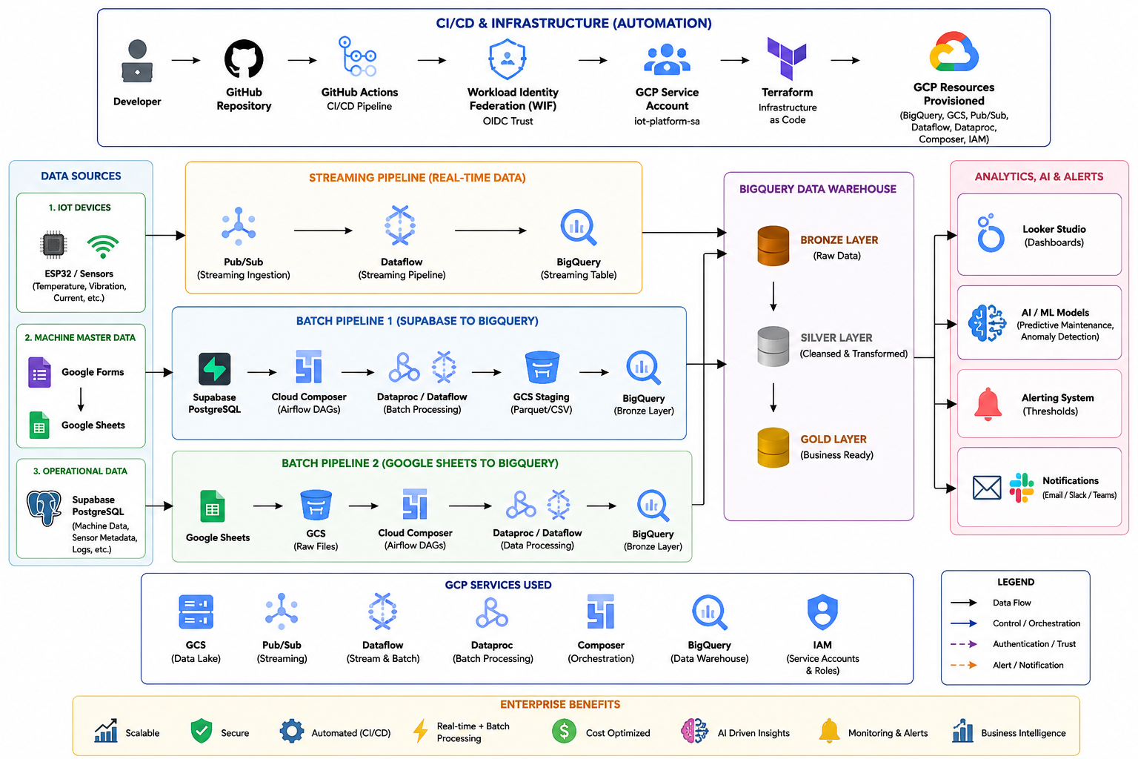

Slide 3
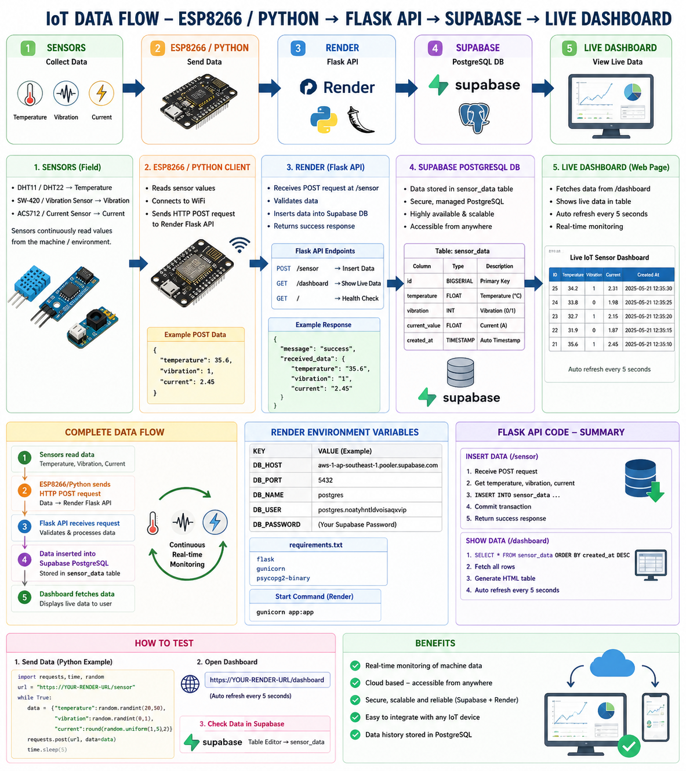

Slide 4
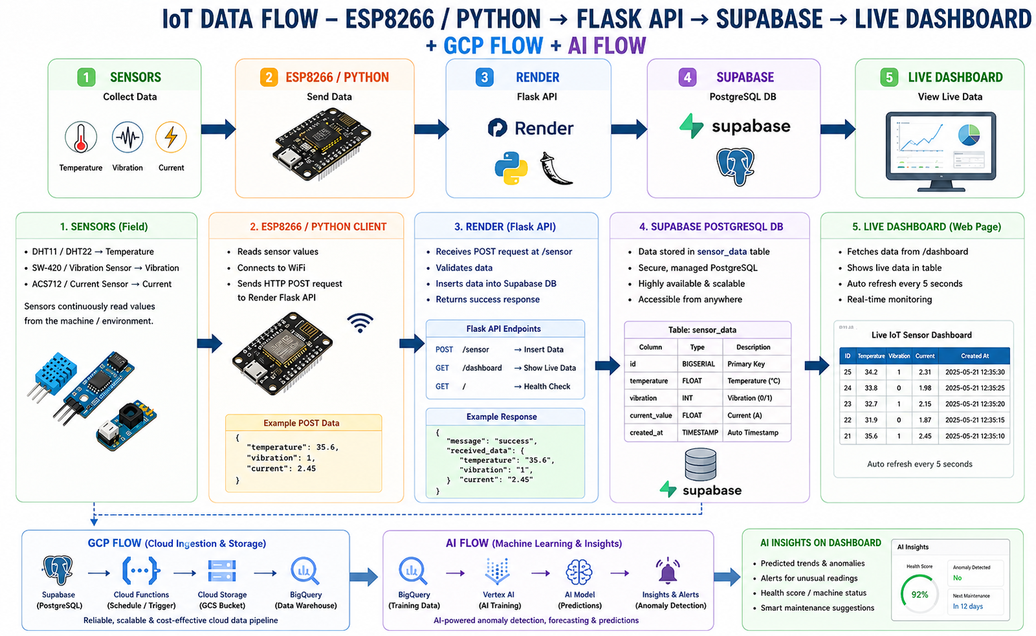

Slide 5
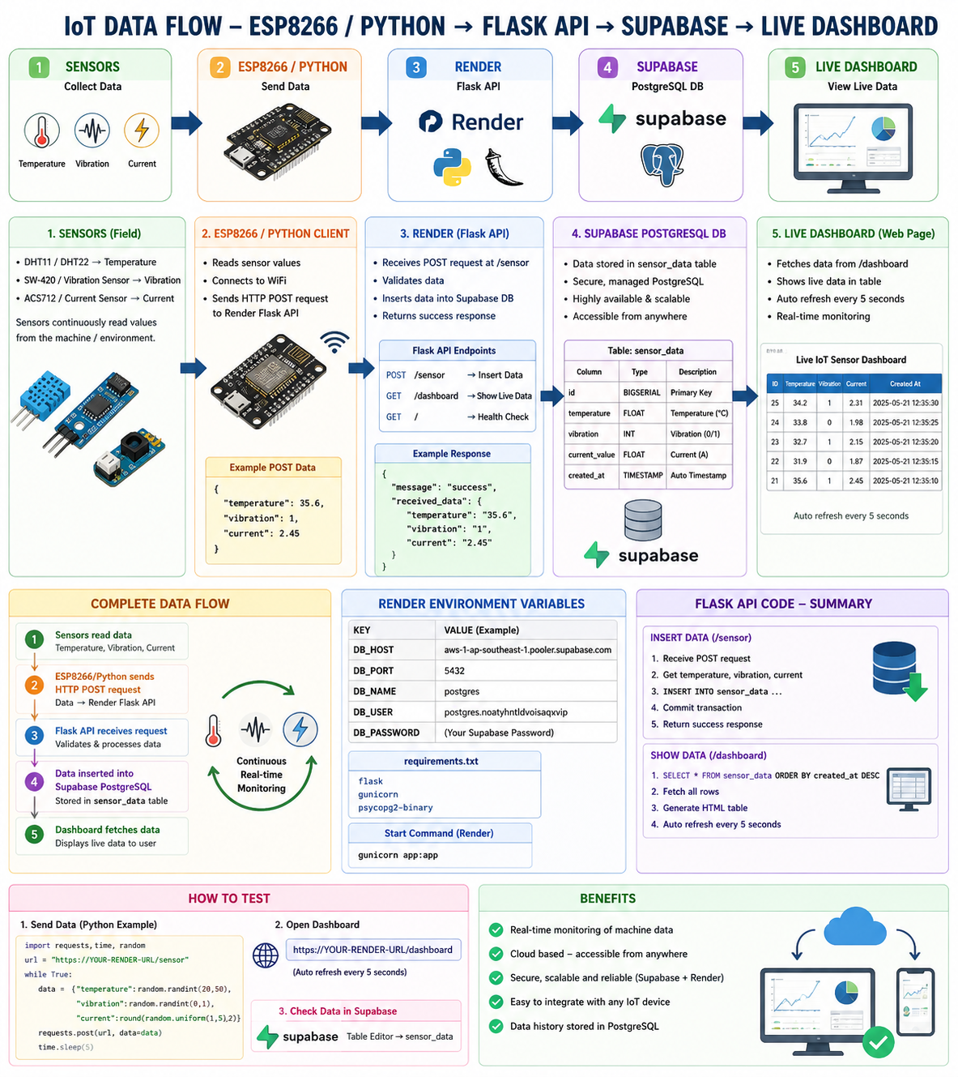

Slide 7
Flask App Repo auto sync in render- loging by github
https://github.com/25007839d/iot_api

Slide 8
api
https://iot-api-6vuj.onrender.com/sensor
dashboard
https://iot-api-6vuj.onrender.com/dashboard
Render ui:
https://dashboard.render.com/web/srv-d86vtobtqb8s7381c23g
Supabase UI:
https://supabase.com/dashboard/project/noatyhntldvoisaqxvip/database/schemas

Slide 9
TEST API:
import requests url = "https://iot-api-6vuj.onrender.com/sensor" data = { "temperature": 34, "vibration": 1, "current": 2.5 } response = requests.post(url, data=data) print(response.text)

Slide 10
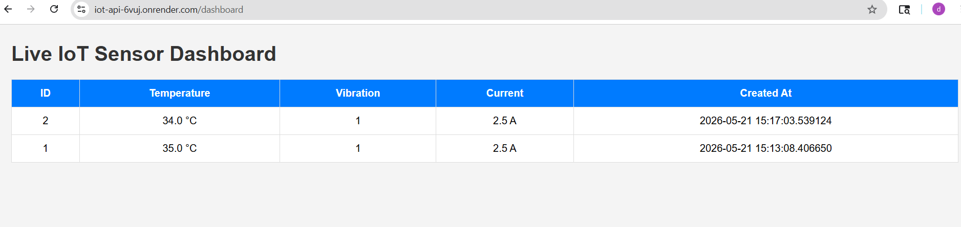
Dashboard

Slide 11
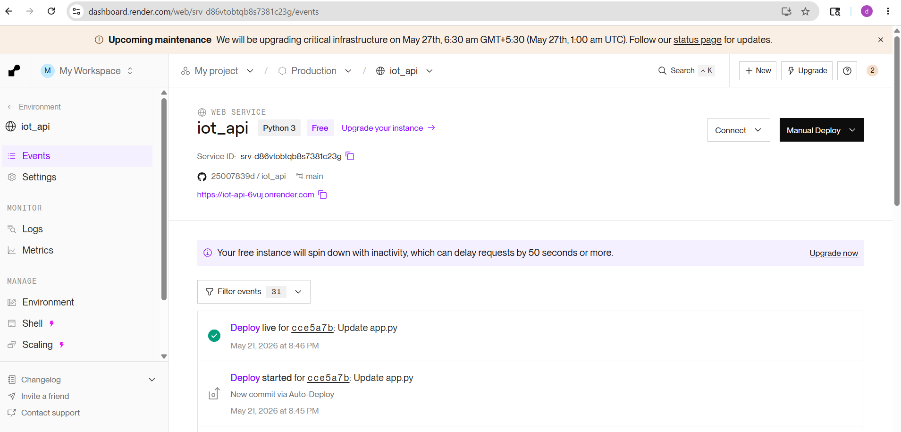
Render server

Slide 12
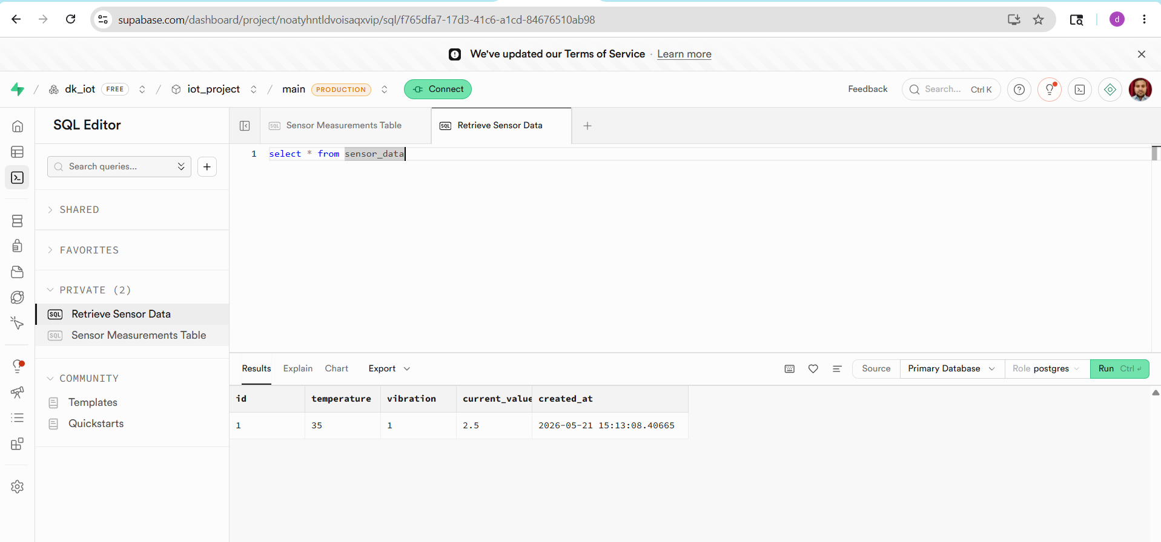
Supabase DB server- login by github
https://supabase.com/dashboard/project/noatyhntldvoisaqxvip/sql/f765dfa7-17d3-41c6-a1cd-84676510ab98

Slide 13
Create a google form and google data sheet for record

Slide 14
Google Machine Onboarding form :
https://docs.google.com/forms/d/e/1FAIpQLSfteA7qHqTCIwHE60Evs8QE0zuVHdrRRB51GPf1LhLz72b0RQ/viewform?usp=publish-editor
Machine data onboarding google sheet: https://docs.google.com/spreadsheets/d/1Vqay7YnqGtA83aJvf16JTDXPS472N0DZtL-mF-NnPGU/edit?usp=sharing

Slide 15
