Slide 1
Prompt Engineering

Slide 2

Agenda
01
Structure
02
Context
03
Advanced Parameters

Slide 3

Structure

Slide 4
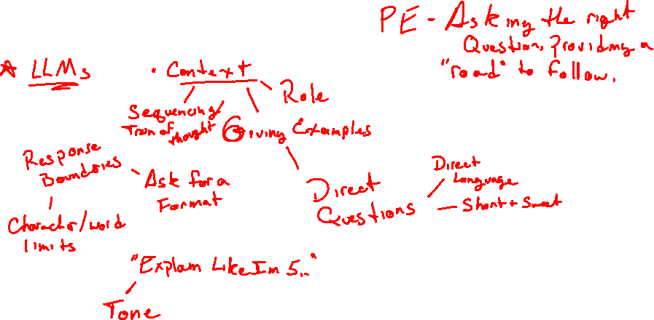
Structure - How can ask an AI the right question? - What can we do to provide constraints on an answer?
Notes:
Highlight Key Feature – {Talking points on the highlighted key feature here}

Slide 5
Structure
Phrase the question
Clarity: clearly define what you want, or how the result should be formatted.
Constraints: give limits to the desired result, like a word-count or tone.
Be Precise: use direct questions and avoid unnecessary words or ideas.
Control Bias: use unbiased language in the prompt and ask for unbiased answers.
Notes:
Highlight Key Feature – {Talking points on the highlighted key feature here}

Slide 6
Context

Slide 7
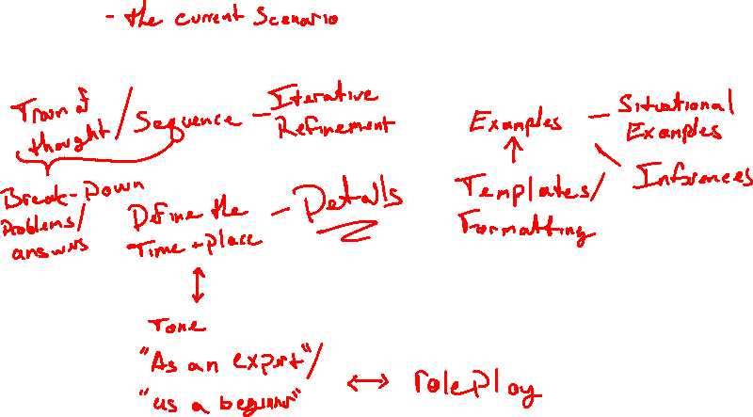
Context - What context may be important to include in a prompt? - How can we encourage an answer to address or be appropriate for a specific context?
Notes:
Highlight Key Feature – {Talking points on the highlighted key feature here}

Slide 8
Context
Explain: give enough details or example to the AI to make decision.
Reflect: ask yourself “Could I understand this if I the AI?”
Define: use accurate and appropriate terminology to provide tone.
Specify: ask for the result to match an intended purpose.
Exclusion/Inclusion: indicate topics/ideas to address in the result.
Explainability: instruct the AI to give a breakdown of reasoning or steps.
Notes:
Highlight Key Feature – {Talking points on the highlighted key feature here}

Slide 9
Advanced Parameters

Slide 10
Advanced Parameters
Model
Temperature
Nucleus Sampling/Top-p
Max Tokens
Stop Sequences
Roles
Iterations
Zero/Few Shot
Fine Tuning
Prompt Prompting
Notes:
Highlight Key Feature – {Talking points on the highlighted key feature here}

Slide 11
Thank You!

