Slide 1

Javascript Canvas
DALAB CBNU
Lkhagvadorj(Leo)
2017/05/19

Slide 2
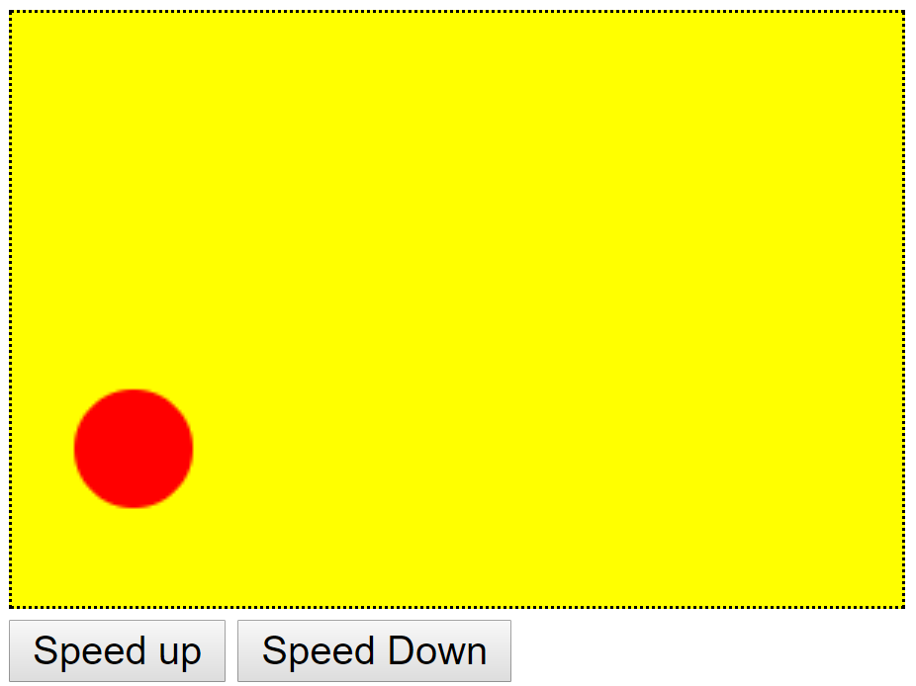
Javascript Canvas
Animation Example
Notes:
Integrated development environment

Slide 3
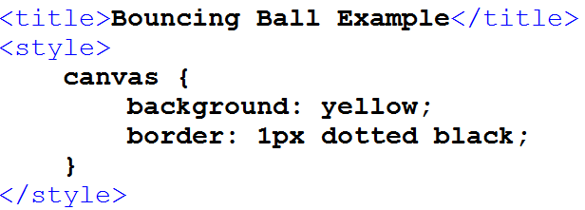
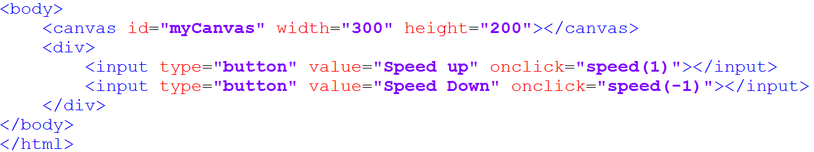
Javascript Canvas
Example Code
Notes:
Integrated development environment

Slide 4
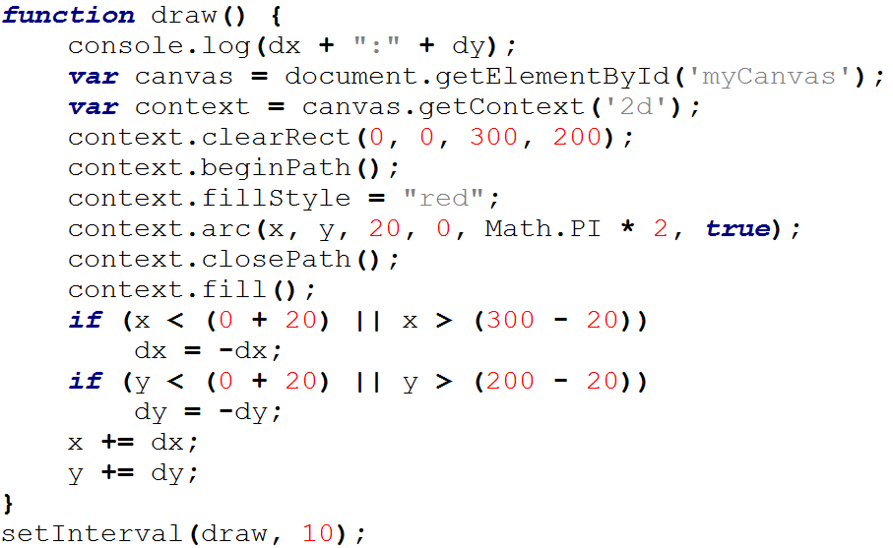
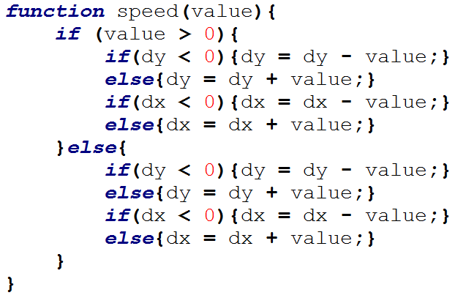
Javascript Canvas
Example Code
Notes:
Integrated development environment

Slide 5
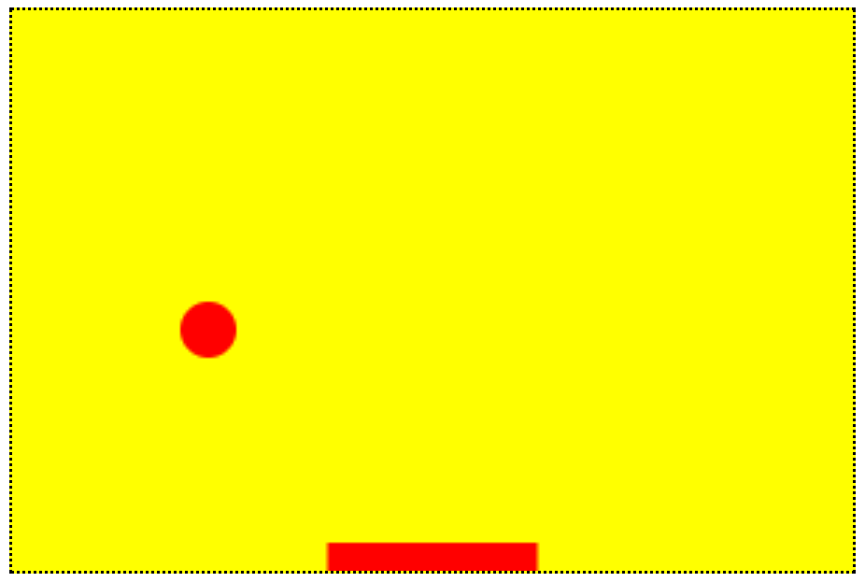
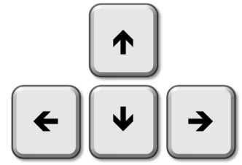
Javascript Canvas
Moving object on event
Notes:
Integrated development environment

Slide 6
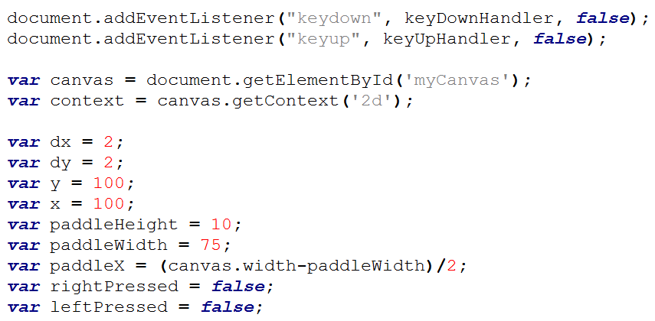
Javascript Canvas
Moving object on event
Notes:
Integrated development environment

Slide 7
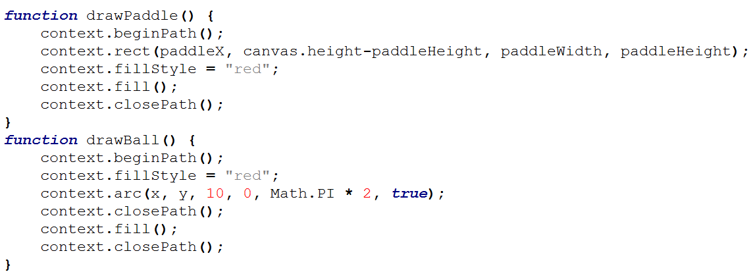
Javascript Canvas
Moving object on event
Notes:
Integrated development environment

Slide 8
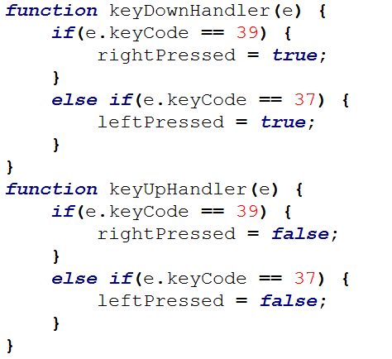
Javascript Canvas
Moving object on event
Notes:
Integrated development environment

Slide 9
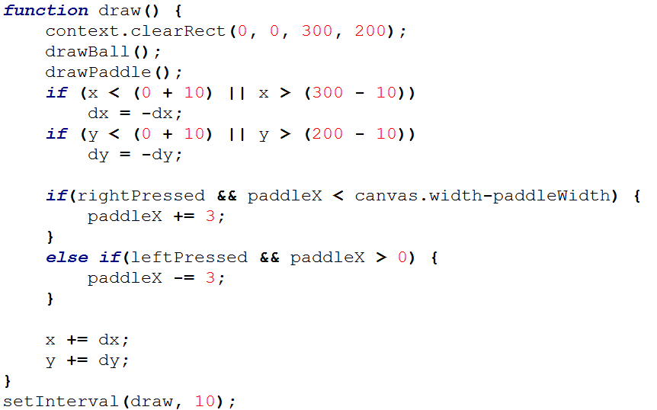
Javascript Canvas
Moving object on event
Notes:
Integrated development environment

Slide 10
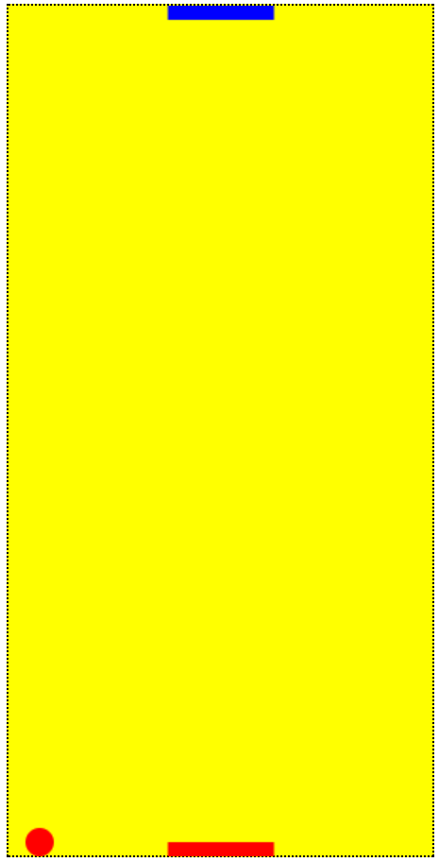
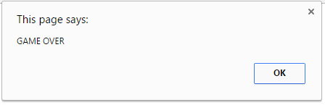
Task#1
Air hockey game against AI
Notes:
Integrated development environment

Slide 11
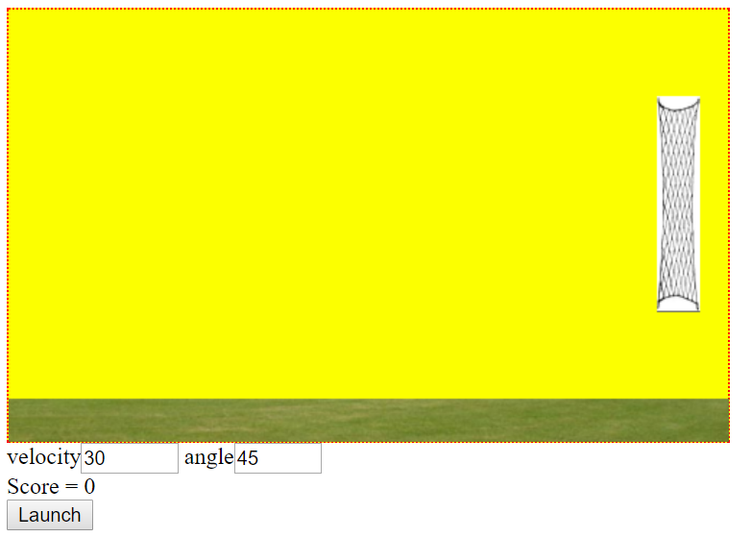
Javascript Canvas
Physics Example
Notes:
Integrated development environment

Slide 12
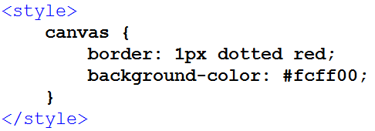
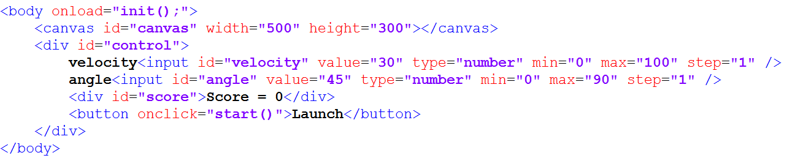
Javascript Canvas
Physics example
Notes:
Integrated development environment

Slide 13
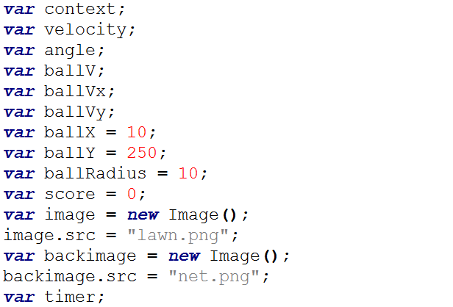
Javascript Canvas
Physics example
Notes:
Integrated development environment

Slide 14
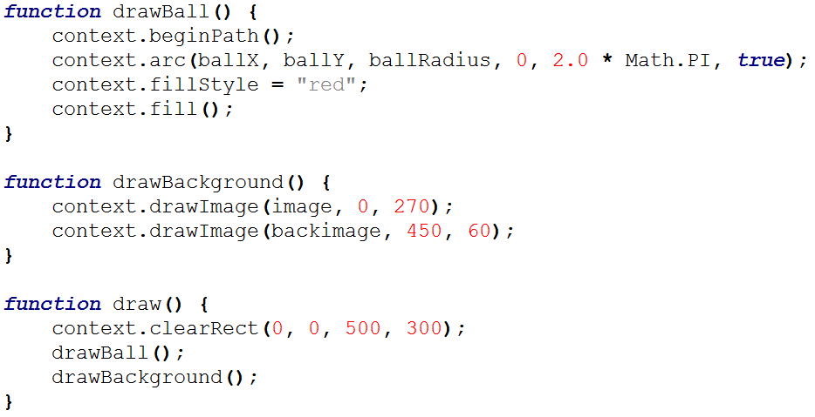
Javascript Canvas
Physics example
Notes:
Integrated development environment

Slide 15
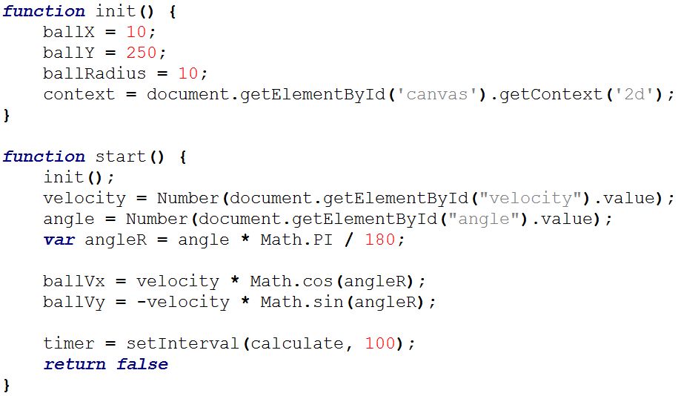
Javascript Canvas
Physics example
Notes:
Integrated development environment

Slide 16
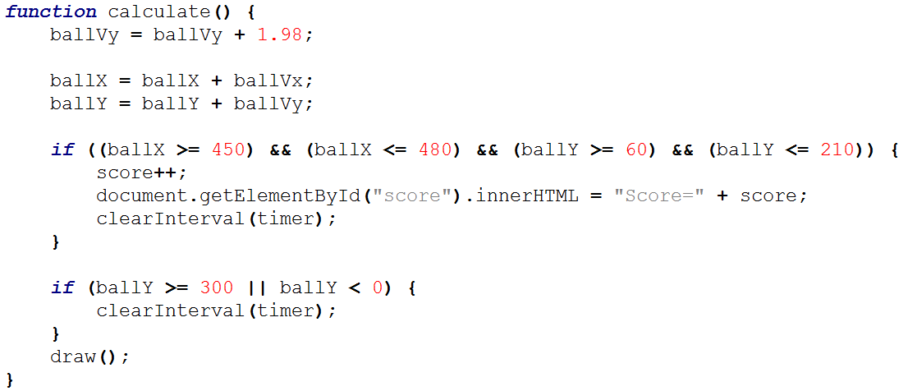
Javascript Canvas
Physics example
Notes:
Integrated development environment

Slide 17
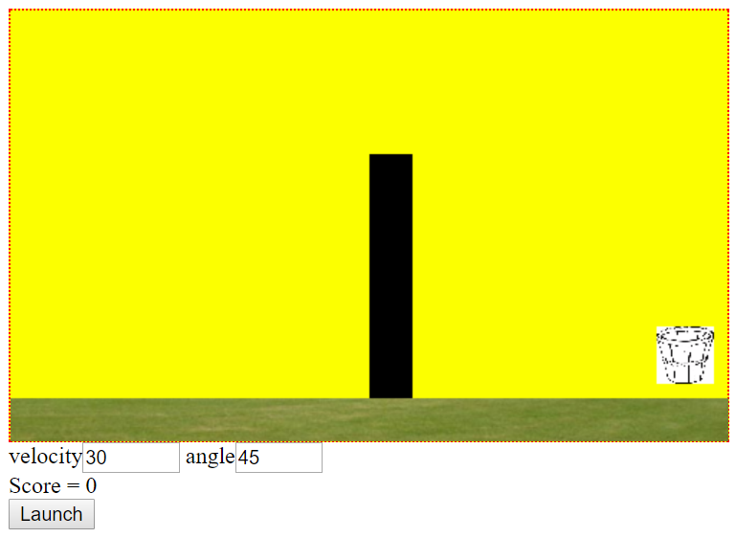
Final Task
Ball to the basket
When the ball hits the wall, It should change direction.
Notes:
Integrated development environment

Slide 18
Q&A?

