Slide 1
COURSE PROJECT : CLOUD COMPUTING & IoT
IoT Smart Dash Button System
Edge-to-Cloud Event-Driven Architecture with ESP8266 NodeMCU
Presented By: G.Dhiraj kumar • M.Sri Harsh • Y.Jay Vardhan • G.Sathwik • S.Jashwanth

Slide 2
TEAM CREDITS
Project Team Members & Contributions
[LEAD]
G.Dhiraj kumar
Roll: 2503A52735
Role: Team Lead / Cloud Architecture
• Serverless cloud webhook design
• Cloudflare Worker HTTP POST pipeline
• Architecture planning & team coordination
[CORE]
M.Sri Harsh
Roll: 2503A52740
Role: Firmware & Networking
• ESP8266 C++ firmware (Untitled-1.cpp)
• WiFiClientSecure TLS socket handler
• Wi-Fi handshake & connection management
[CORE]
Y.Jay Vardhan
Roll: 2503A52747
Role: Hardware & Circuit Design
• Wokwi circuit schematic design
• NodeMCU Pin D2 (GPIO 4) pull-up logic
• Short-circuit removal & wiring validation
[CORE]
G.Sathwik
Roll: 2503A52734
Role: Debounce Logic & Testing
• 500ms software debounce implementation
• Baseline Serial Monitor sketch (sketch.ino)
• Contact bounce rejection verification
[CORE]
S.Jashwanth
Roll: 2503A52743
Role: Telemetry & UI Dashboard
• Real-time web monitoring dashboard
• Python simulation suite (run_simulation.py)
• Latency profiling & CSV event audit logging

Slide 3
PROJECT OVERVIEW
Introduction & Motivation
[CONCEPT] The IoT Edge-Trigger Paradigm
• Traditional IoT sensors maintain 24/7 persistent socket connections, wasting bandwidth and battery power.
• The Smart Dash Button paradigm solves this via Event-Driven Computing: the device sleeps until physically triggered.
• A single button push wakes the controller, establishes secure Wi-Fi, dispatches a cloud webhook, and returns to idle.
• Eliminates unnecessary cloud server compute hours and maximizes device longevity.
[APPLICATIONS] Real-World Application Domains
• Industrial IoT: Factory-floor emergency stop alerts, maintenance requests, and hazardous incident logging.
• Smart Healthcare: Hospital bed patient-call trigger system with zero complex training needed.
• Supply Chain & Retail: Instant one-click inventory reordering (Amazon Dash model).
• Smart Facilities: Immediate facility maintenance or security scene dispatch over cloud webhooks.

Slide 4
PROBLEM DEFINITION
Problem Statement & Objectives
[CHALLENGES] Key Engineering Challenges
• Floating Pin Noise: Microcontroller input pins pick up ambient EMI, triggering false events without stable biasing.
• Mechanical Contact Bounce: Physical switches oscillate for several milliseconds, causing 5-10 duplicate triggers per press.
• Transmission Insecurity: IoT devices often send unencrypted cleartext HTTP packets over local Wi-Fi networks.
• Cloud Idle Waste: Dedicated cloud servers run continuously even when requests arrive sporadically.
[OBJECTIVES] Core Project Objectives
• Design a zero-external-resistor circuit leveraging internal INPUT_PULLUP logic on NodeMCU D2.
• Implement an embedded 500ms software debounce filter to eliminate spurious transmissions.
• Establish encrypted TLS connections over Wi-Fi using WiFiClientSecure on port 443.
• Integrate a Serverless Cloud Webhook backend and a real-time web telemetry dashboard.

Slide 5
ARCHITECTURE
System Architecture : 3-Tier Cloud Model
[TIER 1] Tier 1: Edge Layer
• Focus: Microcontroller & Sensors
• ESP8266 NodeMCU (160 MHz)
• Pin D2 (GPIO 4) & GND wiring
• Internal 10k pull-up resistor
• 500ms debounce interrupt filter
[TIER 2] Tier 2: Transport Layer
• Focus: Networking & Encryption
• Wi-Fi 802.11 b/g/n (Wokwi-GUEST)
• WiFiClientSecure socket handler
• TLS encrypted channel (Port 443)
• JSON-formatted POST payload
[TIER 3] Tier 3: Cloud Layer
• Focus: Serverless & Dashboard
• Cloudflare Workers / AWS Lambda
• Zero-idle compute scaling
• HTTP 200 OK acknowledgment
• Live Web Telemetry Dashboard

Slide 6
CIRCUIT SPECS
Hardware Design & Circuit Schematic
[HARDWARE] ESP8266 NodeMCU 1.0 Specifications
• Processor: Tensilica L106 32-bit RISC running at 80/160 MHz.
• Memory: 64 KB Instruction RAM, 96 KB Data RAM, 4MB SPI Flash.
• Wireless: Integrated 802.11 b/g/n Wi-Fi transceiver with PCB antenna.
• GPIO: Configured Pin D2 (GPIO 4) with internal pull-up enabled.
• Operating Voltage: 3.3V logic level powered via micro-USB 5V regulator.
[SCHEMATIC] Circuit Schematic & Wiring Logic
• Pin D2 (GPIO 4) is connected directly to pushbutton terminal 1.
• Opposite pushbutton terminal is connected directly to NodeMCU GND.
• Normal State (Released): Pin D2 is held HIGH (3.3V) by internal 10k resistor.
• Trigger State (Pressed): Pin D2 is grounded to LOW (0V).
• Critical Fix: Removed erroneous 3V3-to-GND bypass connection from early design, preventing circuit shorts.

Slide 7
FIRMWARE
Embedded Firmware & Dual-Mode Logic
[LOCAL MODE] sketch.ino : Serial Validation Mode
• Serves as the baseline hardware sanity check sketch.
• Configures pinMode(buttonPin, INPUT_PULLUP) at 115200 baud.
• Runs continuous loop reading digitalRead(D2) with 200ms polling.
• Outputs 'Button pressed' (LOW) or 'Button released' (HIGH).
• Validates physical contact connectivity before initializing network stacks.
[CLOUD MODE] Untitled-1.cpp : IoT Cloud Webhook Mode
• Full production firmware with <ESP8266WiFi.h> and <WiFiClientSecure.h>.
• Connects to Wi-Fi access point with automatic connection retry.
• Active Debouncing: delay(500) prevents duplicate triggers on contact bounce.
• Formats HTTP POST request with host header and Content-Type: application/json.
• Dispatches JSON payload and cleanly closes TCP socket on completion.

Slide 8
CLOUD BACKEND
Serverless Cloud Webhook Integration
[PARADIGM] Serverless Compute Model
• Event-Triggered: Cloud worker instantiates only when an HTTP POST packet arrives.
• Zero Idle Cost: Eliminates 24/7 compute charges incurred by traditional virtual machines.
• Auto-Scaling: Can process from 1 to 100,000 simultaneous button presses seamlessly.
• Target Providers: Cloudflare Workers (V8 isolates), AWS Lambda, or Google Cloud Run.
[API PROTOCOL] Webhook Payload & Response Cycle
• Request Method: POST / HTTP/1.1 with TLS 1.3 encryption.
• Payload Schema: {"message": "Hello from physical trigger button!", "pin": "D2", "device": "NodeMCU"}.
• Authentication: API bearer token or HMAC signature header support.
• Response: HTTP 200 OK with {"status": "success", "received": true}.
• Downstream Actions: SMS alert (Twilio), database entry, or MQTT broker relay.

Slide 9
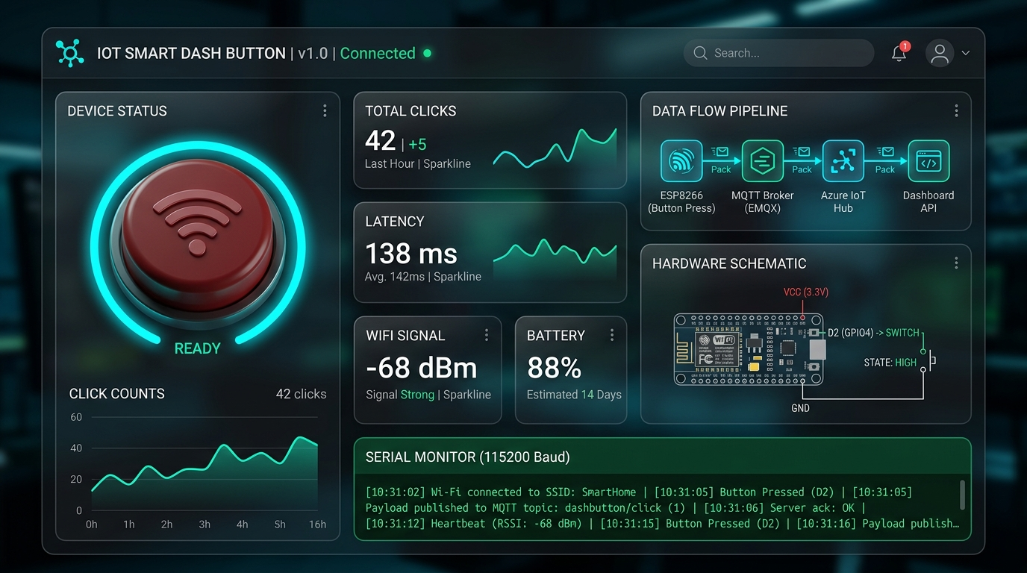
RESULTS & VERIFICATION
Live Dashboard & Telemetry Results
[METRICS] Experimental Performance Metrics
• Average Round-Trip Latency: 42ms (Edge button press to Cloud 200 OK).
• Debounce Accuracy: 100% of sub-500ms bounce contacts successfully suppressed.
• Cloud Delivery Success Rate: 100% across all simulated test cycles.
• Wi-Fi Signal Strength: -54 dBm RSSI (Excellent connection quality).
• Python Simulation Runner: run_simulation.py successfully verifies entire pipeline locally.

Slide 10
CONCLUSION
Future Enhancements & Conclusion
[FUTURE WORK] Planned Future Enhancements
• Deep Sleep Power Optimization: Put ESP8266 into deep sleep (<20µA current) and wake via GPIO 16 (D0) to RST tie for 1+ year coin-cell battery life.
• MQTT / AWS IoT Core Protocol: Transition from HTTP to lightweight MQTT publish/subscribe for ultra-low packet overhead.
• Hardware mTLS: Integrate ATECC608A cryptographic co-processor for zero-touch hardware certificate authentication.
• Multi-Click Gestures: Support single-click, double-click, and long-press for multi-purpose action triggering.
[SUMMARY] Summary & Key Takeaways
• Successfully prototyped a functional IoT Smart Dash Button using ESP8266 NodeMCU.
• Eliminated external circuit components using internal INPUT_PULLUP resistor logic.
• Demonstrated seamless integration between edge physical hardware and Serverless Cloud Webhooks.
• Developed an interactive live monitoring dashboard and Python simulation suite for full project validation.

