Slide 1
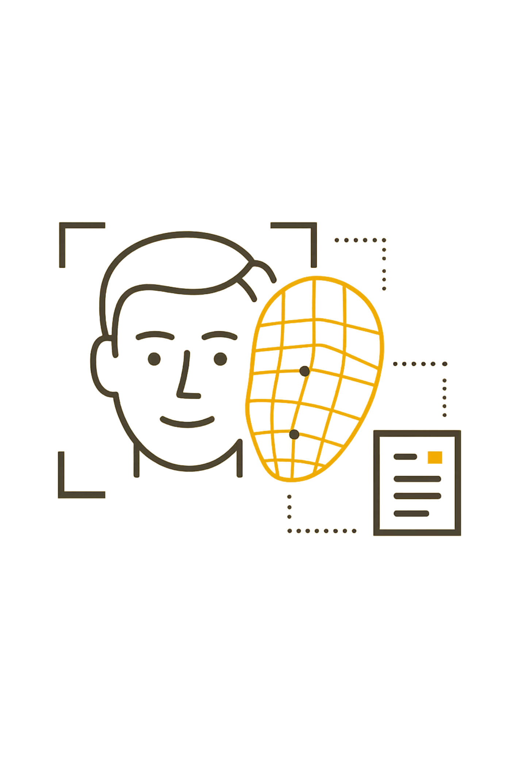
Smart Attendance System using Face Recognition
Machine Learning Project
A.Sudhakar · 2503A52L11
SR University

Slide 2

The Problem with Manual Attendance
⏱ Time-Consuming
🎭 Proxy Attendance
Manual roll calls consume valuable class time every session, reducing instructional time.
Students can easily mark attendance for absent peers — a persistent integrity issue in institutions.
📋 Error-Prone Records
Paper-based logs are difficult to track, search, or analyze efficiently over time.

Slide 3
Project Objectives
This system aims to modernize attendance tracking by leveraging facial recognition — making it faster, smarter, and fraud-resistant.
Automate the Process
Improve Accuracy
Reduce Effort & Errors
Eliminate manual roll calls entirely with camera-based detection.
Use face recognition to ensure only the right student is marked present.
Minimize human intervention and eliminate data-entry mistakes.

Slide 4
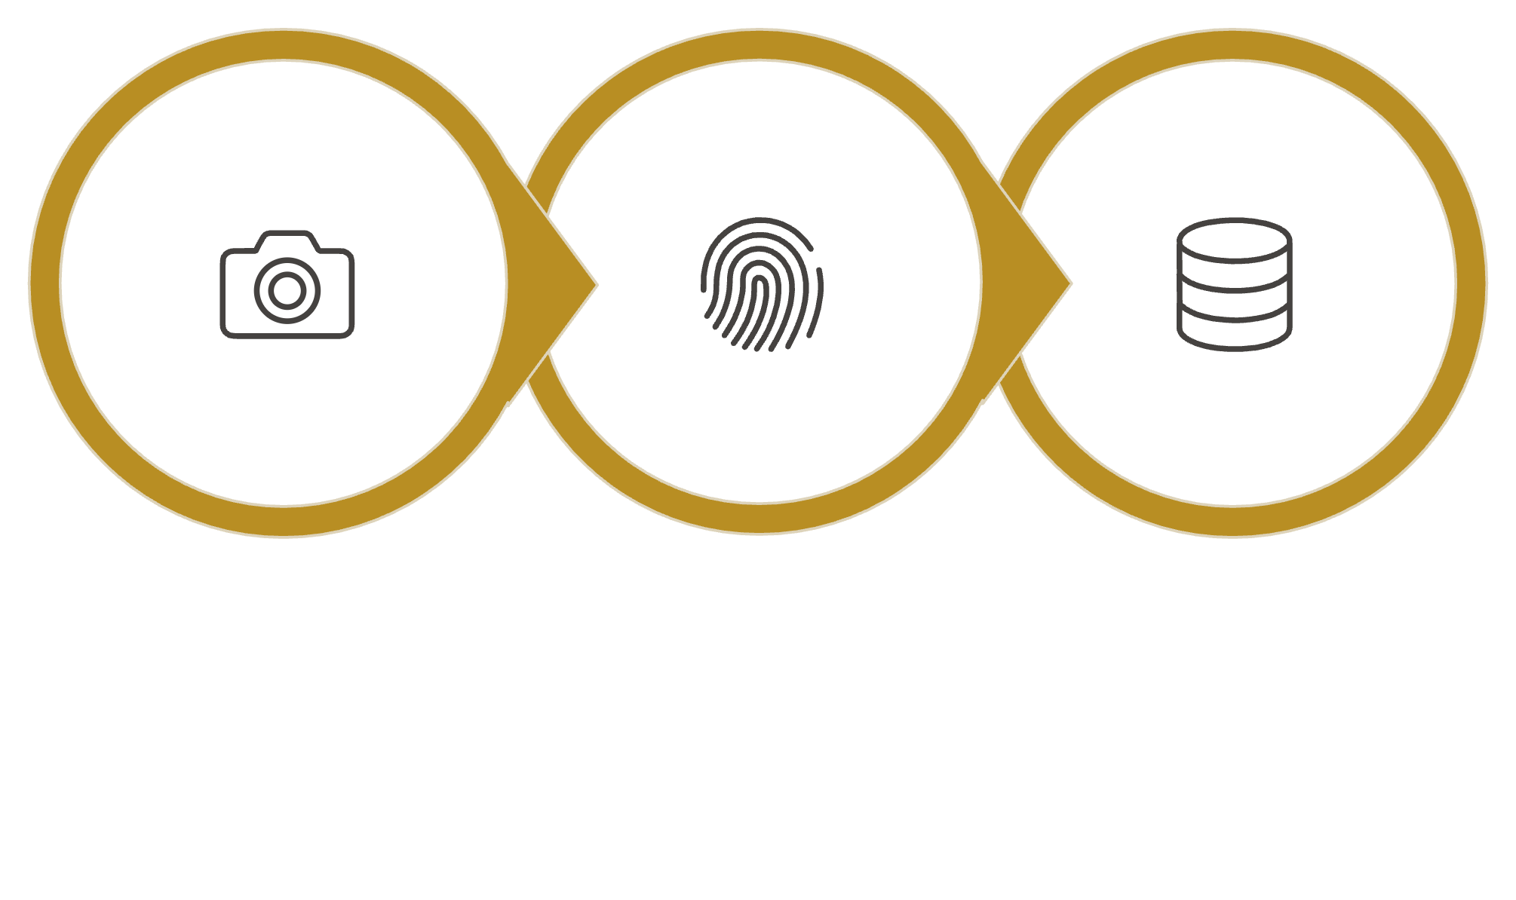
Proposed Solution
A camera-based system that detects, identifies, and logs attendance automatically — in real time.
Match Encoding
Mark Attendance
Detect Face
The system runs continuously during class hours, requiring zero manual input once deployed.

Slide 5
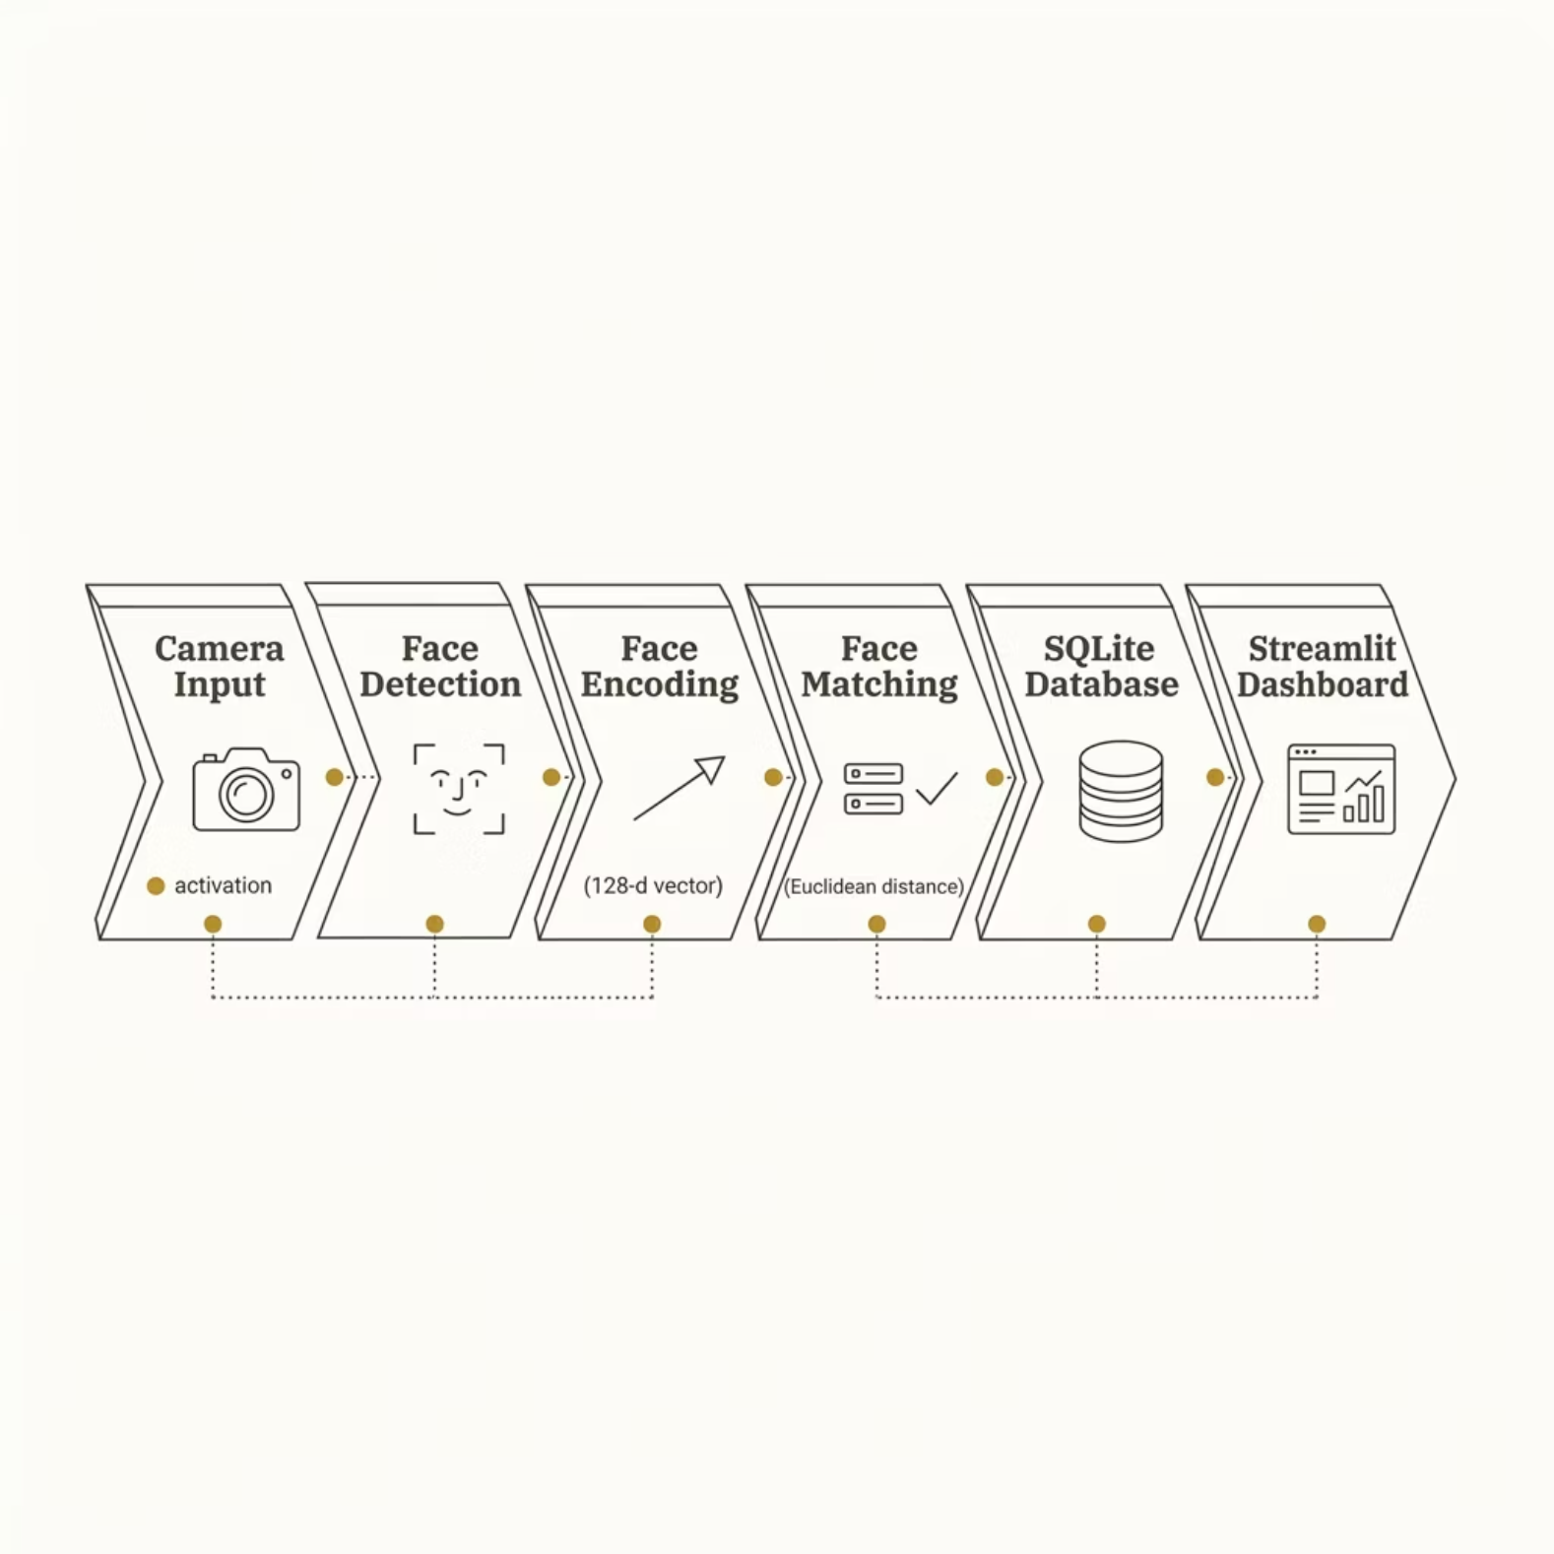


System Architecture
End-to-End Pipeline
Each stage in the pipeline processes the input sequentially — from raw camera frames to a live attendance dashboard. The system operates in real time with minimal latency.
Face encodings are generated once during registration and reused for all future matching sessions.

Slide 6
Technologies Used
Python
OpenCV
face_recognition
Core language for all ML and backend logic
Real-time video capture and image processing
Dlib-based library for detection and encoding
SQLite
Streamlit
Lightweight database for storing records
Interactive web UI and live dashboard

Slide 7
Algorithm & Workflow
How Recognition Works
Step-by-Step Workflow
Face Embeddings: Each face is converted to a 128-dimensional vector
Euclidean Distance: Measures similarity between two face vectors
Threshold (~0.45): Below this value = match confirmed
01
Register User
02
Capture Dataset Images
03
Generate Embeddings
04
Run System
05
Detect Face & Mark Attendance

Slide 8
Key Features
Our Smart Attendance System is built with functionalities designed to bring efficiency, accuracy, and reliability to educational institutions.
Automated & Real-time Logging
Enhanced Fraud Prevention
Attendance is automatically captured and recorded as soon as a student's face is detected, eliminating the need for manual check-ins.
Facial recognition technology ensures that only the registered student can mark their presence, significantly reducing proxy attendance issues.
Accurate & Centralized Records
Intuitive Dashboard & Reports
All attendance data is precisely recorded and stored digitally, providing a reliable and easily accessible source for analysis and reporting.
An interactive Streamlit dashboard offers real-time monitoring and generates comprehensive attendance reports for administrators.

Slide 9

Results & Accuracy
85–90%
~0.45
128
Recognition Accuracy
Match Threshold
Embedding Dimensions
Achieved under controlled lighting and standard angles
Euclidean distance cutoff for positive identification
Each face encoded as a 128-D vector for fast comparison
What We Observed
Face detection operational in real time with live camera feed
Attendance records stored reliably in SQLite database
Dashboard successfully visualizes daily and weekly trends
Accuracy varies with lighting conditions, camera quality, and face angles
Accuracy improves significantly with a larger, diverse training dataset per user.

Slide 10
Challenges & Future Roadmap
CURRENT CHALLENGES
WHAT'S NEXT
⚠️ Known Limitations
🚀 Future Enhancements
Lighting Variations: Low or harsh light reduces detection reliability
Multiple Faces: Simultaneous detection of several faces needs optimization
Camera Performance: Hardware limitations affect frame rate and clarity
Mobile App: Enable attendance marking via smartphone
Cloud Deployment: Scale to multi-classroom, institution-wide use
Deep Learning: Upgrade to CNN-based models for higher accuracy
Multi-Face Tracking: Optimize for crowded classroom environments

Slide 11

THANK YOU

