Slide 1
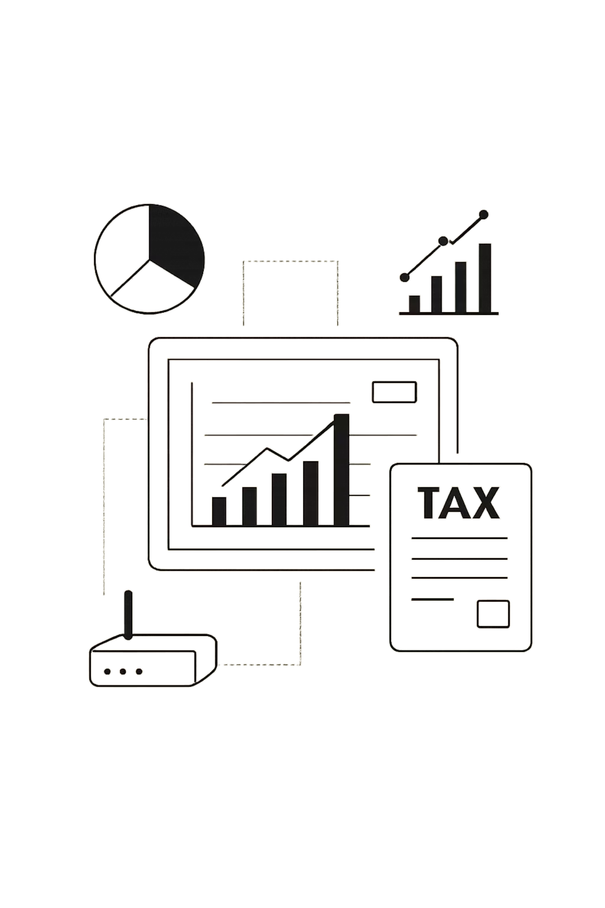
INCOME TAX FRAUD DETECTION AND TAX LIABILITY PREDICTION USING MACHINE LEARNING
Leveraging AI to combat tax evasion and optimize revenue collection

Slide 2


THE TAX FRAUD CHALLENGE
WHAT IS TAX FRAUD?
DETECTION CHALLENGES
Intentional misreporting of income, deductions, or credits to reduce tax liability illegally
Manual review is time-consuming, costly, and prone to human error
WHY ML?
Automated pattern recognition identifies anomalies at scale with consistent accuracy

Slide 3

PROJECT OVERVIEW & OBJECTIVES
SYSTEM PURPOSE
Machine learning framework for two critical tax functions:
Fraud detection and classification
Tax liability prediction
Automated risk scoring
KEY BENEFITS
Real-time fraud screening
Accurate liability forecasting
Resource optimization for audits

Slide 4
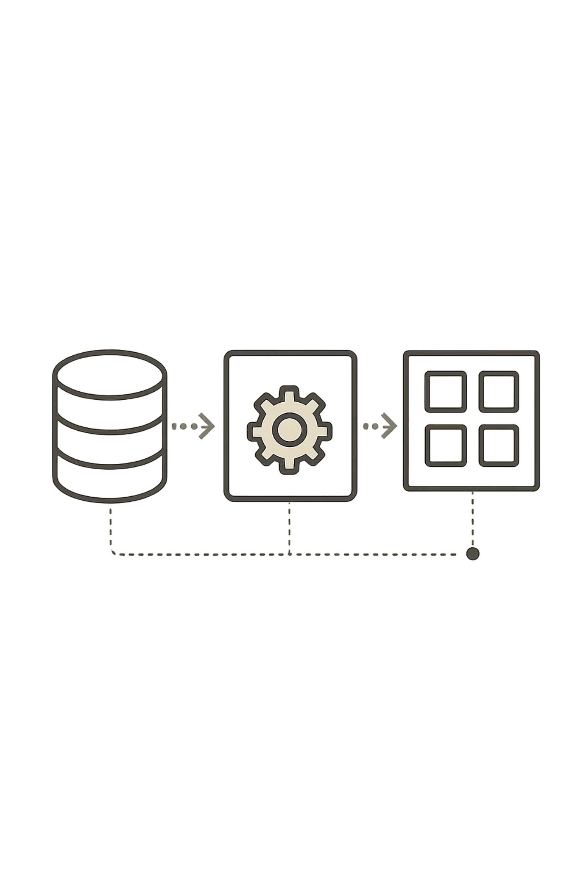




SYSTEM WORKFLOW
DATA INPUT
Tax returns, income records, deduction details, historical data
PREPROCESSING
Data cleaning, feature engineering, outlier detection, normalization
ML MODELS
Classification and regression algorithms analyze patterns
OUTPUT
Fraud probability, risk score, tax liability estimate

Slide 5
CLASSIFICATION ALGORITHMS
Four supervised learning models for fraud detection
1
2
LOGISTIC REGRESSION
DECISION TREE
Statistical model estimating fraud probability using linear combinations of features. Interpretable coefficients identify key risk factors.
Hierarchical rules splitting data based on feature thresholds. Visual decision paths reveal fraud patterns clearly.
3
4
RANDOM FOREST
XGBOOST
Ensemble of decision trees reducing overfitting. Robust performance across diverse tax scenarios.
Gradient boosting framework optimizing prediction accuracy. Handles imbalanced datasets effectively.

Slide 6
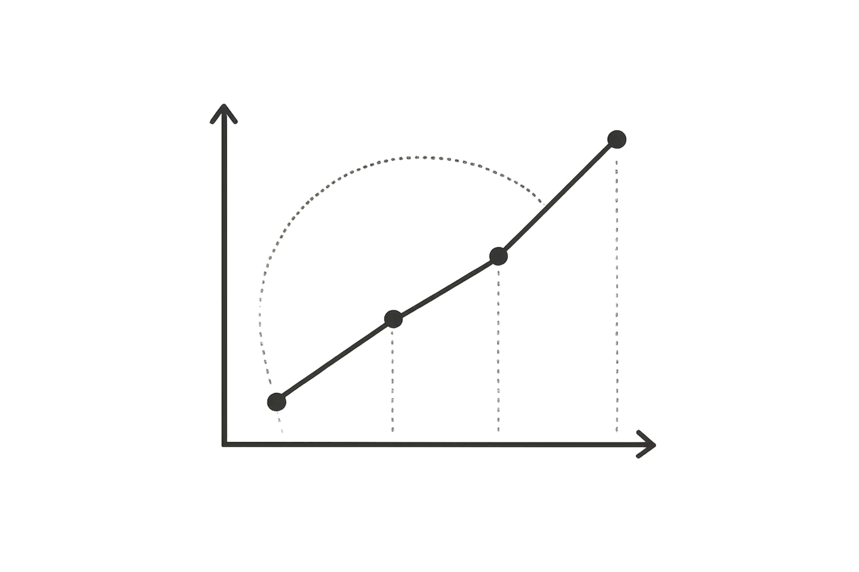
PREDICTION ALGORITHM
LINEAR REGRESSION
Models relationship between tax liability and predictors:
Income level and sources
Number of dependents
Deduction types and amounts
Tax credits claimed
Historical payment patterns
Enables proactive compliance and revenue forecasting

Slide 7
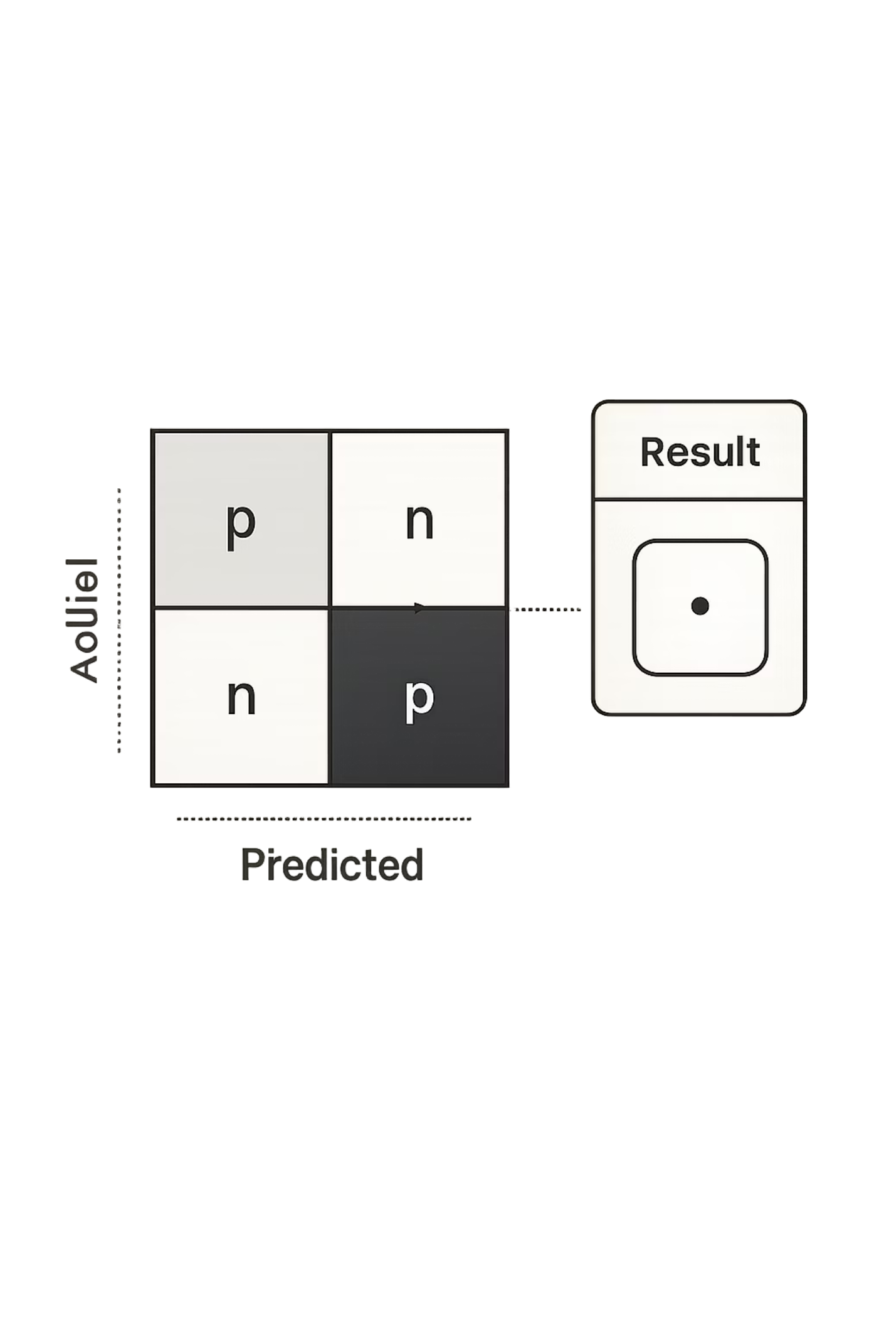
PERFORMANCE METRICS
92%
ACCURACY
Overall correct classifications
89%
PRECISION
Proportion of flagged cases actually fraudulent
94%
RECALL
Fraudulent cases successfully identified
91%
F1-SCORE
Harmonic mean balancing precision and recall

Slide 8
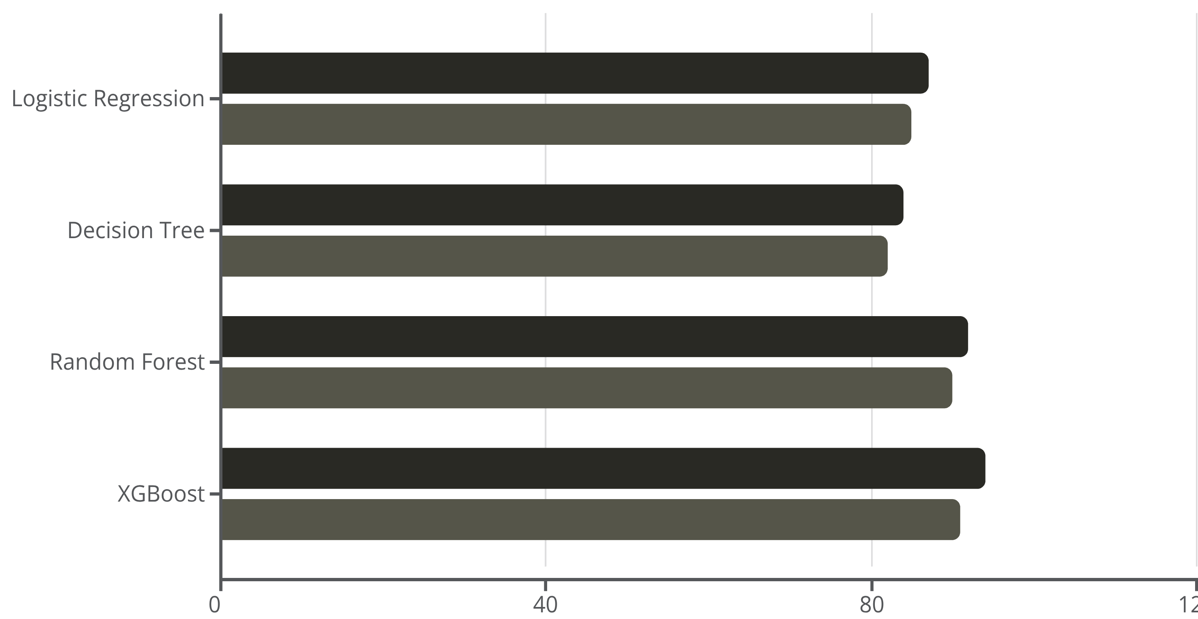
MODEL COMPARISON RESULTS
Accuracy (%)
Precision (%)
XGBoost achieved highest accuracy with strong precision, making it optimal for production deployment

Slide 9
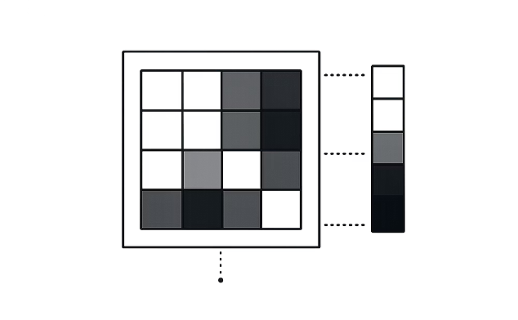
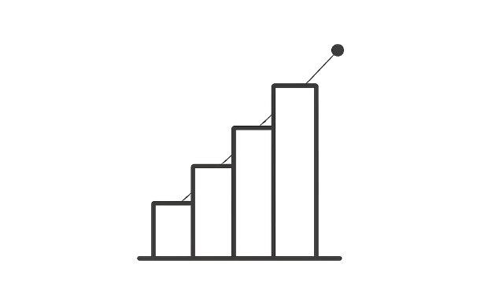
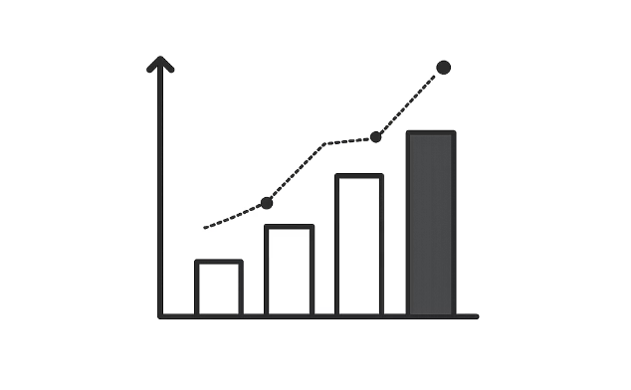
VISUAL ANALYSIS INSIGHTS
CORRELATION HEATMAP
DISTRIBUTION ANALYSIS
FRAUD COMPARISON
Strong positive correlation between income variability and fraud risk
Skewed distributions reveal unusual deduction patterns in fraudulent cases
Mean deduction amounts 3.2× higher in fraudulent returns

Slide 10

CONCLUSION & FUTURE DIRECTIONS
KEY FINDINGS
IMPLEMENTATION BENEFITS
94% fraud detection accuracy
XGBoost outperformed alternatives
Linear regression reliable for liability forecasting
Reduced audit costs
Faster fraud identification
Data-driven resource allocation
FUTURE ENHANCEMENTS
Real-time streaming data processing
Deep learning neural networks
Natural language processing for document analysis

