Slide 1
Smart Energy Consumption Forecasting using Machine Learning
Combining time-series methods and machine learning to predict short- and medium-term electricity consumption from smart meter data. For researchers and technical stakeholders in energy systems and ML.

Slide 2
Why Energy Forecasting Matters
Grid Reliability
Operational Efficiency
Accurate demand forecasts reduce overload risk and inform dispatch decisions.
Improves unit commitment, reduces reserve margins, and lowers cost.
Demand Response & Decarbonization
Enables targeted DSM programs and integration of variable renewables.

Slide 3
Problem Statement
Predict near-term household/feeder electricity consumption with high accuracy.
Handle irregular sampling, missing readings, and seasonal/behavioral patterns.
Compare classical ML (Random Forest) vs sequence models (LSTM) for operational forecasting.

Slide 4
Dataset: UCI Smart Meter
Household-level electricity readings sampled at 10–30 minutes intervals (multiple households, multiple days). Includes timestamps, meter readings, and some contextual metadata.
Size: tens to hundreds of households; long-term logs
Challenges: missing data, irregular intervals, daylight saving shifts

Slide 5
Data Preprocessing
1. Resampling & Alignment
Uniform sampling (e.g., 30-minutely) to create consistent time steps.
2. Missing Value Handling
Short gaps: interpolation; long gaps: flag & exclude or impute with seasonal means.
3. Outlier Detection
Winsorization or z-score filtering per household to remove sensor errors.
4. Scaling
Train-time scaler (Standard / MinMax) fit on training set, applied to validation/test.

Slide 6



Feature Engineering
Time Features
hour of day, day of week, holiday flag, seasonal sin/cos embeddings.
Lag Features
t-1, t-24, t-48 readings to capture autoregressive behavior.
Rolling Features
rolling mean/std (window=3–24 hours) to represent local trends and volatility.

Slide 7
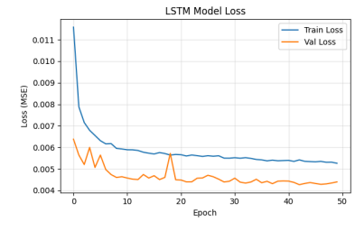
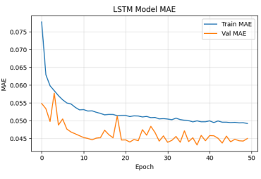
Data Visualization Insights
Strong daily cycle: peak in evening hours and trough at night.
Weekly pattern: weekdays > weekends for many households.
Autocorrelation high at 24-hour lag; residual variance increases during transitional seasons.
Visualizations guide model selection and feature windows (e.g., include 24h and 7d lags).

Slide 8
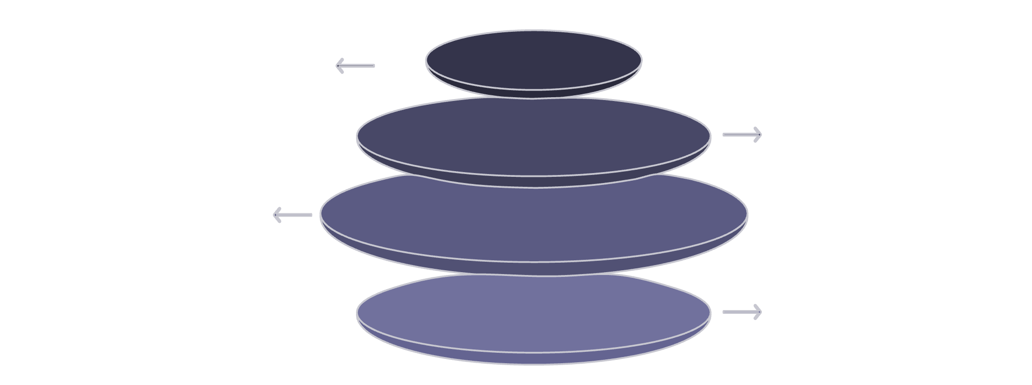
LSTM: Architecture & Training Choices
Input Sequence
Univariate or multivariate time steps
LSTM Layer 1
128 units, dropout 0.2 regularization
Layers: 2 LSTM layers (128 → 64 units) + Dense output.
Regularization: dropout 0.2, L2 weight decay.
Loss & optimization: MSE loss; Adam with cyclical/step LR.
Windowing: lookback 48–168 steps (1–7 days) depending on horizon.
LSTM Layer 2
64 units, dropout 0.2, L2 weight decay
Dense Output
Predict next N steps (sequence output)
Sequence-to-one or sequence-to-sequence configurations; teacher forcing for multi-step training.

Slide 9
Random Forest Model
Setup
Advantages
Gradient-free ensemble using engineered features (lags, rolling stats, time indicators).
Robust to outliers, fast to train, interpretable feature importances.
Limitations
Does not inherently model sequence dynamics; requires rich lag/rolling features for temporal context.

Slide 10
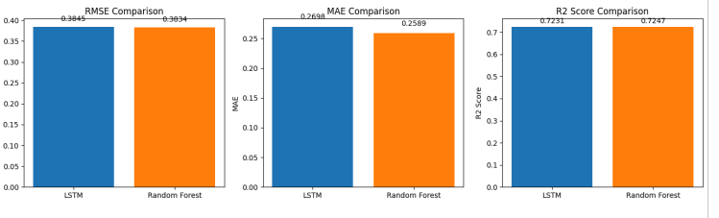
Model Training, Evaluation & Comparison
Training Protocol
Rolling-origin cross-validation, walk-forward retraining on expanding window to simulate production deployment.
Evaluation Metrics
RMSE, MAE, R² reported per-horizon and aggregated; use normalized errors for cross-household comparison.
Comparison Summary
LSTM excels on multi-step continuity and long-range patterns; Random Forest competitive on short-horizon when engineered features capture seasonality.
Recommendation: hybrid approach — RF for rapid short-horizon forecasts; LSTM for sequence consistency and longer horizons.

Slide 11
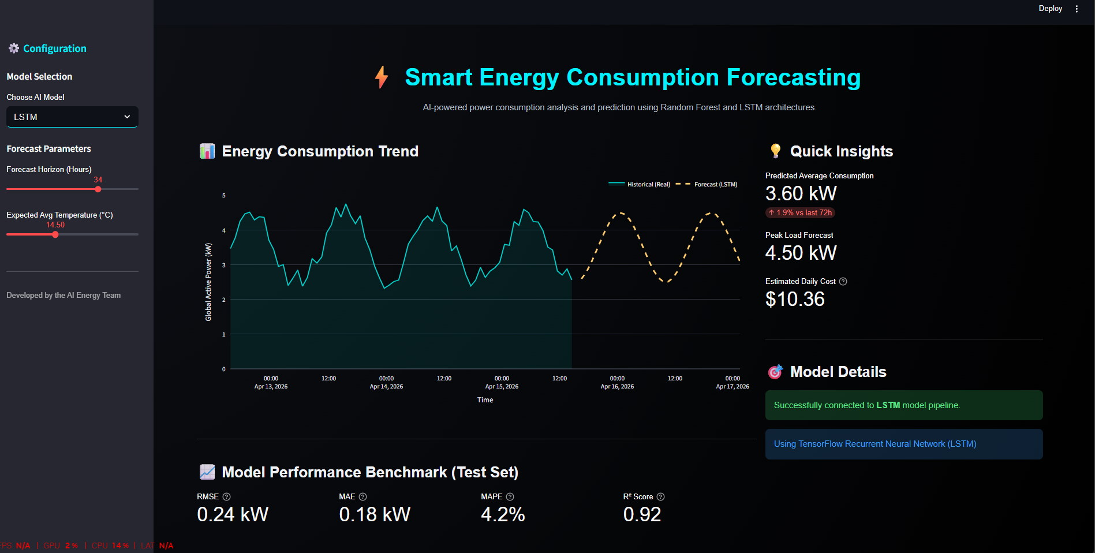
Results

Slide 12
Conclusion
The project successfully developed a smart energy consumption forecasting system using both machine learning and deep learning techniques. The dataset was carefully pre-processed, cleaned, and transformed into a time-series format suitable for modelling. Feature engineering, including lag and rolling statistics, played a crucial role in improving prediction accuracy. Both LSTM and Random Forest models were trained and evaluated effectively on the prepared dataset.
The results showed that both models performed well, with Random Forest slightly outperforming LSTM in key metrics like RMSE, MAE, and R² score. This highlights that traditional models can compete with deep learning when features are well engineered. The importance of past consumption values in forecasting was clearly observed through feature importance analysis. Overall, the project demonstrates the potential of machine learning in energy forecasting and its practical applications in smart energy management.

Slide 13
Thank You

