Slide 1
.NET Foundations

Slide 2

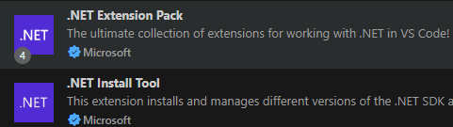
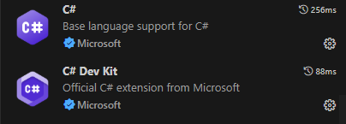
Software Requirements
Docker Desktop
VS Code
Microsoft SQL Server Management Studio
MSSQL VS Code Extension
Git

Slide 3
Agenda
01
02
03
Platform Overview
C# Foundations
C# Level I
What is .NET?
.NET Versions
Dependency Management
.NET SDK
Common SDK commands
What is C#?
Program Structure & the Main method
Data Types & Type Conversion
Operators
Comments
Input/Output
Value Types vs Reference Types
Stack vs Heap
Selection & Iteration
Custom Types & Collections
Serialization/Deserialization
File I/O
LINQ
ASP.NET Core overview
Minimal APIs
Entity Framework Core Overview
Testing Minimal APIs

Slide 4
01
Platform Overview

Slide 5
What is .NET?
.NET is a free, open-source developer platform for building many types of applications for multiple different programming platforms.
With .NET, you can use multiple languages, editors, and libraries to build for web, mobile, desktop, games, and IoT (Internet of Things).
In .NET:
We develop with C#, VB, or F#
It has a cross-platform design, i.e. runs on windows, mac, and linux
Multiple .NET versions can run side-by-side on the same machine to run projects concurrently

Slide 6
If you are coming from Java…
Technology | Java | .NET
Language | Java | C#
Dependency Manager | Maven/Gradle | Nuget
Testing | junit | xunit
SQL Vendor | MySQL/PostgreSQL | SQL Server
DB access | jdbc | ADO.NET
ORM | Hibernate | Entity Framework Core
Web Framework | javalin | ASP.NET Core minimal API
 | Spring | ASP.NET Core

Slide 7
.NET versions and naming
Yearly releases, with even numbers being LTS (long term support)
.NET 8 is the latest release
‘.NET Framework’ is the first ever release (legacy)
‘.NET Core’ began cross-platform implementations
Eventually they dropped ‘Core’ and skipped version 4…
So the version history is something like this: .NET Framework > .NET Core 1 > … > .NET Core 3.1 > .NET 5 > Ect.

Slide 8
What is the .NET SDK?
The .NET SDK is a set of libraries and tools that allows developers to create .NET applications and libraries. It contains the following components that are used to build and run applications:
The .NET CLI (command line interface)
The .NET Runtime and libraries
The Common Language Runtime (CLR) handles memory allocation and management. It includes a virtual machine that executes apps but also generates and compiles code on-the-fly using a JIT compiler.
Code is compiled into a Common Intermediate Language (CIL)
CIL will be executed with a JIT compiler
Base Class Library (BCL) is available OOB, and comprises the System namespace
The .NET driver, which provides an interface to the Microsoft .NET open source software framework for developing applications

Slide 9
Dependency Management
Nuget is responsible for dependency management in .NET, and it comes pre-installed with the .NET SDK. This is how we include further libraries outside of the BCLs.
You can add a new package with:
dotnet add package <package-name>
Dependencies are added to our .csproj file.

Slide 10
Common .NET SDK Commands
dotnet –info – display info on dotnet sdk
dotnet new … - scaffold a new project
dotnet new console –n HelloWorld – scaffold a console app with a project name of ‘HelloWorld’; uses top-level statements
dotnet new console –n HelloWorld –use-program-main – same as above, except it won’t use top level statements or implicit usings, we will get a main method
dotnet new gitignore – create new .NET specific gitignore file
dotnet new list – list all templates available for the dotnet new command
dotnet run –clean, restore, build, and run the project

Slide 11
.NET Overview Challenge 1
Goal:
Create a .NET app.
Scenario: 5 min
Create a Hello World console app and run it.

Slide 12
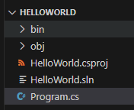
Project Files
Bin is generated when we run the project. Both bin and
Obj folders represent generated project files.
The .csproj file lists project dependencies.
The .sln file (solution file) is responsible for linking multiple
Projects together so they may perform work in tandem.
The .cs is our source code and project entry point.

Slide 13
02
C# Foundations

Slide 14
What is C#?
C# may be described as:
object-oriented
Statically typed
C# program runtime is managed by the CLR (common language runtime).
CLR is the implementation by Microsoft of the common language infrastructure (CLI), an international standard
The CLI is the basis for creating both execution and development environments in which languages and libraries work together seamlessly

Slide 15
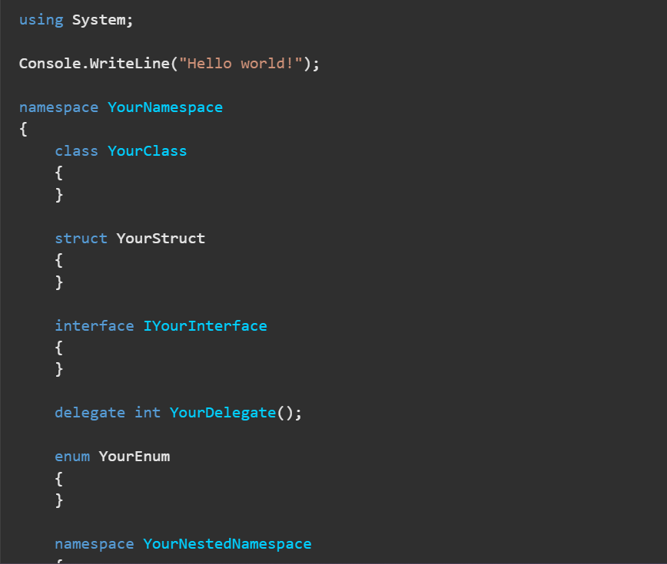
Program Structure
Each C# file contains zero or more namespaces.
A namespace contains types such as classes, structs, interfaces, enums, delegates, and other namespaces.
Namespaces help us organize our code

Slide 16
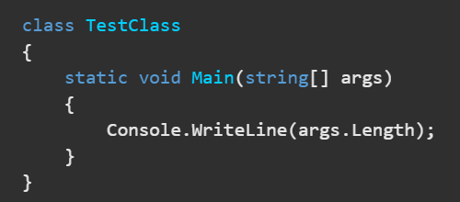
The Main Method
Entry point for application
If multiple classes have main methods, then the StartupObject compiler option may be used to specify which one to use first
Console Apps get Top-Level Statements enabled by default. I.e. no boilerplate class/method, implicit usings, ect.
return 0; in the Main method to exit the application otherwise, use Environment.Exit(0); to exit the application from any method

Slide 17
Built-In Primitive Data Types
Int num = 123;
Alias | Type Name | Type | Size(bits) | Range
short | System.Int16 | signed integer | 16 | -32768 to 32767
int | System.Int32 | signed integer | 32 | -2³¹ to (2³¹)-1
long | System.Int64 | signed integer | 64 | -2⁶³ to (2⁶³)-1
byte | System.Byte | unsigned integer | 8 | 0 to 255
float | System.Single | floating point number | 32 | ±1.5 × 10⁻⁴⁵ to ±3.4 × 10³⁸
double | System.Double | floating point number | 64 | ±5.0 × 10^{-324 to ±1.7 × 10308}
char | System.Char | Unicode character | 16 | U +0000 to U +ffff
string | System.String | text | N/A | N/A

Slide 18
Type Conversion
There are 2 types of type conversion in C#:
Implicit Conversions: No special syntax required, type safe, no data loss
Explicit Conversions (Casting): Requires the cast operator (). A cast is required when data might be lost in the conversion, or when failure could occur.
This is implicit conversion:
Int num = 123;
Long biggerNum = num;
This is explicit conversion:
Double x = 123.4;
Int a = (int)x;

Slide 19
Arithmetic Operators
Operator | Description | Example
+ | Adds two operands | A + B
- | Subtracts second operand from the first | A - B
* | Multiplies both operands | A * B
/ | Divides numerator by denominator | B / A
% | Remainder after an integer division | B % A
++ | Increment operator; increases integer value by one | A++
-- | Decrement operator; decreases integer value by one | A--

Slide 20
Relational Operators
Operator | Description | Example
== | Checks if the values of two operands are equal or not, if yes then condition becomes true. | (A == B) is not true.
!= | Checks if the values of two operands are equal or not, if values are not equal then condition becomes true. | (A != B) is true.
> | Checks if the value of left operand is greater than the value of right operand, if yes then condition becomes true. | (A > B) is not true.
< | Checks if the value of left operand is less than the value of right operand, if yes then condition becomes true. | (A < B) is true.
>= | Checks if the value of left operand is greater than or equal to the value of right operand, if yes then condition becomes true. | (A >= B) is not true.
<= | Checks if the value of left operand is less than or equal to the value of right operand, if yes then condition becomes true. | (A <= B) is true.

Slide 21
Logical Operators
Operator | Description | Example
&& | Logical AND operator. If both the operands are non zero then condition becomes true. | (A && B) is false.
|| | Logical OR Operator. If any of the two operands is non zero then condition becomes true. | (A || B) is true.
! | Logical NOT Operator. Use to reverses the logical state of its operand. If a condition is true then Logical NOT operator will make false. | !(A && B) is true.

Slide 22
Assignment Operators
Operator | Description | Example
= | Simple assignment operator, Assigns values from right side operands to left side operand | C = A + B assigns value of A + B into C
+= | Add AND assignment operator, It adds right operand to the left operand and assign the result to left operand | C += A is equivalent to C = C + A
-= | Subtract AND assignment operator, It subtracts right operand from the left operand and assign the result to left operand | C -= A is equivalent to C = C - A
*= | Multiply AND assignment operator, It multiplies right operand with the left operand and assign the result to left operand | C *= A is equivalent to C = C * A
/= | Divide AND assignment operator, It divides left operand with the right operand and assign the result to left operand | C /= A is equivalent to C = C / A
%= | Modulus AND assignment operator, It takes modulus using two operands and assign the result to left operand | C %= A is equivalent to C = C % A

Slide 23
Increment/Decrement Operators
Postfix and Prefix increment
int i = 3;
Console.WriteLine(i); // output: 3
Console.WriteLine(i++); // output: 3
Console.WriteLine(i); // output: 4
double a = 1.5;
Console.WriteLine(a); // output: 1.5
Console.WriteLine(++a); // output: 2.5
Console.WriteLine(a); // output: 2.5
Postfix and Prefix decrement
int i = 3;
Console.WriteLine(i); // output: 3
Console.WriteLine(i--); // output: 3
Console.WriteLine(i); // output: 2
double a = 1.5;
Console.WriteLine(a); // output: 1.5
Console.WriteLine(--a); // output: 0.5
Console.WriteLine(a); // output: 0.5

Slide 24
Bitwise Operators
Bitwise complement operator ~
Left-shift operator <<
Right-shift operator >>
Unsigned right-shift operator >>>
Logical AND operator &
Logical OR operator |
Logical exclusive OR operator ^

Slide 25
Operator Precedence
Category | Operator | Associativity
Postfix | () [] -> . ++ - - | Left to right
Unary | + - ! ~ ++ - - (type)* & sizeof | Right to left
Multiplicative | * / % | Left to right
Additive | + - | Left to right

Slide 26
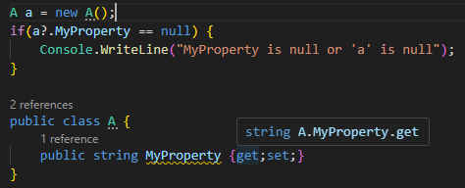
Operator Special Mentions
The null-forgiving operator suppresses all nullable warnings for the preceding expression.
The null-conditional operator evaluates the first operand; if that’s null, stop, with a result of null. Otherwise, evaluate the next operand.

Slide 27
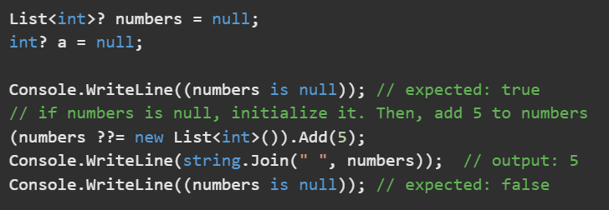
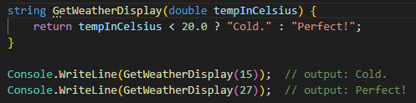
Operator Special Mentions
The null-coalescing operator returns the value of its left-hand operand if it isn’t null; otherwise, it evaluates the right-hand operand and returns its result.
The conditional operator (or ternary conditional operator), evaluates a Boolean expression and returns the result of one of the two expressions, depending on whether the Boolean expression evaluates to true or false.

Slide 28
Comments
// - Represents a single line comment
/* comment */ - Represents a multi-line comment

Slide 29
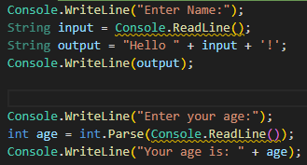
Input/Output
Question Time: What’s the distinction between the single and double quotes on line 3?
Note: Care that Console.ReadLine() returns a string, not an int!

Slide 30
C# Foundations Challenge 1
Goal:
Edit our console app.
Scenario: 5 min
Edit our console app to take in a user email and output it back to the user.

Slide 31
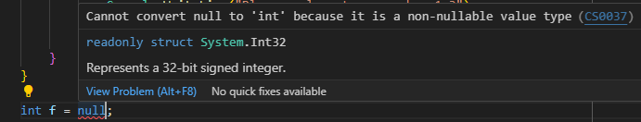
A Note on C# Under-the-hood behavior
Value Types
Reference Types
Represents some data at a memory address
Size is determined up front
You can’t have a null value type
Variable only holds a pointer to a memory address
Size is not determined up front
Can be null

Slide 32
C#, Where memory is always** managed for you!!!
Two areas used to store data for memory management.
The Stack
The Heap
Used for static memory allocation
Stores value types and reference type pointers
Follows LIFO structure
Data is automatically freed once out of scope
Limited in size
Managed by the compiler
Very fast
Used for dynamic memory allocation
Stores Objects, strings, arrays
Structure is just a pile of data, any piece of data can be accessed at any time
Data can exist after method returns
Larger memory space than the stack
Managed by the Garbage Collector
Slow
** Except for unmanaged resources

Slide 33
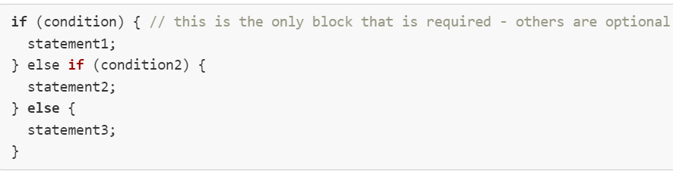
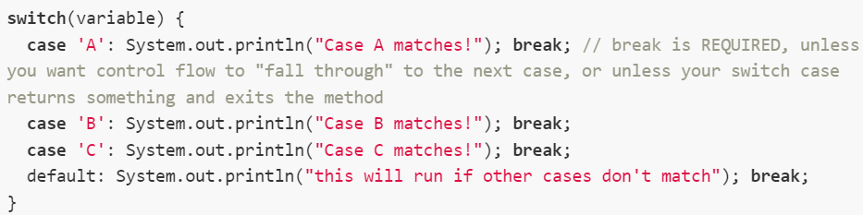
Selection & Iteration

Slide 34
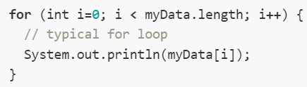

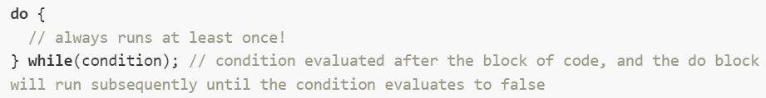
Selection & Iteration

Slide 35
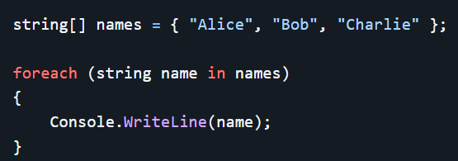
Selection & Iteration
Notes:
Probably pause here as it’s the best stopping point to expand on arrays a bit. The rest of the deck doesn’t expound on arrays to any depth

Slide 36
Custom Types
We use the following to create our own Custom Data Types:
Struct = defined as a value type, good for little or no behavior
Class = defined as a reference type, good for lots of behavior
Interface
Enum
Record
Custom Types Best Practices < Docs

Slide 37

OOB Struct Example
We can use the Guid Struct to create a globally unique identifier (GUID).
For a struct, Guid has a lot of methods.

Slide 38
C# Foundations Challenge 2
Goal:
Create a Car class.
Scenario: 5 min
Create a new class to represent a car.
Let’s include a make, model, year, and Id.

Slide 39
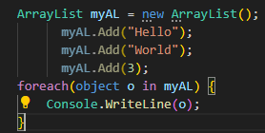

Collections
Lists are indexed collections of the same type(T).
No auto-resize
Not performant/generic
Truly generic & performant
Generic Collections <- Link

Slide 40
C# Foundations Challenge 3
Goal:
Create a Car management application.
Scenario: 15 min
Edit our existing console app so that it has a menu with two options as soon as it loads:
1. Enter New Car
2. List Cars
We should be able to create new instances of a car and add it to a running list that we may view.

Slide 41
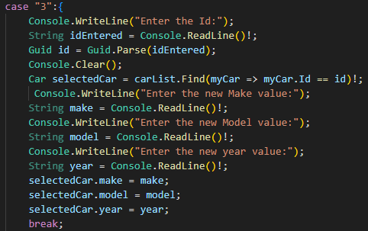
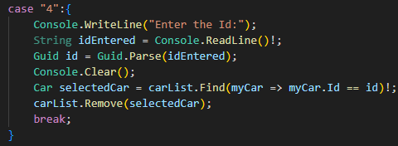
Edit/delete list entry in console app
<- Uses lambda expression!

Slide 42
C# Foundations Challenge 4
Goal:
Edit the Car management application.
Scenario: 15 min
Add the ability to search for a car for update or deletion from a list.

Slide 43
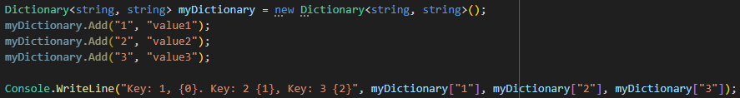
Collections (continued)
Dictionaries are collections of key/value pairs. Each key must be unique. The key and value can be any type(T).
Generic Collections <- Link

Slide 44
Iterating over Dictionaries
Dictionaries may be iterated over with foreach. For each item, the Key property provides access to the key and the Value property provides access to the value.

Slide 45
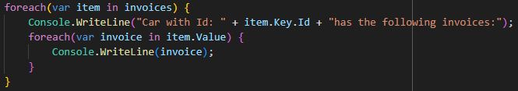
Nested Collections

Slide 46
C# Foundations Challenge 5
Goal:
Edit the Car management application.
Scenario: 15 min
Add the ability to add invoices for a specific car.
Add the ability to print out and view all invoices and the associated car Id.

Slide 47
03
C# Level I

Slide 48
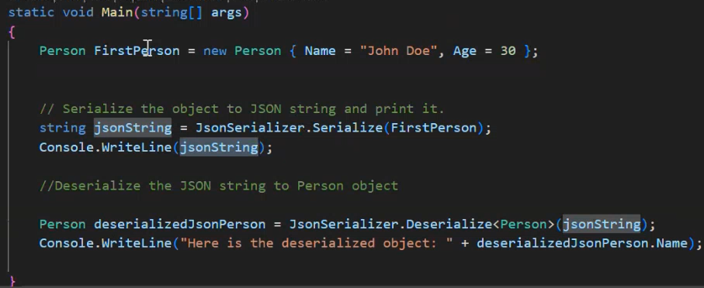
Serialization/Deserialization
Serialization – the process of coverting an object into a format that can be readily persisted or transported.
Serialize an Object
Transport it over the internet using HTTP
Deserialize it at the destination machine
Deserialization – Reconstructs an object from a serialized form.

Slide 49
File I/O
Common Synchronous Options
StreamWriter
Write()
WriteLine()
File
WriteAllLines()
WriteAllText()
AppendAllLines()
AppendAllText()
Common Asynchronous Options
StreamWriter
WriteAsync()
WriteLineAsync()
File
AppendText – returns StreamWriter; can add to existing file or create new one
OpenText() – returns StreamReader
CreateText() – returns StreamWriter; creates or opens a file for writing, if file already exists, its contents are replaced
File class also contains the Exists property, which returns a Boolean of if a file exists or not.

Slide 50
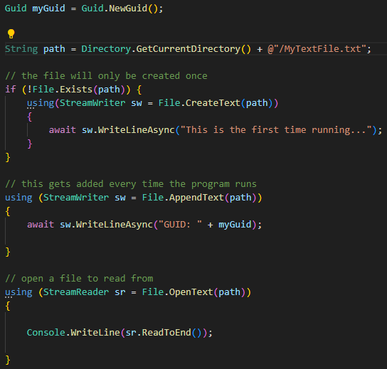
File I/O
The Garbage Collector doesn’t actually manage everything… Unmanaged Resources must be handled by us.
File I/O, Database Connections
iDisposable interface can release resources
Using keyword can release resources

Slide 51
C# Level I Challenge 1
Goal:
Edit the Car management application.
Scenario: 15 min
When quitting the application, we should write all of our cars in JSON format to a local file.
When loading the application, we should read the file to populate our list of cars.

Slide 52
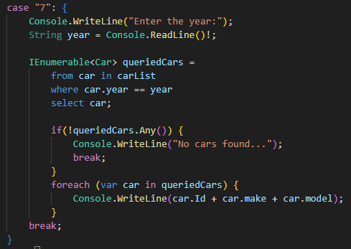
LINQ
Language-Integrated Query (LINQ) is the name for the set of technologies based on the integration of query capabilities directly into the C# language.

Slide 53
C# Level I Challenge 2
Goal:
Edit the Car management application.
Scenario: 15 min
Add a search feature to our application. A user should be able to enter a year for a car and have all the cars of that year print to the console.

Slide 54
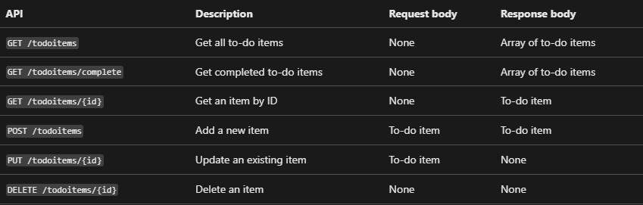
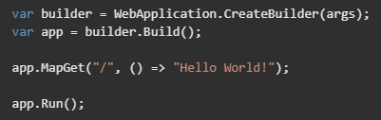
What is an API?

Slide 55
What is ASP.NET Core?
ASP.NET Core is a cross-platform, high-performance, open-source framework for building modern, cloud-enabled, internet-connected apps.
With ASP.NET Core, you can:
- Build web apps and services, Azure IoT (Internet of Things) apps, and mobile backends.
- Use your favorite development tools on Windows, macOS, and Linux.
- Deploy to the cloud or on-premises.
- Run on .NET.

Slide 56
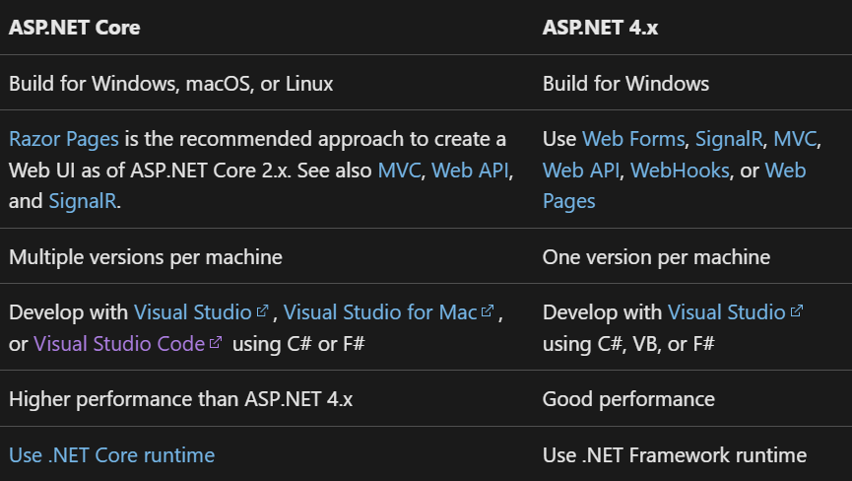
ASP.NET Core vs ASP.NET 4.x

Slide 57
API Options in ASP.NET Core
There are 2 approaches: a controller-based approach and Minimal APIs.
Controllers in an API project are classes that derive from ControllerBase
Classes that take dependencies via constructor injection or property injection
Follows more of an Object-Oriented pattern
Minimal APIs define endpoints with logical handlers in lambdas or methods
Less verbose, intended to include less of the files, features, and dependencies of ASP.NET Core

Slide 58

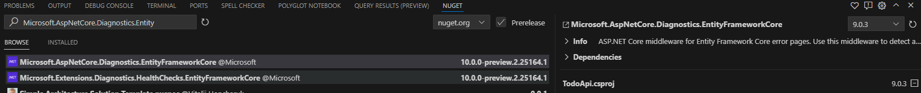

Creating a Minimal API
Create the App
Install Entity Framework Core

Slide 59
C# Level I Challenge 3
Goal:
Create a Minimal API project.
Scenario: 5 min
Create the project and install the necessary nuget packages.

Slide 60
What is Entity Framework Core?
Entity Framework Core is a lightweight, extensible, open source and cross-platform version of the popular Entity Framework data access technology.
EF Core is an O/RM, which:
Enables .NET developers to work with a database using .NET objects
Eliminates the need for most of the data-access code that typically needs to be written
This is the second incarnation. Entity Framework 6 is an O/RM for .NET Framework; no longer being actively developed
Supports LINQ Queries, change tracking, updates, and schema migrations.

Slide 61
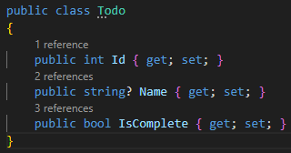
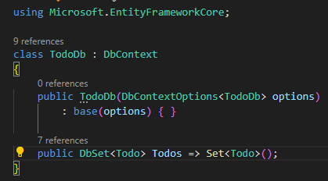
Creating a Minimal API
Todo.cs We create models that represent a tuple.
TodoDb.cs Defines a database context, which is the main class that coordinates Entity Framework functionality for a data model.
This is a constructor initializer. We are passing our database options to the base class: DbContext.

Slide 62
C# Level I Challenge 4
Goal:
Create a model and database context.
Scenario: 10 min
Create a model and database context for Cars.

Slide 63
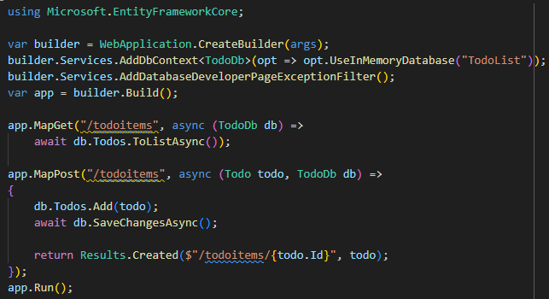
Creating a Minimal API
Program.cs - Our services are built into the app via Dependency Injection.
- Endpoints are mapped to asynchronous anonymous functions.

Slide 64
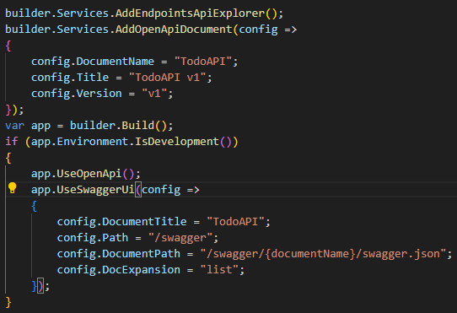
Testing Our Minimal API
Program.cs - Swagger is a robust API testing toolkit
- GUI Provided
- Easily see HTTP status codes, response bodies, response headers, and more

Slide 65
C# Level I Challenge 5
Goal:
Finish the application.
Scenario: 15 min
Create and test an API that can create cars, return a list of all cars, and return all cars of a certain year.

Slide 66
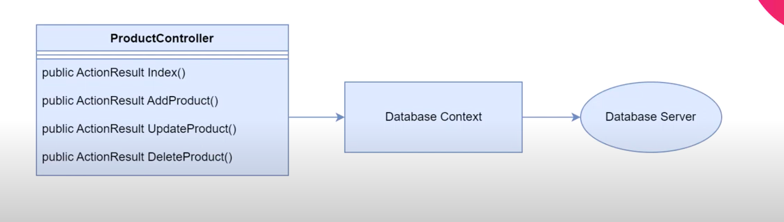
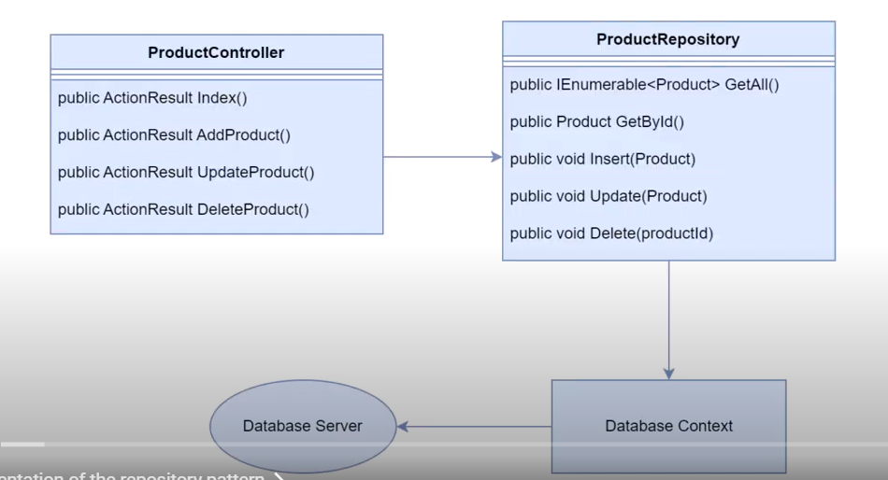
Repository Pattern

Slide 67
Multi-Tenant Architecture
Shared Servers
Isolated Environment
All Salesforce customer orgs are in the cloud, so they share server space.
Each org is an isolated environment from other orgs on the cloud.
Shared Resources
Governor Limits
Because orgs share server space, they also share the physical hardware that keeps the server running. i.e. ram, cpu time, ect.
Limits are in place so that no one org can overuse resources and degrade the performance for everyone else.

Slide 68
MVC
Model
View
Controller
Database Tables, field definitions, ect.
UI elements
Business Logic

Slide 69
MVC
No-Code
Pro-Code
Objects, fields, relatioships
Model
APIs
Apps, Pages, Actions
View
Visualforce, LWC, Aura
Flows, approvals, validation rules
Controller
Apex

Slide 70
No-Code vs Pro-Code
01
Pro-Code
Faster than coding
01
Flexibility
02
Easy to maintain
02
Pixel perfect UI
03
Automatic Updates
03
Integrations
No-Code

