Slide 1

FACTORY CONTEXT
ASTRA
Manufacturing
Intelligence
A visual inspection and root-cause assistant that connects defects, production flow, and decisions.
INDUSTRIAL AI · PROJECT DECK
NEURAX HACKATHON 3.0
2026 · 8-SLIDE PRODUCT OVERVIEW
Notes:
Design direction follows the user-provided factory PowerPoint reference: white canvas, orange signal color, large industrial image, and restrained editorial typography. The factory visual was generated with the built-in image generation tool. The image is placed with contain-fit so the full source frame remains visible. Inspiration research: https://www.creativefabrica.com/de/product/factory-industrial-powerpoint/ ; https://poweredtemplate.com/fabrican-manufacturing-industry-keynote-112538/ ; https://www.slideteam.net/blog/top-10-smart-manufacturing-presentation-templates-with-samples-and-examples

Slide 2
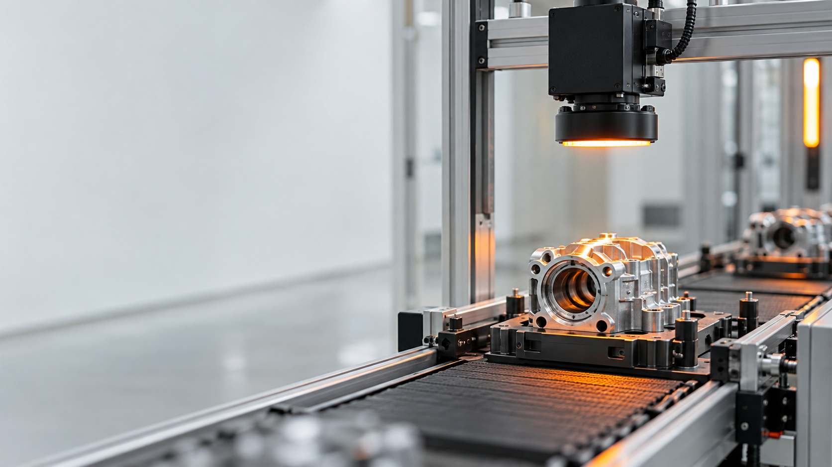
THE PRODUCT THESIS
ASTRA connects the evidence.
The factory can see the defect. ASTRA follows the evidence until the operator can decide what to test next.
INSPECTION CELL · GENERATED VISUAL
IMAGE → DECISION
Defect
What kind? Where? How reliable?
Then connect the result to production context and a testable hypothesis.
THE CONNECTED WORKFLOW
01
02
03
04
05
06
Detect
Localize
Verify
Investigate
Quantify
Simulate
Class + region
Mask + coordinates
Independent check
Batch + context
Flow + economics
Advisory what-if
A ASTRA INTELLIGENCE
Built around evidence. Designed for better decisions.
02
Notes:
Content source: C:/NURAX/README.md, Executive Summary, Core Product Thesis, Visual Inspection Pipeline, Confidence and Trust Model, and Reliability Principles. The generated inspection-cell visual uses contain-fit so the full source frame remains visible.

Slide 3
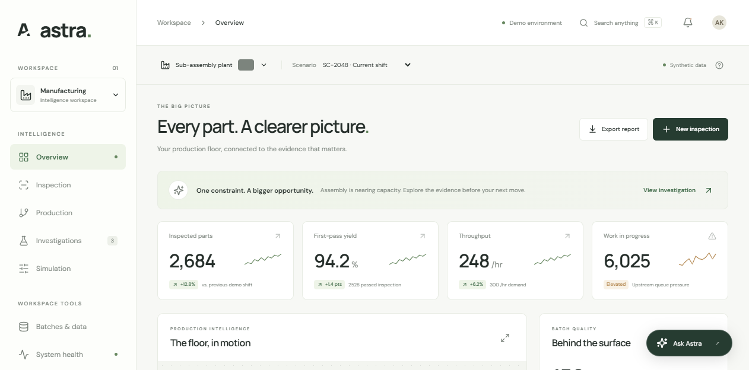
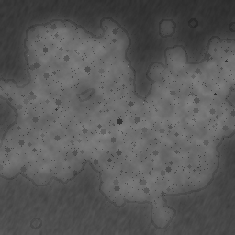
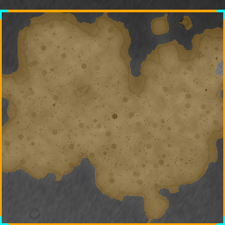

FEATURE 01 + 02 · OVERVIEW AND INSPECTION
From overview to evidence.
The home screen shows the operating picture. Inspection keeps the original, annotated result, and mask together so the operator can verify the label.
ASTRA OVERVIEW · LIVE PRODUCT RENDER
INSPECTION EVIDENCE
ORIGINAL
ANNOTATED
MASK
PRIMARY
SECONDARY
MAX COVERAGE
Hole · 40%
Rust · 20%
65.75%
UPLOADED SAMPLES
DEFECTS FOUND
ACTIVE CLASSES
EVIDENCE CHAIN
5
4
4
Original → mask
real images
80% of batch
includes unknown
one inspection record
A ASTRA INTELLIGENCE
Built around evidence. Designed for better decisions.
03
Notes:
Live product surface checked in the Codex in-app browser at http://127.0.0.1:5174/ on 20 Sep 2026. Overview source: C:/NURAX/ASTRA_Release/frontend/preview-light.png. Batch source: local FastAPI inspection endpoint /api/inspection/batch, batch BAT-408D26BE033F, Model 2, SC-2048. Evidence images: C:/NURAX/ASTRA_Release/backend/app/data/artifacts/BAT-408D26BE033F. All images use contain-fit so the full source frames remain visible.

Slide 4
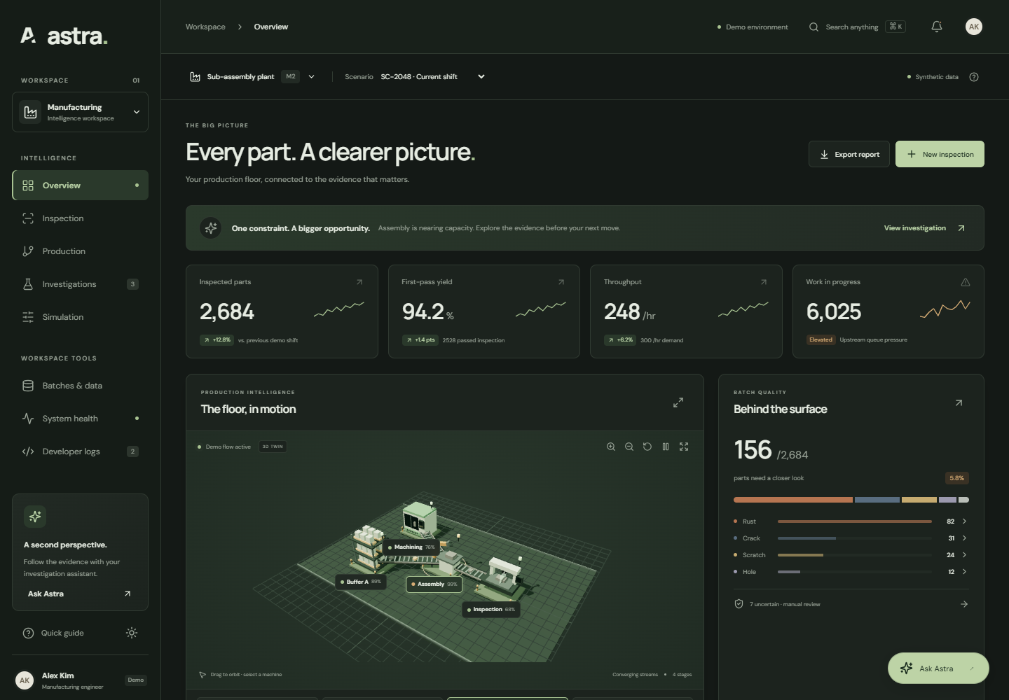
FEATURE 03 + 04 · PRODUCTION AND INVESTIGATIONS
Production signals explain the next question.
ASTRA ranks constraints from the signals that exist, then keeps measured context, hypotheses, and missing joins visibly separate.
3D TWIN · SUB-ASSEMBLY PLANT
MEASURED PRODUCTION
Model_2.csv · row 2048
Output
1,338 parts
Work in progress
188
Constraint
Assembly · 80
INVESTIGATION · MODERATE
Hole · drilling / punching / blanking
Drilling utilization 0.093045
Empirical percentile 3.03th · critical outlier
Direct unit-to-machine join · unavailable
A ASTRA INTELLIGENCE
Built around evidence. Designed for better decisions.
04
Notes:
Live product surface checked in the Codex in-app browser at http://127.0.0.1:5174/. Production source image: C:/NURAX/ASTRA_Release/frontend/preview-3d-dark-fixed.png. Data source: /api/production/2/SC-2048 and /api/bottlenecks/2/SC-2048. Measured: output 1338, WIP 188, Assembly utilization 13.9286%, Assembly score 80 critical. Investigation context: Hole strength moderate; direct unit-to-machine join unavailable. The 3D twin uses contain-fit so the full source frame remains visible.

Slide 5
FEATURE 05 + 06 · SIMULATION AND TRUST LAYER
Simulation stays advisory. The system keeps a record.
ASTRA compares a request with observed scenarios, preserves the batch context, and exposes the health and request trail around the result.
SHAPE AN ALTERNATIVE
CLOSEST OBSERVED ALTERNATIVE
Constraint capacity increase
+15%
SC-0007
distance 0
Target demand
Demand
2 → requested 2 → matched 2
2
dataset units
Nearest-neighbor matching does not establish causality.
RUN WHAT-IF SIMULATION
BATCHES + MODELS
SYSTEM HEALTH
DEVELOPER LOGS
Persisted context
Healthy · AGY ready
Runtime diagnostics
images · artifacts · scenario
API · vision · production · assistant
1 successful · 0 failed
A ASTRA INTELLIGENCE
Built around evidence. Designed for better decisions.
05
Notes:
Live product surfaces checked in the Codex in-app browser at http://127.0.0.1:5174/, Simulation, Batches and models, System, and Developer pages. The live run matched SC-0007 at distance 0 for Demand 2. The UI labels results as Simulated / Advisory and documents method limitations. Current session showed persisted batch context, a healthy live check, and one recorded /api/health request returning 200.

Slide 6
HOW ASTRA CONNECTS THE FACTORY
Quality, flow, and economics converge at the decision layer.
Separate evidence streams become useful when ASTRA keeps them distinct, then combines them at the decision layer.
INSPECTION DATA
PRODUCTION DATA
ECONOMIC DATA
Original image
Defect class
Mask + coordinates
Scenario row
Station signals
Empirical baseline
Scrap cost
Rework assumptions
Margin impact
ASTRA UI
Next
question
DETECTOR
FLOW ENGINE
DECISION LAYER
Measured visual evidence
Constraints + queue context
Explain · hypothesize · simulate
A ASTRA INTELLIGENCE
Built around evidence. Designed for better decisions.
06
Notes:
Content source: C:/NURAX/README.md, Full System Architecture, Economic Intelligence, What-If Simulation, and UI / UX Direction. This slide uses editable boxes and connectors because it explains system structure rather than serving as a decorative illustration.

Slide 7
JUDGE INTERACTION FLOW
Five steps from image to action.
A judge can start with a surface image and end with a defensible next move.
01
02
03
04
05
Load
Inspect
Verify
Investigate
Simulate
Select model + scenario
Upload a real image batch
Open original / mask / result
Review process evidence
Test an observed alternative
REAL BATCH · RUST EXAMPLE
CURRENT EVIDENCE
NEXT MOVE
5 images · 4 defective
Output 1,338 · WIP 188
Assembly score 80 · critical
Investigate abnormal conditions around the leading constraint, then run a controlled scenario match.
A ASTRA INTELLIGENCE
Built around evidence. Designed for better decisions.
07
Notes:
Content source: C:/NURAX/README.md, Judge Interaction Flow and Example Final Investigation. Live batch values from BAT-408D26BE033F and Model_2.csv / SC-2048. Annotated sample asset from C:/NURAX/ASTRA_Release/backend/app/data/artifacts/BAT-408D26BE033F/ART-F64699DFEC554995B2703D09DFC8A1C3.png. The evidence image uses contain-fit so the full sample frame remains visible.

Slide 8
CONCLUSION
ASTRA turns
inspection into
a next question.
The visible defect is only the beginning. The value appears when quality, flow, evidence, and action stay connected.
FROM PIXELS TO PROCESS
A ASTRA INTELLIGENCE
08
Notes:
Closing message summarizes the project thesis from C:/NURAX/README.md: a defect should start an investigation, not end one. The generated inspection visual is placed with contain-fit so the full source frame remains visible.

