Slide 1


What’s in it for me…?
What is Portfolio…?
Importance of Portfolio…?
How to Create Your Portfolio…?

Slide 2
What is Portfolio…?
A portfolio is a compilation of academic and professional materials that exemplify your beliefs, skills, qualifications, education, training, and experiences
Importance of Portfolio…?
Portfolios are a great way to demonstrate the competencies and accomplishments you would list on a resume or talk about in an interview – they allow you to show, not just tell. Your portfolio helps you showcase your proven work to potential employers. It presents evidence of your relevant skills and abilities

Slide 3
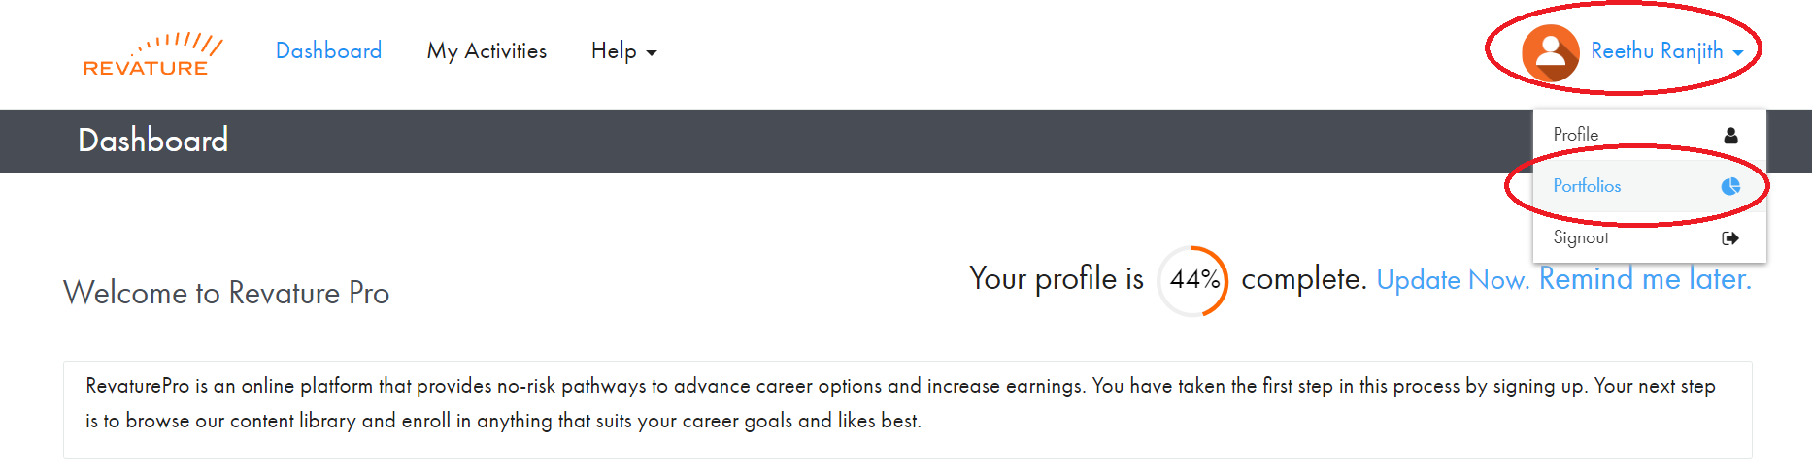
Setup Your Portfolio
Login to RevaturePro
Go to “Portfolios”
Click on “Create Portfolios” (Note: you may need to update your “Profile Name” before you can create your portfolio)

Slide 4
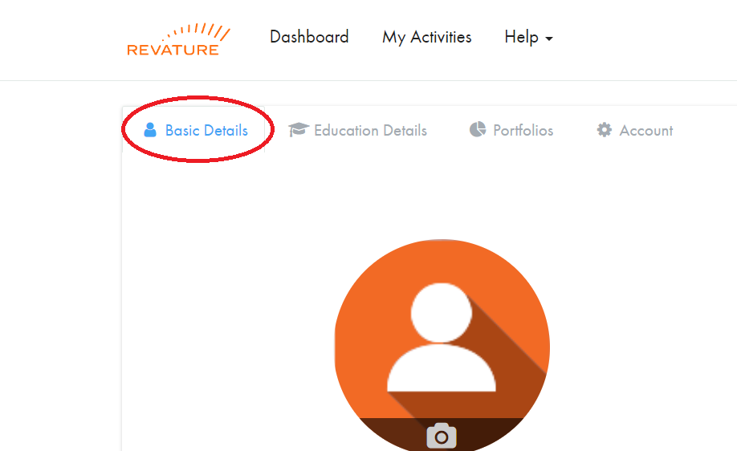
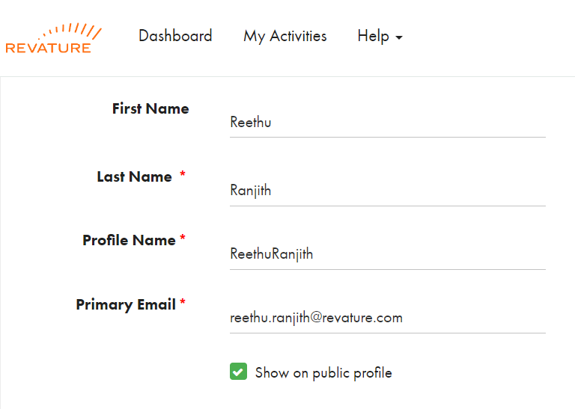
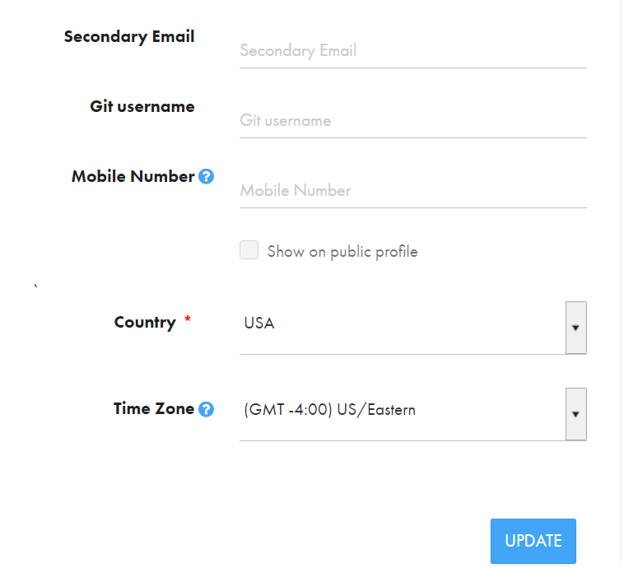
Setup Your Portfolio
Enter a name for your portfolio
This does NOT appear on the published version of the portfolio
Use the convention {{First Name-Last Name}}
E.g. “Reethu_Ranjith”
Fill out the portfolio according to the guidelines.
1
2
3

Slide 5
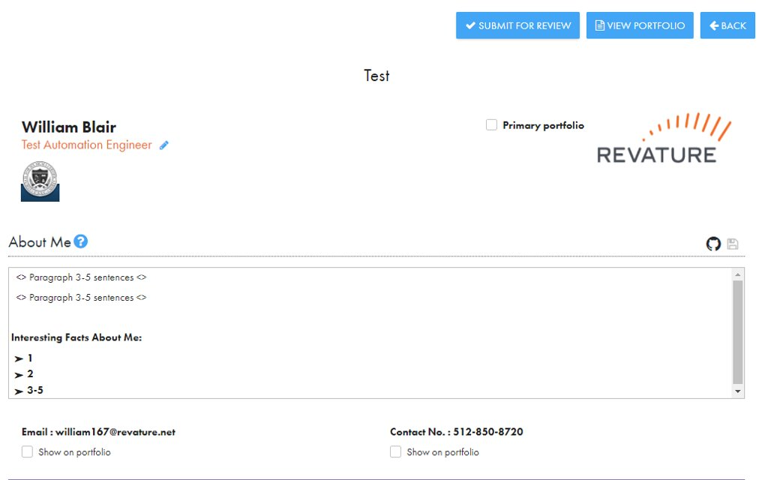
Adding Title & About Me

Slide 6
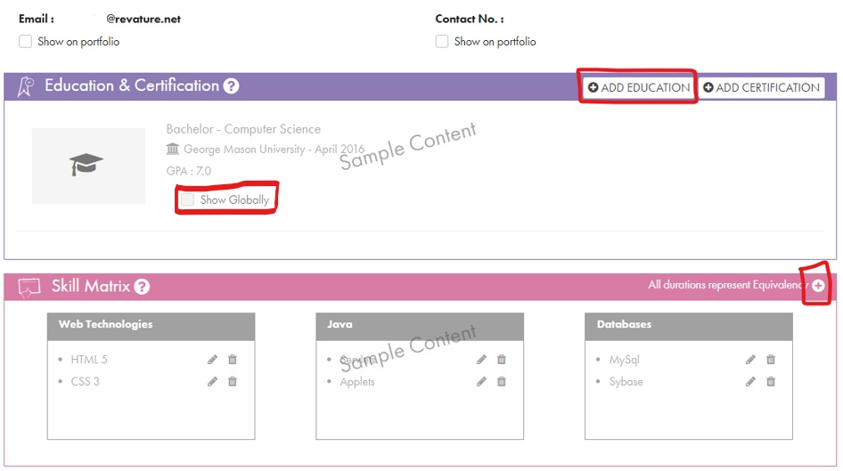
Adding Education & Skills Matrix

Slide 7
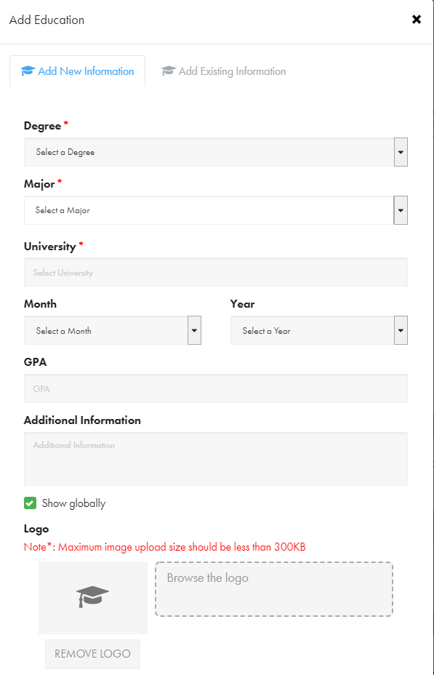
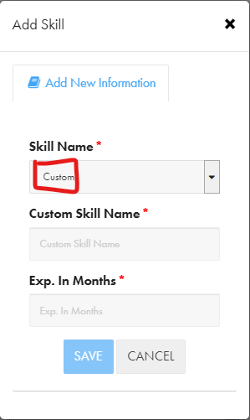
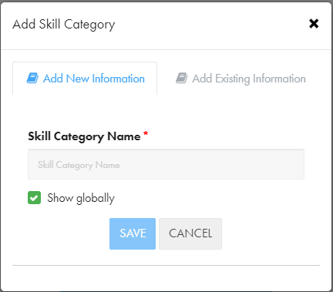
Education Details & Skills Matrix
1
3
2

Slide 8
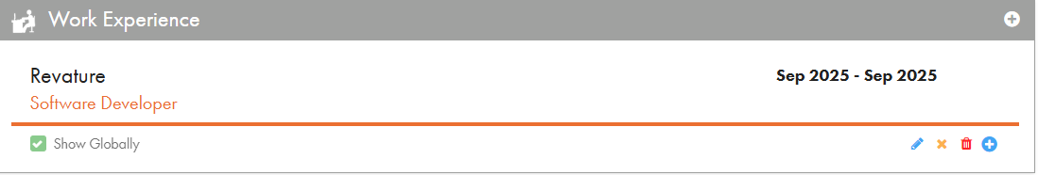
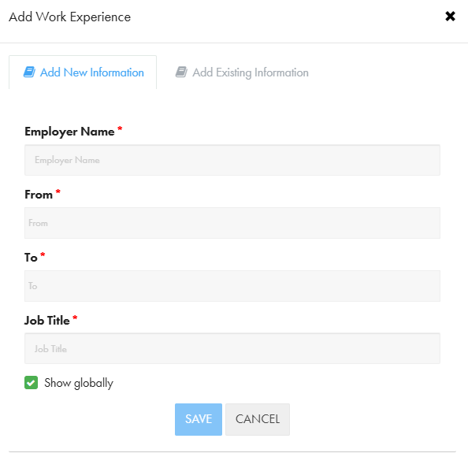
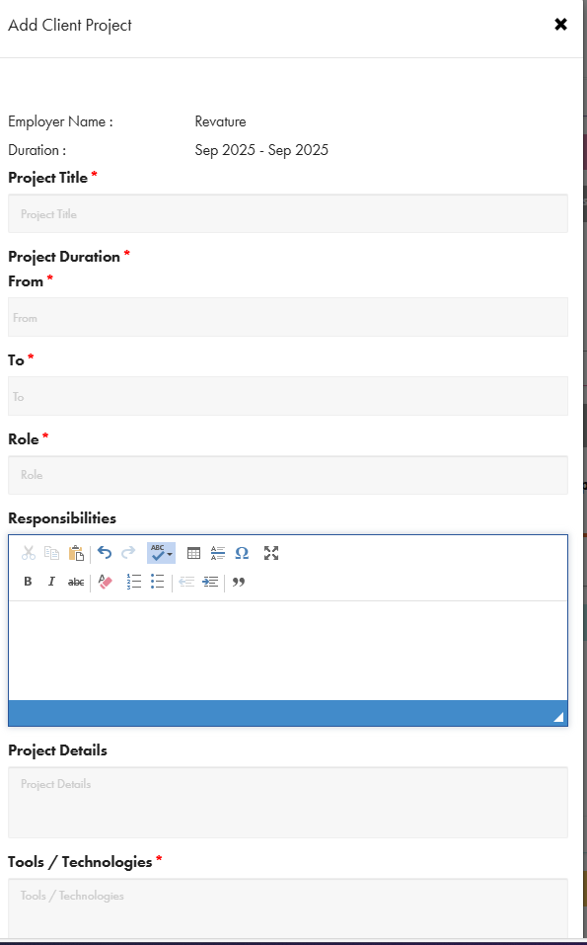
Adding Work Experience, Training Projects
2
1
Click here to add the Project Details
3
Add all the Projects with-
Project Title*
Project Duration* (From*----To*----)
Role*
Responsibilities-
Project Details
Tools / Technologies*

Slide 9
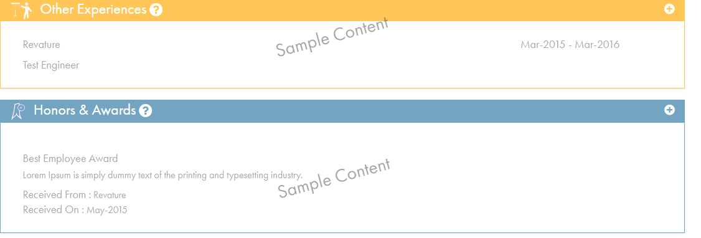
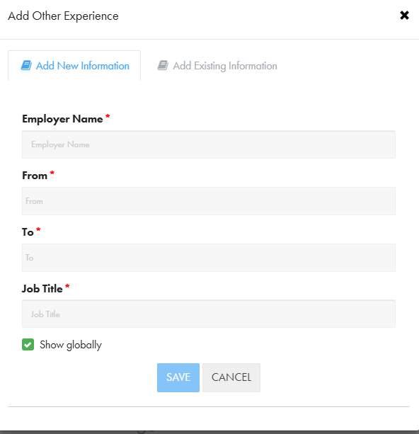
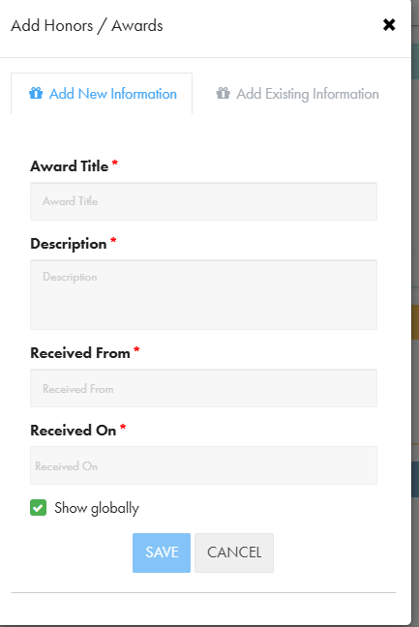
Other Experiences & Honors & Awards
2
3
1
Click here to add
Other Experience (Outside Revature)
Honors & Awards

Slide 10
Points to Remember
Avoid grammatical and spelling mistakes in About Me, make it crisp and clear(Use the Grammarly Plugin)
Before you submit your portfolio, proofread it for formatting, grammar, and spelling mistakes.
You cannot edit your portfolio after you submit it; you must wait for feedback.
Check your revature.net email for updates, reminders, and feedback.
Do NOT clone your portfolio unless asked to do so.
If you have questions or doubts, kindly reach us through email or teams.

Slide 11
Portfolio Process
Create Portfolio
Phase 1
Name & Title
About Me
Education & Certification
Other experience
Project 0
Submit for Review
The reviewer will review it and send it back along with the feedback (if required)
Phase 2
Project 1
Project 2
Skills Matrix
The reviewer will review it and send it back along with the feedback
After the final review, it will be published by the Training OPS manager
The portfolio would be appeared as “Approve”
Link sent to Sales and Delivery teams for sharing with client

Slide 12

Portfolio Deadlines Dates
Phase 1 submission:9/29/2025
Phase 2 submission:10/10/2025
Due Date for submission:10/10/2025

Slide 13

Questions

