Slide 1
SDLC

Slide 2
Agenda
01
02
SDLC Overview
Agile, scrum, & scrumban

Slide 3
01
SDLC Overview

Slide 4
What is SDLC?
The Software Development Lifecycle (SDLC) is the series of steps that we go through when creating software.
Within SDLC, we have both methodologies and frameworks:
Methodologies are categories of development concepts and practices.
Frameworks are specific implementations of a methodology’s concepts.

Slide 5
What are the steps of SDLC?
Requirements Gathering
Analyzing Requirements
Design
Development
Testing
User Acceptance Testing (UAT)
Release
Maintenance
Each of these can be divided into 3 phases:
Design – gather requirements, design
Development – Develop, test, UAT
Delivery – Release, maintenance

Slide 6
“Simple” Methodologies
Big Bang
Waterfall

Slide 7
02
Agile, scrum, & scrumban

Slide 8
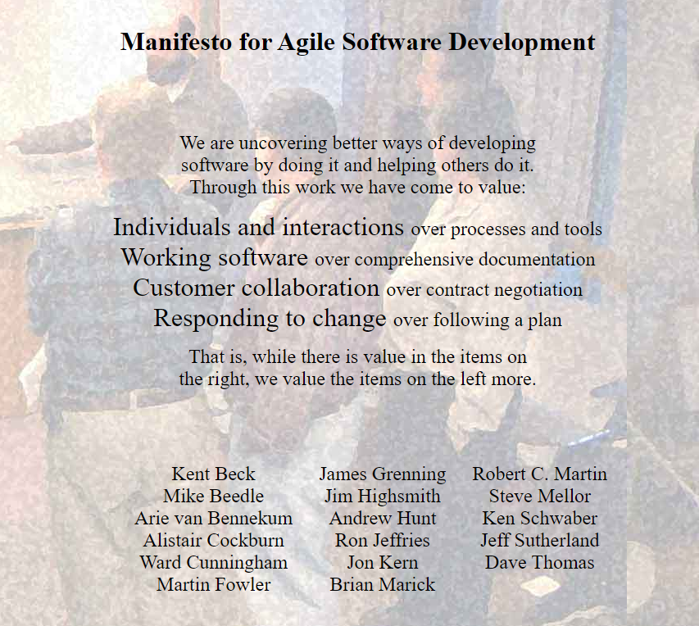
What is Agile?
Agile is a methodology!
It only has 12 principles.
Doesn’t define exactly what to do.

Slide 9
Agile Considerations
Benefits:
Allows us to adapt to quickly changing feature requests
Flexible release schedules
Because the focus is on smaller units of work/iterations, testing is more frequent and can catch issues faster
Drawbacks:
Flexibility can lead to bad practices if we’re not disciplined
E.g. developers may be tempted to avoid fully designing their solutions before starting development because they know there will be another iteration and they can return to the design phase again.
Requires strong commitment from everyone on the team

Slide 10
The Scrum Framework
Scrum is a framework of the Agile methodology that includes ceremonies such as daily standups and retrospectives.
Values are a key component:
Commitment - where each team member dedicates themselves to following Scrum practices and helping the team achieve its goals
Courage - where team members don’t shy away from difficult tasks and aren’t afraid to be honest about any roadblocks they’re facing
Focus - meaning that developers concentrate on the features being developed in the current sprint
Openness - so that developers are open with each other about any challenges or difficulties that they encounter
Respect - meaning that everyone respects the opinions and contributions of each member of the team

Slide 11
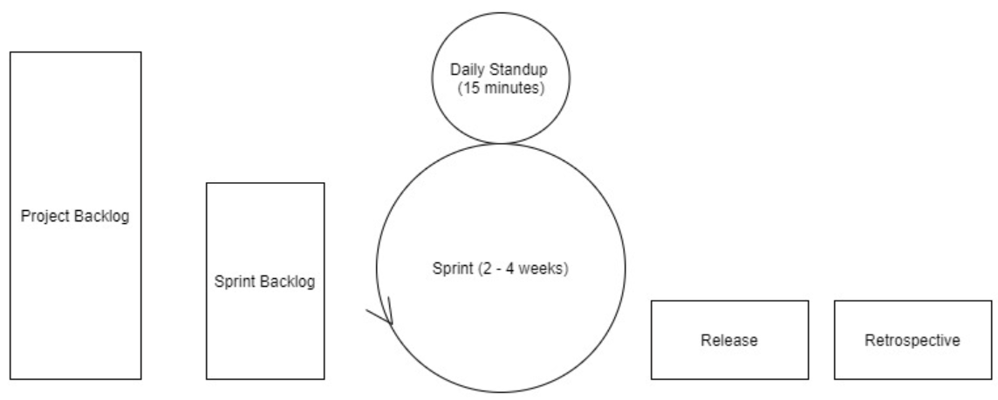
The Scrum Framework
Product Owners – represents & communicates with the customer
Scrum Master – ensures that the team is following and committed to the scrum ceremonies

Slide 12
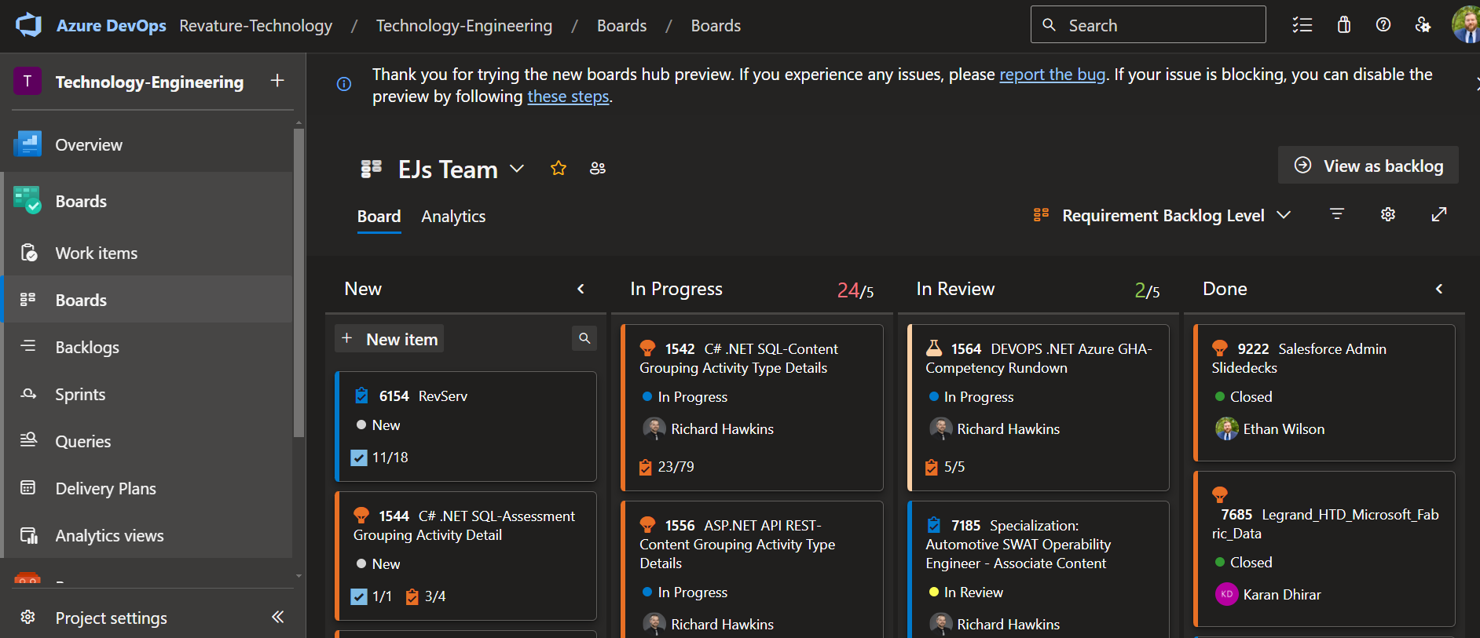
The Scrumban Framework

Slide 13
Planning with Agile Development
User Story – an individual feature of/requirement for a project Epic – a group of related features that are broken down into multiple user stories
Story Points – a level of difficulty assigned to a user story, through use of a number system agreed upon beforehand
Velocity – the sum of story points of all user stories completed during a sprint

