Slide 1
Lab Session 1
Mechanics applied to Aerospace Engineering 26/27-S1
Iñaki Fernández Tena

Slide 2
Objectives
How to write a scientific report
  Structure
  How to present your results
  General remarks
Problem of particle connected to a spool
  Basic Matlab session on ode45
  Reminder of the problem
  Main analytical solutions you need today

Slide 3
Objectives
How to write a scientific report
  Structure
  How to present your results
  General remarks
Problem of particle connected to a spool
  Basic Matlab session on ode45
  Reminder of the problem
  Main analytical solutions you need today

Slide 4
Report writing
The way you present your results is at least as important as obtaining them !
  This is done through writing a scientific report
    It has its own code and rules, that you should respect
This is also the goal of these lab sessions : to learn to write a report and present your work

Slide 5
Report writing
The way you present your results is at least as important as obtaining them !
  This is done through writing a scientific report
    It has its own code and rules, that you should respect
This is also the goal of these lab sessions : to learn to write a report and present your work
Present your work as you’re showing it to someone that doesn’t know anything about it
  Do not assume your teacher will be the one correcting it
  You should explain in detail your reasoning
    in a logical and understandable way
Please read carefully the Laboratory Guidelines and follow them

Slide 6
Report writing : Structure
A report should always start with an INTRODUCTION
  Introduce the problem to the reader
  Present the main objectives / challenges of this work
  Give the plan of the report (different sections etc…)
It doesn’t need to be long, keep it concise and clear, but it’s mandatory
  Many groups didn’t give one in the first report, therefore the mark was zero (0).

Slide 7
Report writing : Structure
The introduction should be followed by the METHODOLOGY
  Present the methods you’re using to solve the problem
In this lab session, you should show :
  The complete analytical development
    Most of it has been done in class already
    I will remind here the main equations needed today, but I expect the full development in the report
      This is evaluated as well
  The “numerical setup” : how you pass from analytical to numerical implementation

Slide 8
How to present your results ?
Then you should present your RESULTS and critically analyze / discuss them in the report
Your results (the figures) should be a tool (not a finality) to show what you want to emphasize
  You’re not just showing data, you’re showing physical phenomena
    So do not just put the plots there, but comment all of them
      A plot without any comment is worthless

Slide 9
How to present your results ?
About the plots themselves
  Make them clear and easily readable (font size in the figures should be roughly the one in the text). We will talk more about this later.
  Show clearly the trends of the graphs
  Be careful about physical quantities (italic), units (non-italic) etc…

Slide 10
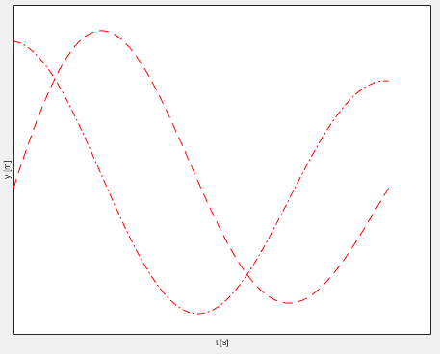
How to present your results ?
About the plots themselves
  Make them clear and easily readable (font size in the figures should be roughly the one in the text)
  Show clearly the trends of the graphs
  Be careful about physical quantities (italic), units (non-italic) etc…
Very bad plot…

Slide 11
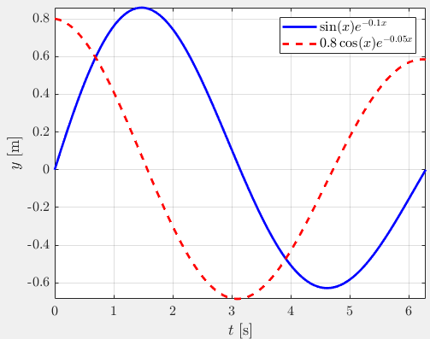
How to present your results ?
About the plots themselves
  Make them clear and easily readable (font size in the figures should be roughly the one in the text)
  Show clearly the trends of the graphs
  Be careful about physical quantities (italic), units (non-italic) etc…
Very bad plot…
… and a much better one !

Slide 12
How to present your results ?
The DISCUSSION part is very important : you should comment the physics behind the data you show
  Please do not comment literally what you’re seeing
  No “the curve goes up”… everyone can see this, but I want you
    To explain why it goes this way
    To explain the consequence of this, what does it mean in our problem

Slide 13
Report writing : Structure
Finally, end your report with a proper CONCLUSION
  Avoid to repeat to much what you said in the intro
  Summarize the work done and the main results
    Highlight the main physical processes that you analyzed

Slide 14
Report writing : Structure
Structure summary
  Introduction
  Methodology
    Analytical developments
  Results
    Plots / Tables
    Discussion
  Conclusion
Avoid to rewrite the questions of the problem in your report
  Of course, you should follow the questions and answer them, but you can structure your reasoning in many ways

Slide 15
Report writing : General remarks
This is also evaluated in these lab sessions (expecting better reports in Lab 2)
  Part of the points are given on the quality of the report

Slide 16
Report writing : General remarks
This is also evaluated in these lab sessions (expecting better reports in Lab 2)
  Part of the points are given on the quality of the report
Preferably use LaTeX for the report (in science everyone uses LaTeX so you need to learn it at some point). EXTRA POINT IF YOU DO IT WITH LATEX (check Overleaf)
  If not, please at least keep a consistent font across the report
  Do not include screenshots (of equations for example)

Slide 17
Report writing : General remarks
This is also evaluated in these lab sessions (expecting better reports in Lab 2)
  Part of the points are given on the quality of the report
Preferably use LaTeX for the report (in science everyone uses LaTeX so you need to learn it at some point). EXTRA POINT IF YOU DO IT WITH LATEX (check Overleaf)
  If not, please at least keep a consistent font across the report
  Do not include screenshots (of equations for example)
You have exactly one week to submit your results on Aula Global
  Submission instructions are given there, please follow them
  Do not include your code in the report (apart in a separate MATLAB file)
    Also, should run directly and produce the plots presented in the report

Slide 18
Objectives
How to write a scientific report
  Structure
  How to present your results
  General remarks
Problem of particle connected to a spool
  Basic Matlab session on ode45
  Reminder of the problem
  Main analytical solutions you need today

Slide 19
Basics
  Integrate simple ODEs in MATLAB
  Harmonic Oscillator
  Parabolic trajectory

Slide 20



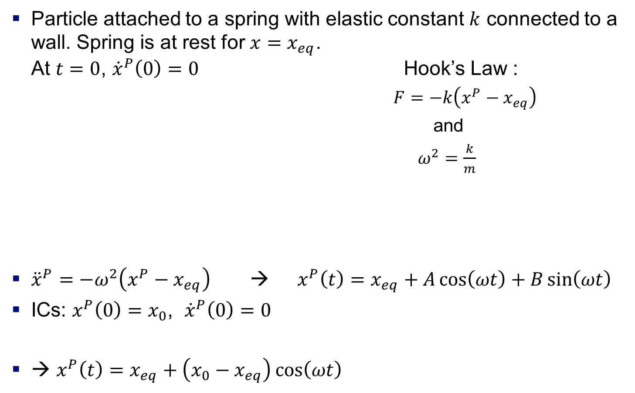




Example 1: Harmonic Oscillator
Particle attached to a spring with elastic constant $k$ connected to a wall. Spring is at rest for $x=x_{eq}$.
At $t=0$, ${\dot{x}}^{P}\left(0\right)=0$ Hook’s Law :
          $F=−k\left(x^{P}−x_{eq}\right)$
          and
          $ω^{2}=\frac{k}{m}$
${\ddot{x}}^{P}=−ω^{2}\left(x^{P}−x_{eq}\right)$ → $x^{P}\left(t\right)=x_{eq}+A\cos\left(ωt\right)+B\sin\left(ωt\right)$
ICs: $x^{P}\left(0\right)=x_{0}$, ${\dot{x}}^{P}\left(0\right)=0$
→ $x^{P}\left(t\right)=x_{eq}+\left(x_{0}−x_{eq}\right)\cos\left(ωt\right)$
$$k$$
$$v_{0}$$
$$O$$
$$x_{eq}$$
$$x_{0}$$
$$\hat{i}$$

Slide 21
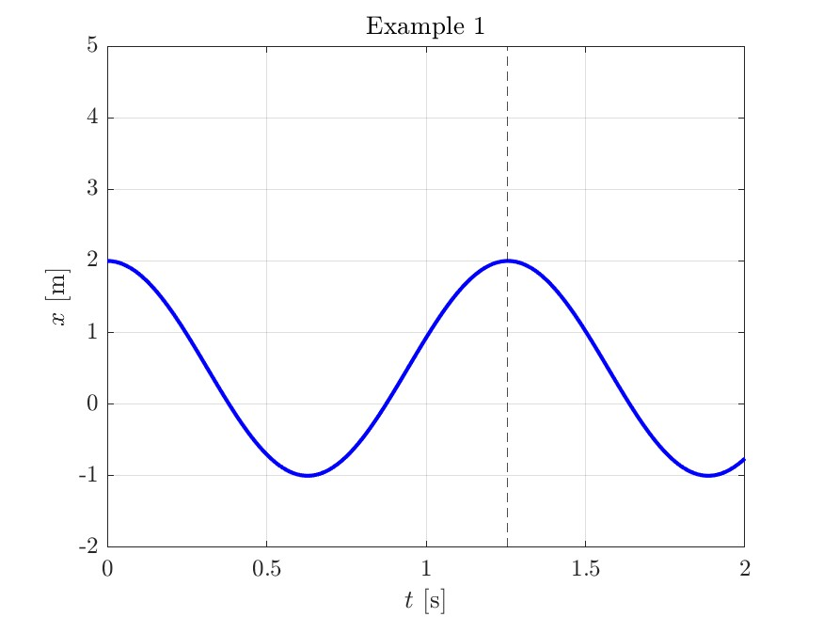
Example 1: Harmonic Oscillator
Analytical solution:

Slide 22
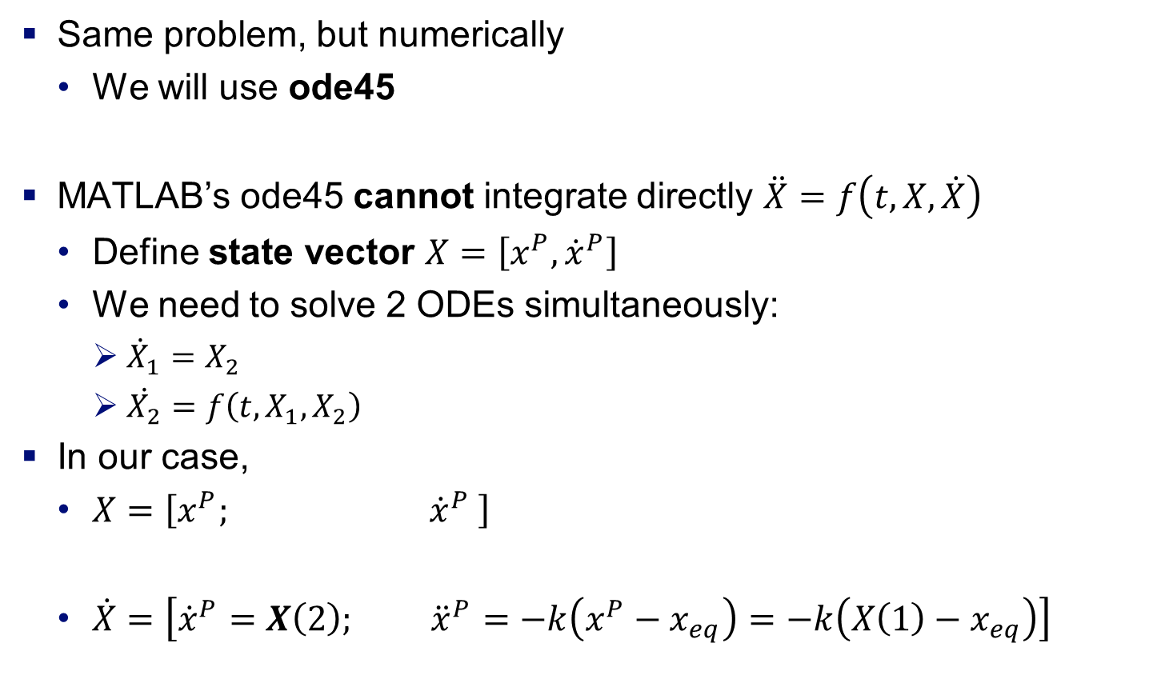
Exercise 1: Harmonic Oscillator
Same problem, but numerically
  We will use ode45
MATLAB’s ode45 cannot integrate directly $\ddot{X}=f\left(t,X,\dot{X}\right)$
  Define state vector $X=\left[x^{P},{\dot{x}}^{P}\right]$
  We need to solve 2 ODEs simultaneously:
    ${\dot{X}}_{1}=X_{2}$
    $\dot{X_{2}}=f\left(t,X_{1},X_{2}\right)$
In our case,
  $X=\left[x^{P}; {\dot{x}}^{P} \right]$
  $\dot{X}=\left[{\dot{x}}^{P}=X\left(2\right); {\ddot{x}}^{P}=−k\left(x^{P}−x_{eq}\right)=−k\left(X\left(1\right)−x_{eq}\right)\right]$

Slide 23
Exercise 1: Harmonic Oscillator
Define function Xdot = diffeq(t, X, w, x_eq)
  Xdot = [X(2); -w^2*(X(1) – x_eq)
  End
Define Ics = [x_0; 0]
Define timespan = 0:dt:t_end
Integrate:
  [tSol, stateSol] = ode45(@(t,X) diffeq(t,X,k,x_eq), timespan, ICs)
Obtain X(1) = stateSol(:,1)

Slide 24
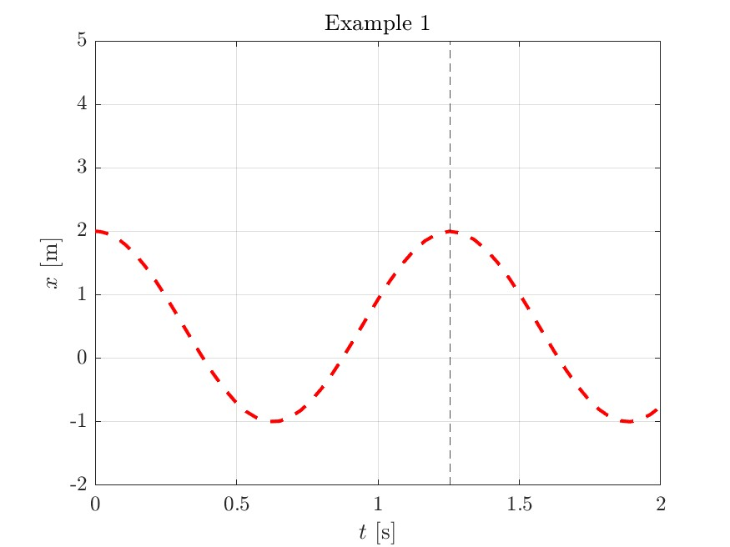
Exercise 1: Harmonic Oscillator
Numerical:

Slide 25
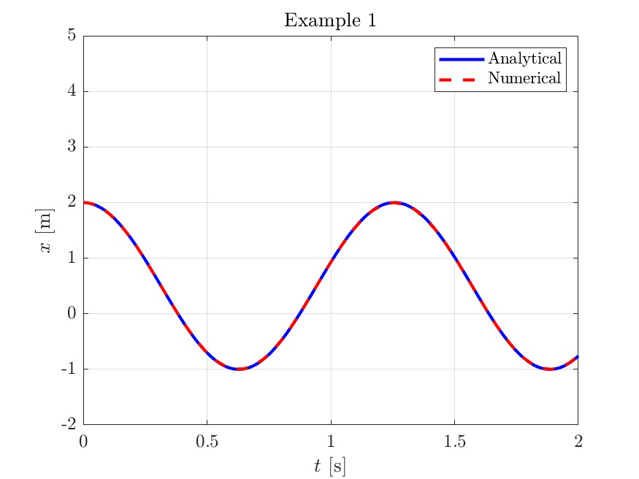
Exercise 1: Harmonic Oscillator
Numerical vs. Analytical solution:

Slide 26
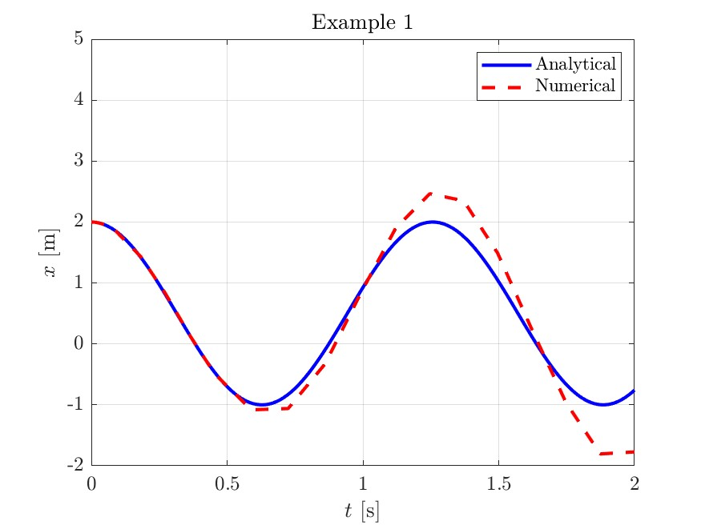
Exercise 1: Harmonic Oscillator
Change tolerances:

Slide 27
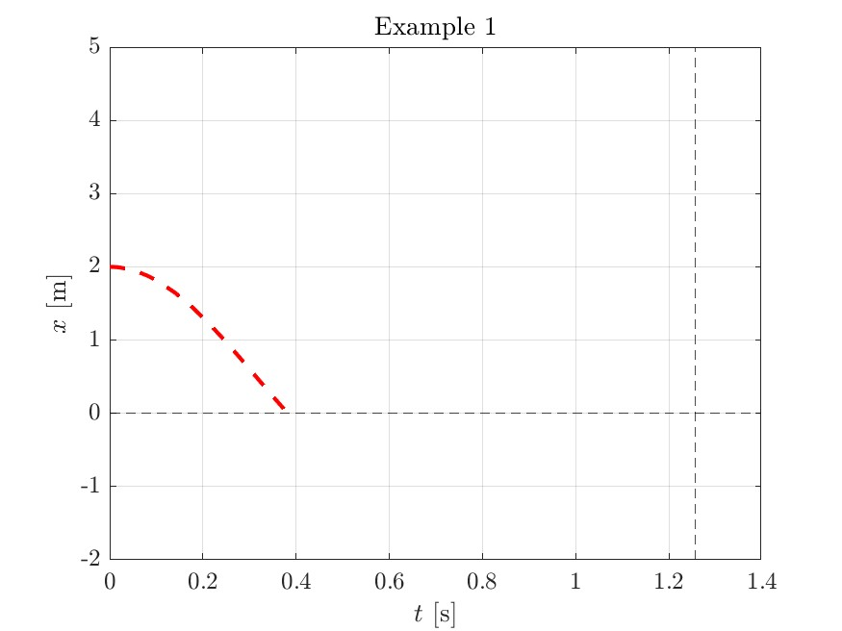

Exercise 1: Harmonic Oscillator
Add a constrain on $x^{P}=X\left(1\right)$:

Slide 28









Exercise 2: Parabolic trajectory
Bullet shot at angle $α$ with velocity $v_{0}$
${\ddot{x}}^{P}=0$
${\ddot{y}}^{P}=−g$
$x^{P}\left(0\right)=x_{0}$, $y^{P}\left(0\right)=y_{0}$, ${\dot{x}}^{P}\left(0\right)=v_{0}\cos{α}$, ${\dot{y}}^{P}\left(0\right)=v_{0}\sin{α}$
→ $x^{P}\left(t\right)=x_{0}+tv_{0}\cos{α}$
→ $y^{P}\left(t\right)=y_{0}+tv_{0}\sin{α}−t^{2}g/2$
$$\hat{j}$$
$$v_{0}$$
$$g$$
$$α$$
$$y_{0}$$
$$O$$
$$x_{0}$$
$$\hat{i}$$

Slide 29
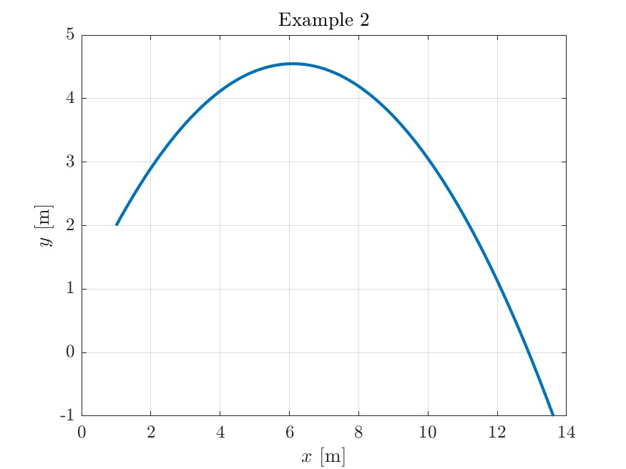
Exercise 2: Parabolic trajectory
Analytical solution:

Slide 30

Exercise 2: Parabolic trajectory
Same problem as before
  Solve the system of ODEs:
    $\dot{X}=F\left(t,X\right)$
In our case,
  $X=\left[x^{P}; y^{P}; {\dot{x}}^{P}; {\dot{y}}^{P}\right]$
  $\dot{X}=\left[{\dot{x}}^{P}=X\left(3\right); {\dot{y}}^{P}=X\left(4\right); {\ddot{x}}^{P}=0; {\ddot{y}}^{P}=−g\right]$

Slide 31
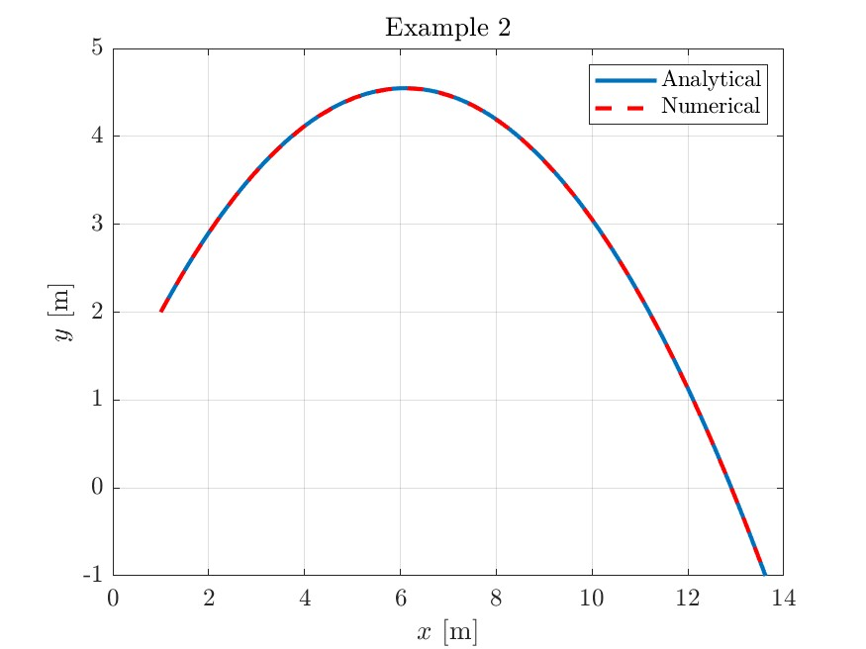
Exercise 2: Parabolic trajectory
Numerical vs. Analytical solution:

Slide 32
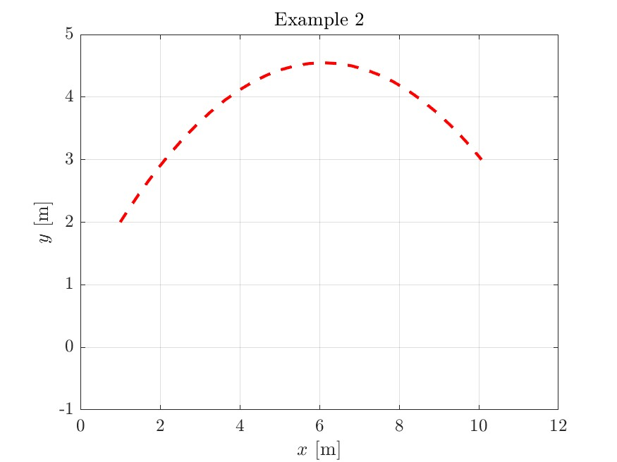

Exercise 2: Parabolic trajectory
Add a constraint: stop the integration when $y^{P}$ reaches $3$ from above:
  Set direction=-1 in @stopfun

Slide 33
Thank you!
Contact:
inaferna@ing.uc3m.es
Please sign the attendance sheet
and do teams of maximum 3

