Slide 1
SweetVerse
By Harsha Gundavelli

Slide 2
About
SweetVerse is a specialized inventory management and point-of-sale system designed for ice cream parlors. It simplifies daily operations by integrating the sales process directly with stock management.

Slide 3
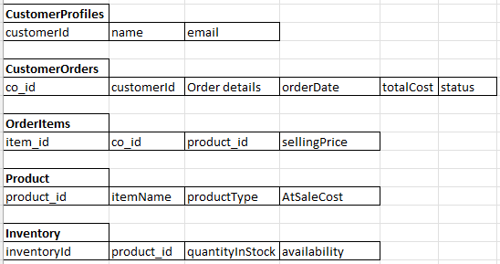
Tables

Slide 4
Many-to-Many Relationship
CustomerOrders
Products
OrderItems - Junction

Slide 5
Demo
Application
Test Cases

Slide 6
Questions?

