Slide 1

Sales Analysis
By Aditya Kumar

Slide 2
Problem Statement:
Sales management has gained importance to meet increasing competition and the need for improved methods of distribution to reduce cost and to increase profits. Sales management today is the most important function in a commercial and business enterprise.

Slide 3
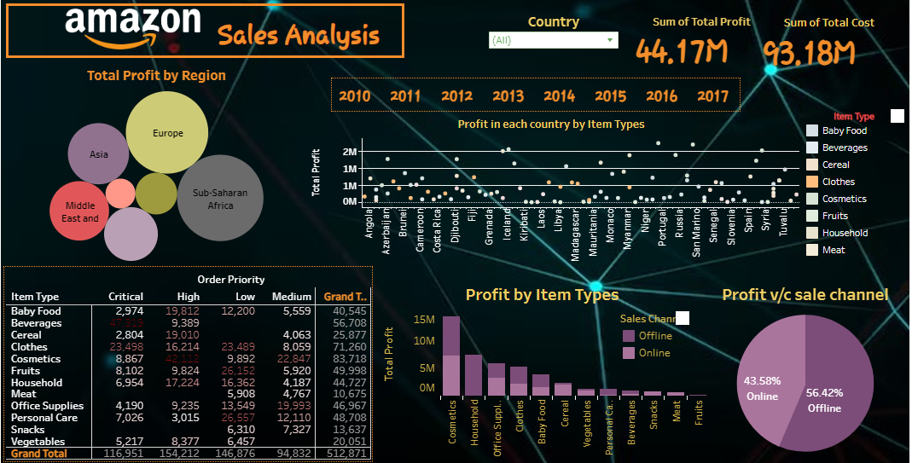

Slide 4

Raw Data:
Click here to access Dataset.
Data Manipulation and ETL:
Convert text format to Datetime format in order date as well as Ship Date.
Cleaning Data to remove duplicates, missing values and outliers for accurate Analysis.
Writing the full form in the column name ORDER PRIORITY were written as :
C- critical
H- High
L – Low
M – Medium

Slide 5
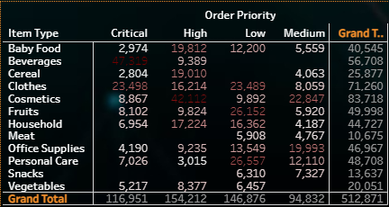
This chart show the order priority of each Item Types.
As scene in this picture order priority are given:
Critical
High
low
Medium
More the darker mean the more priority in particular field like
Priority of baby food are high in it
Priority of beverages are critical likewise

Slide 6
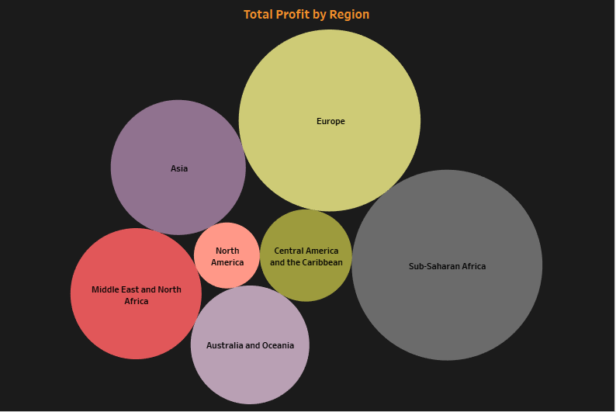
This chart indicate the profit as per different region.
More big circle means profit from that region is high. For example profit from sub-Saharan Africa is highest
Small circle means vice-versa. For example profit from North America is lowest here.

Slide 7
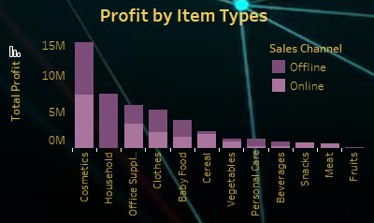
This chart show the profit as per Item type and
also categorized by sales channel like online and offline
Here the cosmetics item are more valuable for the company because this type of item sold more and return more profit .

Slide 8
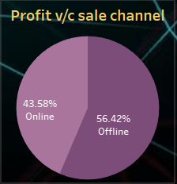
Categorization of profit over sales channel.
Online – 43.58%
Offline – 56-42%

Slide 9
Insights & Analysis:
Evaluate the impact of marketing campaigns, pricing changes, and promotions on sales.
Explored correlations between Customers demographics, product category, and sales performance.
Identify Sales and profit on the basis of Sales channel, year wise , Items types
Report Generation & presentation:
Compiled a comprehensive project report with key findings, actionable insights, and strategic recommendations.
Presented visualizations, Charts and Tables from Tableau Public in a clear and structured format.

Slide 10
Thank you.

