Slide 1

CROP
PRODUCTION ANALYSIS
INDIA
By Aditya Kumar

Slide 2

Introduction:-
The agriculture business domain plays a critical role in the supply chain and is poised for significant evolution in the coming years, driven by advancements in the Future Internet. This paper introduces a novel Business-to-Business (B2B) collaboration platform tailored to the agri-food sector. The platform aims to facilitate effective and flexible collaboration among stakeholders from various associated business domains.

Slide 3
Problem Statement:-
This dataset provides comprehensive information on crop production in India spanning several years. The primary objective is to leverage this dataset to predict crop production and uncover key insights into the factors influencing production metrics.

Slide 4
Data Sources:
The Ministry of Agriculture & Farmers Welfare, Government of India, for providing comprehensive data on crop area, yield, and production through their online portal.
I got this data from Unified Mentor Pvt Ltd.
Researchers and Analysts:
Gratitude is extended to the researchers and analysts who have previously investigated crop production in India. Their past work has informed the approach and methodology used in this analysis.
Software and Tools:
Thanks to the developers of the software and tools used for data analysis and visualization that is Tableau. This tools facilitated the exploration and interpretation of the data.
A functional Dashboard that summarizing key findings and insights from Analysis.

Slide 5
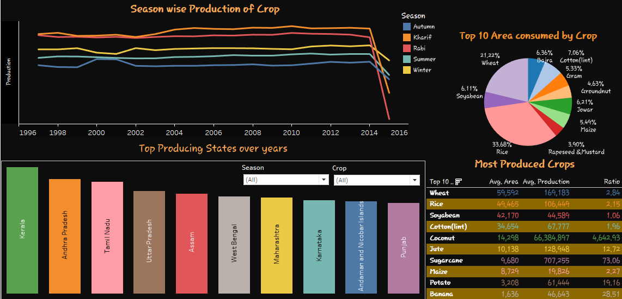

Slide 6
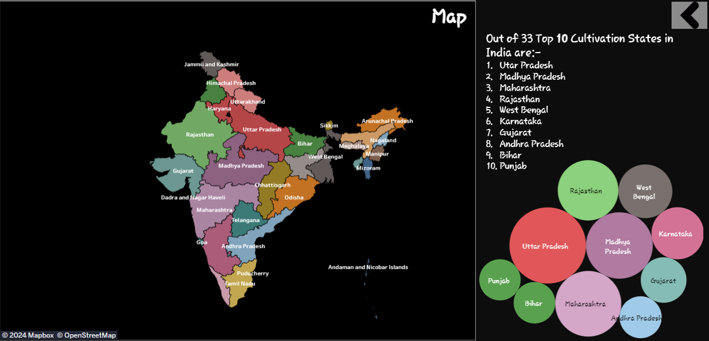

Slide 7
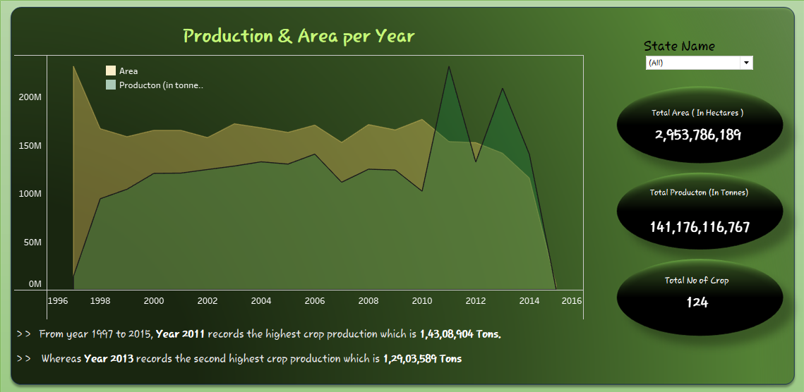

Slide 8
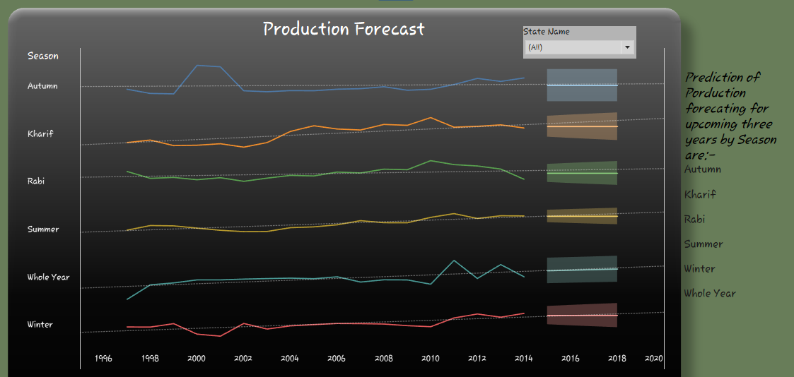

Slide 9
Thank you

