Slide 1
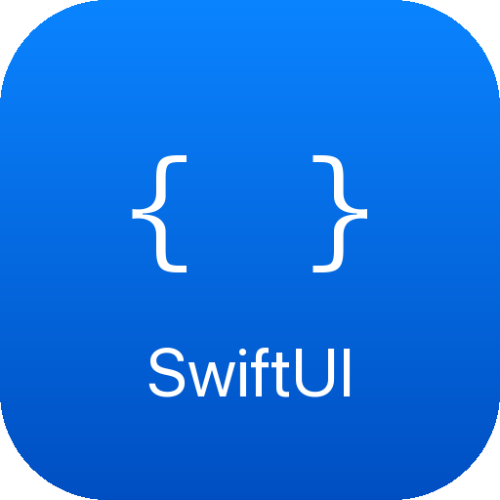

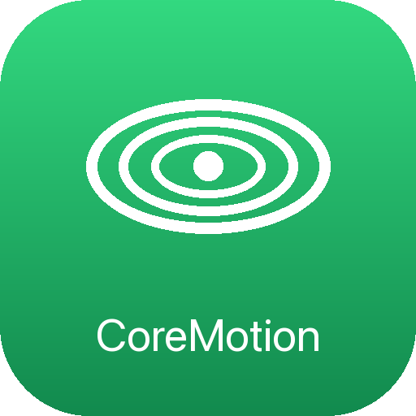



EASYPILOT · 4AHITM DRONE PROJECT
The EasyPilot iOS App
A SwiftUI companion app that auto-discovers the drone on the network,
streams live telemetry at 10 Hz, flies a 3D simulator, and sends
flight commands over WebSocket.

Slide 2
SYSTEM OVERVIEW
How the app talks to the drone
ESP32-C3 · WiFi
└─ UDP broadcast "EASYPILOT:<IP>" every 5 s · port 4242
→ iOS auto-discovers the IP, no typing
└─ WebSocket server · port 81
←→ commands out · telemetry JSON in @ 10 Hz
iPhone — EasyPilot App
3
10 Hz
~3,400
tabs: Dashboard · Simulator · Algorithms
telemetry & motion update rate
lines of Swift across 18 files

Slide 3
TECHNOLOGIES USED
The iOS stack
Swift 5
SwiftUI
Network.framework
Apple's modern, type-safe language for the whole app.
Declarative UI — TabView, glass cards, live bindings.
NWListener UDP discovery + WebSocket data link.
SceneKit
CoreMotion
Espressif ESP32
Real-time 3D flight simulator with .usdz drone model.
Gyro / accelerometer read at 10 Hz for tilt control.
On-drone firmware: WiFi, WebSocket server, beacon.

Slide 4
CODE · LIVE TELEMETRY
Decoding 10 Hz telemetry into the UI
// Codable struct mirrors the ESP32 JSON exactly
struct DroneTelemetry: Codable {
let roll, pitch, yaw: Float
let m1, m2, m3, m4: Int?
let voltage: Float?, armed: Bool?, mode: String?
}
private func decodeJSON(_ text: String) {
let decoded = try JSONDecoder().decode(DroneTelemetry.self, ...)
DispatchQueue.main.async {
self.telemetry = decoded // @Published → SwiftUI redraws
self.isConnected = true
} }

Slide 5
CODE · SENSORS & COMMANDS
Phone tilt → drone command
// CoreMotion device-motion updates @ 10 Hz
motionManager.startDeviceMotionUpdates(to: .main) { data, _ in
let r = 180 / .pi
self.pitch = data.attitude.pitch * r
self.roll = data.attitude.roll * r
}
// Type-safe JSON command builder (ControlProfile)
func startBalanceCommand() -> String {
"""{"cmd":"START_BALANCE","baseThrottle":\(baseThrottle),
"kPRoll":\(kPRoll),"kPPitch":\(kPPitch)}"""
}

Slide 6
CHALLENGES
What was hard — and how we solved it
Finding the drone
Detecting a dropped link
The ESP32 gets a random DHCP IP. A UDP beacon broadcasts the IP every 5 s, so the app auto-connects — no typing.
WiFi can die silently. A 3 s timeout timer + 5 s WebSocket pings flip isConnected false the instant data stops.
Thread safety
Flight safety
SceneKit physics runs on the render thread, SwiftUI only on main. Physics writes _vars, synced to @Published at 20 Hz.
Accidental motor spin is dangerous. 1.5 s hold-to-arm, debounced safe-test, and a tilt-over-60° emergency stop.

Slide 7
CODE · THE THREADING CHALLENGE
Two threads, one drone
Physics on SceneKit's render thread must never touch SwiftUI directly — so internal state is kept separate from published state.
class DroneSimulator: ObservableObject {
// Main thread only — drives SwiftUI
@Published var simRoll = 0.0
@Published var isCrashed = false
// Render thread only — raw physics integration
var _roll = 0.0
var _vel: SIMD3<Float> = .zero
func tick(dt: Double) { /* render thread: physics */ }
func syncPublished() { /* main: _vars → @Published */ }
}

Slide 8
WRAP-UP
Where we are & what's next
✓ Done
→ Next (Sprint 6)
• Auto-discovery + WebSocket telemetry
• Live Dashboard with 3D drone view
• Full 3D flight Simulator (Rate / Balance / PosHold)
• Mode 2 virtual joysticks
• Tunable, savable control profiles
• Live mode — fly the real drone from the joysticks
• Real MSP telemetry from the Betaflight FC
• Landscape UI polish & touch-aware stabilization
EasyPilot · 4AHITM HTL · iOS subsystem overview

