Slide 1
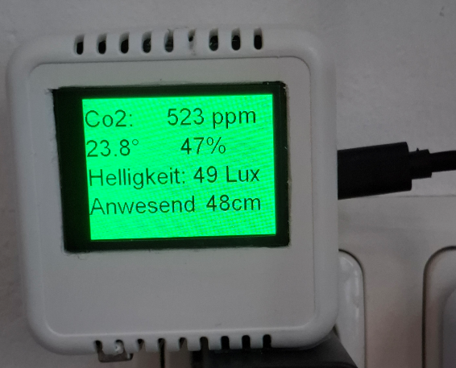
Sensorbox 2025

Slide 2
Sensorbox in Klasse
Ziele
  Luftqualität in Klassen hoch halten
  Mindestmaß an Sicherheit (Authentication, Verschlüsselung)
Grundkonzept
  Kommunikation über MQTT
    Keine direkte Einbindung in HomeAssistant
  Programmierung mittels EspHome
    YAML-basiert

Slide 3
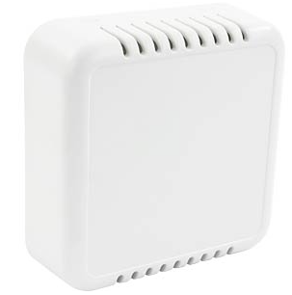
Gehäuse
CB RS02VWH
Reichelt
  https://www.reichelt.at/at/de/shop/produkt/sensorgehaeuse_74x74x25_5_mm_belueftet_weiss-317699?PROVID=2807&gad_source=1&gad_campaignid=20946573290&gbraid=0AAAAADwnxtYXVRI5GP9bVSBG_rb7VdoHp&gclid=CjwKCAjw4efDBhATEiwAaDBpbmL_2IdlwPeaRi9OWRuRgoHUdS2C4nPwOrCqMHqKqlqrfzIGSTVy_BoCFJwQAvD_BwE

Slide 4
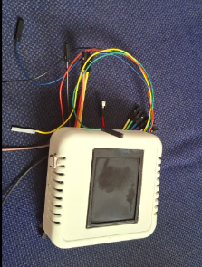
Vorderansicht
Oled-Display
SCD40 CO2-Sensor

Slide 5
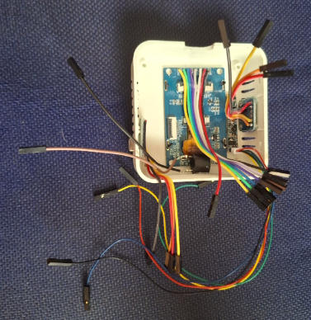
Innenansicht
Lux-Meter
Radarsensor
OLED-Display
Buzzer
CO2-Sensor

Slide 6
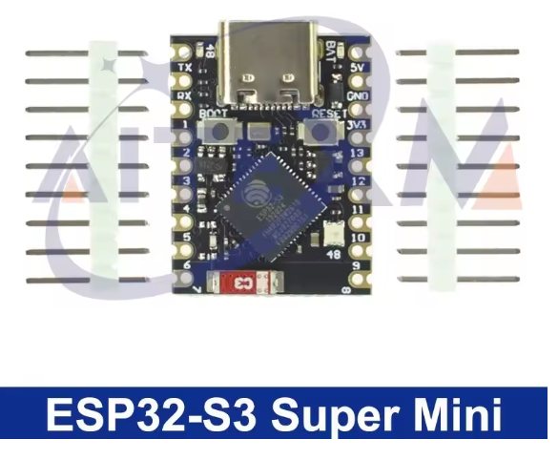
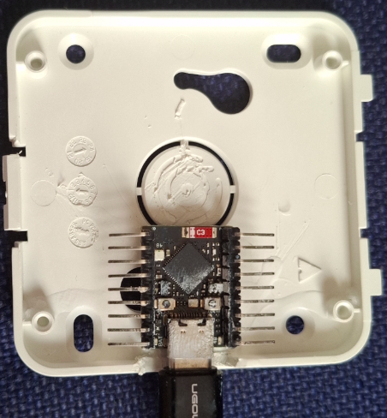
Prozessor ES32-S3-Super-Mini
Montage per Superkleber

Slide 7
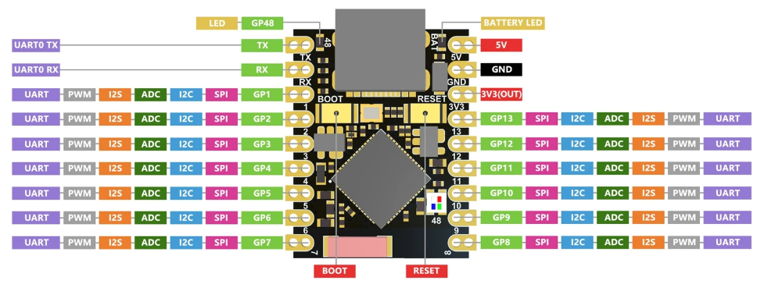
S3-Supermini Pinout

Slide 8
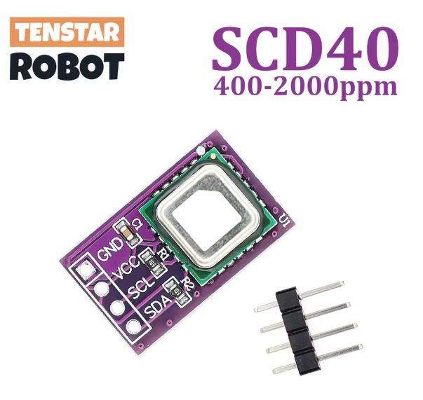
CO2-Sensor SCD40
CO2, Temperatur und Luftfeuchtigkeit
I2C
Preis: ca. 15€
Ersetzt MH-Z19

Slide 9
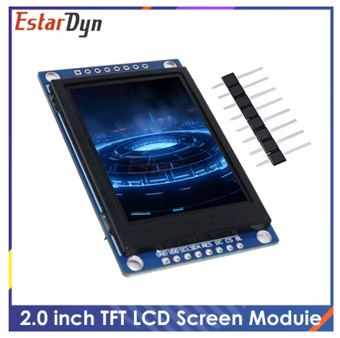
2“ OLED-Display
Signalisierung statt Neopixel
Textausgabe der Sensorwerte
SPI-Interface
  WEISS SCL ➔ GPIO01
  GRAU SDA ➔ GPIO02
OLED
  VIO RES ➔ GPIO05
  BLAU DC ➔ GPIO04
  GRÜN CS ➔ GPIO03
  GELB BL ➔ GPIO06

Slide 10
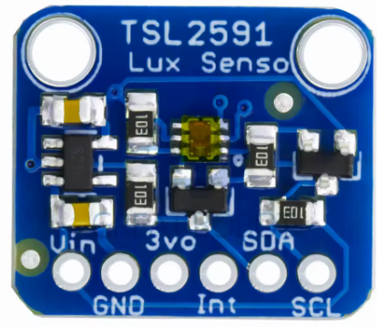
Luxmeter TSL2591
I2C
Statt LDR

Slide 11

Buzzer 3V3
GPIO07

Slide 12
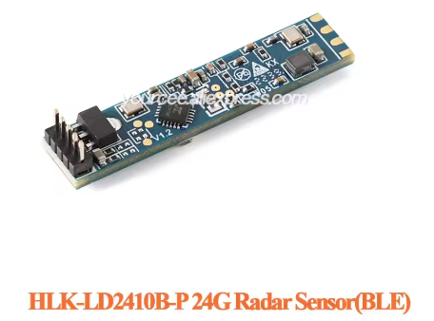
Bewegungsmelder per Radarsensor
Mit BLE ➔ per App konfigurierbar
5V Versorgung ➔ keine Störungen der OLED
UART-Schnittstelle

Slide 13
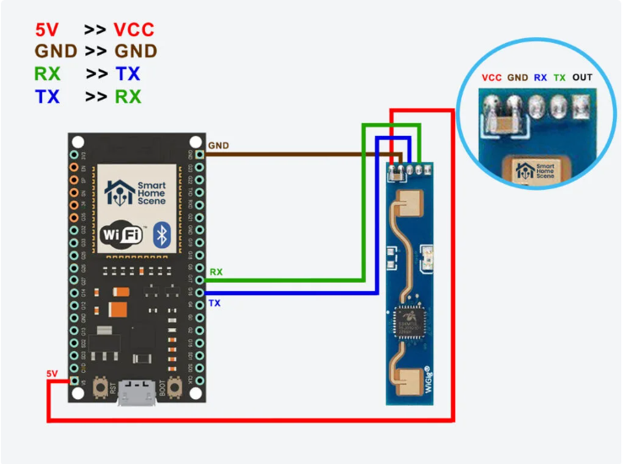
LD2410B - Verkabelung
Rx – Tx auskreuzen
  2410 Rx ➔ ESP32 PIO10
  2410 Tx ➔ ESP32 PIO11

Slide 14
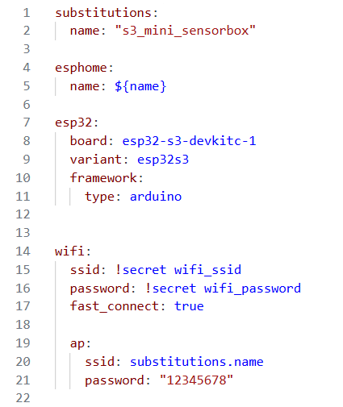
YAML-Datei
Notes:
substitutions:
name: "s3_mini_sensorbox"
esphome:
name: ${name}
esp32:
board: esp32-s3-devkitc-1
variant: esp32s3
framework:
type: arduino
wifi:
ssid: !secret wifi_ssid
password: !secret wifi_password
fast_connect: true
ap:
ssid: substitutions.name
password: "12345678"
captive_portal:
logger:
ota:
password: "585353d758e3f126d2f4982f0695d956"
platform: esphome
web_server:
port: 80
# api:
# encryption:
# key: "18T6rbg6kRjpusDhj2opiK2Rr9jksMd7ikNJ7IwsSeE="
mqtt:
broker: !secret mqtt_broker
username: !secret mqtt_user
password: !secret mqtt_password
i2c:
sda: GPIO09
scl: GPIO08
scan: true
id: bus_a
uart:
id: ld2410_uart
rx_pin: GPIO11
tx_pin: GPIO10
baud_rate: 256000
parity: NONE
stop_bits: 1
spi:
clk_pin: GPIO01
mosi_pin: GPIO02
ld2410:
uart_id: ld2410_uart
binary_sensor:
- platform: ld2410
has_target:
name: ${name}_Presence
id: presence
on_press: # This is now correctly nested under the 'presence' binary sensor
- light.turn_on:
id: tft_light
brightness: 100% # Set to 100% when someone is present
on_release: # This is now correctly nested under the 'presence' binary sensor
- light.turn_on:
id: tft_light
brightness: 20% # Dim to 20% when no one is present
has_moving_target:
name: ${name}_Moving_Target
has_still_target:
name: ${name}_Still_Target
sensor:
- platform: ld2410
light:
name: ${name}_light
moving_distance:
name: ${name}_Moving_Distance
id: ld2410_distance
still_distance:
name: ${name}_Still_Distance
moving_energy:
name: ${name}_Move_Energy
still_energy:
name: ${name}_Still_Energy
detection_distance:
name: ${name}_Detection_Distance
- platform: scd4x
co2:
name: ${name}_scd41_CO2
id: co2
temperature:
name: ${name}_scd41_Temperature
id: scd41_temperature
filters:
- lambda: return x - 6.5;
humidity:
name: ${name}_scd41_Humidity
id: scd41_humidity
# temperature_offset: -6.5
- platform: tsl2591
name: "Tsl 2591"
id: "my_tls2591"
address: 0x29
update_interval: 5s
gain: auto
device_factor: 53
glass_attenuation_factor: 14.4
visible:
name: ${name}_TSL2591_visible_light
infrared:
name: ${name}_TSL2591_infrared_light
full_spectrum:
name: ${name}_TSL2591_full_spectrum_light
calculated_lux:
id: i_lux
name: ${name}_TSL2591_Lux
actual_gain:
id: "actual_gain"
name: ${name}_TSL2591_actual_gain
unit_of_measurement: lx
text_sensor:
- platform: ld2410
version:
name: "LD2410 Firmware Version"
font:
- file: "fonts/Arial.ttf"
id: font1
size: 40
display:
- platform: ili9xxx
model: ST7789V
dc_pin: GPIO04
reset_pin: GPIO05
cs_pin: GPIO03
data_rate: 40MHz
update_interval: 1s
invert_colors: true
rotation: 270
dimensions:
width: 240
height: 320
lambda: |-
Color background_color;
Color text_color = Color::WHITE;
// CO2-abhängige Hintergrundfarbe
if (id(co2).state <= 700) {
background_color = Color(0, 255, 0); // Grün
text_color = Color::BLACK;
} else if (id(co2).state <= 1000) {
background_color = Color(255, 255, 0); // Gelb
text_color = Color::BLACK;
} else {
background_color = Color(255, 0, 0); // Rot
}
it.fill(background_color);
it.printf(0, 10, id(font1), text_color, "Co2: %d ppm", (int)id(co2).state);
it.printf(0, 60, id(font1), text_color, "%.1f°", id(scd41_temperature).state);
it.printf(160, 60, id(font1), text_color, "%d%%", (int)id(scd41_humidity).state);
it.printf(0, 110, id(font1), text_color, "Helligkeit: %d Lux", (int)id(i_lux).state);
if (id(presence).state) {
it.printf(0, 160, id(font1), text_color, "Anwesend");
} else {
it.printf(0, 160, id(font1), text_color, "Frei");
}
it.printf(200, 160, id(font1), text_color, "%dcm", (int)id(ld2410_distance).state);
it.fill(background_color);
it.printf(0, 10, id(font1), text_color, "Co2: %d ppm", (int)id(co2).state);
it.printf(0, 60, id(font1), text_color, "%.1f°", id(scd41_temperature).state);
it.printf(160, 60, id(font1), text_color, "%d%%", (int)id(scd41_humidity).state);
it.printf(0, 110, id(font1), text_color, "Helligkeit: %d Lux", (int)id(i_lux).state);
if (id(presence).state) {
it.printf(0, 160, id(font1), text_color, "Anwesend");
} else {
it.printf(0, 160, id(font1), text_color, "Frei");
}
it.printf(200, 160, id(font1), text_color, "%dcm", (int)id(ld2410_distance).state);
output:
- platform: ledc
pin: GPIO06
id: backlight_pwm
frequency: 20000Hz
- platform: gpio
pin: GPIO07
id: buzzer_output
switch:
- platform: output
name: ${name}_Buzzer
output: buzzer_output
id: buzzer_switch
light:
- platform: monochromatic
output: backlight_pwm
name: "TFT Backlight"
id: tft_light
default_transition_length: 0s
restore_mode: ALWAYS_ON
on_turn_on:
then:
- light.dim_relative:
id: tft_light
relative_brightness: 100%

Slide 15
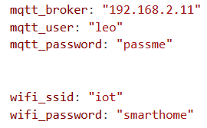
secrets.yaml

