Slide 1
ADVANCED ENGINEERG PHYSICS
UNIT-3
Magnetic and Dielectric Materials
Introduction to magnetic materials, origin of magnetic moment-classification of magnetic materials, hysteresis, Weiss domain theory of ferromagnetism, soft and hard magnetic materials, synthesis of ferrimagnetic materials using sol-gel method, applications: magnetic hyperthermia for cancer treatment, magnets for EV, Giant Magneto Resistance (GMR) device.
Introduction to dielectric materials, types of polarization (qualitative): electronics, ionic & orientation; ferroelectric, piezoelectric, pyroelectric materials and their applications: Ferroelectric Random-Access Memory (Fe-RAM), load cell and fire sensor.

Slide 2
Introduction to Magnetic Materials:
Magnetic materials are substances that respond to an applied magnetic field and can be magnetized to produce their own magnetic field.
Their unique behavior arises from the motion of electrons, particularly the spin and orbital angular momentum, which give rise to magnetic dipole moments.
The collective alignment of these dipole moments determines the overall magnetic properties of the material. Magnetic materials play a vital role in science and technology.
They are used in transformers, electric motors, data storage devices, sensors, medical imaging, and communication systems. Advances in nanotechnology and spintronics are also expanding their applications in quantum computing and next-generation electronics.

Slide 3
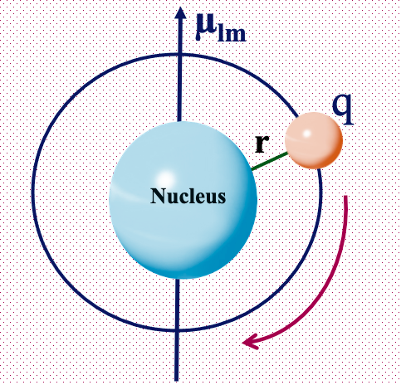
Origin of Magnetic Moment:
The magnetic moment in materials originates from the motion of electrons, mainly due to:
Orbital motion of electrons around the nucleus.
Spin of electrons on their own axis.
The net magnetic moment of an atom is the vector
sum of these contributions. In solids, the interaction and alignment of these moments among atoms lead to different types of magnetism.
The magnetic moment in a material originates from the orbital motion and spinning motion of electrons in an atom. Consider an atom & each electron in that, orbiting around the nucleus produces a loop current i = q/t (or) i = qf, where ‘f’ is a frequency of the electron.

Slide 4
If ‘L’ is the angular momentum of electron, the magnetic moment of the electron
µ_{lm} = (area of the loop) x (current in the loop)
Bohr magneton is the natural unit used to express the magnetic moment
of electrons in atoms

Slide 5
Classification of Magnetic Materials:
Magnetic materials are broadly classified based on their response to external magnetic fields:
Diamagnetic materials – Exhibit very weak, negative susceptibility and are repelled by a magnetic field (e.g., copper, bismuth).
Paramagnetic materials – Have small, positive susceptibility and are weakly attracted to a magnetic field due to unpaired electrons (e.g., aluminum, platinum).
Ferromagnetic materials – Show strong magnetization even after removal of the external field because of parallel alignment of magnetic domains (e.g., iron, cobalt, nickel).
Antiferromagnetic materials – Exhibit ordered but opposite alignment of magnetic moments, resulting in no net magnetization (e.g., MnO).
Ferrimagnetic materials – Similar to antiferromagnetic, but unequal opposing moments produce a net magnetization (e.g., magnetite Fe₃O₄).

Slide 6
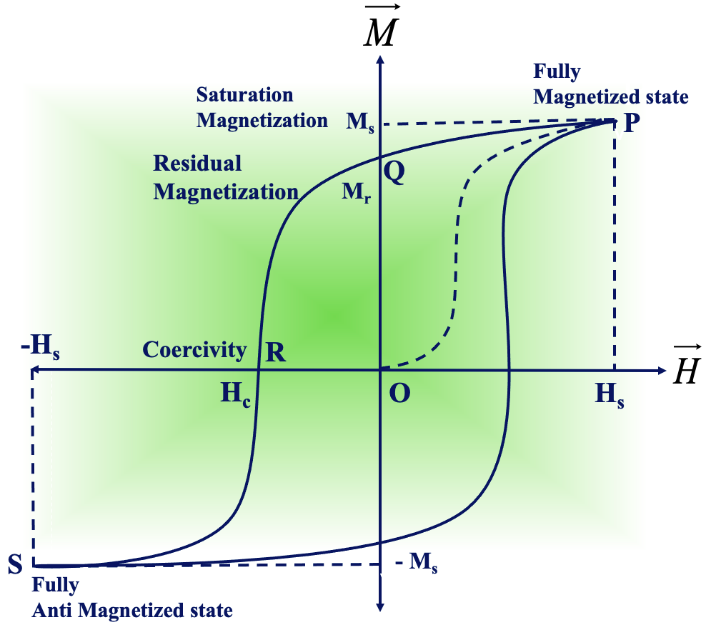
Hysteresis: Ferromagnetic Material M-H (or) B-H Curve
Hysteresis is the characteristic curve, and a relation between magnetization and the strength of magnetic field about ferro magnetic material.
Definition
Hysteresis is the lagging of magnetization M (or magnetic flux density B) behind the applied magnetic field H.
In other words, when a magnetic material is magnetized by an external magnetic field and then the field is reduced or reversed, the material does not return to its original unmagnetized state immediately. Instead, it retains some magnetization — this delayed response is called hysteresis.

Slide 7
Key features of the loop:
Initial Magnetization Curve:
When H increases from zero, B (or M) rises and eventually saturates (all magnetic domains aligned).
Remanence (Residual Magnetism, Br​):
When H=0 after saturation, B does not fall to zero. The material retains some magnetization — this is called remanence.
Coercivity (Hc​):
The negative field required to bring B (or M) back to zero is called coercive field.
Saturation:
At very high H, further increase in H does not increase B, because all domains are aligned.
Energy Loss:
The area inside the hysteresis loop represents energy loss per unit volume per cycle, mainly as heat, due to domain realignment.

Slide 8
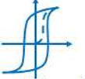
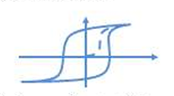
Types of Magnetic Materials (based on hysteresis loop)
Soft Magnetic Materials:
  Narrow hysteresis loop
  Low coercivity & remanence
  Small energy loss
  Used in transformer cores, electromagnets
Hard Magnetic Materials:
  Wide hysteresis loop
  High coercivity & remanence
  Large energy loss but strong permanent magnetization
  Used in permanent magnets, magnetic storage devices

Slide 9
Weiss Domain Theory of Ferromagnetism
The Weiss domain theory, proposed by Pierre Weiss (1907), explains the origin of ferromagnetism in materials like iron, cobalt, and nickel. It resolves why these materials exhibit spontaneous magnetization even without an external magnetic field.
Spontaneous Magnetization: In ferromagnetic materials, groups of atomic magnetic moments align parallel to each other due to a strong internal interaction called the exchange interaction. This produces a region of uniform magnetization even in the absence of an external magnetic field.
Formation of Magnetic Domains: The entire crystal does not align in one direction. Instead, the material splits into small regions called Weiss domains, each magnetized to saturation but oriented in different directions. This domain arrangement minimizes the total magnetostatic energy of the crystal, keeping the bulk specimen unmagnetized in the absence of an external field.
Effect of an External Magnetic Field: When an external magnetic field is applied, domains favorably oriented with the field grow at the expense of others (domain wall motion). At higher field strengths, all domains align, and the material reaches saturation magnetization.

Slide 10
Weiss Molecular Field Hypothesis
  Weiss proposed the existence of an internal molecular field (Weiss field) acting on each magnetic moment.
  This field is proportional to the overall magnetization M:
  Hint=λM where λ is the Weiss constant.
  This molecular field is responsible for the parallel alignment of spins.
Curie–Weiss Law
  Above the Curie temperature (T_{C}​), ferromagnetic materials lose their spontaneous magnetization and behave as paramagnets.
  The magnetic susceptibility follows:
  Χ = CT−θ, ​where C is the Curie constant and θ≈T_{C}​.
The Weiss domain theory explains ferromagnetism by introducing the idea of magnetic domains and a strong exchange interaction (Weiss molecular field). In the absence of an external field, random domain orientations cancel overall magnetization, but under an applied field, domain alignment gives rise to strong ferromagnetic behavior.

Slide 11
Synthesis of ferrimagnetic materials using sol-gel method
The sol–gel method is one of the most widely used wet-chemical synthesis routes for preparing ferrimagnetic materials such as ferrites (MFe₂O₄, where M = Co, Ni, Mn, Zn, etc.). It offers good control over particle size, stoichiometry, and homogeneity at relatively low processing temperatures.
In the sol–gel process, metal alkoxides, metal nitrates, or acetates are used as precursors. For ferrites, typically metal nitrates are chosen due to their high solubility in water. For example, to synthesize cobalt ferrite (CoFe₂O₄​), cobalt nitrate [Co(NO₃)₂·6H₂O] and ferric nitrate [Fe(NO₃)₃·9H₂O] are taken in the stoichiometric molar ratio of 1:2.
Preparation of Solution (Sol Formation): The required amounts of metal salts are dissolved in distilled water. A chelating agent such as citric acid or ethylene glycol is added to control hydrolysis and to ensure uniform mixing of cations. The solution is continuously stirred, and the pH is adjusted (usually around 7) using ammonia or another base to promote gel formation.

Slide 12
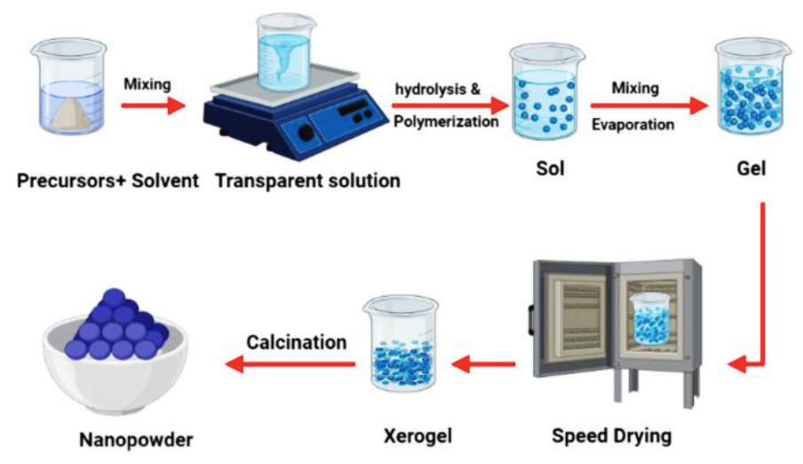
Gel Formation: On heating (≈ 70–90 °C), water gradually evaporates, and the solution transforms into a viscous gel through hydrolysis and polycondensation reactions. The chelating agent ensures homogeneous distribution of cations within the gel network.
Drying and Decomposition: The gel is dried to remove excess solvents, leading to a xerogel. On further heating, the organic components (citric acid/ethylene glycol) decompose, releasing gases (NO₂, CO₂, H₂O), and a porous powder is obtained.

Slide 13
Calcination:
The dried precursor powder is calcined at moderate temperatures (≈ 400–800 °C). This step promotes crystallization of the ferrite phase and removes any remaining organic matter. The calcination temperature and time directly affect crystallite size, surface area, and magnetic properties.
Formation of Ferrimagnetic Phase:
After calcination, the material typically exhibits a well-defined spinel structure (AB2O4​), where divalent cations occupy tetrahedral (A) sites and trivalent Fe³⁺ ions are distributed between tetrahedral and octahedral (B) sites. The unequal distribution of magnetic moments between A and B sublattices results in ferrimagnetism.
Advantages of Sol–Gel Method
Produces highly homogeneous and fine powders.
Lower synthesis temperatures compared to solid-state methods.
Better control over particle size, morphology, and stoichiometry.
Suitable for coating applications (thin films) as well as bulk powders.

Slide 14
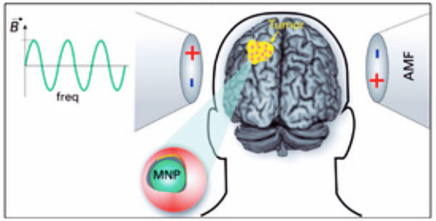
Magnetic Hyperthermia for Cancer Treatment
Introduction
Magnetic hyperthermia is a promising cancer therapy that utilizes magnetic nanoparticles (MNPs) to generate localized heat when exposed to an alternating magnetic field (AMF). The temperature in tumor tissues is raised to 42–46 °C, which damages or kills cancer cells while sparing healthy tissue.

Slide 15
Principle
Magnetic nanoparticles (such as Fe₃O₄, γ-Fe₂O₃, CoFe₂O₄, or doped ferrites) are injected or delivered to the tumor site.
When exposed to an alternating magnetic field (100–500 kHz), these nanoparticles dissipate energy as heat.
Cancer cells are more sensitive to heat compared to normal cells; thus, hyperthermia induces apoptosis (programmed cell death) or necrosis in tumor tissue.
It can also enhance the effectiveness of chemotherapy and radiotherapy.
Procedure
Synthesis of Magnetic Nanoparticles: Typically via sol–gel, co-precipitation, thermal decomposition, or hydrothermal methods.
Surface Functionalization: Coating with biocompatible polymers (PEG, dextran, silica) ensures stability, targeting, and reduced toxicity.
Delivery to Tumor Site: Intravenous injection, targeted delivery using ligands/antibodies, or direct injection.

Slide 16
Application of AMF: External alternating magnetic field is applied; nanoparticles generate heat.
Tumor Cell Death: Cancer cells undergo apoptosis/necrosis, and the therapy can be combined with drugs or radiation.
Magnetic hyperthermia uses magnetic nanoparticles as heat mediators under an alternating magnetic field to selectively kill cancer cells, offering a targeted and minimally invasive approach to cancer therapy.
Advantages
Localized, minimally invasive treatment.
Selective heating of tumor cells while sparing healthy tissue.
Can be combined with chemotherapy or radiotherapy for higher efficiency.
Potential for real-time monitoring (MRI contrast agents).

Slide 17
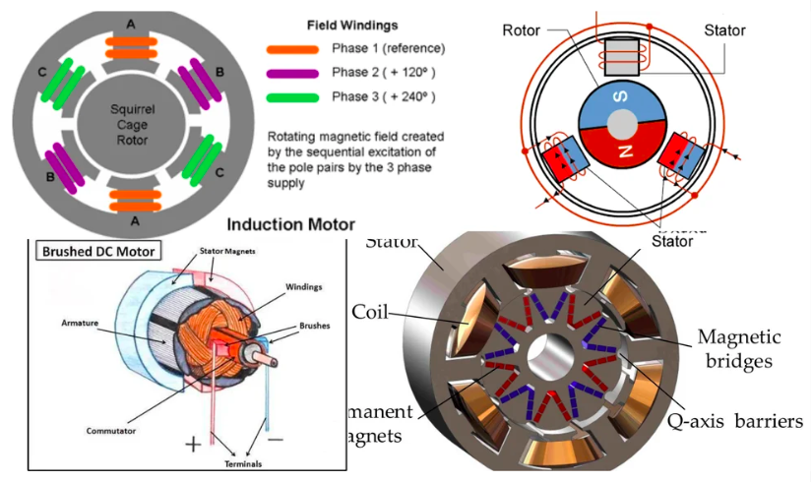
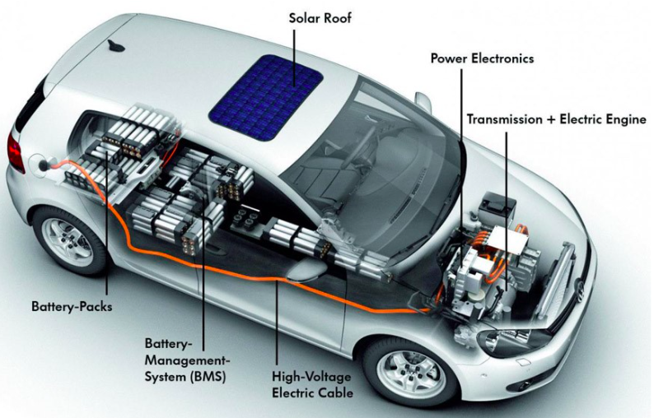
Magnets for Electric Vehicles (EVs):
Magnets play a crucial role in the performance of electric vehicles (EVs), particularly in the motors and generators that drive them. Among the different types, neodymium–iron–boron (NdFeB) permanent magnets are the most widely used due to their high magnetic strength, excellent energy density, and ability to make motors more compact, lightweight, and efficient.

Slide 18
They provide high torque-to-weight ratios, which improves both acceleration and driving range. In high-performance applications, samarium–cobalt (SmCo) magnets are also employed because of their superior temperature stability, though their higher cost limits their widespread use.
On the other hand, ferrite magnets are less expensive and resistant to corrosion, but they produce lower magnetic strength, making them more suitable for auxiliary systems or cost-sensitive EV designs.
Despite their advantages, rare-earth-based magnets like NdFeB present challenges, including high cost, supply risks, and temperature sensitivity, although doping with elements like dysprosium can improve thermal stability. To overcome these limitations, researchers are developing advanced ferrites, hybrid magnet systems, and alternative alloys, as well as exploring large-scale recycling of rare-earth magnets.
Overall, NdFeB magnets dominate EV applications today, but ongoing research aims to create more sustainable and cost-effective magnetic materials for the future of electric mobility.

Slide 19
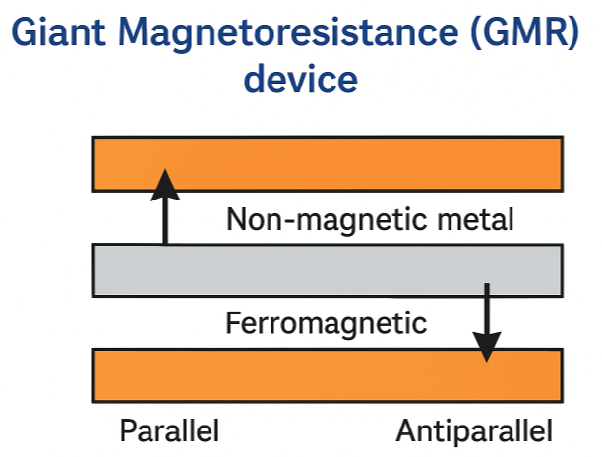
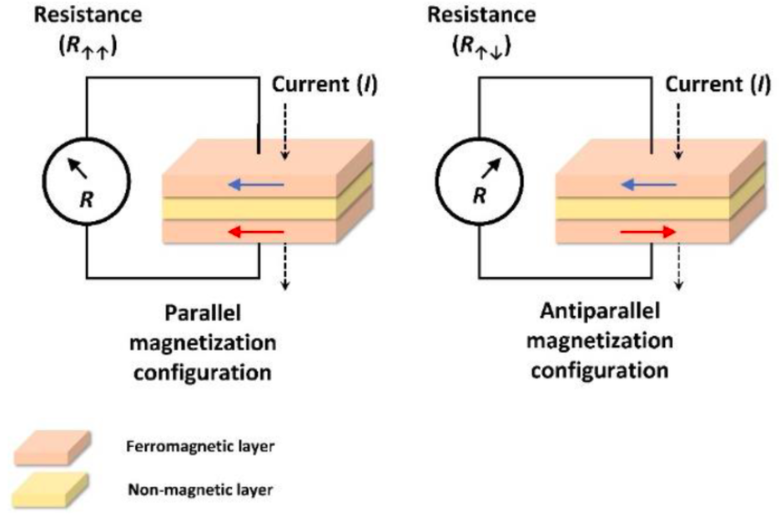
Giant Magnetoresistance (GMR) Device :
A Giant Magnetoresistance (GMR) device is a spintronic component that exploits the quantum mechanical property of electron spin to achieve a very large change in electrical resistance in response to an external magnetic field.
GMR was first discovered in 1988 in multilayer thin films of alternating ferromagnetic and non-magnetic conductive layers.

Slide 20
The effect arises because the resistance of the device depends on the relative alignment of magnetization in the ferromagnetic layers: when the layers are aligned parallel, electron spins experience less scattering, leading to low resistance, whereas in the antiparallel configuration, scattering is high, resulting in high resistance.
This sharp change in resistance with magnetic field is far larger than conventional magnetoresistance, hence the name "giant." GMR devices are highly sensitive magnetic field sensors and are widely used in hard disk drives (for reading magnetic data), magnetic random-access memory (MRAM), and biosensors.
The discovery of GMR revolutionized data storage technology, allowing for the miniaturization and dramatic increase of storage capacity in modern electronics.

Slide 21
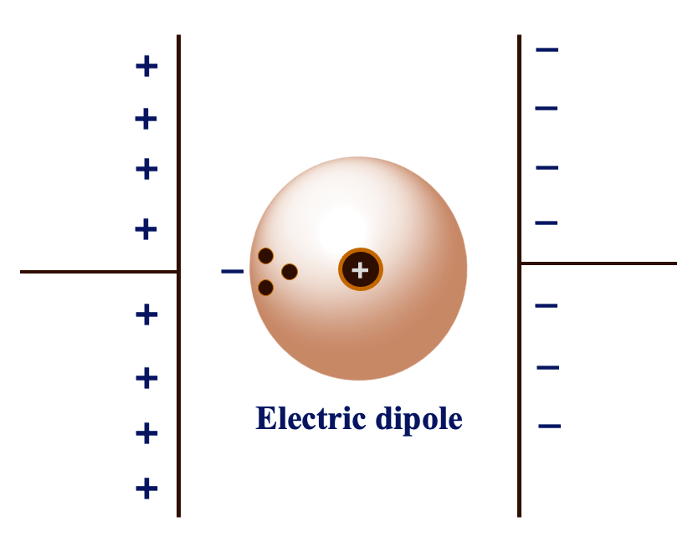
Introduction to Dielectric Materials :
Dielectrics are the materials having permanent electric dipole moment. In general, all dielectrics are the electrical insulators, and they are mainly used to store the electrical energy. A dipole is an entity in which equal positive and negative charges are separated by a small distance.
The product of magnitude of either of the charges and distance between charges is called dipole moment.
µ = qL (units - coulomb meter)
Dielectric constant is the ratio between the permittivity of the medium to the permittivity of free space.

Slide 22
Polarization: The process of producing electric dipoles by an electric field is called polarization in dielectrics.
Polarizability: The induced dipole moment per unit electric field is called polarizability. The induced dipole moment is proportional to the intensity of the electric field.
Types of Polarization in Dielectric Materials (Qualitative):
When a dielectric material is placed in an external electric field, polarization occurs due to the displacement or alignment of charges within the material. The major types of polarization are:
Electronic Polarization,
Ionic Polarization
3. Orientation (Dipolar) Polarization

Slide 23

Electronic Polarization:
Electronic polarization is the displacement of the negatively charged electron cloud with respect to the positively charged nucleus of an atom under the influence of an applied electric field, resulting in the formation of an induced dipole moment.
Occurs in all dielectric materials.
It happens when the external electric field displaces the electron cloud of an atom relative to its nucleus.
The induced dipole moment is directly proportional to the applied field and is extremely fast (responds even at optical frequencies).
Where ‘α_{e}’ is the electronic polarizability constant. It is independent of temperature, increase of atomic volume, and occurs at 10¹⁵ Hz of frequency.

Slide 24
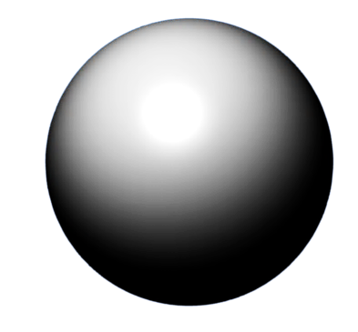
Ionic polarization:
The ionic polarization occurs, due to a relative displacement of the atomic components of the molecule in the presence of an electric field. It occurs at a frequency 10¹³ Hz, and it is independent of temperature. The resultant dipole moment µ = q ( x₁ + x₂)
_
+
+
_
-
_
+
+
cation
anion
_
+
Electric field
_
+

Slide 25
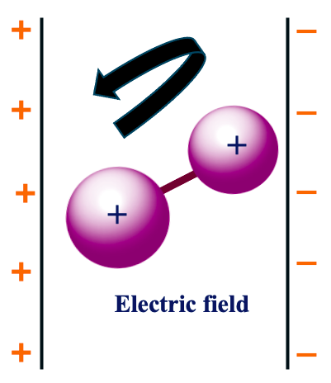

Orientation (Dipolar) Polarization:
Orientation polarization takes place in materials having permanent dipoles, where the external electric field tends to align these dipoles in its direction, reducing their random orientation and producing a net polarization.
Found in materials with permanent dipoles (e.g., H₂O, NH₃).
In the absence of an external field, the dipoles are randomly oriented due to thermal agitation.
Under an electric field, dipoles tend to align with the field direction, producing net polarization.
This type of polarization is temperature-dependent and decreases at higher temperatures due to thermal vibrations
It occurs at a frequency of 10⁶ Hz to 10¹⁰Hz. And It greatly depends on temperature.

Slide 26
Ferroelectric Materials:
Definition: These are dielectric materials that exhibit a spontaneous electric polarization even in the absence of an external electric field, and this polarization can be reversed by applying an external field.
Examples: Barium titanate (BaTiO₃), Lead zirconate titanate (PZT).
Applications: Non-volatile ferroelectric random-access memory (FeRAM), capacitors with high permittivity, sensors, actuators, and electro-optic devices.
Piezoelectric Materials :
Definition: Materials that generate an electric charge when subjected to mechanical stress (direct piezoelectric effect) and conversely undergo mechanical deformation when an electric field is applied (converse piezoelectric effect).
Examples: Quartz (SiO₂), Rochelle salt, Lead zirconate titanate (PZT).
Applications: Microphones, ultrasonic transducers, piezoelectric sensors, actuators, igniters, and vibration energy harvesters.

Slide 27
Pyroelectric Materials:
Definition: Materials that generate a temporary electrical potential when they are heated or cooled, due to a change in their spontaneous polarization with temperature.
Examples: Lithium tantalate (LiTaO₃), Tourmaline, Triglycine sulfate (TGS).
Applications: Infrared detectors, motion sensors, thermal imaging devices, and fire alarms.
Ferroelectric Random-Access Memory (Fe-RAM):
Definition:
Ferroelectric Random-Access Memory (Fe-RAM or FRAM) is a type of non-volatile memory that uses a ferroelectric capacitor instead of a conventional dielectric capacitor to store data. It retains stored information even when the power supply is turned off.

Slide 28
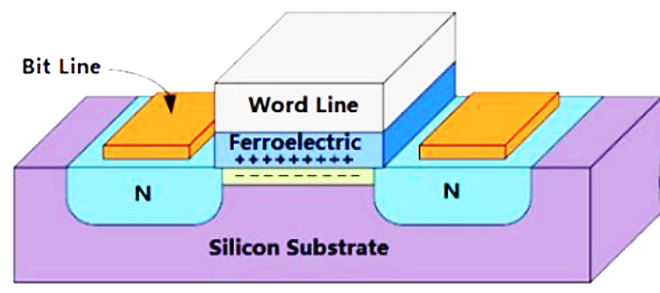
Working Principle:
In Fe-RAM, the data is stored based on the orientation of spontaneous polarization in a ferroelectric material (e.g., Lead Zirconate Titanate – PZT).
The polarization state (upward or downward) corresponds to binary states “0” and “1”.
Writing data involves applying an electric field to switch the polarization direction.
Reading data requires sensing the polarization state, often using destructive readout (data must be rewritten after being read).
Applications:
Smart cards and RFID systems.
Medical devices (like pacemakers).
Automotive electronics (where high reliability is required).
Low-power embedded systems.

Slide 29
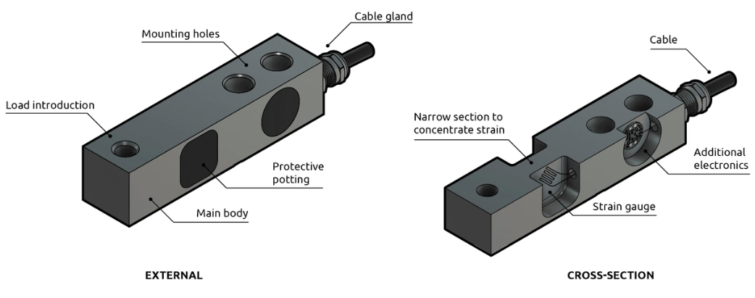
Load Cell:
A load cell is a transducer that converts mechanical force (load, weight, or pressure) into an electrical signal.
Working Principle: Most load cells work on the strain gauge principle, where applied force causes strain (deformation) in the material, changing the resistance of strain gauges. This change in resistance is measured as an electrical signal proportional to the force.
Applications:
  Weighing machines and electronic balances.
  Industrial automation for force and pressure measurement.
  Structural health monitoring.
  Robotics and aerospace systems.

Slide 30

Fire Sensor:
A fire sensor is a device designed to detect fire or flame presence through heat, smoke, light (UV/IR), or gas emissions, and trigger an alarm or safety response.
Types & Working:
  Smoke Detectors: Detect smoke particles using ionization or photoelectric sensors.
  Heat Detectors: Sense an abnormal rise in temperature.
  Flame Detectors: Detect infrared (IR) or ultraviolet (UV) radiation from flames.
Applications:
  Fire alarm systems in homes, offices, and industries.
  Safety systems in aircraft, automobiles, and spacecraft.
  Industrial plants (oil refineries, chemical factories).

