Slide 1
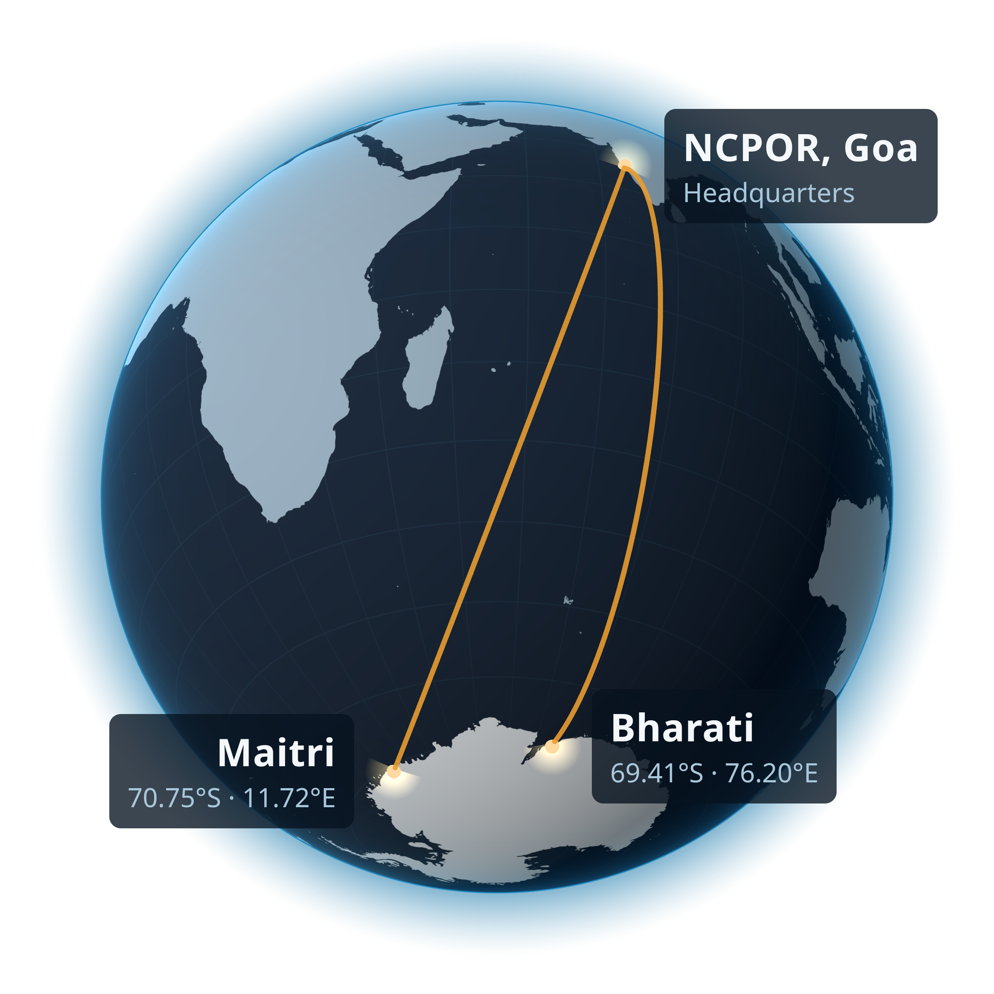

SMART INDIA HACKATHON 2026
TITLE PAGE
Problem Statement ID – SIH26063
Problem Statement Title- Integrated Polar Science Outreach, Knowledge Repository and Media Dissemination Portal
Theme- Smart Education
PS Category- Software
Team ID- 170341
Team Name (Registered on portal) - Nemoire
Station coordinates: NCPOR met-data portal. Globe: Three.js render, Natural Earth land.

Slide 2
IDEA TITLE
Nemoire
Proposed Solution (Describe your Idea/Solution/Prototype)
Detailed explanation of the proposed solution
How it addresses the problem
Innovation and uniqueness of the solution

Slide 3
TECHNICAL APPROACH
Nemoire
Technologies to be used (e.g. programming languages, frameworks, hardware)
Methodology and process for implementation (Flow Charts/Images/ working prototype)

Slide 4
FEASIBILITY AND VIABILITY
Nemoire
Analysis of the feasibility of the idea
Potential challenges and risks
Strategies for overcoming these challenges

Slide 5
IMPACT AND BENEFITS
Nemoire
Potential impact on the target audience
Benefits of the solution (social, economic, environmental, etc.)

Slide 6
RESEARCH AND REFERENCES
Nemoire
Details / Links of the reference and research work

