Slide 1
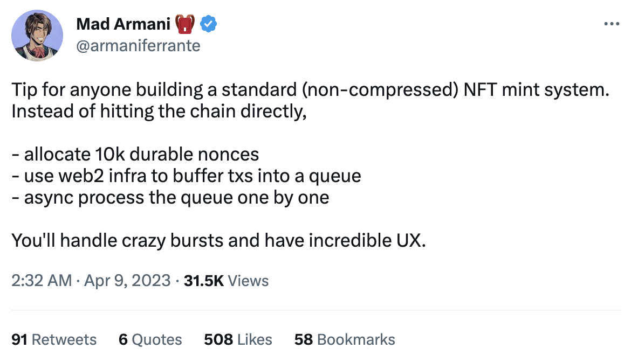
What is Mad Mints?
JST May 21 2023
Improves the speed of minting transactions. With this approach, you'll be able to handle high demand and experience incredible UX. We call "Mad Mints".
Source: Mad Armani 🎒 Twitter
https://twitter.com/armaniferrante/status/1644755048436736001

Slide 2
Detailed Explanation by ChatGPT-3.5
JST May 24 2023
3 STEPs to Implement Mad Mints.
STEP1
Allocate Durable Nonces
STEP2
Buffer transactions into queue
STEP3
Async process
Allocate 10,000 durable nonces: Nonces are integer values used to differentiate transactions with the same key. By allocating 10,000 durable nonces, you ensure that transactions can be easily tracked and duplicates can be avoided. These nonces are stored in persistent memory and won't be deleted even during reboots or upgrades.
Docs: https://solanacookbook.com/references/offline-transactions.html
Use web2 infrastructure to buffer transactions into a queue: Employ web2 infrastructure, which refers to traditional web infrastructure, to buffer incoming transactions into a queue. Instead of sending transactions directly to the chain, you add them to the queue for processing. This helps handle sudden bursts of transactions and enhances scalability.
Asynchronously process the queue one by one: Process the transaction queue asynchronously, meaning you handle each transaction one by one. This allows you to manage the order in which transactions are processed. You won't move on to the next transaction until the current one has completed all its processing steps.

Slide 3
Process Overview
JST May 24 2023
STEP1
Allocate Durable Nonces
STEP2
Buffer transactions into queue
STEP3
Async process
Create Durable Nonce
Sign Transaction
Queue
Send Transaction
Sign
Add
Async request
Nonce Account
Buffer Transaction
Buffer Transaction
Signature
Function
Data
Action

Slide 4
Conclusion of Mad Mints
JST May 28 2023
If you need fine-tuning speed, you should use Mad Mints.
Pros
(Value)
Mad Mints is 16 to 27 times faster than the standard.
The more NFTs you mint, faster it tends to become.
Easy to implement Mad Mints.
Cons
Create and store Durable Nonce Account in advance.
(Option) You may need to build a queueing system for transactions.
Example Case
It is useful when fine-tuning speed is required in milliseconds.
e.g. Minting Site, DEX and Fully On-chain site.
If speed is not a priority, standard transaction method is sufficient.
This conclusion is unofficial, in my opinion.

Slide 5
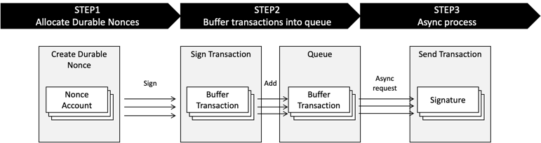
Mint NFTs - Speed Test Result (rough estimate)
JST May 28 2023
Speed test scope of Mad Mints
Number of Mint NFTs *1 |  | Mad Mints | Standard (Request directly) | Results
 |  | Average *2 | Average
Transactions | 1 NFT | 50 ms | 800 ms | Mad Mints 16 times faster
 | 100 NFTs | 1,900 ms | 46,000 ms | Mad Mints 24 times faster
 | 1,000 NFTs | 17,000 ms | 460,000 ms | Mad Mints 27 times faster
*1 Using Metaplex JavaScript SDK.
*2 Use performance.now method of JS using Solana Test Validator v 1.15.2. macOS Monterey 12.6.5, MacBook Pro (13-inch, 2018), 2.7 GHz Core i7, Memory 16 GB

Slide 6
Transfer SOL - Speed Test Result (rough estimate)
JST May 28 2023
Speed test scope of Mad Mints
Number of Instructions per transaction *1 |  | Mad Mints | Standard (Request directly) | Results
 |  | Average *2 | Average
Transactions | 1 Instruction | 10 ms | 20 ms | Mad Mints 2 times faster
 | 10 Instructions | 13 ms | 29 ms | Mad Mints 2.2 times faster
 | 40 Instructions | 20 ms | 53 ms | Mad Mints 2.6 times faster
*1 Transfer SOL instructions using Solana web3.js.
*2 Use performance.now method of JS using Solana Test Validator v 1.15.2. macOS Monterey 12.6.5, MacBook Pro (13-inch, 2018), 2.7 GHz Core i7, Memory 16 GB

Slide 7
Conclusion of Mad Mints
JST May 21 2023
If you need fine-tuning speed, you should use Mad Mints.
Value
Over 2 to 2.5 times faster than the standard.
Even with a large number of instructions (e.g. 40), the speed is fast.
When the number of instructions is low, there is not much variation. However, "Many drops make a shower", and there is a significant difference in speed when the trading volume is high.
Maintains a consistent and stable speed without any deviation(under 0.5 ms).
Example Case
It is useful when fine-tuning speed is required in milliseconds.
e.g. Minting Site, DEX and Fully On-chain site.
If speed is not a priority, standard transaction method is sufficient.

Slide 8
Transaction Processing Bottleneck
JST May 24 2023
Speed bottleneck is "create and use Nonce" process in Sign Transaction.
(AsIs)
Standard
Speed Test Scope
Create Instructions
Sign Transaction
Send Transaction
Create and Use Nonce
Speed Bottleneck
Improve
(ToBe)
Mad Mints
Create Nonce in advance
Speed Test Scope
Create Instructions
Create Instructions
Sign Transaction
Send Transaction
Create Durable Nonce
Use Nonce

Slide 9
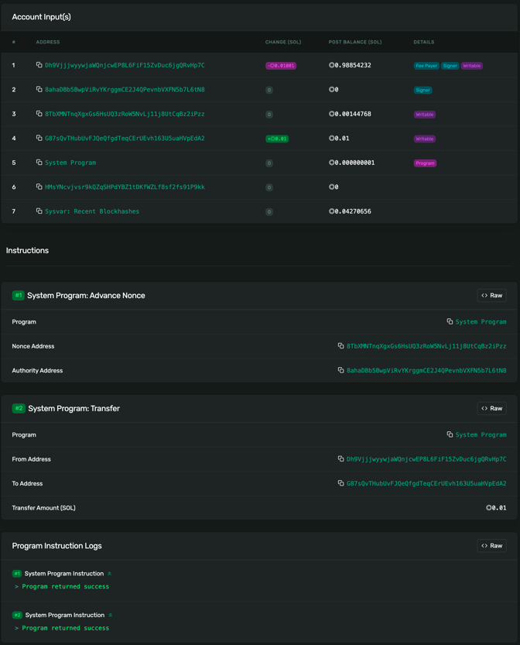
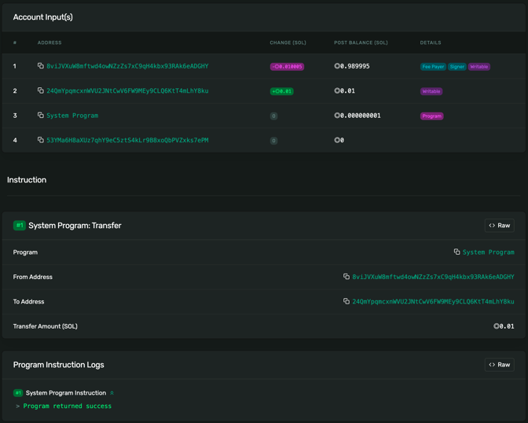
Difference Between Mad Mints and Standard Transaction (Transfer SOL Instruction)
JST May 21 2023
Mad Mints
Standard
Use Nonce here ->

Slide 10

Example Code
JST May 21 2023
https://github.com/256hax/mad-mints
Experiment purpose only.

Slide 11

Mad Mints Logo (Unofficial, Fan art)
JST May 21 2023
I expect discussions like, "Hey, should we use Mad Mints or Standard for our Minting System?" within your team.
Fan art by shiroperu
https://twitter.com/shiroperu

