Slide 1


Slide 2
Anatomy of Mad Mints
by 256hax

Slide 3
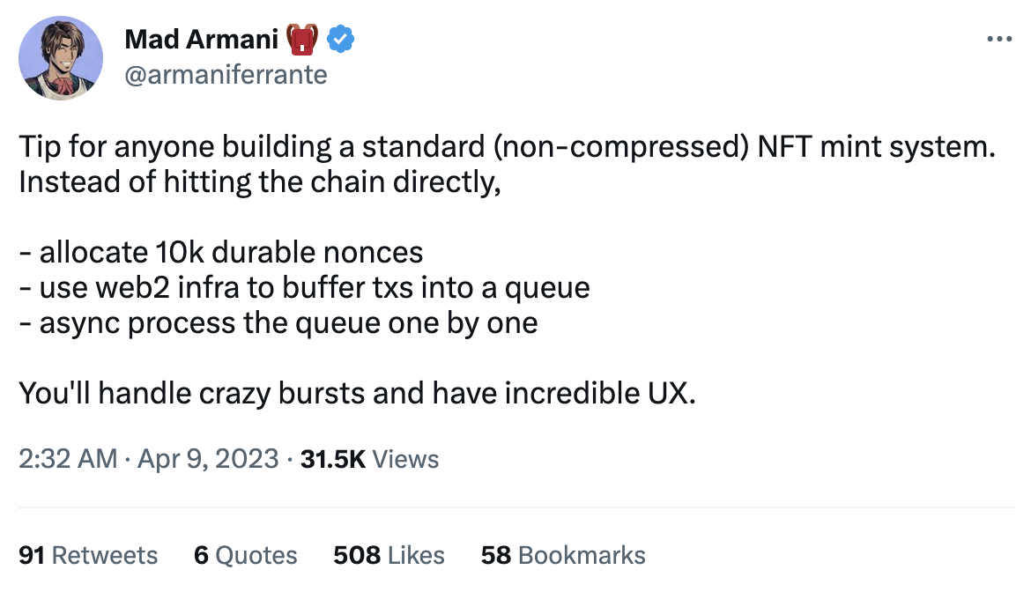
What is Mad Mints?
JST Jul 2 2023
Improves the speed of minting transactions. With this approach, you'll be able to handle high demand and experience incredible UX. Armani found this approach and named "Mad Mints".
Source: Mad Armani 🎒 Twitter
https://twitter.com/armaniferrante/status/1644755048436736001

Slide 4
Detailed Explanation by ChatGPT-3.5
JST May 24 2023
3 STEPs to Implement Mad Mints.
STEP1
Allocate Durable Nonces
STEP2
Buffer transactions into queue
STEP3
Async process
Allocate 10,000 durable nonces: Nonces are integer values used to differentiate transactions with the same key. By allocating 10,000 durable nonces, you ensure that transactions can be easily tracked and duplicates can be avoided. These nonces are stored in persistent memory and won't be deleted even during reboots or upgrades.
Docs: https://solanacookbook.com/references/offline-transactions.html
Use web2 infrastructure to buffer transactions into a queue: Employ web2 infrastructure, which refers to traditional web infrastructure, to buffer incoming transactions into a queue. Instead of sending transactions directly to the chain, you add them to the queue for processing. This helps handle sudden bursts of transactions and enhances scalability.
Asynchronously process the queue one by one: Process the transaction queue asynchronously, meaning you handle each transaction one by one. This allows you to manage the order in which transactions are processed. You won't move on to the next transaction until the current one has completed all its processing steps.

Slide 5
Process Overview
JST May 24 2023
STEP1
Allocate Durable Nonces
STEP2
Buffer transactions into queue
STEP3
Async process
Create Durable Nonce
Sign Transaction
Queue
Send Transaction
Sign
Add
Async request
Nonce Account
Buffer Transaction
Buffer Transaction
Signature
Function
Data
Action

Slide 6
Conclusion of Mad Mints
JST Jun 12 2023
If you need fine-tuning speed, you should use Mad Mints.
Pros
(Value)
Mad Mints is 16 to 27 times faster than the standard.
The more NFTs you mint, faster it tends to become.
Easy to implement Mad Mints.
Cons
Create and store Durable Nonce Account in advance.
Total fees are higher, ranging 0.0014 - 0.02 SOL per transaction. e.g. 10K mints are up to 200 SOL
(Option) You may need to build a queueing system for transactions.
Example Case
It is useful when fine-tuning speed is required in milliseconds. e.g. Minting Site, DEX and Fully On-chain site.
If speed is not a priority, standard transaction method is sufficient.
This conclusion is unofficial, in my opinion.

Slide 7
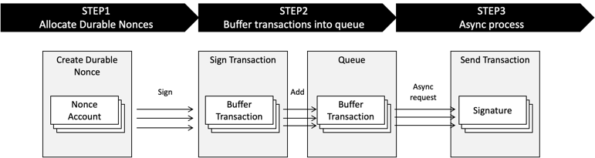
Mint NFTs - Speed Test Result (rough estimate)
JST May 28 2023
Speed test scope of Mad Mints
Number of Mint NFTs *1 |  | Mad Mints | Standard (Request directly) | Results
 |  | Average *2 | Average
Transactions | 1 NFT | 50 ms | 800 ms | Mad Mints 16 times faster
 | 100 NFTs | 1,900 ms | 46,000 ms | Mad Mints 24 times faster
 | 1,000 NFTs | 17,000 ms | 460,000 ms | Mad Mints 27 times faster
*1 Create Mint Account and Metadata Account Using Metaplex JavaScript SDK. It's not including upload Metadata JSON and image, verify collection.
*2 Use performance.now method of JS using Solana Test Validator v 1.15.2. macOS Monterey 12.6.5, MacBook Pro (13-inch, 2018), 2.7 GHz Core i7, Memory 16 GB

Slide 8
Transfer SOL - Speed Test Result (rough estimate)
JST May 28 2023
Speed test scope of Mad Mints
Number of Instructions per transaction *1 |  | Mad Mints | Standard (Request directly) | Results
 |  | Average *2 | Average
Transactions | 1 Instruction | 10 ms | 20 ms | Mad Mints 2 times faster
 | 10 Instructions | 13 ms | 29 ms | Mad Mints 2.2 times faster
 | 40 Instructions | 20 ms | 53 ms | Mad Mints 2.6 times faster
*1 Transfer SOL instructions using Solana web3.js.
*2 Use performance.now method of JS using Solana Test Validator v 1.15.2. macOS Monterey 12.6.5, MacBook Pro (13-inch, 2018), 2.7 GHz Core i7, Memory 16 GB

Slide 9
Transaction Processing Bottleneck
JST Jul 2 2023
Speed bottleneck is "create and use Nonce" process in Sign Transaction.
(AsIs)
Standard
Create Instructions
Sign Transaction
Send Transaction
Create and Use Nonce
Speed Bottleneck
Create Nonce in advance
(ToBe)
Mad Mints
Create Instructions
Create Instructions
Sign Transaction
Send Transaction
Create Durable Nonce
Use Nonce

Slide 10
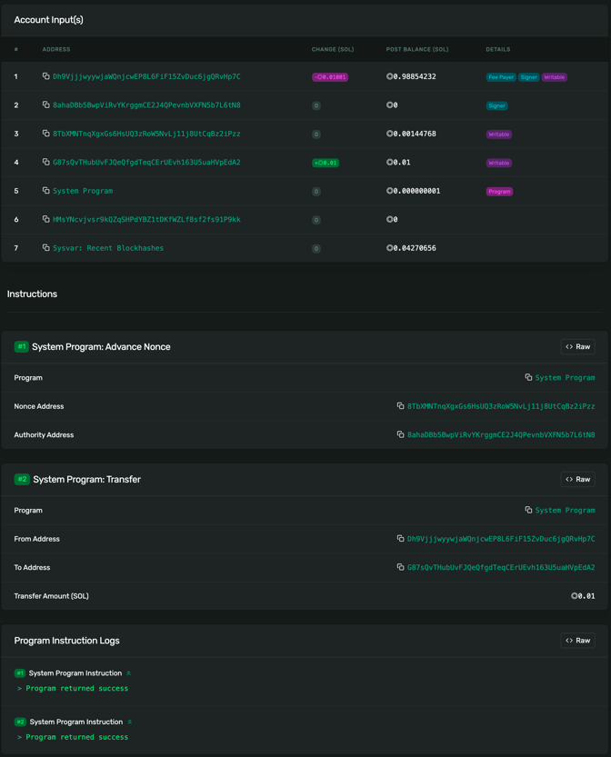
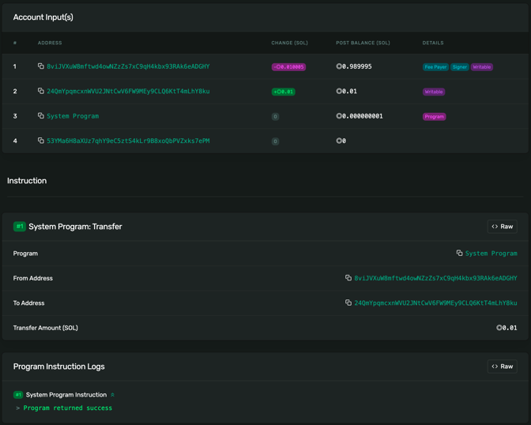
Difference Between Mad Mints and Standard Transaction (Transfer SOL Instruction)
JST May 21 2023
Mad Mints
Standard
Use Nonce here ->

Slide 11
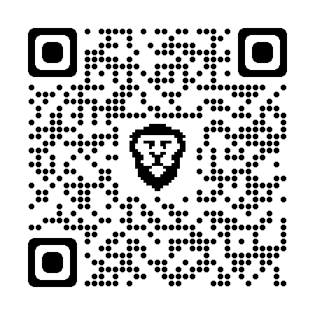
Example Codes
JST May 21 2023
https://github.com/256hax/mad-mints
Experimental purpose only.

Slide 12
Directory Structure and Overview of Example Codes
JST Jul 2 2023
mad-mints
+--- anchor
+--- docs
+--- packages
+--- queue
...
packages
(private packages for utility)
common
script
(e.g. create durable nonce)
call
call
anchor
(example codes and validator)
queue
(queueing example codes)
example code
(including speed test)
local validator
(clone Metaplex programs for NFT)
example code
(mint large amount NFTs)
queue system
(serverless queueing)
request
request
request

Slide 13
Note
JST Nov 22 2023
I made only Mad Mints example codes.
If you need to inquire "Mad Mints" brand, please contact Armani (@armaniferrante).
Mad Mints logo(fan art) was created by @shiroperu (Designer).

Slide 14


