Slide 1
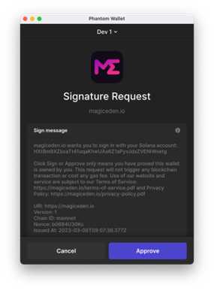




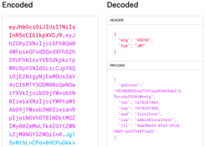
System Process – Sign Message and JWT
This program scope is here
Device / Wallet
Sign Message (auth)
Frontend
Backend
(API Server)
2. Request approve to sign message
1. Create message
3. Approve
4. Request verify signature
Signature
User
Create JWT (if passing auth)
2. Set JWT to cookie
1. Create JWT
JWT
Keep Sign In (Verify JWT)
1. Read JWT in cookie
2. Request verify JWT
JWT
4. Display signed in
3. Return result (decoded JWT)
System
Data
Data
Device
Action

