Slide 1

Solana Blockchain Outline Figure for Project Manager (Unofficial, Draft)
by 256hax

Slide 2
System Architecture

Slide 3
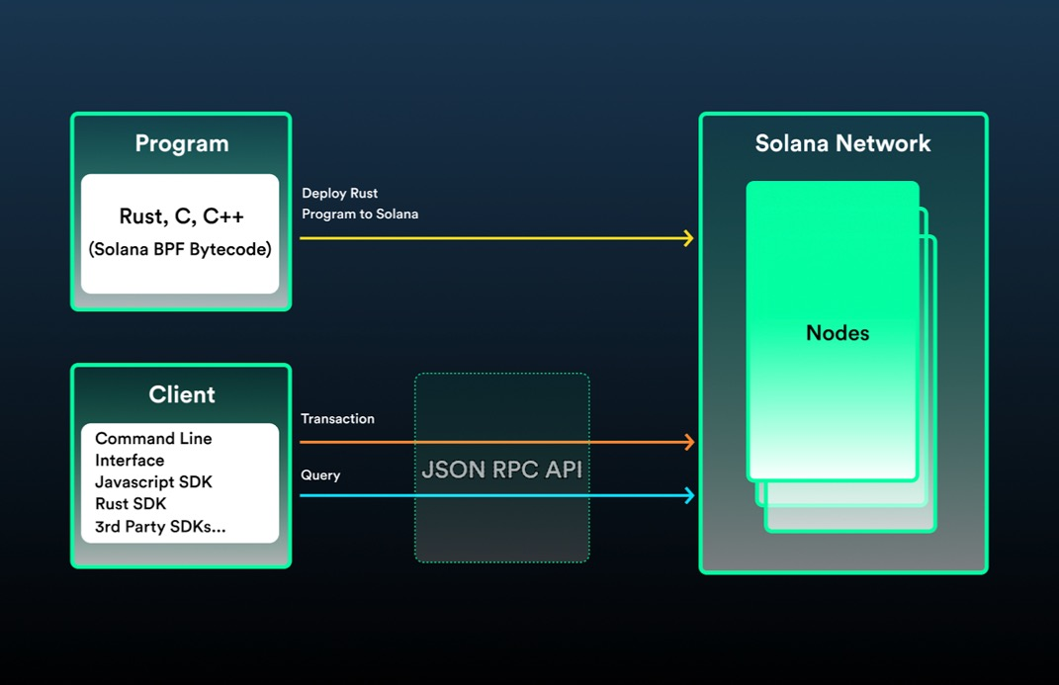
High level representation of the Solana development workflow
Dec 18 2021
Source: https://solana.com/ja/news/getting-started-with-solana-development
"It’s important to note that this is an oversimplification of the Solana network for the purposes of learning in an easy-to-understand way.
Starting at the top left of the diagram (Program) you can see the first development workflow that allows you to to create and deploy custom Rust, C and C++ programs directly to the blockchain. Once these programs are deployed, anyone who knows how to communicate with them, can use them. You can communicate with these programs by writing dApps with any of the available client SDKs (or the CLI), all of which use the JSON RPC API under the hood. The second development workflow is the dApp side starting on the bottom left (Client) where you can write dApps that communicate with deployed programs. Your apps can submit transactions with instructions to these programs via a client SDK to create a wide variety of applications such as wallets, DEXs and more. These two pieces work together to create a network of dApps and programs that can communicate with each other to update the state and query the blockchain. Developers can think of Solana as a global computer where anyone in the world can deploy programs to it, and communicate with the ones that already exist."

Slide 4






Standard System Architecture Example
Dec 18 2021
UI/UX Improvement
e.g.) The Graph
Web Analytics
e.g.) Google Analytics
Read/Verify
Security Check
e.g.) Certik, PhishFort
Read
Read
Write
Mint
Wallet
e.g.) Phantom
Send/Receive
Frontend
e.g.) JS (Solana/Anchor Web3), React, Vue, Metaplex, Raydium
Solana Cluster
(Blockchain)
e.g.) Solana Mainnet Beta
User
Deploy
Read
Read/Write
Read
Market / Report
e.g.) CoinMarketCap, DefiLlama
Backend
e.g.) Ruby on Rails, PHP, Python
Permanent Storage
e.g.) Arweave, IPFS: NFT.Storage, Pinata Cloud
Manage Solana Programs/Account
Deploy Files
Develop
e.g.) Solana CLI, Rust, Anchor
Wallet
e.g.) Solana CLI
System
Device
Developer
Action

Slide 5



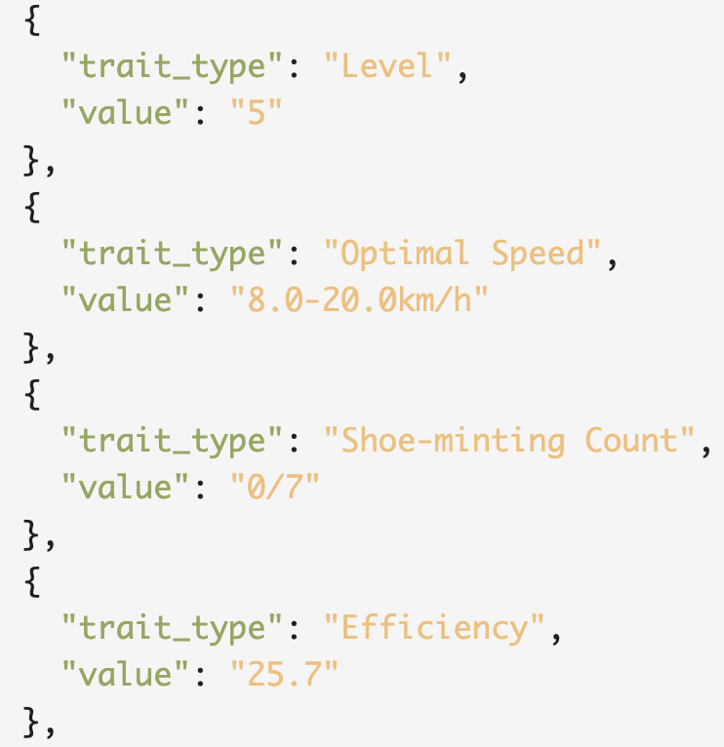
NFT Mint Tools Decision Tree (Draft)
May 08 2023
Do you have logic and dynamic status in NFT?
Y
Do you update status frequently?
Y
(Web2)
Scratch Development
Difficult /
Customizable
N
N
Do you have Marketing Channel?
Y
(web3 )
Metaplex
Candy Machine
with Umi
For example, when minting STEPN shoes, there are dynamic status parameters such as level and efficiency.
N
Do you need to implement own page?
e.g. Landing Page
Y
SaaS
e.g. Thirdweb
N
NFT Marketplace
e.g. Magic Eden,
Opensea
Easy /
Template

Slide 6
Marketing

Slide 7
Marketing Funnel – Mint NFT (Draft)
May 08 2023
User
(Minter)
Acquisition
Check
(PJ, potential, scam...)
Apply White List
Mint
User action
transition rate
Visit Rate
OO％
Apply Rate
OO％
Views
OO Impressions
Mint Rate
OO％
Visitors
OO Users
Users
OO Wallets
Mint
OO NFTs
Promotions
(Influencers/
Ad Banners)
Landing page
Apply WL
(Acquire User
Wallet)
Mint
(Conversion)

Slide 8

Value Proposition of DRiP
[Details]
Twitter thread "Awesome @drip_haus"
https://twitter.com/256hax/status/1657409855546871810
Discovering
favorite
artists
Wow!
(UX, Tech)

Slide 9
X to/and Earn

Slide 10






User and System Action Overview of STEPN (hypothesis)
Jul 05 2022
Function
Data
Action
STEPN App (Off-chain)
Transfer (On-chain)
Earn
Spending = Game Wallet
(User's
Off-chain Wallet)
STEPN Bank
(STEPN's
On-chain Wallet)
STEPN Solana Wallet
(User's
On-chain Wallet)
Use Sneakers
Move
Get Tokens
Send Token
Tokens
Sneakers
Measurement
Transfer
History
Send Tokens
Transfer
Maintenance
Tokens
Sneakers
Tokens
Sneakers
Level up
Pay Tokens
DOOAR(STEPN)
Write Trans History
Repair
Grow Sneakers
Swap (Orca SDK)
Transfer
Transfer
Mint
Mint
Swap Tokens
DEX (Orca)
Marketplace
Update Metadata
Pay/Get Tokens
Swap
Sell / Buy
Send/Get Sneakers
Add Liquidity
Liquidity Pool

Slide 11
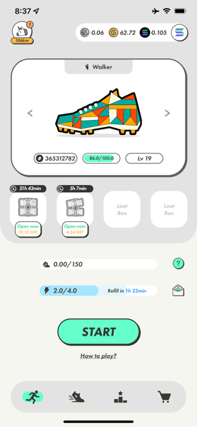
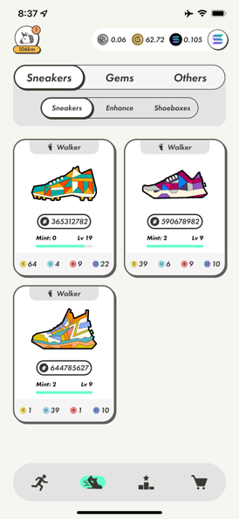
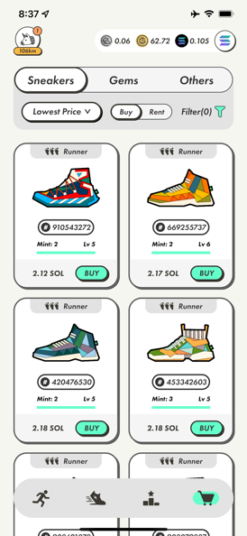
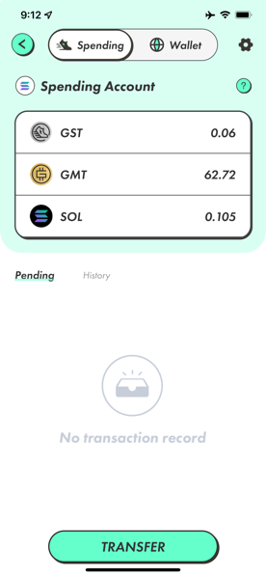
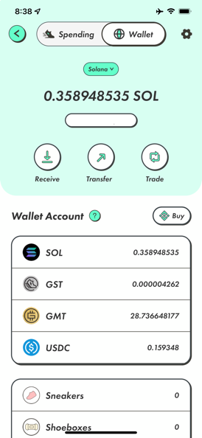
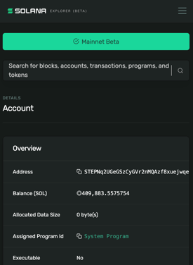
(Appendix) STEPN Screenshot
Jul 05 2022
Off-chain
On-chain
STEPN App
Earn
Maintenance
Marketplace
Spending = Game Wallet
STEPN Solana Wallet
STEPN's On-chain Wallet
STEPNq2UGeGSzCyGVr2nMQAzf8xuejwqebd84wcksCK

Slide 12
Web3.js Mapping to System (hypothesis)
Jul 05 2022
STEPN doesn't use own Rust programs?
It doesn't need to transfer real token.
Only Web2.0 Tech?
Solana Web3.js
Metaplex Web3.js
Metaplex Candy Machine(JS)
(Metaplex Sugar)
Metaboss(CLI)
How to implementation?

Slide 13
When does STEPN mint Sneaker NFTs? (hypothesis)
Jul 05 2022
Sneakers born at STEPN App(Off-chain) so, It doesn't need mint NFTs.
STEPN mint a Sneaker NFT in STEPN Bank when user send Wallet.
The cost is optimized. Users doesn't need to use On-chain because there's Marketplace in STEPN App(Off-chain).
It expensive and lack of stock for STEPN Sneakers in Magic Eden.

Slide 14
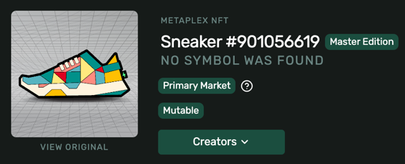
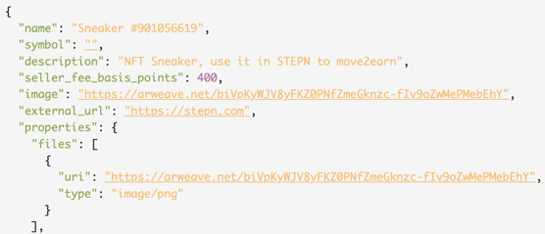

Where Stored NFTs of STEPN?
Jul 05 2022
Solana chain (On-chain)
STEPN Server (Off-chain)
Arweave chain (On-chain)
Mint Account
Metadata
Image
https://explorer.solana.com/address/3jG1i97xv1kvvhxCe6TPjRPbRNf78hFbhgZWUQon9R3Y/metadata
Note:
NFT = Mint Account + Metadata + Image
There's not in Arweave.
Because of reduce updating Metadata cost?
https://api.stepn.com/run/nftjson/103/33778417947
Refer to the Metadata Account Address.
(Using Metaplex Token Metadata Program)
https://arweave.net/biVpKyWJV8yFKZ0PNfZmeGknzc-fIv9oZwMePMebEhY
Refer to Image file in Arweave.

Slide 15
Yield Farming

Slide 16










Yield Farming Customer Journey Outline
Dec 18 2021
RAY, Governance Token
Domestic
Exchange
DEX
Exchange
Liquidity
Earn
Specials
Trading
(Orderbooks)
Liquidity
Pools
Staking
Send ETH
Mint
Special NFTs
Overseas
Exchange
AcceleRaytor
Earn Tokens
+
Swap
(AMM)
Farms
IDO
DropZone
Send SOL
Earn
Governance Token
Lottery
Wallet
Exchange
SOL to RAY Token
Add Liquidity
(Get LP Token)
Earn Tokens
Get Specials

Slide 17
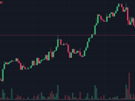


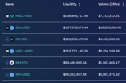
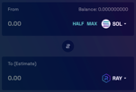
Listing Token to Market - Outline Figure (Draft)
Dec 18 2021
Web3.0 Team
Orderbooks
Consumers
Market
Application
(Dexlab)
Serum Market
Trading
(Dexlab?)
Submit?
Submit?
List?
Trade
Token
User A
Create
Token
AMM (Raydium)
Product
Manager
Pools
Swap
Add to Pool?
List?
Exchange
User B
Reference: Create and List a Solana Token in a UI with Zero Development in 5 Minutes

Slide 18
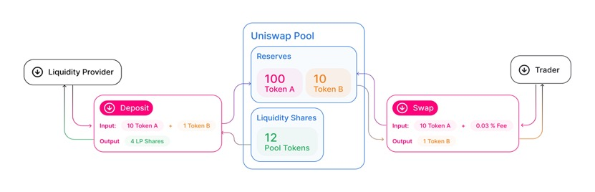
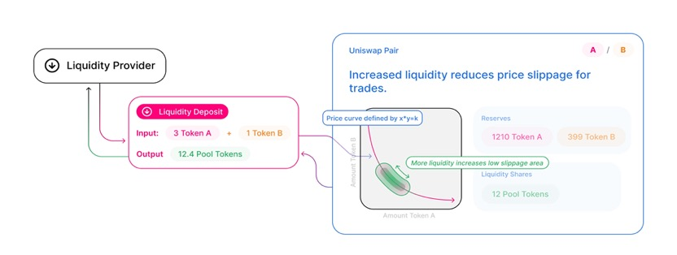
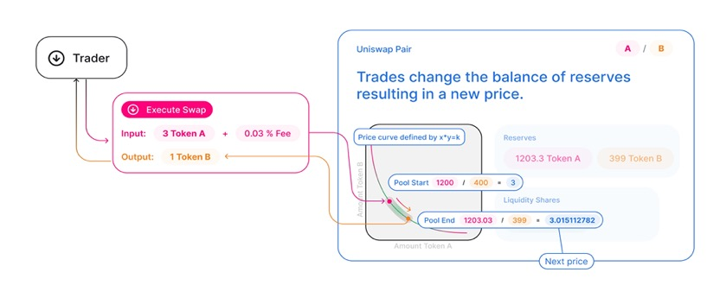
How Uniswap V2 works
Dec 18 2021
Source: https://docs.uniswap.org/protocol/V2/concepts/protocol-overview/how-uniswap-works
"Anyone can become a liquidity provider (LP) for a pool by depositing an equivalent value of each underlying token in return for pool tokens. These tokens track pro-rata LP shares of the total reserves, and can be redeemed for the underlying assets at any time."
"Pairs act as automated market makers, standing ready to accept one token for the other as long as the “constant product” formula is preserved. This formula, most simply expressed as x * y = k, states that trades must not change the product (k) of a pair’s reserve balances (x and y). Because k remains unchanged from the reference frame of a trade, it is often referred to as the invariant. This formula has the desirable property that larger trades (relative to reserves) execute at exponentially worse rates than smaller ones.
In practice, Uniswap applies a 0.30% fee to trades, which is added to reserves. As a result, each trade actually increases k. This functions as a payout to LPs, which is realized when they burn their pool tokens to withdraw their portion of total reserves. In the future, this fee may be reduced to 0.25%, with the remaining 0.05% withheld as a protocol-wide charge."
"Because the relative price of the two pair assets can only be changed through trading, divergences between the Uniswap price and external prices create arbitrage opportunities. This mechanism ensures that Uniswap prices always trend toward the market-clearing price."

Slide 19
NFT

Slide 20
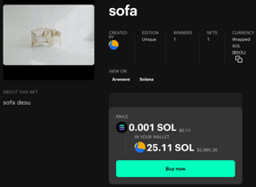
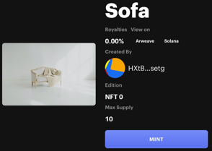
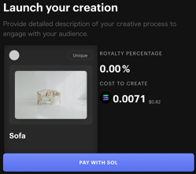
Start Up Metaplex Store Steps (Draft)
Dec 18 2021
Init
Create
Mint*
Sell
Creator (Owner)
Consumer
Metaplex (UI)
Solana Cluster (Blockchain)
Arweave (Storage)
Init Store
Create an NFT
Mint from Master Edition NFT
Sell an NFT
Display
Init Page
Display Create Page
Display NFT Details Page with Mint Button
Display Sell Page
Init
(create many accounts.)
Create (NFT) Token
Create (NFT) Token
Update State Account?
(selling mode?)
Upload File and Add Metadata
Upload File and Add Metadata
Update Metadata?
(selling mode?)
* You can skip Mint step. Selling with copy(mint from Master Edition) in Sell Page (Choose: "Sell limited number of of copies").

Slide 21


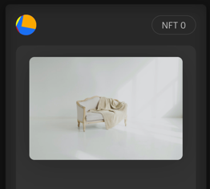
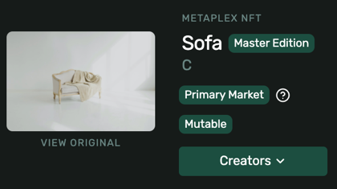
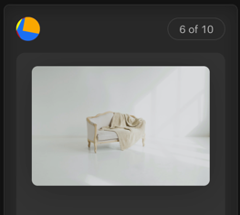
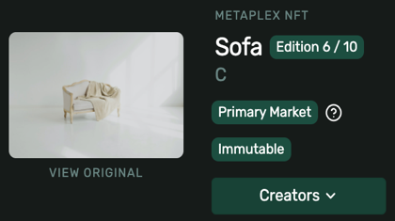
What is Master Edition / Edition NFT?
Dec 18 2021
Master Edition NFT can mint (copy) image. Edition NFT is copy image.
Image Data
Metaplex
Master Edition NFT
by Pexels
Metaplex
Solana Explorer
Create(Mint) an NFT
for First Edition.
Edition NFT
Metaplex
Solana Explorer
Mint an NFT from Master Edition.
(copy image from Master Edition)

Slide 22
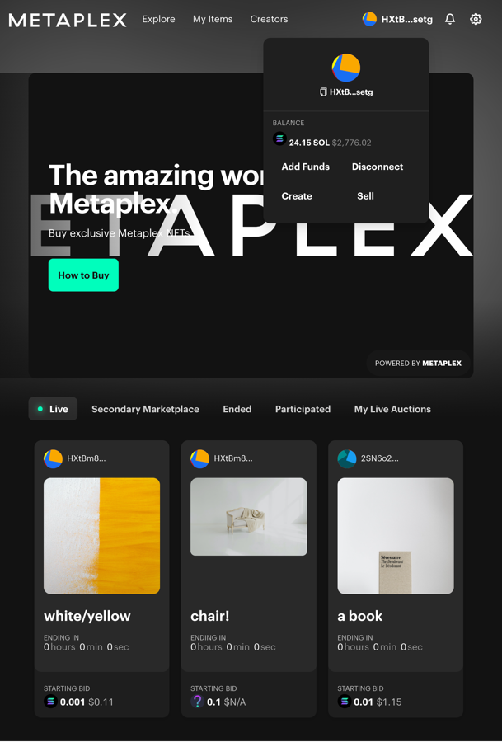
Metaplex Terminology - Storefront (http://localhost:3000/#/)
Dec 18 2021
Creators Menu Create: create NFT Sell: sale for primary/secondary market
Market Live: primary market Secondary Marketplace: secondary market
Price Pricing is depend on token. "?" icon means sale for own governance token.
(1)
(2)
(3)

Slide 23
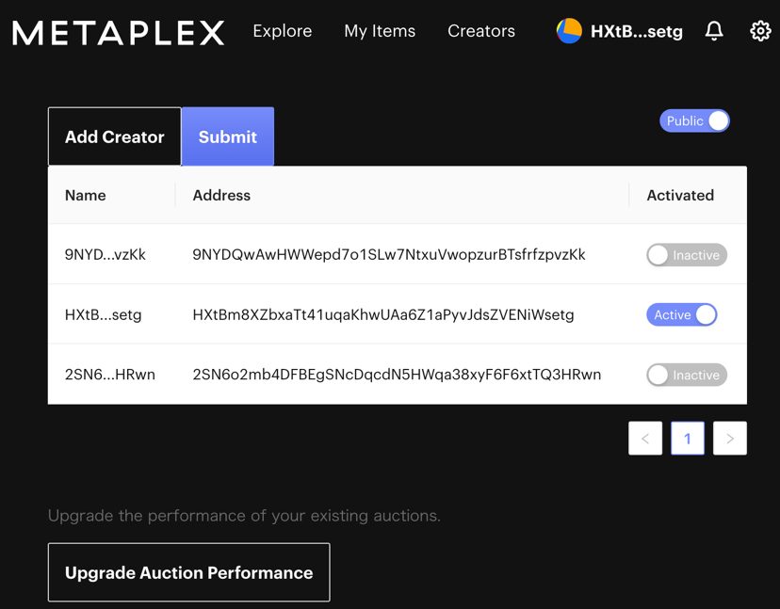
Metaplex Terminology - Admin Page (http://localhost:3000/#/admin)
Dec 18 2021
Authority (for Create NFT) Starting a variety of auctions for primary/secondary sales.
Whitelist Creators
Activation Status for Whitelist
Save Admin Settings (Transaction to Solana Blockchain)
(4)
(1)
(2)
(3)

Slide 24
Metaplex Admin Page Behavior (Draft)
Dec 18 2021
Conclusion
- Authority "Public": All creators sale for primary market. And ignore Whitelist settings.
- Authority "Whitelist Only"
Listed Creators: has Create NFT authority and sale for primary market.
Not Listed Creators: No Create NFT authority and sale for secondary market.
Case | Admin Page |  | Storefront - Listed Creators |  |  | Storefront - No Listed Creators
 | Authority (for Create) | Activation Status | Create | Sell | Buy | Create | Sell | Buy
Case A: Public x Active | Public | Active | Yes* | Yes (primary)* | Yes | Yes | Yes (primary) | Yes
Case B: Public x Inactive | Public | Inactive | Yes | Yes (primary) | Yes | Yes | Yes (primary) | Yes
Case C: Whitelist x Active | Whitelist Only | Active | Yes | Yes (primary) | Yes | No | Yes (secondary) | Yes
Case D: Whitelist x Inactive | Whitelist Only | Inactive | No* | Yes (secondary)* | Yes | No | Yes (secondary) | Yes
* Yes: has execute permission, No: no permission, primary: primary market sale, secondary: secondary market sale
Note: Verified by Metaplex v 1.1.1.

Slide 25
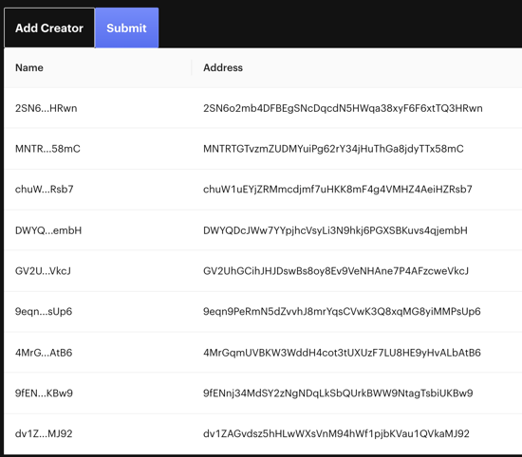
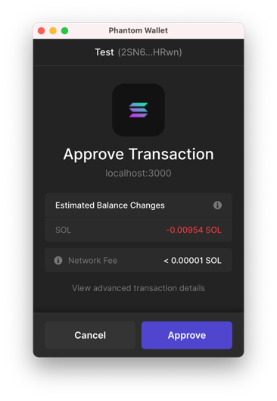
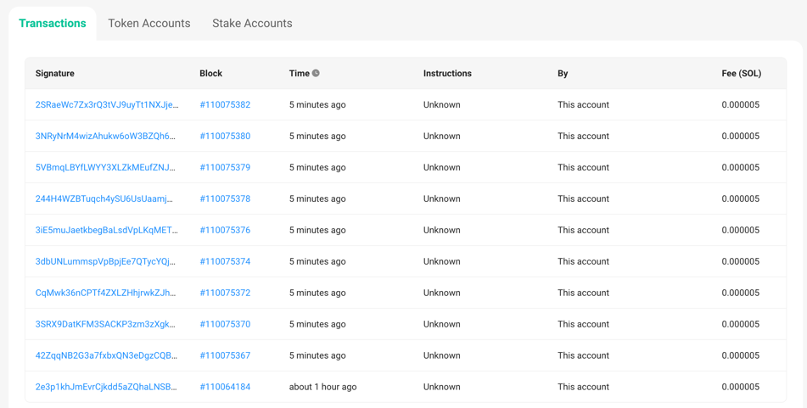
Metaplex Admin Page Transaction
Dec 18 2021
Add store info and whitelist to State Account when you Submit.
1. Submit Admin Settings (http://localhost:3000/#/admin)
2. Approve
Transaction
3. Confirm Transactions
Add Creators to Whitelist then Submit.
Send all Instructions (status) data.
Init (first time): Set store info and create accounts with data
Update: Set store info and update data
All Creators are approved with only Approval once.
Save status to accouns On-Chain.
e.g.) Account A -> activated(Whitelist): true
Ref:
Metaplex: instrunctions.rs, set_store.rs, SetStore.ts, set_whitelisted_creator.rs, SetWhitelistedCreator.ts

Slide 26
Sign(Verify) and Sell Simplification an NFT - Simplification Outline
Dec 18 2021
One Creator
Metaplex
Multiple Creators
(Split Royalty)
Storefront
Mint + Sign and Sell an NFT
Mint + Sign
One Creator: Mint + Sign an NFT.
Another Creator: Need to sign with CLI.
Sign
Update
Note: An NFT starting sell if All Creators signed (verify).
Sell
Creator A
Creator
NFT
Sell an NFT by Creator(s) if you want.
Notice: It need to sign (verify) by all Creators before sell.
Another Way (CLI and UI)
Creator B
Candy Machine
CLI
Candy Machine
UI
Metaboss
CLI
NFT
Mint and
(Sign * Creators)
Mint and Sign
Mint
Mint + Sell
Mint
Note: It's completed with only Metaplex if one creator selling.
Sign
Sign
Note: One creator can sign(verify) at Metaplex but another creator need to sign with CLI.
Update
Update
probably the most common use

Slide 27

NFT Metadata Relationships - Outline
Dec 18 2021
Metaplex
Storefront(UI)
Create an NFT
Send Transaction
Send Transaction
Send Transaction?(Upload)
Solana(Blockchain)
Arweave(Blockchain)
Metaplex Metadata
Account Info(updateAuhority, mint address, isMutable)
NFT Info(name, Metadata uri)
Creators Info
Metadata Details
NFT Info(name, description, image uri, collection)
Properties(Creators Royalty, files uri)
File
image(Base64?)
refer
refer
System
Data

Slide 28
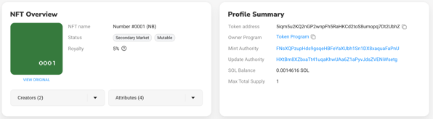
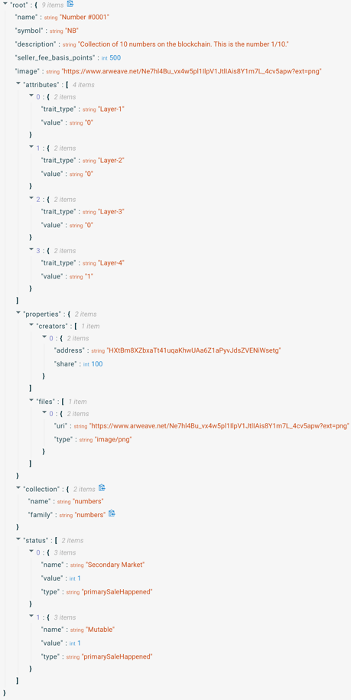
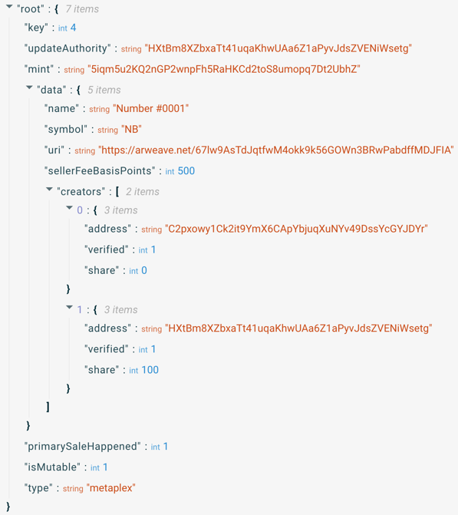
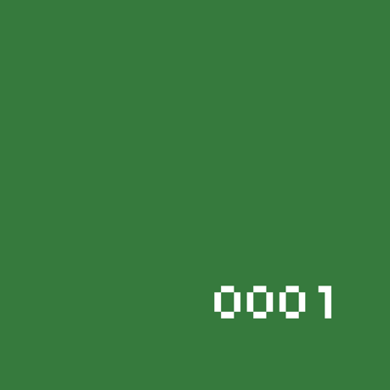
NFT Metadata Relationships - Example Data
Dec 18 2021
NFT (Solscan)
Metadata Details (Arweave)
Metaplex Metadata (Solana on-chain data)
File (Arweave)
refer
refer

Slide 29
Transactions

Slide 30
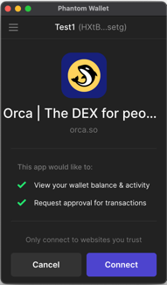
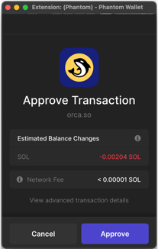
Transaction Process with Phantom Wallet (Draft)
Dec 18 2021
User A
User B
Phantom
Frontend (UI)
Solana Cluster (Blockchain)
Visit
website
Connect
wallet
Start
transaction
(ex: Swap)
Approve
transaction
send wallet address?
Requesting
connect to
wallet
Stored(?)
wallet address
Requesting
Approve
Transaction
(with simulation?)
Send transaction
sign
Display
wallet UI
Display
transaction
UI
Display
Completion
UI
Simulate
transaction?
Confirm
transaction
Reference: Phantom - Staying safe with Phantom, Orca

Slide 31
Sign and Confirm Transaction Process (Draft)
Dec 18 2021
User A
User B
Phantom
Frontend (JavaScript)
Solana Cluster (Blockchain)
Start
transaction
Approve
transaction
Requesting
Approve
Transaction
(with simulation?)
Send transaction
sign
Set transaction
config
(web3.Transaction)
Request
transaction sign
Send
transaction
Send
confirm
Simulate
transaction?
Send
transaction
signature
Confirm
transaction
Transaction
Success / Failed
Example Code: 256hax - react sign_and_transaction

Slide 32
Send and Confirm Transaction Process (Skip Sign) (Draft)
Dec 18 2021
User A
User B
Phantom
Frontend (JavaScript)
Solana Cluster (Blockchain)
Start
transaction
Set transaction
config
(web3.Transaction)
Send and Confirm
Transaction
send and confirm function
Give Signer
(public key
and secret key)
Confirm
transaction
Transaction
Success / Failed

Slide 33
Reference
Dec 18 2021
Solana Validator 101: Transaction Processing https://jito-labs.medium.com/solana-validator-101-transaction-processing-90bcdc271143
Solana Cookbook - Retrying Transactions https://solanacookbook.com/guides/retrying-transactions.html#how-rpc-nodes-broadcast-transactions

Slide 34
Accounts

Slide 35
Accounts – Execution Programs/Transactions Process (Draft)
Dec 18 2021
STEP 1, 2 (Deploy, Re-Deploy Program)
Assign
Deploy Program
Execute Program
System Program Account
Overview: God of User's Account
Address: 1111...1111
Executable: Yes
User Account (Developer)
Overview: Developer via Mac
Address: HXtB...
Assigned Program: System Program
Executable: No
Program Account
Overview: Execute Program
Address: 5BzF...
Executable: Yes
Executable Data: : HMto...
Upgradeable: Yes
Upgrade Authority: HXtB...
Executable Data Account
Overview: Program Data
Address: HMto...
Data (Bytes): 357501
Upgradeable: Yes
Upgrade Authority: HXtB...
User Account (Consumer)
Overview: Consumer via Phantom
Address: 2SN6...
Assigned Program: System Program
Executable: No
State Account
Overview: Management State
Address: Hd7E...
Allocated Data Size: 16 byte(S)
Assigned Program Id: 5BzF...
Executable: No
Assign
Transactions
Management Data?
STEP 3, 4 (Create Account, then Add/Update Data)

Slide 36
Accounts – Execution Programs/Transactions Process (Draft) – Signature (Devnet)
Dec 18 2021
Step with Signature(Devnet) | 1. First Deploy Program: 2EJNKDAdHi8foaLirDrEjKrubBkMs27gQHYHCaFzehsVrUqqwELUXnbZa4fc2WJpPVdZqazvYVAkqs6Fhfd9cxUv 2. Re-Deploy(upgrade program): 2MzxcwxR8z7AVbobkpdfnefpmNPBTXnheK7RQmvuTy5xCBq9pZutygnyuoSZqj4u7Fg7hX2bP4H8gHX3rfE18CQH 3. Create Instruction Data(16bytes) Account with adding data(1234): 3ZK8pACVU5eKh5MegD7HXBLQQqQBk3NVTnFL7myNjVjWzb99WDP19ejz7cfXMcJdGieCLakqZ5Coe28cpMcNeQQV 4. Update data(4321): 2rAdweWojqqnnEGrrHGfHgaGFRSThS6cp2hJ6ZJvBwZacy4Z8R6cgn3iKQAnDK1rZdnarKETAL65MfsFGQ6V3LgH
Public Key (Address) | User Account (Developer): % solana address -k ~/.config/solana/id.json Program Account: % solana address -k target/deploy/<Program Name>-keypair.json

Slide 37
Accounts – Sending Token Process (Draft)
Dec 18 2021
STEP 1 (Create Token)
Token
Address: 6cWx...
Supply: 100.000000000
Mint Authority: HXtB...
Owner: TokenkegQ...
User Account (Developer)
Overview: Developer via Mac
Address: HXtB...
Account
Token
Relation
Action
User Token Account (Developer)
Address: FHx9...
Mint: 6cWx...
Owner: HXtB...
STEP 2 (Create Token Account)
STEP 3 (Mint 100 Tokens)
User Account (Consumer A)
Overview: Consumer via Phantom
Address: 2SN6...
Token Program Account
Overview: Management Token? Escrow?
Address: TokenkegQ...
Assigned Program: BPF Loader 2
User Account (Consumer B)
Overview: Consumer via Phantom
Address: GV2U...
Token
Token
User Token Account (Consumer)
Address: 772U...
Mint: 6cWx...
Owner: 2SN6...
Send?
1 Token
Recieve?
1 Token
User Token Account (Consumer)
Address: 9Ej4...
Mint: 6cWx...
Owner: 2SN6...
STEP 4 (Send Token)

Slide 38
Accounts – Sending Token Process (Draft) – Signature (Devnet)
Dec 18 2021
Step with Signature(Devnet) | 1. Create Token: 2c67zVpfkUdJP2ZziC1nBmGsEPC3NoK6fisxDJKpZCuZERajyycchWunkSspjvdcxMnMSzxjvfoo7dKkNeDKbs6p 2. Create Token Account and Association): 28pZaLUia6BDcPARLcyDsVZhc3ADVsS9kxNeMxmKwEij1UhraYc4xV6cF85m4sJye1KofW9BjynVXGj83SF4uvQA 3. Mint 100 Tokens: 5U8bH6paBugh96HjTy1haUbCZijpVUK4MoPXqdCVZGNjP2kz5WQk3aGr4By5VPEtSfagpVZ91rTeWpj4tsNQRBs2 4. Send 10 Tokens from Developer to Consumer: omit 5. Send 1 Token from Consumer to Consumer: 3RQ52gXVRkphwJFJehcLawDyi2isZ4A6JkKonW8QnA9N28pUkAqZ8Yevi8R656drk8JzAXvWCDToiBQxMrkCsVif

Slide 39
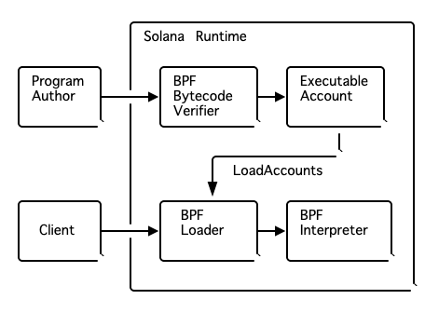
Deploying
Dec 18 2021
Source: https://docs.solana.com/developing/on-chain-programs/deploying
"As shown in the diagram above, a program author creates a program, compiles it to an ELF shared object containing BPF bytecode, and uploads it to the Solana cluster with a special deploy transaction. The cluster makes it available to clients via a program ID. The program ID is an address specified when deploying and is used to reference the program in subsequent transactions.
Upon a successful deployment the account that holds the program is marked executable. If the program is marked "final", its account data become permanently immutable. If any changes are required to the finalized program (features, patches, etc...) the new program must be deployed to a new program ID.
If a program is upgradeable, the account that holds the program is marked executable, but it is possible to redeploy a new shared object to the same program ID, provided that the program's upgrade authority signs the transaction."

Slide 40
Escrow

Slide 41
Source Code and Reference
Dec 18 2021
[Program Source]
GitHub - project-serum / anchor escrow https://github.com/project-serum/anchor/tree/master/tests/escrow
[Remarks]
Escrow behavior is based on anchor escrow program. Check escrow.ts and lib.rs files.
My debug program: https://github.com/256hax/solana-anchor-react-minimal-example/tree/main/anchor/escrow
[Reference]
Programming on Solana - An Introduction | Paulx https://paulx.dev/blog/2021/01/14/programming-on-solana-an-introduction/
SolanaのAnchorで実装されたEscrowのコード解説 https://zenn.dev/razokulover/articles/c2338cb83f459b
Program Derived Address日本語で https://efficacious-flat-24a.notion.site/Program-Derived-Address-8537ebca002245639beb531842f87f2c#3f01f8b4ddc04ed4b55fdfc0160b9436
Anchor Example: Escrow Program https://hackmd.io/@ironaddicteddog/anchor_example_escrow

Slide 42
Overview: Rolls and Relations
Dec 18 2021
Token A
Account
User Account (Payer)
Create token
User Token Account (initializerTokenAccountA)
Initializer's token A account.
User Token Account (takerTokenAccountA)
Taker's token B account
Token
Initializer want to send Token A (500) for Taker
Relation
Action
Payer
Escrow
Token A
PDA Account (pda)
Authorize transaction instead authorizer.
State Account
(escrowAccount)
Management for state of escrow (Initializer's transaction)
Authority
Authority
Authority
User Account (provider.wallet)
Escrow and token owner account
Assigned Program
Token B
Program Account
(escrow)
Escrow program.
CPI (Cross Program Invocations)
Upgrade Authority
PDA Source
Authority
Authority
Mint Authority
Token B
User Account (mintAuthority)
Mint token
User Token Account (initializerTokenAccountB)
Initializer's token B account
User Token Account (takerTokenAccountB)
Taker's token B account
Taker want to send Token B (1,000) for Initializer

Slide 43
Step1. Initialize escrow state
Dec 18 2021
Token A
Account
User Account (Payer)
10 SOL (airdrop)
User Token Account (initializerTokenAccountA)
500 token
User Token Account (takerTokenAccountA)
Token
Relation
Action
Create
Escrow
Token A
mint 500
Create
Create
User Account (provider.wallet)
Token B
mint 1,000
Create
Create
Mint
Token B
User Account (mintAuthority)
User Token Account (initializerTokenAccountB)
User Token Account (takerTokenAccountB)
1,000 token

Slide 44
Step2. Initialize escrow
Dec 18 2021
Token A
Account
User Account (Payer)
User Token Account (initializerTokenAccountA)
500 token
User Token Account (takerTokenAccountA)
Token
Relation
Action
Payer
Escrow
Token A
PDA Account (pda)
State Account
(escrowAccount)
initializer/taker Account
initializer/taker Amount
...
Authority
Authority
Authority
Create
User Account (provider.wallet)
Create PDA from Seed
(findProgramAddress)
Assigned Program
Token B
Program Account
(escrow)
CPI (Cross Program Invocations)
Deploy
Authority
Authority
[Set Authority to PDA]
current authority: provider.wallet
new authority: pda
Mint Authority
Token B
User Account (mintAuthority)
User Token Account (initializerTokenAccountB)
User Token Account (takerTokenAccountB)
1,000 token

Slide 45
Step3-1. Exchange escrow – Transfer Token
Dec 18 2021
Token A
Account
User Account (Payer)
User Token Account (initializerTokenAccountA)
0 token
User Token Account (takerTokenAccountA)
500 token
Token
Transfer 500 (Authority: PDA)
Relation
Action
Payer
Escrow
Token A
PDA Account (pda)
State Account
(escrowAccount)
initializer/taker Account
initializer/taker Amount
...
Authorize
Authority
Authority
User Account (provider.wallet)
Read and Verify Data
Token B
PDA Source
Program Account
(escrow)
Upgrade Authority
Authorize
Authority
Transfer Instruction
(token::transfer)
Transfer Instruction
(token::transfer)
Mint Authority
Token B
User Account (mintAuthority)
User Token Account (initializerTokenAccountB)
1,000 token
User Token Account (takerTokenAccountB)
0 token
Transfer 1,000 (It doesn't need escrow)

Slide 46
Step3-2. Exchange escrow – Set Authority (Close Escrow)
Dec 18 2021
Token A
Account
User Account (Payer)
User Token Account (initializerTokenAccountA)
0 token
User Token Account (takerTokenAccountA)
500 token
Token
Relation
Action
Payer
Escrow
Token A
PDA Account (pda)
State Account
(escrowAccount)
Authority
Authority
Authority
Authority
User Account (provider.wallet)
Set Authority (close State Account)
new: provider.wallet
Token B
PDA Source
Program Account
(escrow)
Upgrade Authority
Authority
Authority
[Set Authority (close PDA)]
current authority: pda
new authority: provider.wallet
Mint Authority
Token B
User Account (mintAuthority)
User Token Account (initializerTokenAccountB)
1,000 token
User Token Account (takerTokenAccountB)
0 token

Slide 47


Case: List and Buy Escrow by Magic Eden (hypothesis)
Aug 15 2022
Seller
Magic Eden (NFT Marketplace)
Buyer
Transfer List Price (SOL)
Transfer List Price from Buyer to Seller
Program Account
M2mx...
Executable: Yes
Authority: 1BWu... ?
Create
PDA Account for SOL?
Buyer: HXtB...
Mint: bbpj...
Token Account: HGL8...
Price: XXX SOL
Account?
(ex: vault)
HGL8...
Authority: PDA?
Deposit List Price (SOL)
Authorize
Create
User Account (Wallet)
5xud...
Owner: System Program
User Account (Wallet)
HXtB...
Owner: System Program
Set New
Authority
(Owner)
Transfer Instruction
Transfer an NFT from Seller to Buyer
Associated Token Account
(ex: vault)
4doj...
Owner: 5xud...
User Account
(Magic Eden's Bank)
(ex: key of vault)
1BWu...
Owner: System Program
PDA Account for NFT?
Seller: 5xud...
Mint: bbpj...
Token Account: 4doj...
Price: xxx SOL
Associated Token Account
HTH3...
Owner: HXtB...
Write
Authority
(=Owner)
Transfer
Instruction
Transfer NFT
NFT Data
OddKey (NFT Coummunity)
NFT (Token Address)
bbpj...
Owner: Token Program
User Account
(Update Authority)
Metadata
(Arweave)
User Account
(Mint Authority)
Image
(Arweave)
Account
Relation
Action

Slide 48
(Appendix) Anchor - A framework for building Solana programs

Slide 49
Init Account Process Overview
Jul 23 2022
[Frontend]
Test Code
(ts file)
Generate new Keypair
const counter =
anchor.web3.Keypair.generate();
Request data for backend
program.methods
.create()
.accounts({
counter: counter.publickey,
user: program.provider.publickey,
})
.signers([counter])
.rpc()
[Backend]
Program Code
(rs file)
Get data from frontend
pub fn create(ctx: Context<Create>)
-> Result<()> {}
Input struct of context
#[derive(Accounts)]
pub struct Create<'info> {
#[account(init, payer = user, space = 40)]
pub counter: Account<'info Counter>
}
Input struct of accounts
#[account]
pub struct Counter {
}
[Blockchain]
On-chain
Generated new account
Address: counter.publickey
Code Example: https://github.com/coral-xyz/anchor/tree/master/examples/tutorial/basic-2

Slide 50
Requests and Data Flow
Dec 18 2021
basic-1.js
lib.rs
const assert = require("assert");
const anchor = require("@project-serum/anchor");
const { SystemProgram } = anchor.web3;
describe("basic-1", () => {
const provider = anchor.Provider.local();
anchor.setProvider(provider);
it("Creates and initializes an account in a single atomic transaction (simplified)", async () => {
const program = anchor.workspace.Basic1;
const myAccount = anchor.web3.Keypair.generate();
const init_tx = await program.methods.initialize(
new anchor.BN(1234),
)
.accounts({
myAccount: myAccount.publicKey,
user: provider.wallet.publicKey,
systemProgram: SystemProgram.programId,
})
.signers([myAccount])
.rpc()
const account = await program.account.myAccount.fetch(myAccount.publicKey);
assert.ok(account.data.eq(new anchor.BN(1234)));
});
});
use anchor_lang::prelude::*;
declare_id!("Fg6PaFpoGXkYsidMpWTK6W2BeZ7FEfcYkg476zPFsLnS");
#[program]
mod basic_1 {
use super::*;
pub fn initialize(ctx: Context<Initialize>, data: u64) -> Result<()> {
let my_account = &mut ctx.accounts.my_account;
my_account.data = data;
Ok(())
}
}
#[derive(Accounts)]
pub struct Initialize<'info> {
#[account(init, payer = user, space = 8 + 8)]
pub my_account: Account<'info, MyAccount>,
#[account(mut)]
pub user: Signer<'info>,
pub system_program: Program<'info, System>,
}
#[account]
pub struct MyAccount {
pub data: u64,
}
"init" means create account.
(myAccount.publicKey is created account address in this case)
Validation
Created
Account
Source: https://github.com/project-serum/anchor/tree/master/examples/tutorial/basic-1

