Slide 1
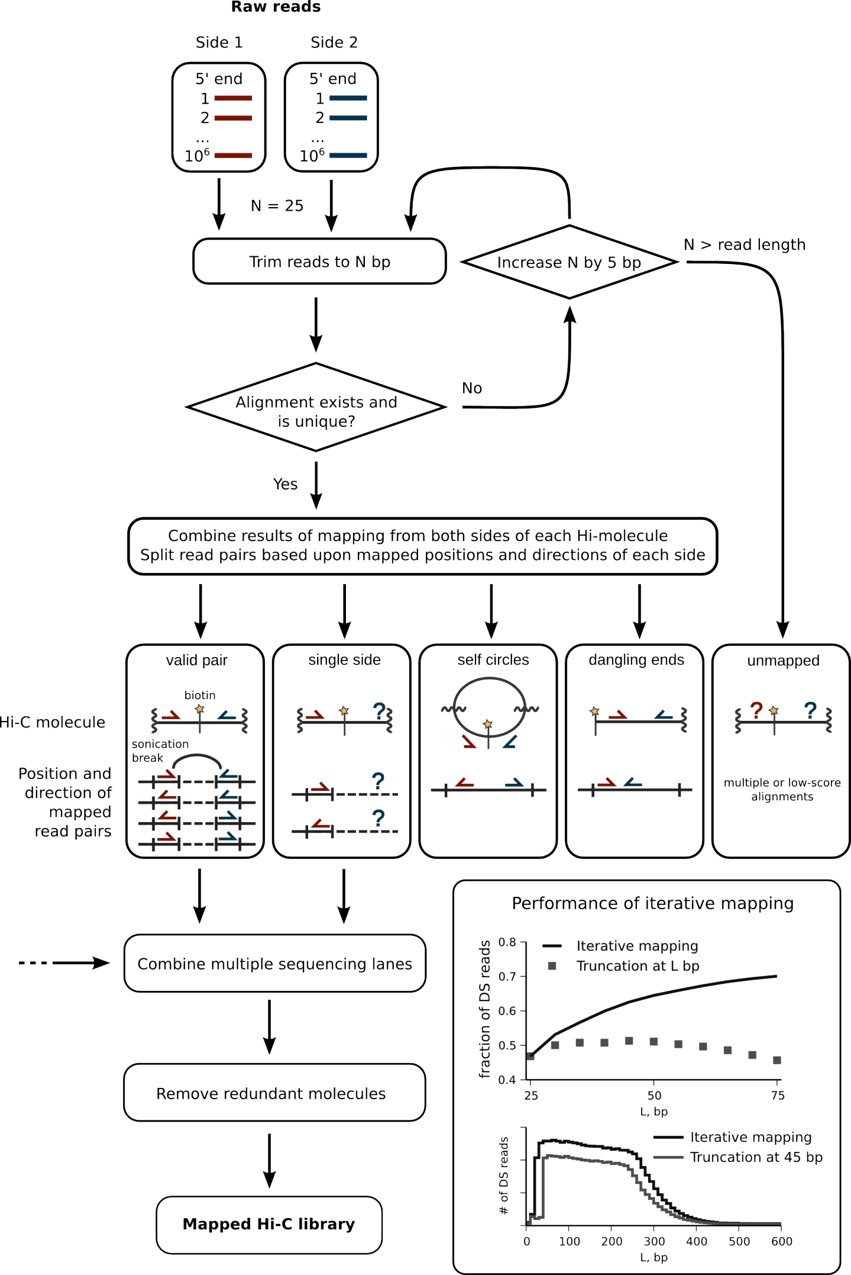

Slide 2
Multithreaded
R1.fastq + R2.fastq
R1.bam + R2.bam
R1.aln + R2.aln
Global Alignement
R1.bam + R2.bam
R1.aln + R2.aln
Local Alignement
R1.aln + R2.aln
Merge global and local alignments
R1.out + R2.out
Keep uniquely mappedreads
.aln
Combine multiple sequencing lanes
.tsv
.mat
Contact map

Slide 3
Multithreaded
R1.fastq + R2.fastq
R1.bam + R2.bam
Global Alignement
R1.bam + R2.bam
Local Alignement
.bam
Merge global and local alignments
Combine R1 and R2 alignements
Keep uniquely mappedreads
.bam
Combine multiple sequencing lanes
.bam
Remove duplicates
.mat
Contact map

