Slide 1
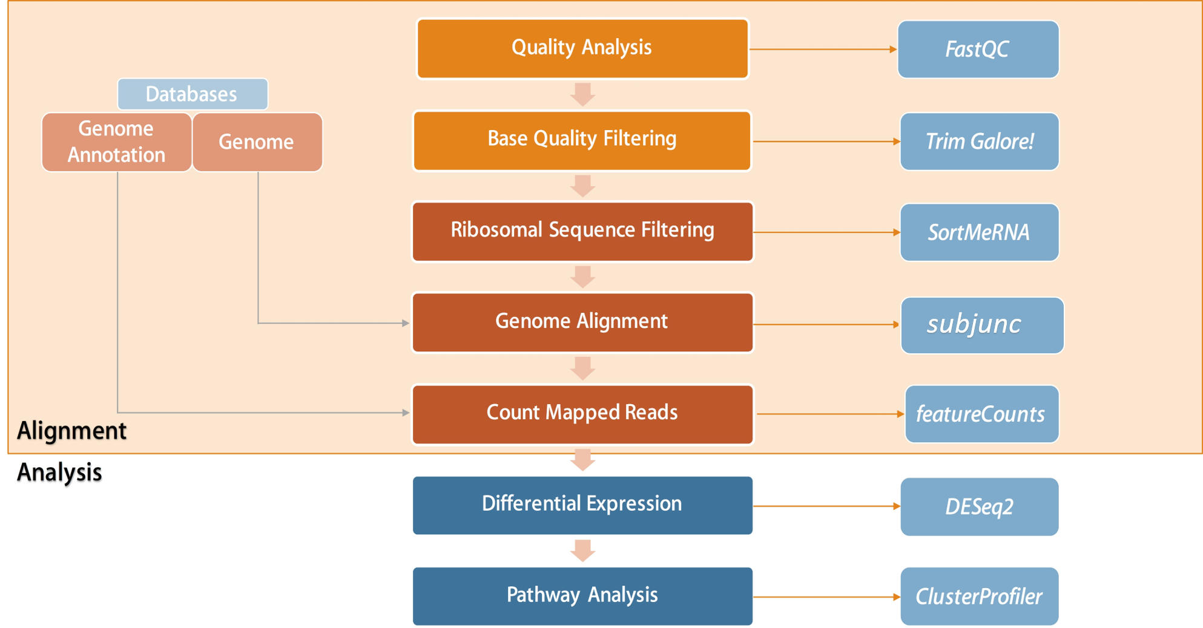
salmon
Free Alignment
Analysis

