Slide 1
Data formats and Quality Control
Sandra Cortijo, SLCU (sandra.cortijo@slcu.cam.ac.uk)
Denis Seyres, NHSBT (ds777@medschl.cam.ac.uk)

Slide 2
HTS analysis workflow
Biological Sample
Prepare library, sequence
FASTQ
Align short reads to genome
BAM
Call variants, differential expression, …
VCF, BED, …
Downstream analysis

Slide 3
From the sequencer to you
Sequencing is usually done by core facilities
Each sequencing run will generate millions of short (~50 to 150 bp) reads
+ read quality score for each base
They often perform initial processing
Adaptor trimming
Basic quality control
Demultiplexing
You will (usually) receive a FASTQ file

Slide 4
FASTQ Files
FASTQ = FASTA + Quality
What is FASTA?

Slide 5
FASTA Format
>CHROMOSOME_1
GATTTGGGGTTCAAAGCAGTATCGATCAAATAGTAAATCCATTTGTTC
AACTCACAGTTTGGTTCAAAGCAGTATCGATCAAATAGTAAATCCATT
…
>CHROMOSOME_2
TCACAGTTTGGTTCAAAGCAGTATCGATCATATCGATCAAATAGTAAA
…
Format for raw DNA sequences
For each DNA sequence:
> NAME
Nucleotides, with line breaks every ~60 bp

Slide 6
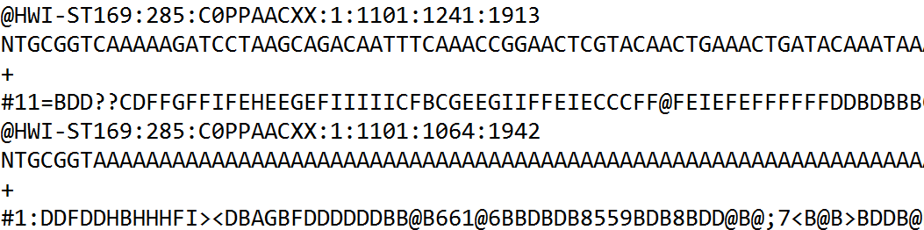
FASTQ format
Format for DNA sequencing reads
For each read:
@ Read ID ; In FASTA files, it was starting with >
Nucleotide sequence of the read
+ (could be followed by read ID again)

Slide 7
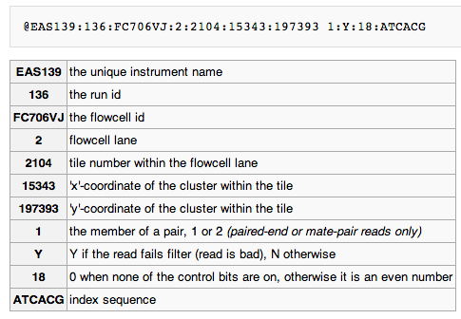
Illumina sequence identifiers

Slide 8
FASTQ format
Format for DNA sequencing reads
For each read:
@ Read ID ; In FASTA files, it was starting with >
Nucleotide sequence of the read
+ (could be followed by read ID again)
Quality score for each nucleotide of the read ; same size of the 2nd line

Slide 9
Quality Scores
P = probability that the base call is wrong
p = 0.1 → Q = 10
p = 0.01 → Q = 20
P = 0.001 → Q = 30
Encoding:
Sanger/Phred format can encode a quality score from 0 to 93 using ASCII 33 to 126:
!"#$%&'()*+,-./0123456789:;<=>?@ABCDEFGHIJKLMNOPQRSTUVWXYZ[\]^_`abcdefghijklmnopqrstuvwxyz{|}~
| |
33 126

Slide 10
Quality Score Encoding
ASCII Code
Quality Score
!"#$%&'()*+,-./0123456789:;<=>?@ABCDEFGHI
| | | |
33 59 64 73
0........................26...31.......40
Each character has an associated ASCII Code
ASCII Code − Offset = Quality Score
Usual Sanger Encoding is Phred + 33
Lowest: “!” = ASCII 33 = Quality 0
Highest: “I” = ASCII 73 = Quality 40

Slide 11
Quality Encoding Example
!"#$%&'()*+,-./0123456789:;<=>?@ABCDEFGHI
| | | | | | | | |
33 40 45 50 55 59 64 70 73
0......7........17.......26...31.......40

Slide 12
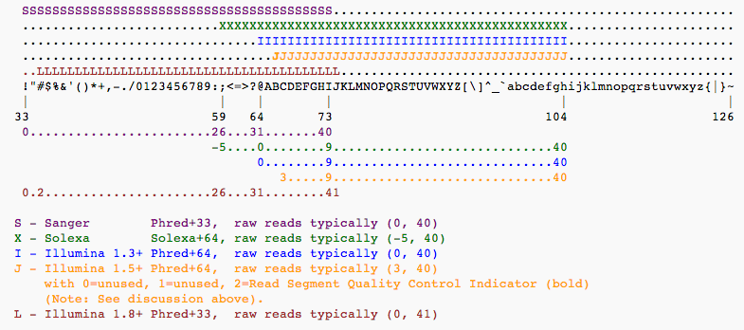
Different Quality Encodings
Beware of different versions! (especially for old data)

Slide 13
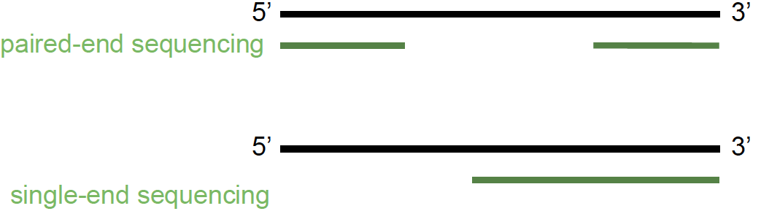
Single end vs paired-end
Sequence both the 5' and 3' end of a fragment
Will result in two FASTQ files for a single run
file1_{n} ↔︎ file2_{n}

Slide 14
Sample barcoding and de-multiplexing
Barcoding
De-multiplexing
Barcode 1
Sample 1
# Read 1
ATTAGACCTAAGCA
# Read 2
GAGCAACGACTAC
# Read 3
ATTAGGCCATACAT
# Read 4
CCATAGGCTGACTA
...
Barcode 2
+
Sample 2
Barcode 3
Sample 3
Notes:
Another variation in the library preparation step…
Demultiplexing is an extra step in the filtering process
Whether you do it or not will depend on your data
The idea behing this is that nowadays you can obtain lots and lots of reads from a single sequencing lane.
That’s very useful for species with big genomes, like human, but you might think of it as a waste for species like yeast
To take more advantage of the money invested in sequencing, people have come up with this library preparation step
Which consists on preparing let’s say 3 different samples and marking them with a known barcode
And then mixing everything together and sequencing it on the same lane
This is called multiplexing or barcoding
(For example, it allows to sequence 12 yeast samples at 30X coverage in a single lane of an Illumina GenomeAnalyzer GAIIx)
Of course, this comes at a cost: separating the reads afterwards (de-mutiplexing)
The difficult bit comes due to sequencing errors introduced on those barcodes
But luckily enough there are tools for that.

Slide 15
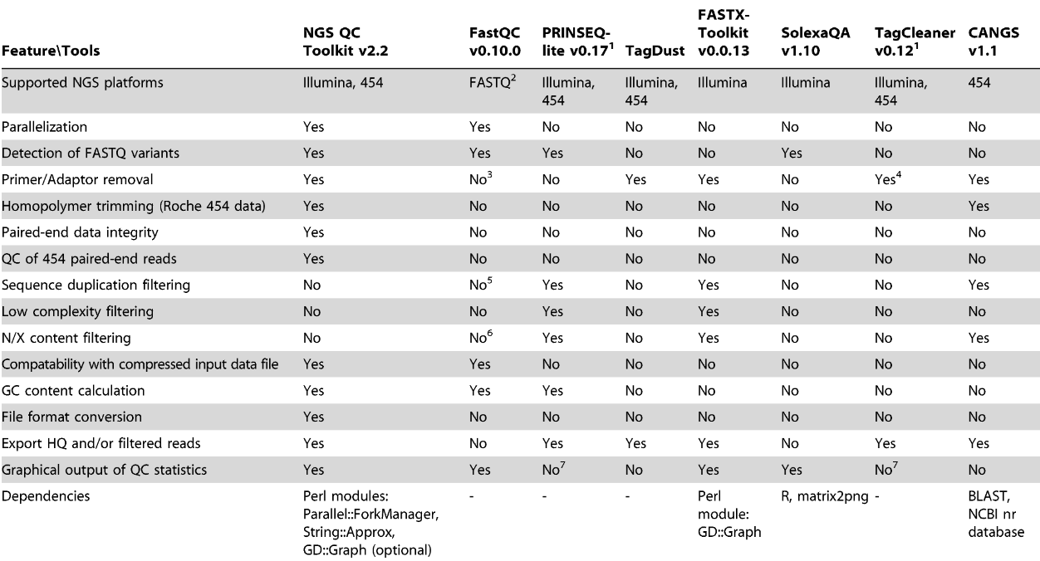
Comparison of various features across available QC tools
Notes:
15

Slide 16
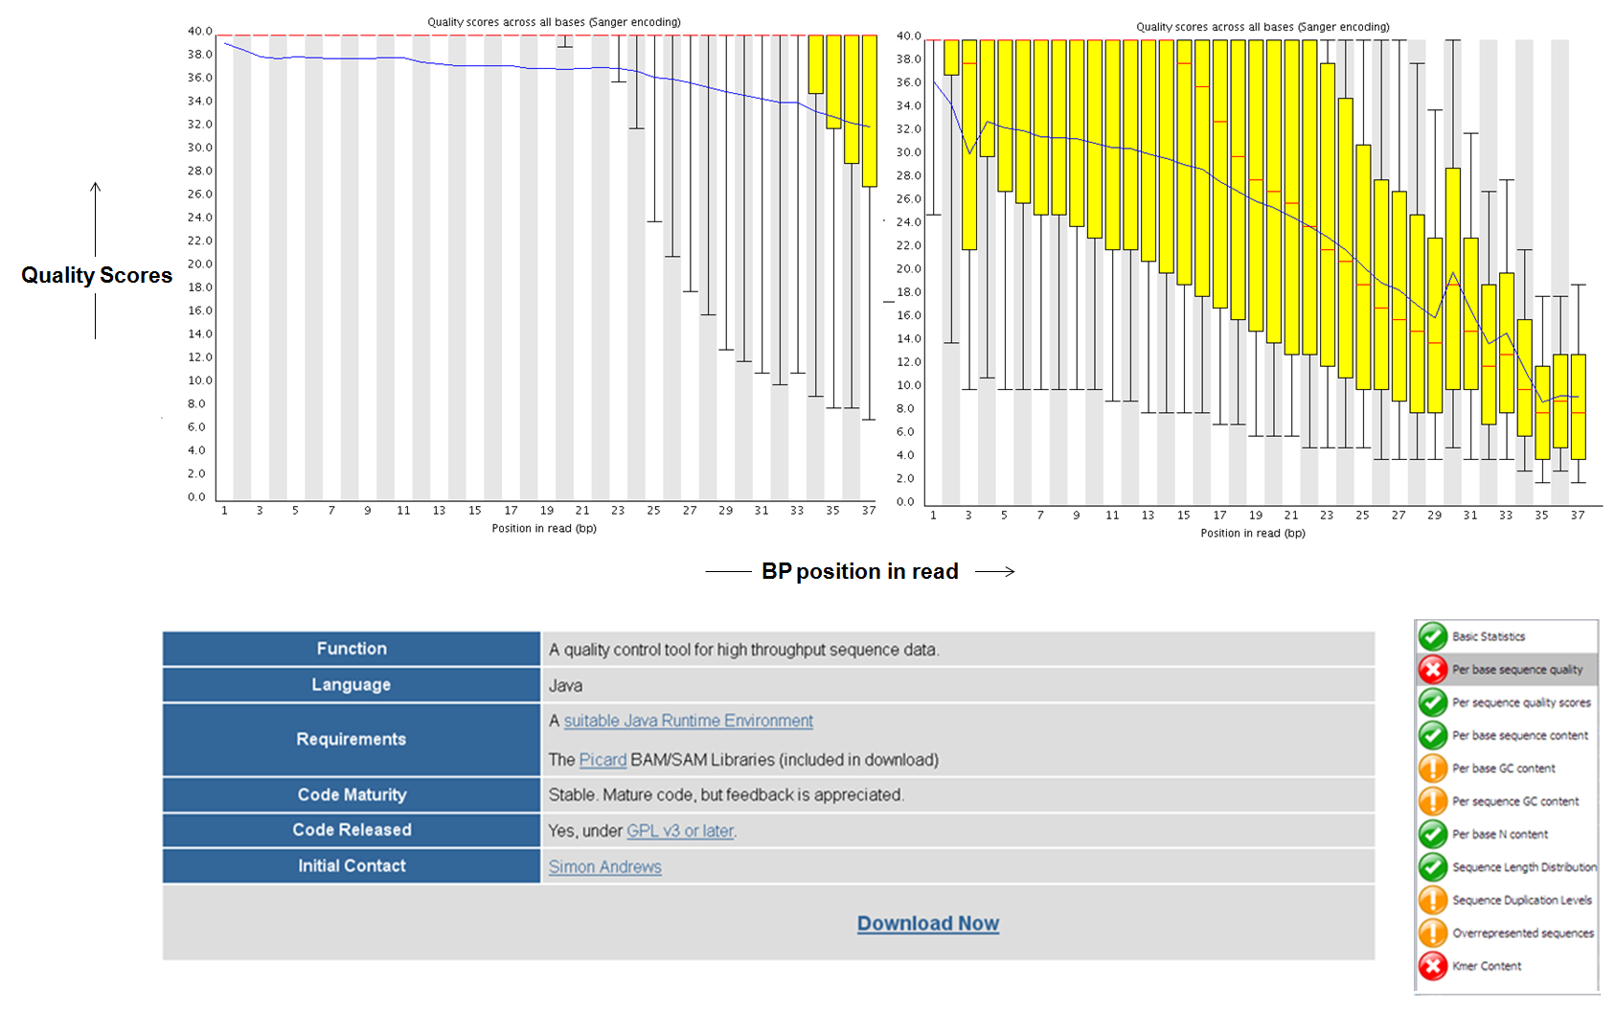
FastQC: Per base sequence quality
FastQC: http://www.bioinformatics.babraham.ac.uk/projects/fastqc/
Notes:
16

Slide 17
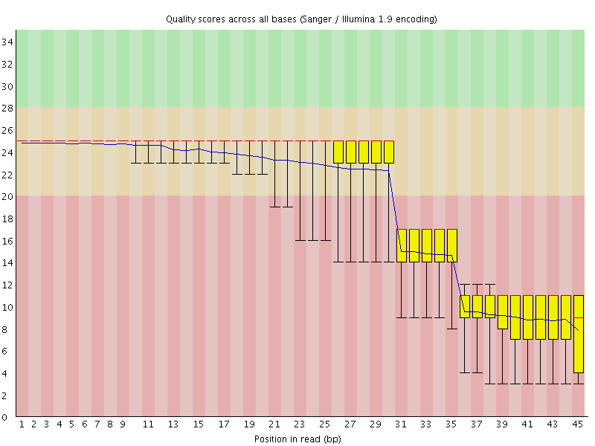
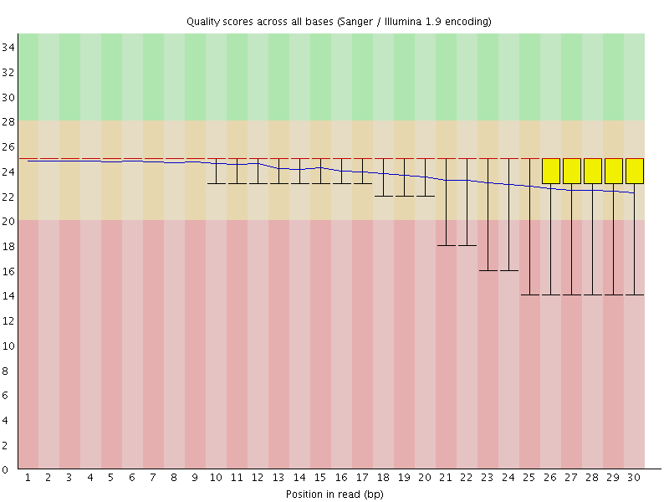
Filtering example
Before
After
Notes:
The goal … to optimise the mapping step

Slide 18
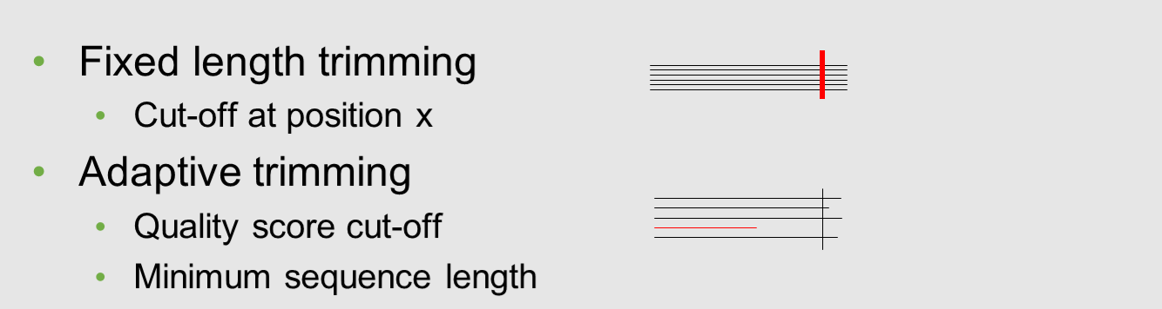
Quality trimming
Notes:
18

Slide 19
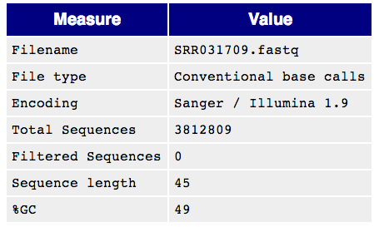
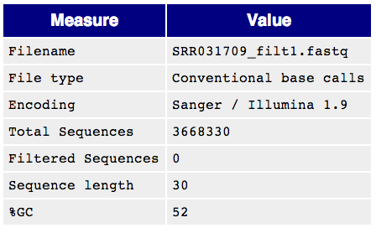

Filtering comes at a price
Notes:
Sometimes mapping tools + downstream analysis tools take things into account
No general recipe, depends pretty much on our data + the tools we plan to use
It’ll depend pretty much on the analysis we have planned

Slide 20
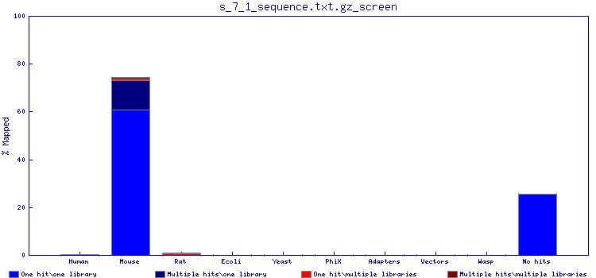
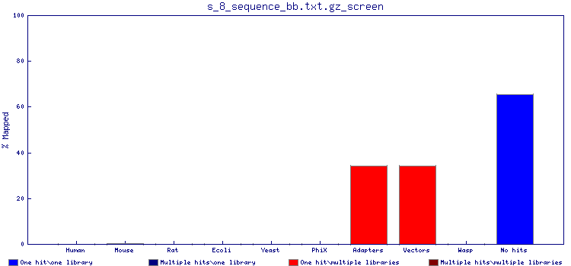
FastqScreen: contamination
Notes:
A very nice tool to check for contamination is FastqScreen
We will not use it in the practical because it takes too long to execute
The idea is that you take your input fastq file and you map it to several genomes: mouse, human, vectors, E.coli, yeast…
This way you can confirm that the data you got back corresponds to your species, and it doesn’t consist only of adapters and vectors as here.

Slide 21
Filtering
How?
Fastx (http://hannonlab.cshl.edu/fastx_toolkit/)
PRINSEQ (http://prinseq.sourceforge.net/)
Tally and Reaper:
http://www.ebi.ac.uk/~stijn/reaper/tally.html
http://www.ebi.ac.uk/~stijn/reaper/reaper.html#recipe
http://www.ebi.ac.uk/~stijn/reaper/src/reaper-12-048/
ShortRead (R) (http://www.bioconductor.org/packages/release/bioc/html/ShortRead.html)
Notes:
About the tools, again I’m providing some listing based on what I use, but many more tools out there

Slide 22
FASTQ Processing – FASTX Toolkit
http://hannonlab.cshl.edu/fastx_toolkit/
Many tools for common operations on FASTQ files:
Conversion
Trimming (remove barcodes)
Clipping (remove adapters)
Quality trimmer (trim off low-quality bases)
Quality filter (remove low-quality reads)

Slide 23
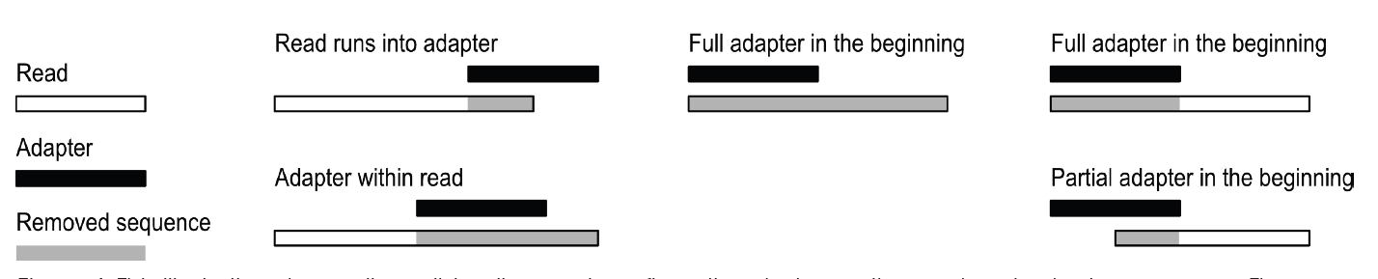
Removal of adapter sequences
Necessary when the read length > molecule sequenced e.g. small RNAs.
Different scenarios requiring adapter removal
Trim the 3’ end
Trim/discard the reads based on the residual minimum read length.
Trim the adapter region but retain reads only with a minimum read-length.
Tools for adapter trimming
fastx_clipper (FastX-Toolkit), PRINSEQ
1
2
3
1
2
3
Notes:
23
Cutadapt : A tool used for removing adapter sequences
Cutadapt supports a variety of file formats produced by second-generation sequencers.
Cutadapt can search for multiple adapters in a single run of the program and will remove the best matching one.
Other tools for adapter trimming
HTSeq, Biostrings, SOAP, Novoalign, Vectorstrip ( EMBOSS), fastx_clipper (FastX-Toolkit)
23

Slide 24
Single end vs paired-end
my_sequence.fastq
Single end sequencing
5’
3’
@HWI-BRUNOP16X_0001:1:1:1466:1018#0/1
AAGGAAGTGCTTGTCTGGCTAACACAGCNAGNCACGTGAC
+
aVfbe`^^^_TTTSSdffffdfffabbZbbfebafbbbbb
SE
my_sequence_1.fastq
Paired end sequencing
@HWI-BRUNOP16X_0001:1:1:1278:989#0/1
NAAATTTCGAATTTCTGTGAAGTAAGCATCTTCTTTGTCAT
+
BJJGGKIINN^^^^^QQNTUQOOTTTRTOTY^^Y^\\^^^\
5’
3’
PE
my_sequence_2.fastq
@HWI-BRUNOP16X_0001:1:1:1278:989#0/2
AACCCACACAGGAGAGCAGCCTTACAGATGCAAATACTGTG
+
]K___fffffggghgeggggggdgggggfgggggegggghh
Notes:
Now it’s important to distinguish between SE and PE data
SE data is generated just as we described
The main difference with PE is that here we are using two different adaptors
And we are sequencing the molecule from both ends (and we know which end is)
This has the main advatage that we can obtain more information without having to sequence longer reads
For RNA-seq though PE data provides more information: splicing events
Also, for DNA-seq, SVs
In terms of output, different fastq files
Read names
Although the pipeline is the same, we’ll probably have to hange some options in the software we execute, as we’ll see

Slide 25
Important: PE files
my_sequence_1.fastq
my_sequence_2.fastq
@HWI-BRUNOP16X_0001:1:1:1278:989#0/1
NAAATTTCGAATTTCTGTGAAGTAAGCATCTTCTTTGTCAT
+
BJJGGKIINN^^^^^QQNTUQOOTTTRTOTY^^Y^\\^^^\
@HWI-BRUNOP16X_0001:1:1:1278:989#0/2
AACCCACACAGGAGAGCAGCCTTACAGATGCAAATACTGTG
+
]K___fffffggghgeggggggdgggggfgggggegggghh
filtering
filtering
mapping
Notes:
Reads need to be paired
Perform filtering steps which are consistent with that
Or use trim Galore for trimming

Slide 26
Important: PE files
my_sequence_1.fastq
my_sequence_2.fastq
@HWI-BRUNOP16X_0001:1:1:1278:989#0/1
NAAATTTCGAATTTCTGTGAAGTAAGCATCTTCTTTGTCAT
+
BJJGGKIINN^^^^^QQNTUQOOTTTRTOTY^^Y^\\^^^\
@HWI-BRUNOP16X_0001:1:1:1278:989#0/2
AACCCACACAGGAGAGCAGCCTTACAGATGCAAATACTGTG
+
]K___fffffggghgeggggggdgggggfgggggegggghh
filtering
filtering
mapping
How?
Trim Galore! (http://www.bioinformatics.babraham.ac.uk/projects/trim_galore/)
Notes:
Reads need to be paired
Perform filtering steps which are consistent with that
Or use trim Galore for trimming

Slide 27
Common sequence artefacts in NGS data
Read errors
Base calling errors
Small insertions and deletions
Poor quality reads
Primer / adapter contamination

Slide 28
Conclusions
Read errors
Base calling errors
Small insertions and deletions
Poor quality reads
Primer / adapter contamination
Quality control of sequencing data is essential for downstream analysis.
A range of QC tools are available to remove noise
Decide which data can be corrected and discard the rest.
Notes:
28
De novo assembly.
Re-sequencing which involves alignment to reference genomes.
Expression analysis for RNA-seq , small RNA data.
Variation detection including SNP and indel detection.
Sequencing error removal.
Primer/adapter trimming.
Base level trimming based on quality values.
28

Slide 29
(Short) Read Alignment
GOAL: From FASTQ format to meaningful alignment (SAM/BAM)
@Read_id_1 CTGATGTGCCGCCTCACTTCGGTGGT + @@@DDDDDH8<BAHG@BHGIHIII>( @Read_id_2 TGATGTGCCGCCTCACTACGGTGGTG + FHHHHHJIJIJIJIIIJJIIJGIGII @Read_id_3 GATGTGCCGCCTCACTTCGGTGGTGA + @@@FFFFFFFHHHJIIEHIJIGGGGG

Slide 30

(Short) Read Alignment
But align reads to what?
We, of course, need a reference sequence

Slide 31
(Short) Read Alignment
GOAL: Given a reference sequence and a set of short reads, align each read to the reference sequence
GCTGATGTGCCGCCTCACTTCGGTGG
CTGATGTGCCGCCTCACTTCGGTGGT
TGATGTGCCGCCTCACTACGGTGGTG
GATGTGCCGCCTCACTTCGGTGGTGA
GCTGATGTGCCGCCTCACTACGGTG
GCTGATGTGCCGCCTCACTACGGTG
Reference sequence
Short reads
{

Slide 32
Keep in mind
Reference sequence availability
No -> de novo assembly
Yes -> use available reference sequences
Allow for mismatches when aligning reads to a reference sequence
Number of expected mismatches (1~2 per 36bp)
Sequencing machines are not infallible
Species polymorphism
Distinguish between SNPs and sequencing errors
Different types of sequencing errors across multiple platforms
Insertion and deletion errors at homopolymers (454)
Unpredictable distributions of low quality calls (Illumina)

Slide 33
Alignment for different HTS assays
Whole genome sequencing
usually no reference sequence – de novo assembly
ChIP-seq
align to reference genome
RNA-seq
reference sequence can either be genome or transcriptome

Slide 34
Indexed genome
The human genome contains over 3 billion base pairs
Window-based search across the genome would take long
To perform read alignment, aligners build a special index into the reference genome.
Building such an index occurs once and may take hours for a large genome sequence, but allows sequences to be mapped quickly.

Slide 35
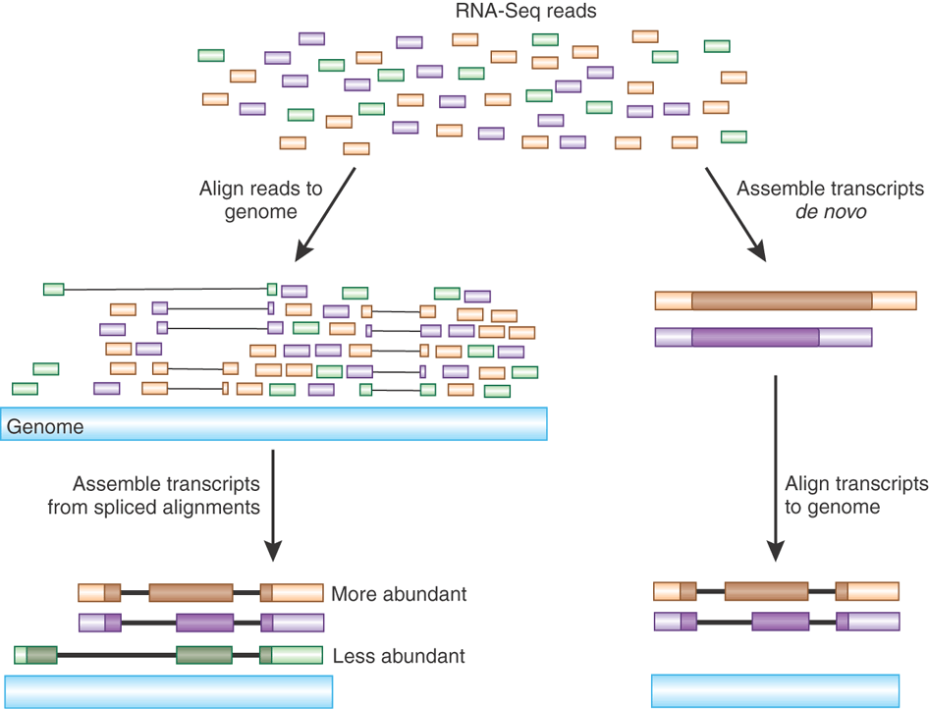
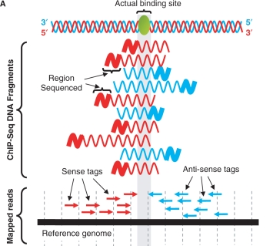
To go spliced or not
Picture adjusted from: Haas BJ et al, Nature Biotechnology (2010)
Picture adjusted from: Jothi R et al, Nucl. Acids Res. (2008)

Slide 36
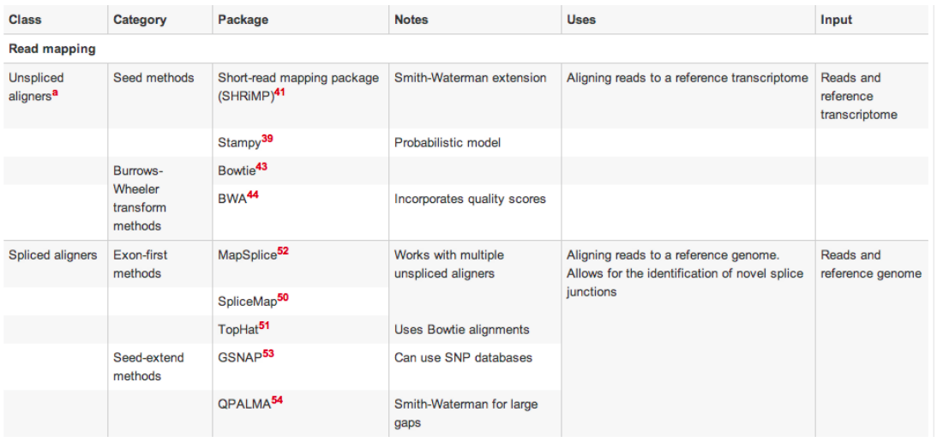
Short read aligners

Slide 37
Reads can map in multiple locations
>CHROMOSOME_1
GATTTGGGGTTCAAAGCAGTATCGATCAAATAGTAAATCCATTTGTTCAACTCACATTAAATAGTCGATCAAATAGTTGGTTCAAAGCAGTCCATT
TTCAAAGC
Some parts of the genome will not be unique:
Common, repeated motifs (proteins domains)
Repeat regions
This can not always be resolved

Slide 38
The SAM format
Well defined specifications for SAM/BAM
Advanced interacting programs
Samtools – by Sanger (http://samtools.sourceforge.net)
Command-linetool
Packages a number of utilities to access the information stored in SAM/BAM file
Picard – By Broad Institute (http://picard.sourceforge.net)
Command-line tool, required Java1.6
Designed to run in 2GB of JVM( Xmx2g is recommended)
MarkDuplicates, CollectAlignmentSummaryMetrics, SamToFastq
More advanced options than Samtools, Running time consuming
Bio-SamTool (http://search.cpan.org/~lds/Bio-SamTools/)

Slide 39
The SAM format
SAM = Sequence Alignment/Map (Li et al., 2009)
De facto standard alignment format
used in 1000 Genomes project
Simple tab-separated format
One alignment per line
Can also be used to store unmapped reads (instead of FASTQ)

Slide 40
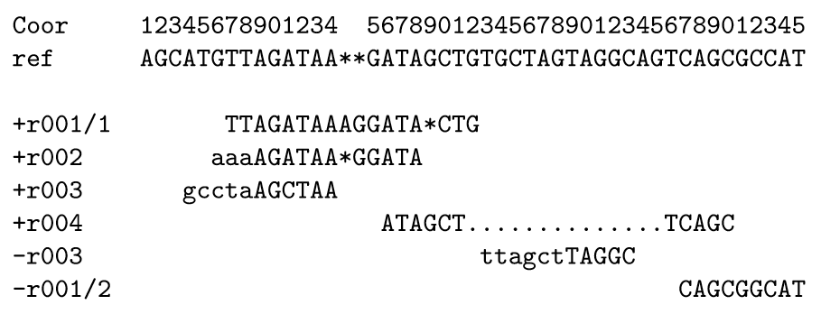
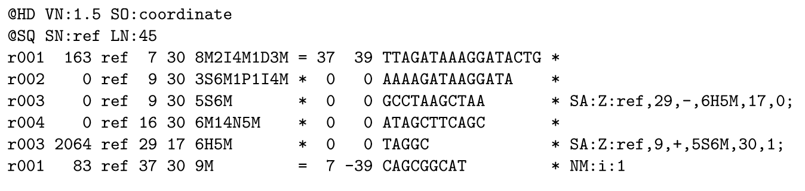
SAM Example
Alignment
SAM Columns
SAM Representation

Slide 41
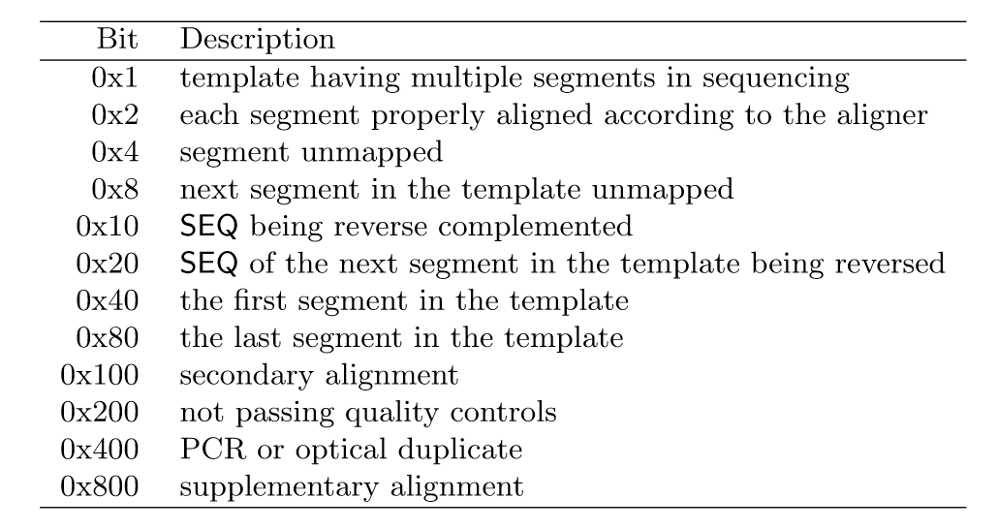
SAM Flags
Base 10
1
2
4
8
16
32
64
128
256
512
1024
2048
E.g. reverse + secondary alignment = 16 + 256 = 272

Slide 42
SAM/BAM tools examples
Convert SAM to BAM format
samtools view -bS aln.sam > aln.bam
Sort BAM file according to position on reference sequence
samtools sort aln.bam aln_sorted.bam
Index BAM file (needed for visualising the alignment)
samtools index aln_sorted.bam aln_sorted.bai
Extract the header information from a BAM file
samtools view –h aln_sorted.bam > aln.sam
Generate a FASTQ file from a BAM file
bam2fastq -o aligned.fastq --no-unaligned aln.bam

Slide 43
Alignment challenges
Gold standard aligner?
Sorry.. no
benchmarking of spliced aligners by the RGASP project (http://www.gencodegenes.org/rgasp/)
Aligners need to be fast and accurate
Trade-off between speed and sensitivity
Running time with the growing sequence capacity
Illumina HiSeq produces at the moment 200m reads

Slide 44
Paired-end sequencing
Align both FASTQ files of a sample (reads_1.fast and reads_2.fastq) together
Use paired-end to improve mapping:
Reads must match within a certain distance of each other
Reads must match in a certain order àresolve multi-mapping problems

