Slide 1
DETECTING AND ANALYZING OPEN CHROMATIN REGIONS
Sankari Nagarajan, (Sankari.Nagarajan@cruk.cam.ac.uk)

Slide 2
Chromatin accessibility
1

Slide 3
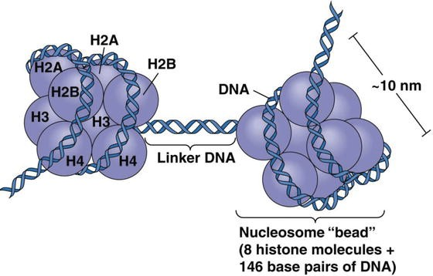
Chromatin accessibility
1
Nucleosome - Spiral-shaped region in DNA consisting of 147bp tightly wrapped around a core octamer of histones.
But ~200 bps of DNA in total are associated with the nucleosome.
Not static – can slide on the genome and modify DNA exposure
Linker DNA – Nucleosome-free regions (NFRs) or accessible chromatin
From Caputi et al. , "Neuroblastoma - Current State and Recent Updates” October 25, 2017 Chapter 7

Slide 4
Why chromatin accessibility matters?
2
Transcriptionally active chromatin is more “open”
Direct assays show that it is more accessible to DNases.
More accessible to components of the transcriptional apparatus:
Transcription factors
Histone modifiers
Chromatin proteins
□ …

Slide 5
Methods to capture accessible chromatin
3
DNase-seq (DNase I hypersensitive sites Sequencing) uses the sensitivity of accessible regions in the genome to the DNase I
FAIRE-seq (Formaldehyde-Assisted Isolation of Regulatory Elements sequencing) uses the chemical properties of protein-bound DNA in a two- phase separation method
ATAC-seq (Assay for Transposable Accessible Chromatin sequencing) uses the Tn5 transposase to integrate (synthetic) transposons into accessible regions of the genome
MNase-seq (Micrococcal Nuclease sequencing) uses the micrococcal nuclease enzyme to identify nucleosome positioning throughout the genome

Slide 6
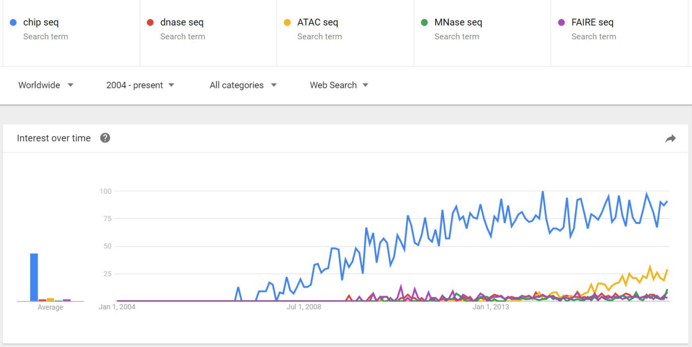
Popularity of the methods
4
From https://bioinformatics.cancer.gov/sites/default/files/course_material/LobanovBTEP2017.pdf

Slide 7
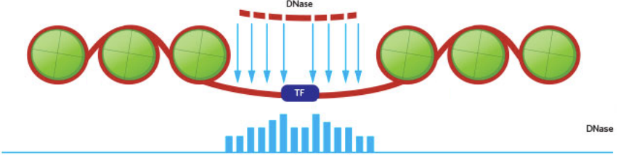
DNAse-seq
5
DNase-seq has historically been a valuable tool for identifying all different types of regulatory elements, including promoters, enhancers, silencers, insulators and locus control regions.
DNase-seq is better established than any of the other chromatin accessibility methods. It was applied to a wide range of cell types and species, including plants.
Its cutting bias is better understood.
DNase-seq could be used for analysis of protected regions of the genome (DNase footprinting)
Modified from: www.the-scientist.com

Slide 8
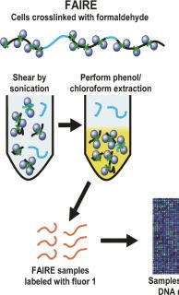
FAIRE-seq
6
Antibody and enzyme independency.
In contrast to DNase-seq, the FAIRE-seq protocol doesn't require the permeabilization of cells or isolation of nuclei, and can analyze any cell types
Analysis. Extensive amount of computational processing and analysis is required for comprehensive interpretation of genome-wide results.
Absence of transcription factor footprinting. Low signal-to-noise ratio.
Fixation variation among tissues.
Adapted from Giresi et al., Genome Res. 2007

Slide 9
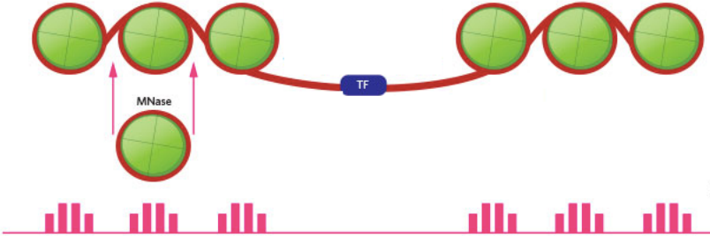
MNase-seq
7
MNase works by cutting both exposed DNA strands of the genome; the DNA associated with nucleosomes is recovered and sequenced. Higher concentration of enzyme leads to a majority of mono-nucleosomes.
Conceptually, reverse of DNA-seq and ATAC-seq. So it indirectly identifies open-chromatin regions of the genome.
Enzymes used since 40 years!
Modified from: www.the-scientist.com

Slide 10
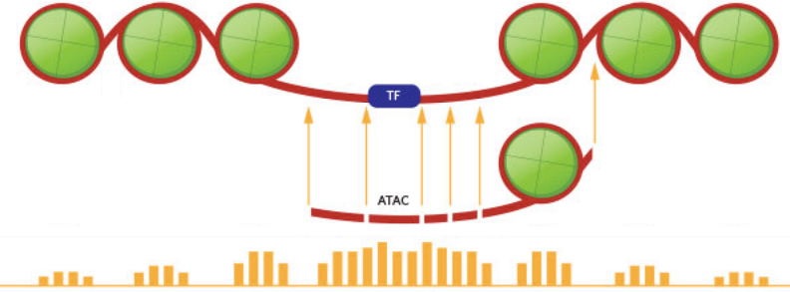
ATAC-seq
8
ATAC-seq simultaneously cuts and ligates sequencing adapters preferentially in nucleosomes- free regions using the enzyme Tn5 transposase. The DNA bits captured between the adapters are then amplified and sequenced.
50,000 cells are sufficient for this technique, as opposed to others like MNase-seq or DNase- seq that require at least 1,000-fold more material.
Modified from: www.the-scientist.com

Slide 11
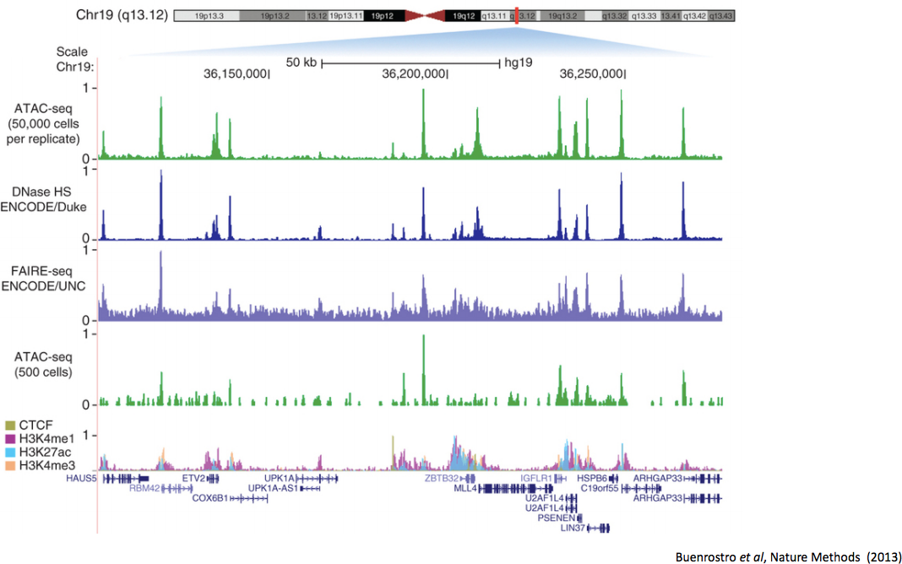
ATAC-seq
9

Slide 12
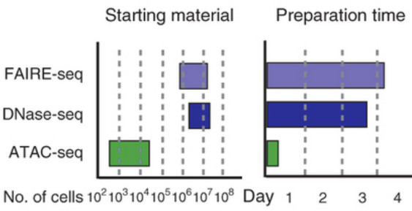
ATAC-seq
10
Low requirements on the amount of the biological sample. Speed: The whole protocol requires 3 hours in total.
High signal-to-noise ratio
Modified from: www.the-scientist.com

Slide 13
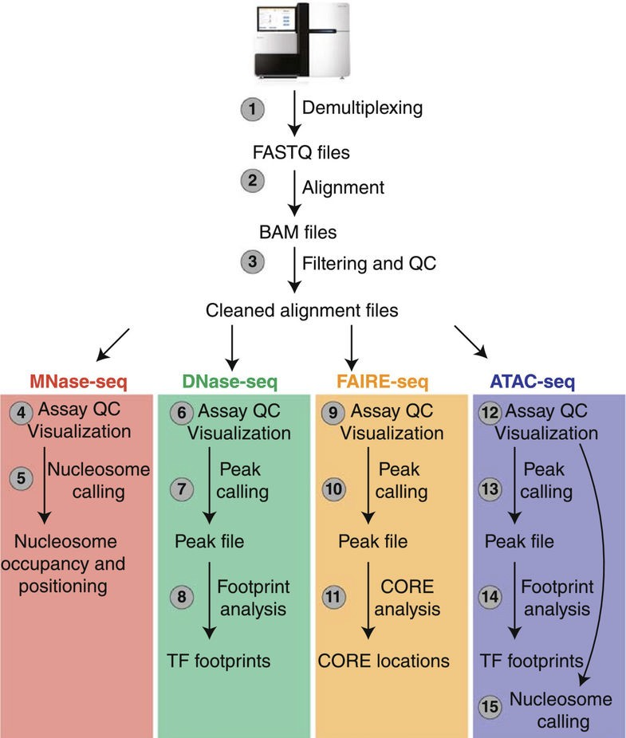
ChIP-seq-based workflows
11
Adapted from Tsompana and Buck, Epigenetics & Chromatin 2014

Slide 14
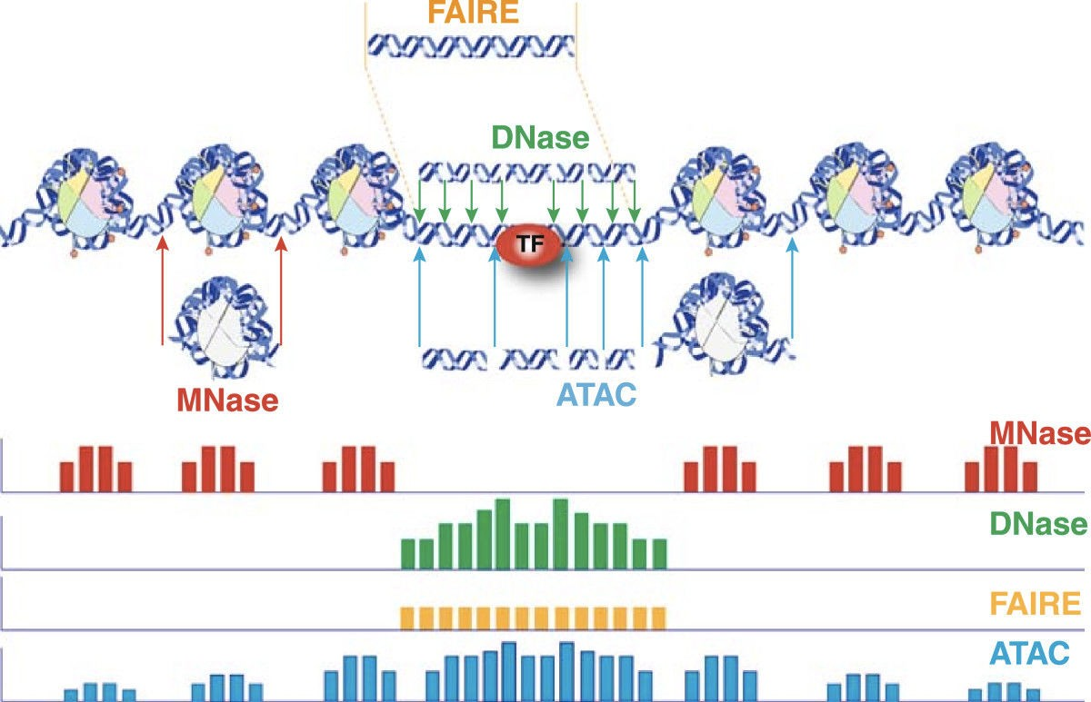
Methods overview
12
From Tsompana and Buck, Epigenetics & Chromatin 2014

Slide 15
ATAC-seq data processing
2

Slide 16
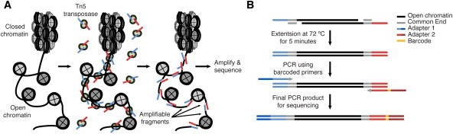
Experimental procedure and design
13
From Buenrostro et al. Curr Protoc Mol Biol. 2015
Replicates
To begin with, two replicates per experimental group are sufficient.
Controls
Not typically run, but it would be similar ChIP control (input). Useful to help define regions of the genome that are more challenging to sequence or to align reads unambiguously.
PCR amplification
As for ChIP-seq, as few PCR cycles as possible
Sequencing depth
In human, it is recommended to have 40-50 million mapped reads per sample. For transcription factor foot-printing >200M mapped reads is recommended (Neph et al., 2012)
Sequencing mode
Paired-end highly recommended but single-end works also well (with limitations!)

Slide 17
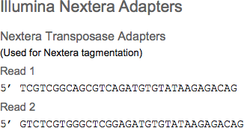
Read processing
14
ATAC-seq library preparation generally uses the Illumina Nextera library prep kit.
Read trimming needs to be perform according to these adapters which appear clearly over- represented in FastQC step.
Read mapping to reference genome does not require particular options. It can be done with all tools available for ChIP-seq (Bowtie, BWA…).
ATAC-seq analysis requires removal of PCR duplicates reads, as for ChIP-seq.

Slide 18
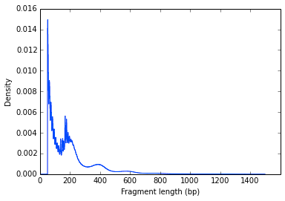
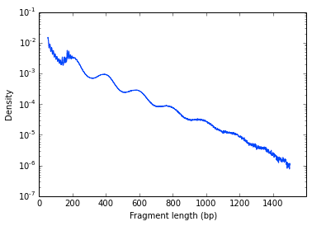
Quality control
15
Fragment size density of the libraries
Regular scale Log scale
Sharp peak at <100 bp region (open chromatin), a peak at ~200bp region (mono-nucleosome), and other larger peaks (multi-nucleosomes)
Clear nucleosome phasing pattern indicates a good quality of the experiment

Slide 19

ATAC-seq data analysis
3
Peak-calling
Nucleosome positionning

Slide 20
Peak calling
16
ATAC-seq techniques doesn’t provide properly speaking an ‘input’ as for ChIP-seq.
Peak callers like MACS2, which perform best when they work with an input file, may encounter some difficulties with ATAC-seq data.
Otherwise, MACS2 is the most used tool in ATAC-seq analysis. Playing with parameters like
--shift and --extsize with --nomodel can provide more narrow peaks that fits best inter- nucleosomal regions.
Other methods (Fseq, ZINBA) analyze density variation of the reads rather than trying to perform a comparison to input. These tools provide in general broad regions.
Best practices are to call peaks with different tools and compare.
This ‘naive’ peak calling could be followed by a more accurate, refined, nucleosome-free regions identification based on nucleosome positioning analysis.

Slide 21
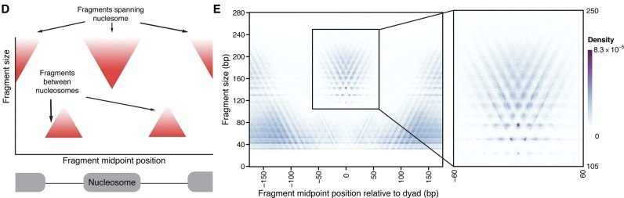
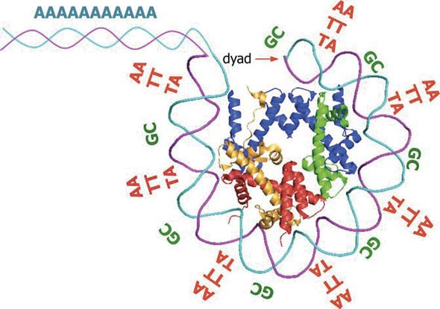
Nucleosome positioning – V plots
17
V-plots demonstrate structured ATAC-seq signal around nucleosomes. It plots the density of fragment sizes versus fragment center locations relative to a genomic feature of interest (in this case, nucleosome dyads)
From Liu et al. , The Yeast Role in Medical Applications, Chapter 6
January 17, 2018
Adapted from Schep et al., Genome Res. 2015
The apex of the “V” represents the smallest possible fragment that spans the DNA protected by a nucleosome (117bp). The most frequent fragment size is ~143bp.
“Short ATAC-seq fragments are concentrated at nucleosome-free regions (NFR), whereas long fragments are enriched at nucleosome-associated DNA” (Buenrostro et al. 2013)

Slide 22
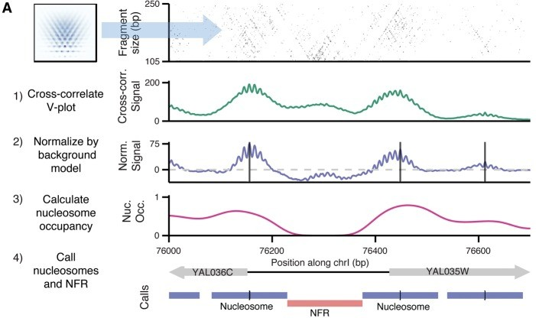
Nucleosome positioning
18
From Schep et al., Genome Res. 2015

Slide 23
Hands-on!
19
Open ATAC-seq analysis tutorial and follow carefully each steps
□ ~/Desktop/ATAC-seq/ATAC-seq-Practical.pdf

