Slide 1
Introduction Chip-seq and atac-seq training, October 2019
Sandra Cortijo, SLCU (sandra.cortijo@slcu.cam.ac.uk) Sergio Martinez Cuesta (Sergio.MartinezCuesta@cruk.cam.ac.uk) Sankari Nagarajan (Sankari.Nagarajan@cruk.cam.ac.uk) Ashley Sawle ‎(Ashley.Sawle@cruk.cam.ac.uk)

Slide 2
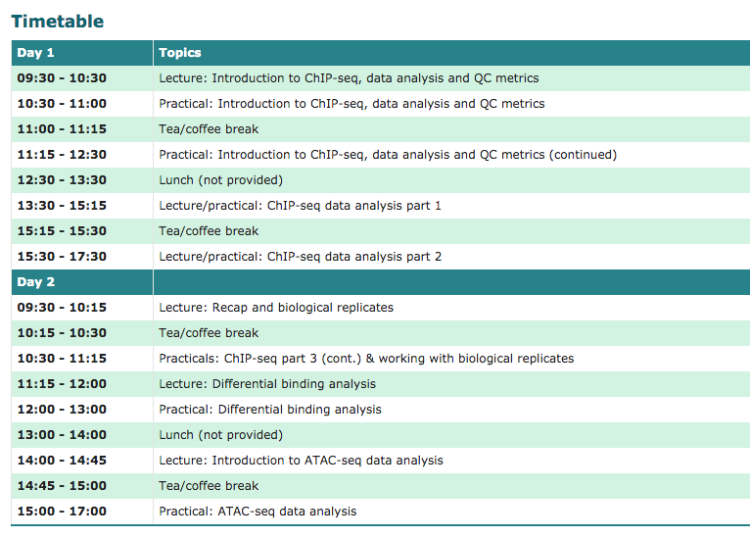

Slide 3
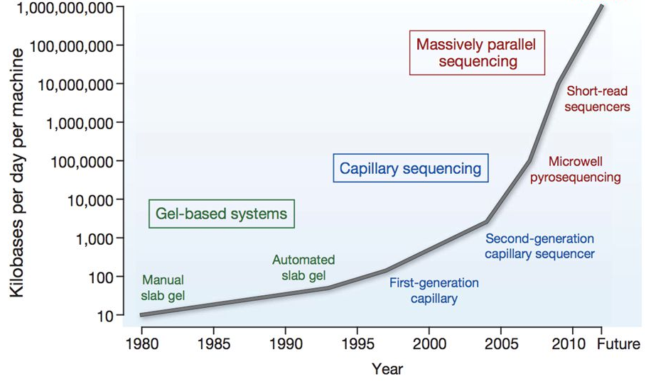
A BRIEF HISTORY OF SEQUENCING
High Throughput sequencing (HTP)
Single cell sequencing
Single molecule

Slide 4




HTS TECHNOLOGIES

Slide 5
Sequencing by synthesis
https://www.youtube.com/watch?annotation_id=annotation_228575861&feature=iv&src_vid=womKfikWlxM&v=fCd6B5HRaZ8
Notes:
per lane
human genome 3.2 Gb

Slide 6
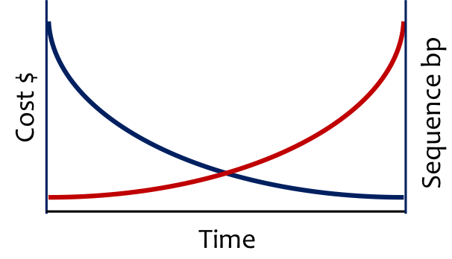
Data Volume
Data Complexity

Slide 7

DATA VOLUME
Scientists are expecting as many as 1 billion people to have their genomes sequenced by 2025
The amount of data being produced daily is doubling every seven months
Primary data measured in terabytes
Includes raw data from sequence machine
Not usually required
Sequence data
FASTQ files 10-100GB
Analysis data are smaller (10%)
Minimum that needs to be kept
Movement of data (once only)

Slide 8

DATA COMPLEXITY
Multiple samples
Multiple runs
Multiple platforms
Sample details not evident from data
120424_H183_0157_AC0KP3ACXX@HWI-HI83:157:C0KP3ACXX:6:1101:1210:1974 1:N:0:AGTCAA
Metadata is important
Describes the data

Slide 9
HTS APPLICATIONS
What do we study?

Slide 10
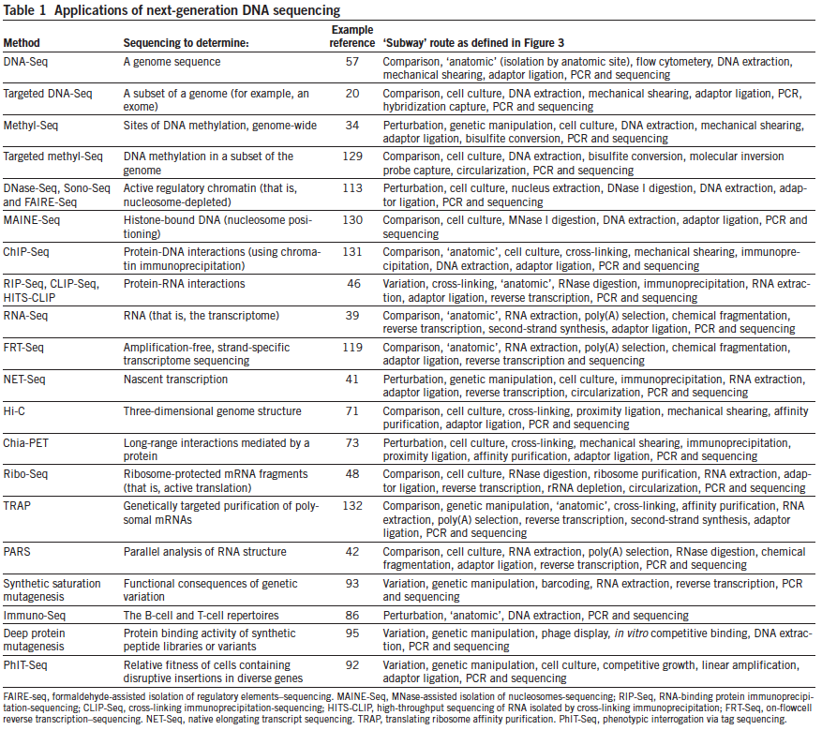
GENOME
EPIGENOME
TRANSCRIPTOME
EPIGENOME
TRANSCRIPTOME
Shendure J. et al., Nat Biotechnol. 2012 Nov;30(11):1084-94

Slide 11
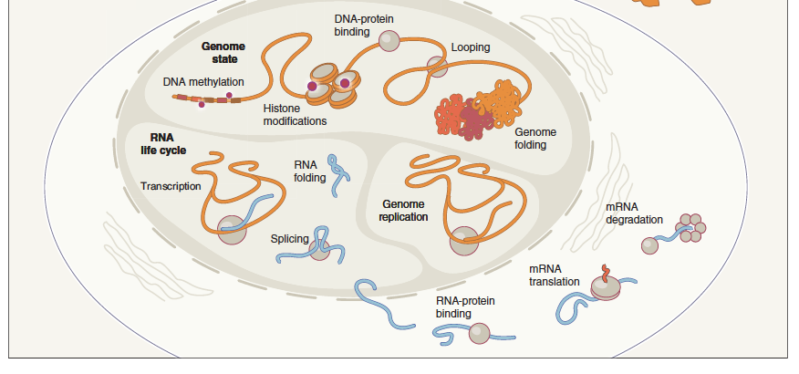
Epigenomic and Transcriptomic Assays
ChIP-seq & ATAC-seq
WGB-seq
promoter capture HiC
RNA-seq
Shendure J. et al., Nat Biotechnol. 2012 Nov;30(11):1084-94

Slide 12
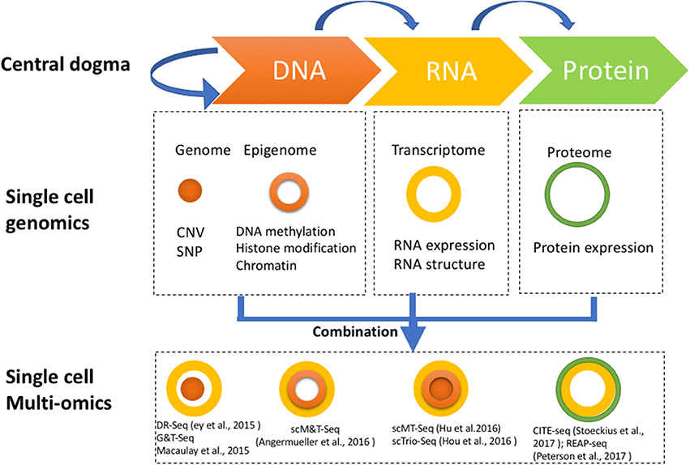
Single-cell multi-omics
Hu et al., Front. Cell Dev. Biol. 2018 Apr 20;6:28

Slide 13
HTS experimental design
Coverage
Batch effect

Slide 14
COVERAGE
Coverage: the number of reads representing a given nucleotide in the reconstructed sequence
Formula: N*L/G, where
G = length of haploid genome
N = the number of reads
L = average read length
e.g human genome = 3,000,000,000 (3Gb)
coverage = (100 bp)*(189×10⁶)/(3×10⁹ bp) = 6.3
each base in the genome will be sequenced between 6 and seven times on average
Notes:
WHY:
*You need multiple observations per base to come to a reliable base call.
*Reads are not distributed evenly over an entire genome, simply because the reads will sample the genome Therefore many bases will be covered by fewer reads than the average coverage, while other bases will be covered by more reads than average.
For applications where you aim to sequence only a defined subset of an entire genome, like targeted resequencing or RNA sequencing, coverage means the amount of times you sequence that subset.
For example, the level of coverage for human genome mutations/SNPs/ rearrangements detection that most publications require is from 10x to 30x depth of coverage depending on the application and statistical model. For ChIP-Seq studies where reads map to only a subset of a genome, often the researchers/publications require coverage around 100x. (http://res.illumina.com/documents/products/technotes/technote_coverage_calculation.pdf)
The term "deep" has been used for a wide range of depths (>7×),[citation needed] and the newer term "ultra-deep" has appeared in the scientific literature to refer to even higher coverage (>100×).[2]

Slide 15
OF NOTE
coverage is non-uniform across the genome
read length, region mappability and GC content influence the coverage
“callability” ≈ accessible portion of the genome
“generating 50x mapped coverage (60x before read mapping/filtering are applied) renders ~95% of the genome and ~81% of the exome callable”
A Guide for Deep Sequencing of Human Genomes
Subramanian et al. 2011
Notes:
render=deliver, give

Slide 16
COVERAGE
Category | Detection or Application | Recommended Coverage (x) or Reads (millions) | References
Transcriptome Sequencing | Differential expression profiling | 10-25M | Liu Y. et al., 2014; ENCODE 2011 RNA-Seq
 | Alternative splicing or Allele specific expression | 50-100M | Liu Y. et al., 2013; ENCODE 2011 RNA-Seq
 | De novo assembly | >100M | Liu Y. et al., 2013; ENCODE 2011 RNA-Seq
DNA Target-Based Sequencing | ChIP-Seq | 10-14M (sharp peaks); 20-40M (broad marks) | Rozowsky et al., 2009; ENCODE 2011 Genome; Landt et al., 2012
 | Hi-C | 100M | Belton, J.M et al., 2012
 | DNAse 1-Seq | 25-55M | Landt et al., 2012
DNA Methylation Sequencing | MeDIP-Seq | 60M | Taiwo, O. et al., 2012
 | Bisulfite-Seq | 5-15X; 30X | Ziller, M.J et al., 2015; Epigenomics Road Map
From: genohub.com recommemded coverage for mammalian genome (3Gb)
ATAC-seq: More than 50 million reads for human samples
From: https://informatics.fas.harvard.edu/atac-seq-guidelines.html

Slide 17
WHEN TO SEQUENCE MORE
Researching rare events
low binding activities in ChIP-seq
Certain genomes need more sequencing
certain regions may be hard to sequence

Slide 18
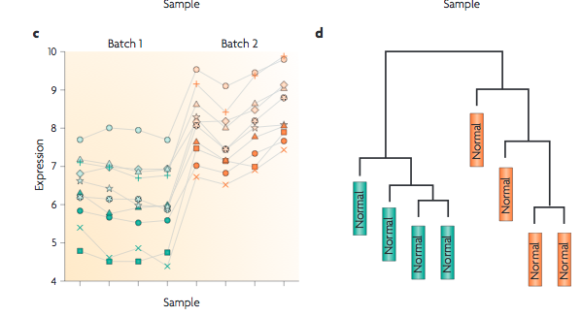
BATCH EFFECT
Leek et al. 2010

Slide 19
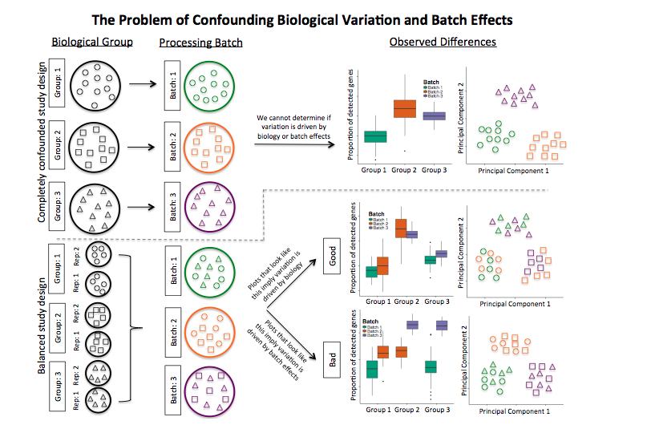
CONFOUNDING BIOLOGICAL VARIATION AND BATCH EFFECT
Hicks et al. 2015

Slide 20
CONFOUNDING BIOLOGICAL VARIATION AND BATCH EFFECT
Hicks et al. 2015

