Slide 1
Data formats and Quality Control
Sandra Cortijo, SLCU (sandra.cortijo@slcu.cam.ac.uk) Sergio Martinez Cuesta (Sergio.MartinezCuesta@cruk.cam.ac.uk) Sankari Nagarajan (Sankari.Nagarajan@cruk.cam.ac.uk) Ashley Sawle ‎(Ashley.Sawle@cruk.cam.ac.uk)

Slide 2
ChIP-seq ANALYSIS OVERVIEW
Sequencing
50-100bp
reads
Quality
check
Alignment
Peak calling
Non-peak
based analysis
Control
sample
Enriched
areas
Other
Genome
browser
Other
Heatmaps at
annotations
Profile at
annotations
Comparison
of samples
SubPeaks
Data
integration
Peak
annotation
Sequencing
Motif
analysis
Bioinformatics analysis
Downstream analysis
Notes:
The raw data for chromatin immunoprecipitation followed by sequencing (ChIP–seq) analysis are images from the next-generation sequencing platform (top left). A base caller converts the image data to sequence tags, which are then aligned to the genome. On some platforms, they are aligned with the aid of quality scores that indicate the reliability of each base call. Peak calling, using data from the ChIP profile and a control profile (which is usually created from input DNA), generates a list of enriched regions that are ordered by false discovery rate as a statistical measure. Subsequently, the profiles of enriched regions are viewed with a browser and various advanced analyses are performed

Slide 3
DATA FORMAT

Slide 4
From the sequencer to you
Sequencing is usually done by core facilities
Each sequencing run will generate millions of short (~100 bp) reads
+ read quality score for each base
They often perform initial processing
Adaptor trimming
Basic quality control
Demultiplexing
You will (usually) receive a FASTQ file

Slide 5
FASTQ Files
FASTQ = FASTA + Quality
So what is FASTA?

Slide 6
FASTA Format
>CHROMOSOME_1
GATTTGGGGTTCAAAGCAGTATCGATCAAATAGTAAATCCATTTGTTC
AACTCACAGTTTGGTTCAAAGCAGTATCGATCAAATAGTAAATCCATT
…
>CHROMOSOME_2
TCACAGTTTGGTTCAAAGCAGTATCGATCATATCGATCAAATAGTAAA
…
Format for raw DNA sequences
For each DNA sequence:
> NAME
Nucleotides, with line breaks every ~60 bp

Slide 7
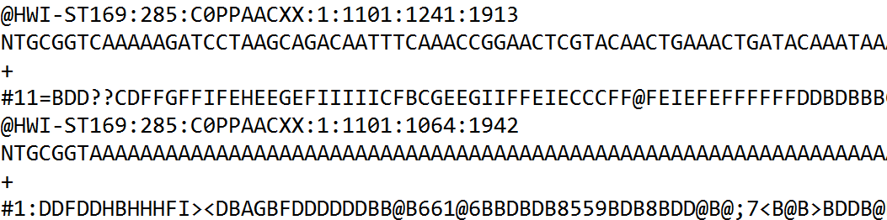
FASTQ format
Format for DNA sequencing reads
For each read:
@ Read ID
Nucleotide sequence of the read
+
Quality score for each nucleotide of the read

Slide 8
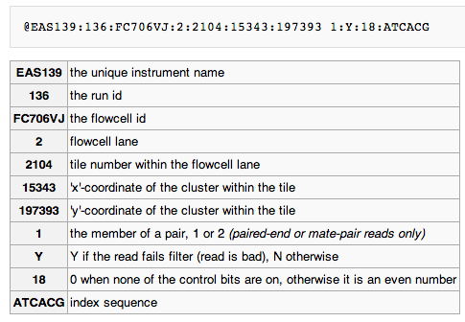
Illumina sequence identifiers

Slide 9
Quality Scores
P = probability that the base call is wrong
p = 0.1 → Q = 10
p = 0.01 → Q = 20
P = 0.001 → Q = 30
Encoding:
Sanger/Phred format can encode a quality score from 0 to 93 using ASCII 33 to 126:
!"#$%&'()*+,-./0123456789:;<=>?@ABCDEFGHIJKLMNOPQRSTUVWXYZ[\]^_`abcdefghijklmnopqrstuvwxyz{|}~
| |
33 126

Slide 10
Quality Score Encoding
ASCII Code
Quality Score
!"#$%&'()*+,-./0123456789:;<=>?@ABCDEFGHI
| | | |
33 59 64 73
0........................26...31.......40
Each character has an associated ASCII Code
ASCII Code − Offset = Quality Score
Normal Sanger Encoding is Phred + 33
Lowest: “!” = ASCII 33 = Quality 0
Highest: “I” = ASCII 73 = Quality 40

Slide 11
Quality Encoding Example
!"#$%&'()*+,-./0123456789:;<=>?@ABCDEFGHI
| | | | | | | | |
33 40 45 50 55 59 64 70 73
0......7........17.......26...31.......40

Slide 12
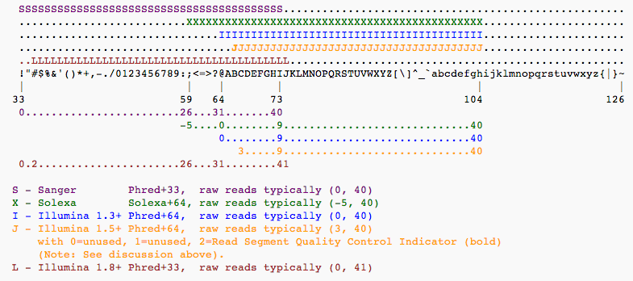
Different Quality Encodings
Beware of different versions! (especially for old data)

Slide 13
Single end vs paired-end
my_sequence.fastq
Single end sequencing
5’
3’
@HWI-BRUNOP16X_0001:1:1:1466:1018#0/1
AAGGAAGTGCTTGTCTGGCTAACACAGCNAGNCACGTGAC
+
aVfbe`^^^_TTTSSdffffdfffabbZbbfebafbbbbb
SE
my_sequence_1.fastq
Paired end sequencing
@HWI-BRUNOP16X_0001:1:1:1278:989#0/1
NAAATTTCGAATTTCTGTGAAGTAAGCATCTTCTTTGTCAT
+
BJJGGKIINN^^^^^QQNTUQOOTTTRTOTY^^Y^\\^^^\
5’
3’
PE
my_sequence_2.fastq
@HWI-BRUNOP16X_0001:1:1:1278:989#0/2
AACCCACACAGGAGAGCAGCCTTACAGATGCAAATACTGTG
+
]K___fffffggghgeggggggdgggggfgggggegggghh
Notes:
Now it’s important to distinguish between SE and PE data
SE data is generated just as we described
The main difference with PE is that here we are using two different adaptors
And we are sequencing the molecule from both ends (and we know which end is)
This has the main advatage that we can obtain more information without having to sequence longer reads
For RNA-seq though PE data provides more information: splicing events
Also, for DNA-seq, SVs
In terms of output, different fastq files
Read names
Although the pipeline is the same, we’ll probably have to hange some options in the software we execute, as we’ll see

Slide 14
QUALITY CHECK

Slide 15
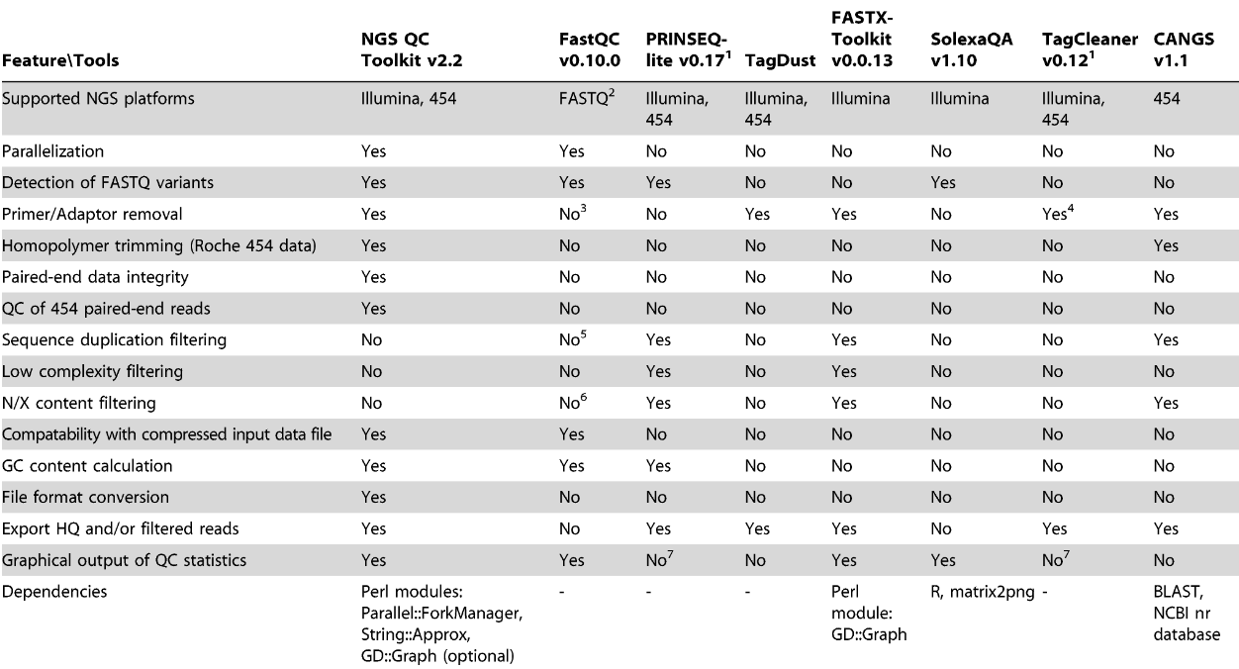
Comparison of various features across available QC tools
Notes:
15

Slide 16
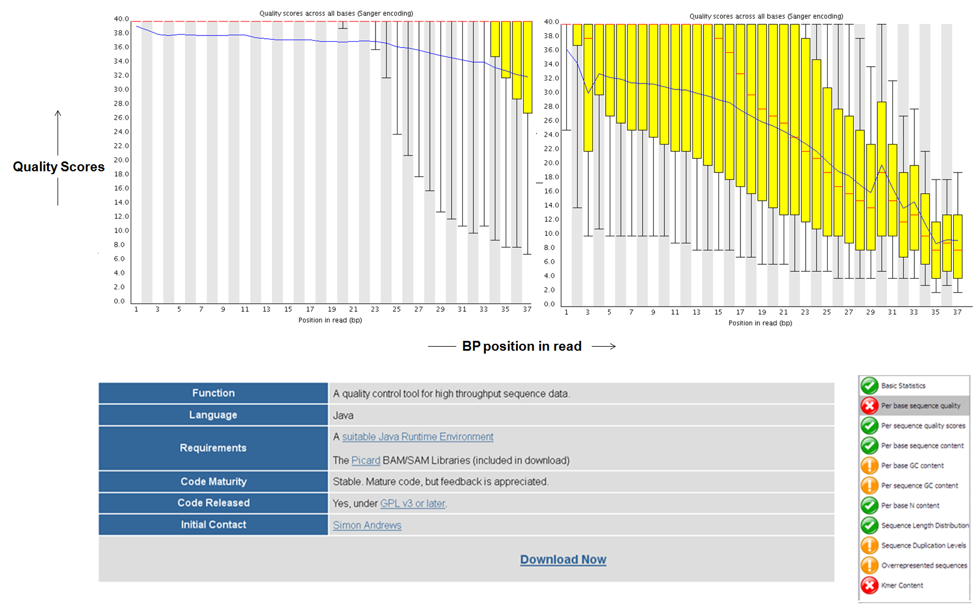
FastQC: Per base sequence quality
FastQC: http://www.bioinformatics.babraham.ac.uk/projects/fastqc/
Notes:
16

Slide 17
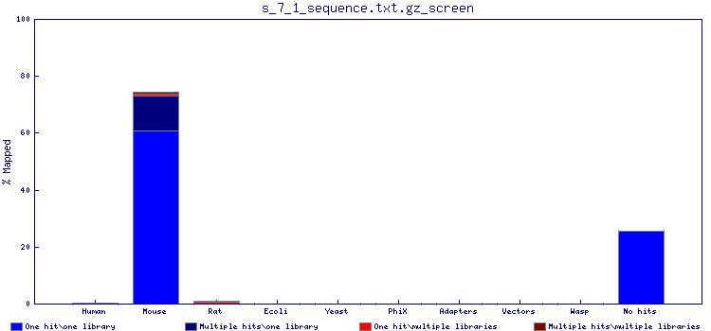
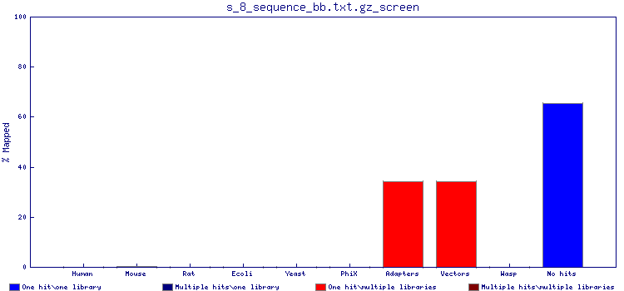
FastqScreen: contamination
Notes:
A very nice tool to check for contamination is FastqScreen
We will not use it in the practical because it takes too long to execute
The idea is that you take your input fastq file and you map it to several genomes: mouse, human, vectors, E.coli, yeast…
This way you can confirm that the data you got back corresponds to your species, and it doesn’t consist only of adapters and vectors as here.

Slide 18
Common sequence artefacts in NGS data
Read errors
Base calling errors
Small insertions and deletions
Poor quality reads
Primer / adapter contamination

Slide 19
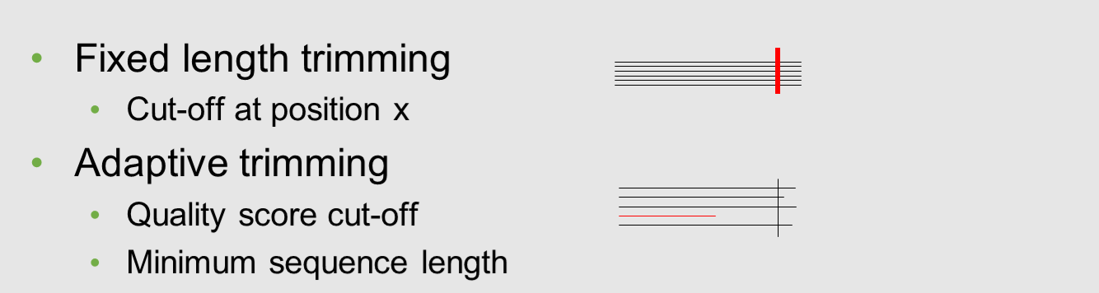
Quality trimming
Notes:
19

Slide 20
Filtering
How?
Fastx (http://hannonlab.cshl.edu/fastx_toolkit/)
PRINSEQ (http://prinseq.sourceforge.net/)
Tally and Reaper:
http://www.ebi.ac.uk/~stijn/reaper/tally.html
http://www.ebi.ac.uk/~stijn/reaper/reaper.html#recipe
http://www.ebi.ac.uk/~stijn/reaper/src/reaper-12-048/
ShortRead (R) (http://www.bioconductor.org/packages/release/bioc/html/ShortRead.html)
Notes:
About the tools, again I’m providing some listing based on what I use, but many more tools out there

Slide 21
FASTQ Processing – FASTX Toolkit
http://hannonlab.cshl.edu/fastx_toolkit/
Many tools for common operations on FASTQ files:
Conversion
Trimming (remove barcodes)
Clipping (remove adapters)
Quality trimmer (trim off low-quality bases)
Quality filter (remove low-quality reads)

Slide 22
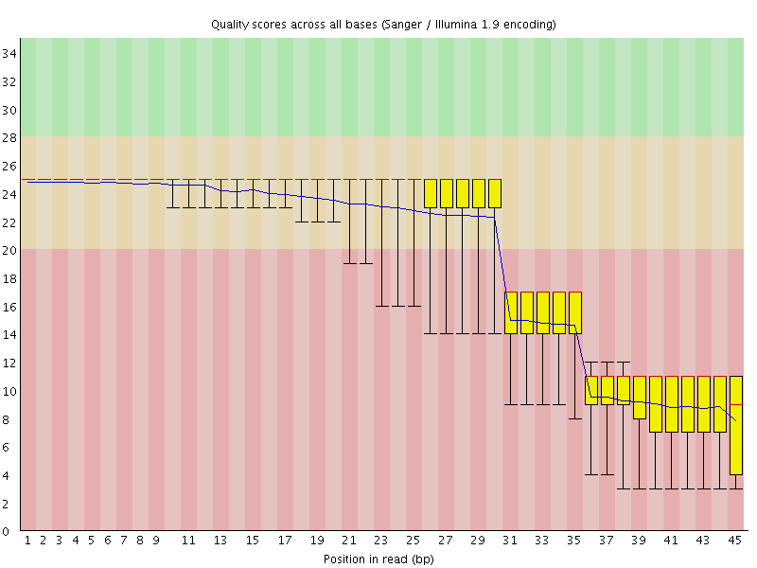
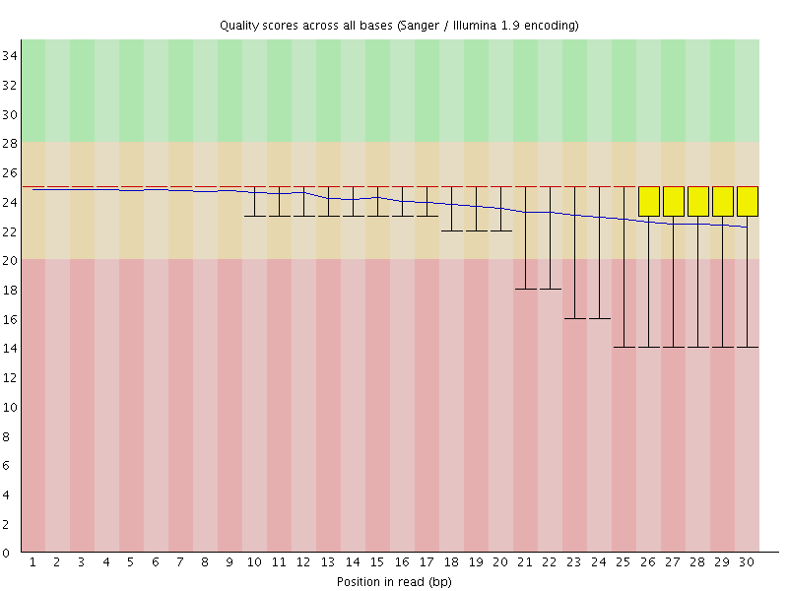
Filtering example
Before
After
Notes:
The goal … to optimise the mapping step

Slide 23
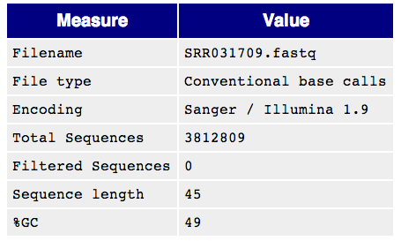
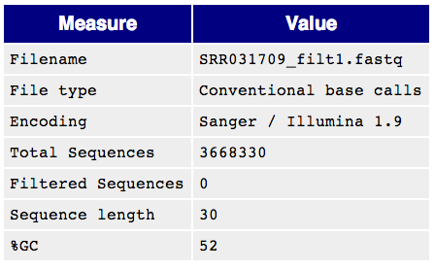

Filtering comes at a price
Notes:
Sometimes mapping tools + downstream analysis tools take things into account
No general recipe, depends pretty much on our data + the tools we plan to use
It’ll depend pretty much on the analysis we have planned

Slide 24
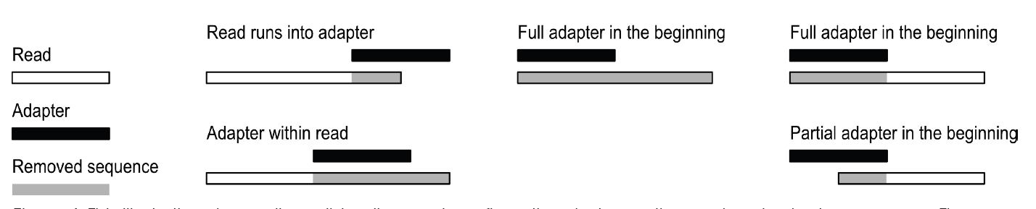
Removal of adapter sequences
Necessary when the read length > molecule sequenced e.g. small RNAs.
Different scenarios requiring adapter removal
Trim the 3’ end
Trim/discard the reads based on the residual minimum read length.
Trim the adapter region but retain reads only with a minimum read-length.
Tools for adapter trimming
fastx_clipper (FastX-Toolkit), PRINSEQ
1
2
3
1
2
3
Notes:
24
Cutadapt : A tool used for removing adapter sequences
Cutadapt supports a variety of file formats produced by second-generation sequencers.
Cutadapt can search for multiple adapters in a single run of the program and will remove the best matching one.
Other tools for adapter trimming
HTSeq, Biostrings, SOAP, Novoalign, Vectorstrip ( EMBOSS), fastx_clipper (FastX-Toolkit)
24

Slide 25
Important: PE files
my_sequence_1.fastq
my_sequence_2.fastq
@HWI-BRUNOP16X_0001:1:1:1278:989#0/1
NAAATTTCGAATTTCTGTGAAGTAAGCATCTTCTTTGTCAT
+
BJJGGKIINN^^^^^QQNTUQOOTTTRTOTY^^Y^\\^^^\
@HWI-BRUNOP16X_0001:1:1:1278:989#0/2
AACCCACACAGGAGAGCAGCCTTACAGATGCAAATACTGTG
+
]K___fffffggghgeggggggdgggggfgggggegggghh
filtering
filtering
mapping
How?
Trim Galore! (http://www.bioinformatics.babraham.ac.uk/projects/trim_galore/)
Notes:
Reads need to be paired
Perform filtering steps which are consistent with that
Or use trim Galore for trimming

Slide 26
Conclusions
Quality control of sequencing data is essential for downstream analysis.
A range of QC tools are available to remove noise
Decide on which data can be corrected and discard the rest.
Notes:
26
De novo assembly.
Re-sequencing which involves alignment to reference genomes.
Expression analysis for RNA-seq , small RNA data.
Variation detection including SNP and indel detection.
Sequencing error removal.
Primer/adapter trimming.
Base level trimming based on quality values.
26

