Slide 1
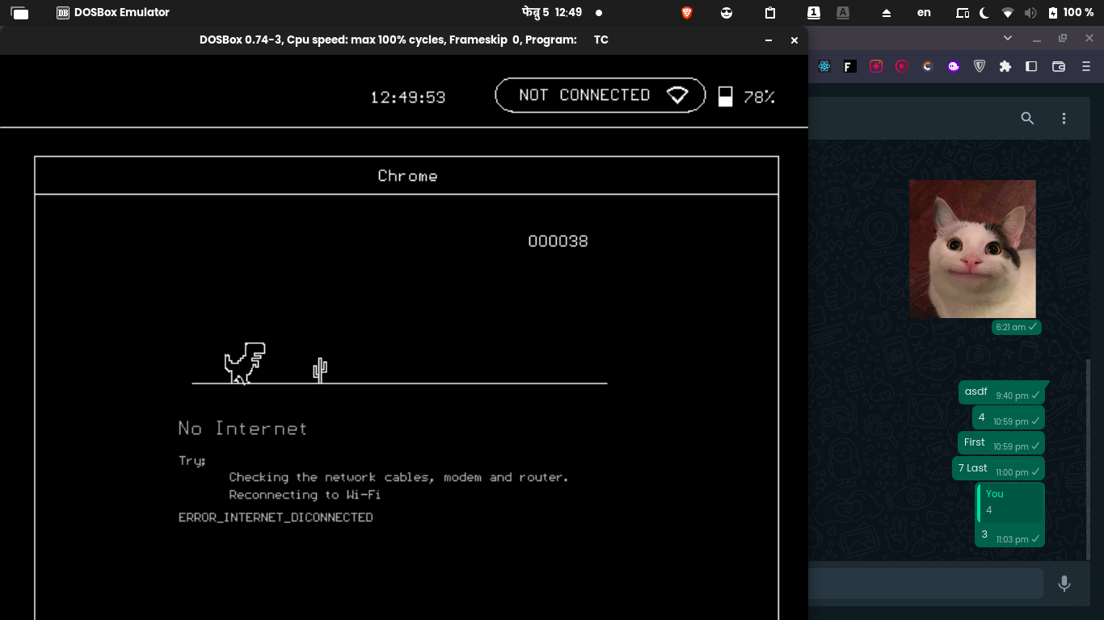
The Dino
Alive, after 70 million years, roaring,
running, destroying.

Slide 2
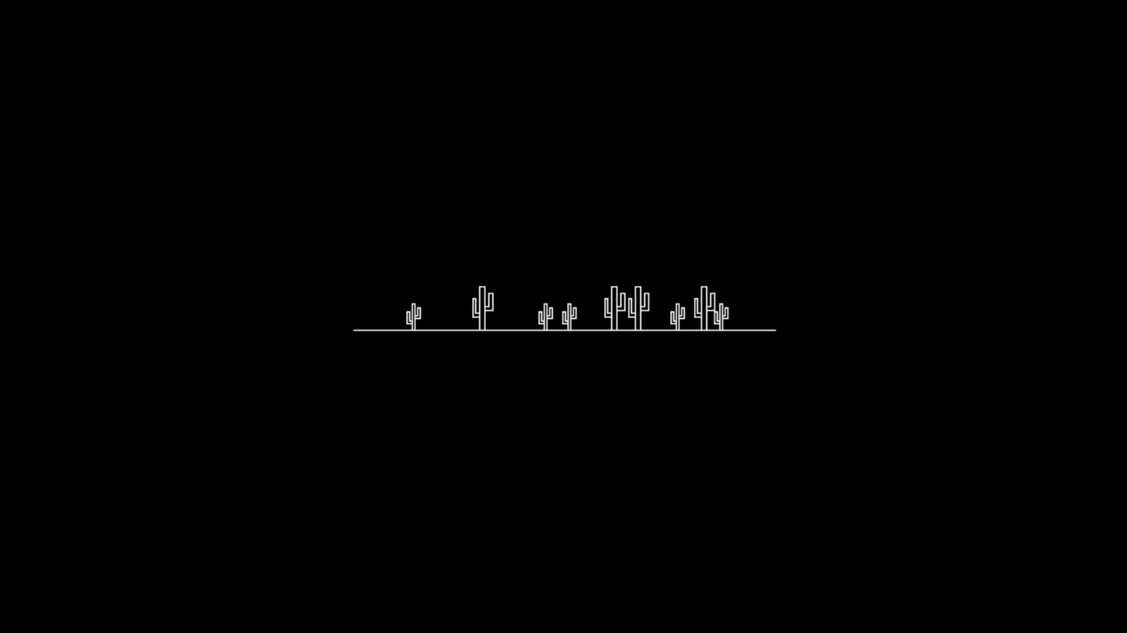
Obstacles
But I defeated
them!

Slide 3
Dinosaur
void dino(int x, int y) {
// Code to draw dino
}

Slide 4
setcolor(WHITE);
setcolor(BLACK);
circle(x,y,20);
circle(x,y,20);
x,y

Slide 5
Dinosaur
void dino(int x, int y) {
// Code to draw dino
}
void clr_dino(int x, int y) {
setcolor(BLACK);
dino(x,y);
setcolor(WHITE);
}

Slide 6
Collision
obs x,y = 100,100
if(dino_x > obs_x && dino_x < obs_x+20 &&
dino_y > obs_y) {
game_over();
}
dino x,y = 80,120

Slide 7
Randomization
rand()
int rand_distance() {
return rand() % 250 + 150;
}
rand() % 5
rand() % 5 + 1
int rand_obs_no() {
return rand() % 5 + 1;
}
obs1_x = last_x + rand_distance();
cur_obs1 = rand_obs_no();

Slide 8
Oh no! Again?
Thank You!

