Slide 1

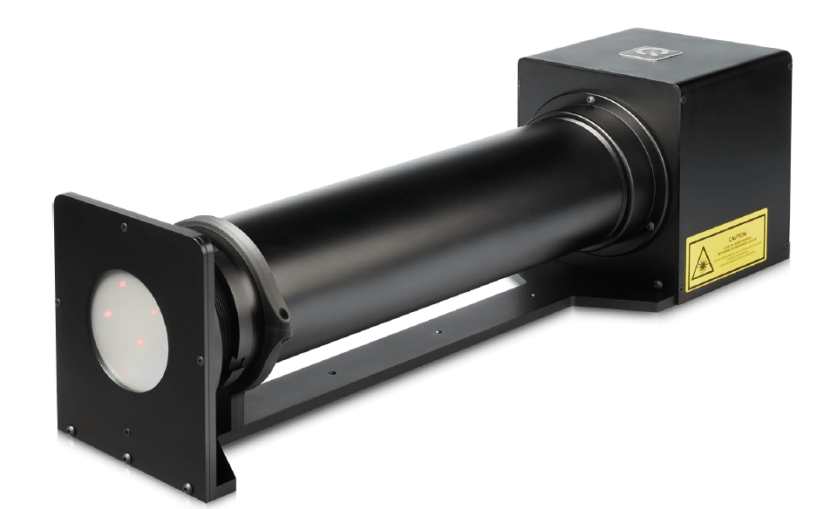
Geocal Calibration
Crystal Ruotong Yu

Slide 2
目录
catalog
01
Introduction
02
Process
03
04
Demo
Experiment & Result
05
Future

Slide 3
01
Introduction

Slide 4
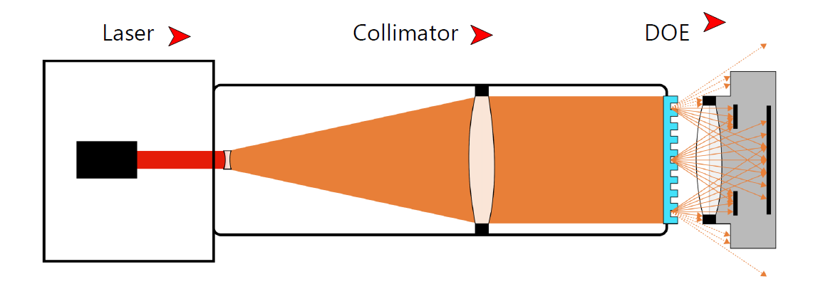
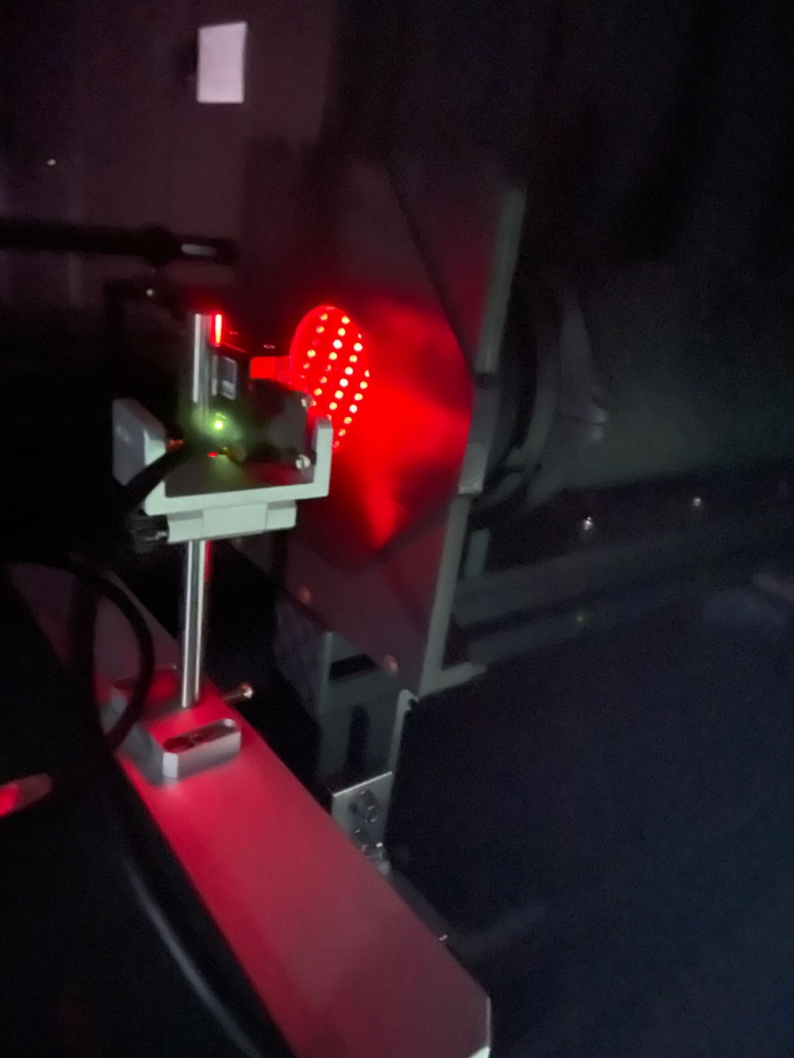
Principle
Notes:
标定板的原理，光栅平行光
镜头摆正，主点接近中心

Slide 5
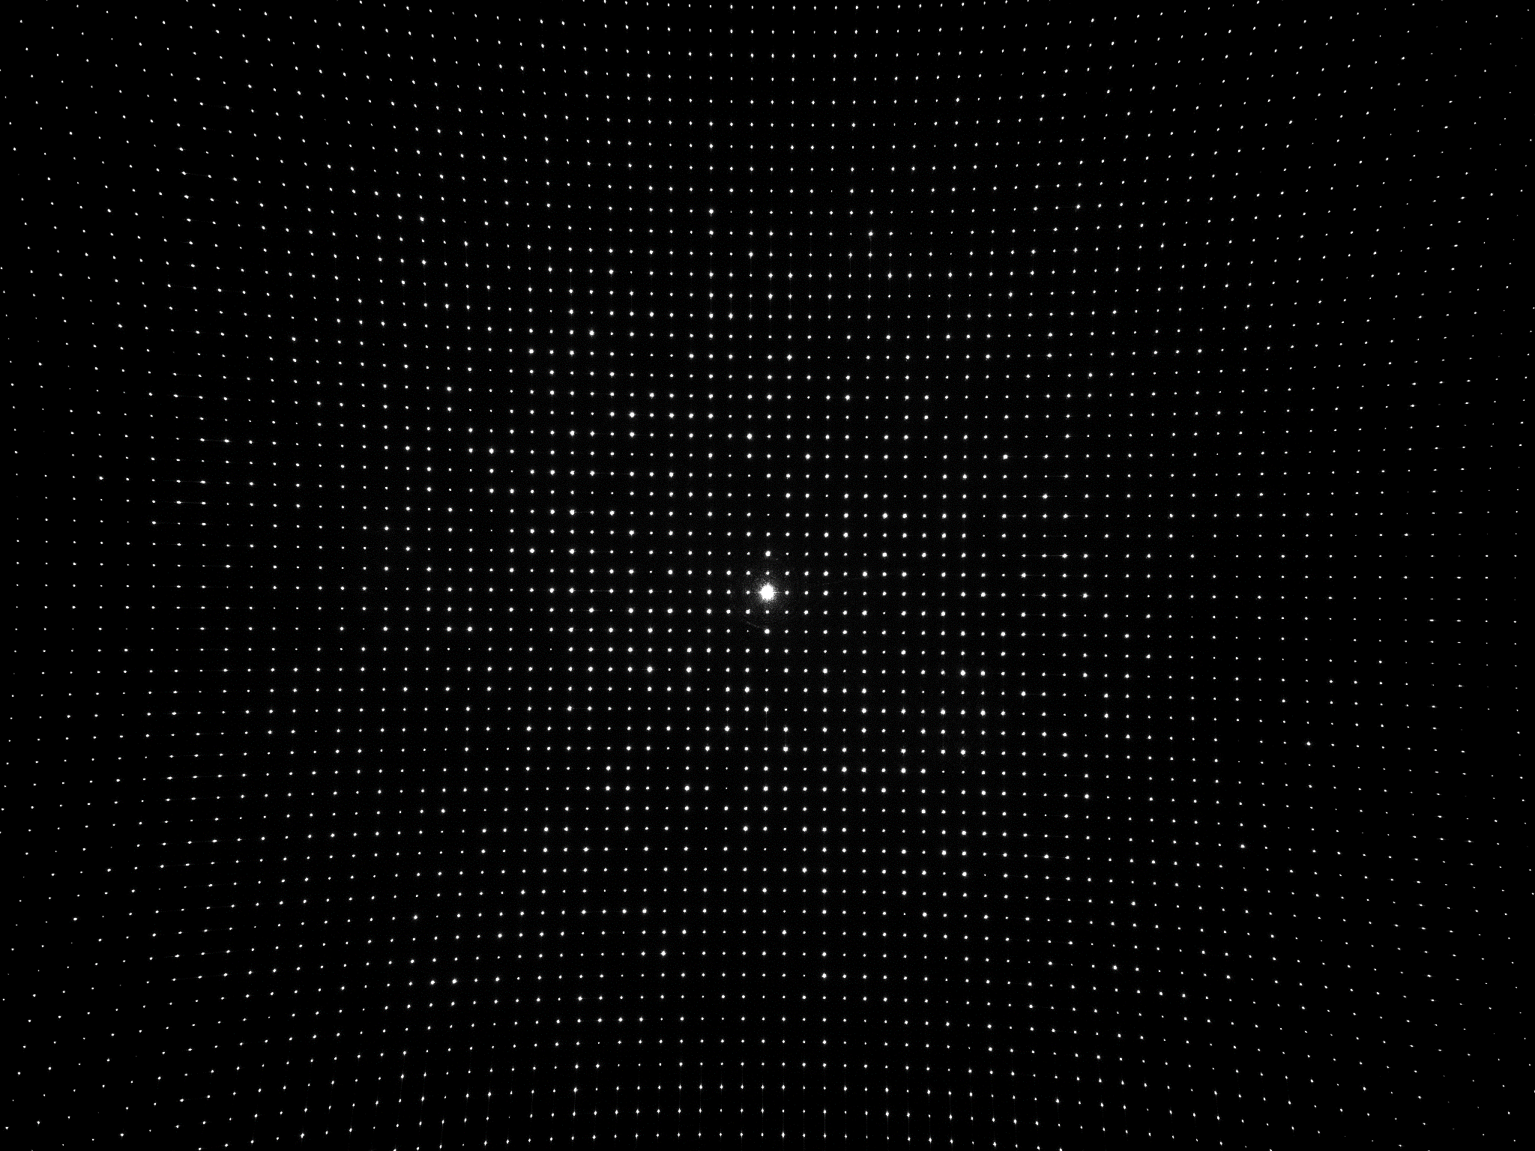

Images and Tools
Notes:
黑白相机，拍摄图像的展示
基于python

Slide 6
02
Process

Slide 7
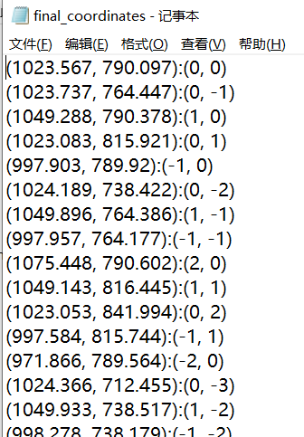
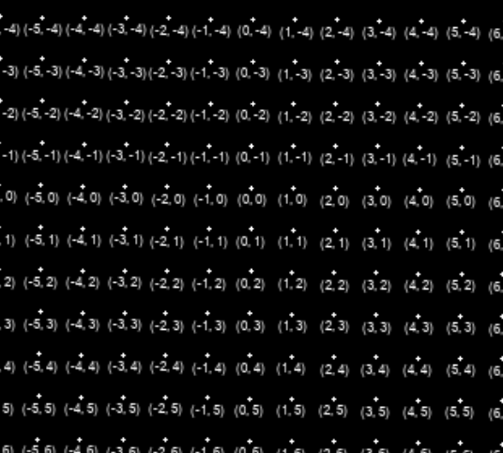
2.1 Grid detection
Below is the goal we want to reach in this step.
visualization
Pixel coordinates : world coordinates
Notes:
目标：为每个点的像素坐标获取对应的世界坐标。特征点，角点提取
可视化如左图

Slide 8
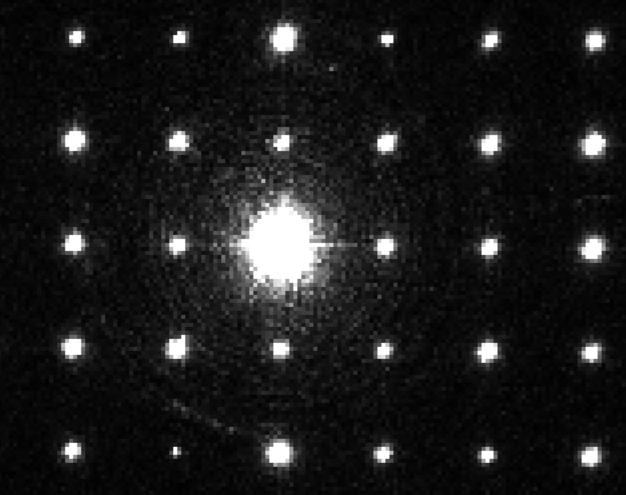
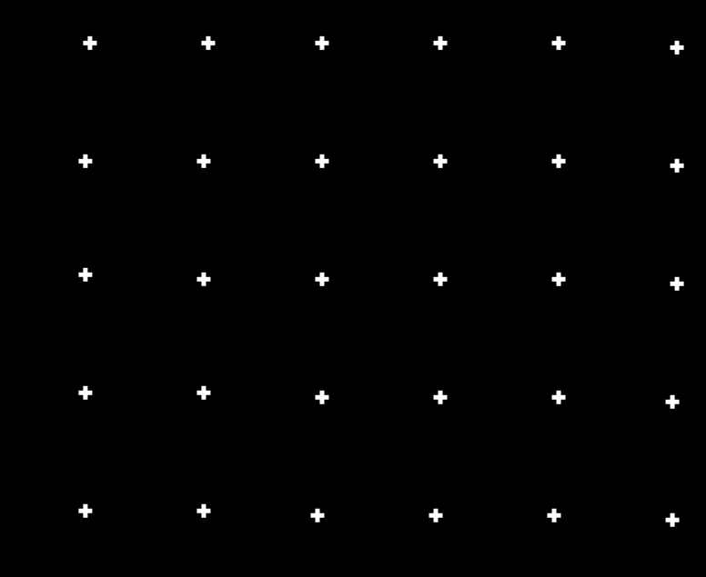
To get grid points, first processing the original images to give each point an accurate position.
Original image
Preprocessed image
Notes:
一开始拍摄的图片并不是这么干净，需要先处理一下，每个点提供一个准确位置
从左边变成右边这样

Slide 9
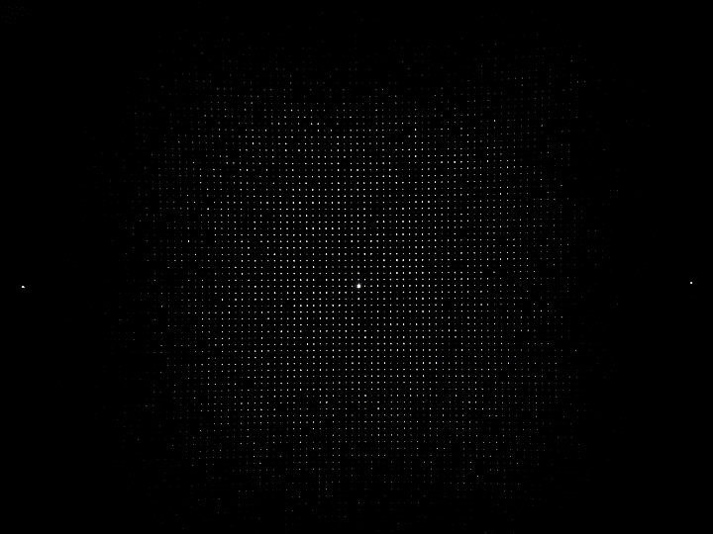
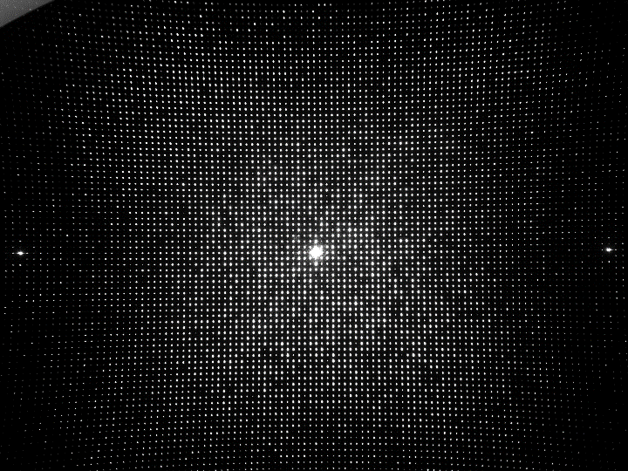
To get more points and reduce noise impact, we can observe the images in different exposure time
Short exposure
Long exposure
Exposure time: 200 us
Center: good
Range: small
Exposure time: 8000 us
Center: bad
Range: large
Notes:
为了得到更多点，并且减少噪声的影响
需要曝光融合
拍摄了不同曝光时间的，短曝光中心好，长曝光范围大，想要综合这些优点

Slide 10
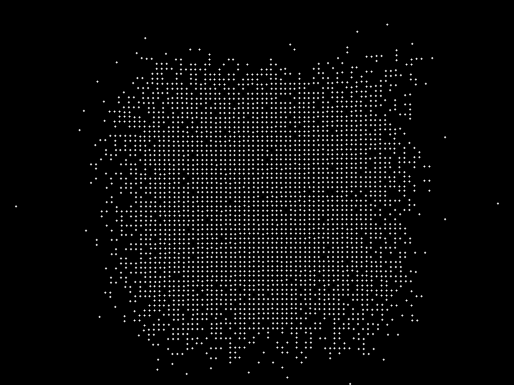
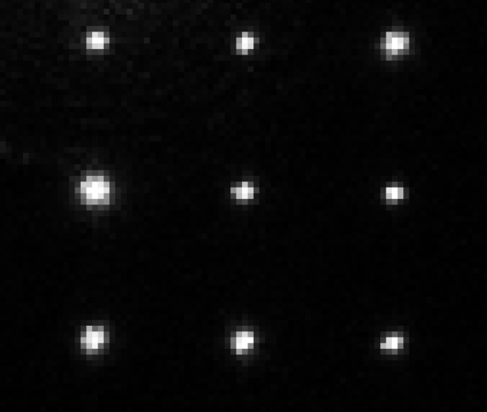
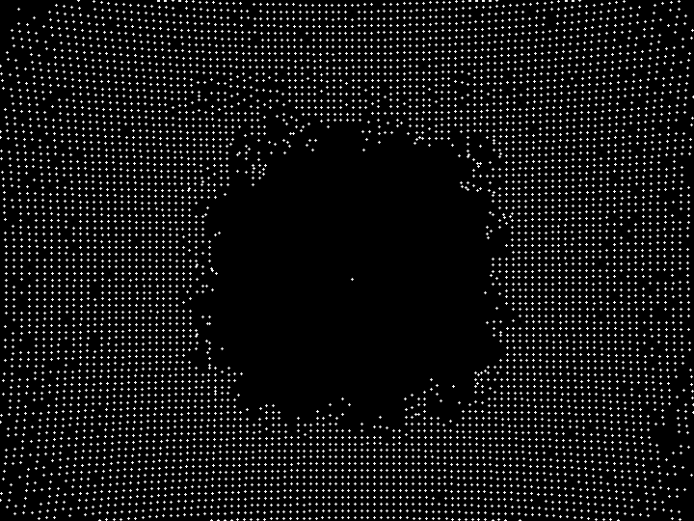
Centroid Method（质心法）is used to determine point position
Set a brightness threshold and extract the contour（轮廓） for each point. Each contour obtains a center of gravity position based on the brightness value
Extract results example
Short exposure
Long exposure
Notes:
曝光点是一团一团的，质心法提取每团的重心。
黑色部分不一定值为0，设立亮度阈值，再应用轮廓检测。每个轮廓获取一个重心位置。
右侧是提取结果，（解释一下）

Slide 11

Exposure fusion is applied to several extracted images
Image after Exposure fusion(融合）
Centroid again
Notes:
融合后的图像包含大量点。再进行一次质心提取，解决轻微不重合。

Slide 12

Grid generation
length
root
$$θ$$
Main idea for each point
Start from (0, 0) at center
Judge range
Center point and its four neighbors should not missing (to determine axises)
Notes:
主要思想：对于每个点，在这样一个（解释）范围内找邻居，四个（有可能缺失）。迭代内，对每个邻居进行操作(相当于把这个中心移动到邻居身上，再向外找邻居。
保证了只要你有一个邻居，你就能被检测到。
怎么找邻居（确定它是你周围的点）？判断：方向、角度范围、长度范围。
需要保证（0，0）以及它周围的四个点存在，确立坐标系，否则会出问题。

Slide 13
This is data structure for each point object.
Attribute
Pixel coordinate
World coordinate
Search vectors(list)
Neighbors(list)
flag
Update from its parent root
Netpoint
Notes:
一旦在限定的范围内找到新的点，判断它没有被找过，就为这个点建立实例，类属性如下。
最终需要的就是前两项。
递归改为迭代，解决堆栈溢出，显式堆栈模拟系统堆栈。

Slide 14
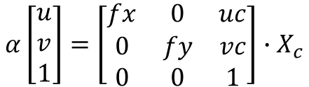


2.2 Calibration
$$α\left[\begin{matrix}u \\ v \\ 1\end{matrix}\right]=\left[\begin{matrix}fx & 0 & uc \\ 0 & fy & vc \\ 0 & 0 & 1\end{matrix}\right]∙X_{c}$$
Intrinsic matrix
Extrinsic matrix
Distortion coefficients
$$X_{c}=\left[R|t\right]∙X_{w}$$
$$\tilde{x}=x(1+k_{1}r^{2}+k_{2}r^{4}+k_{3}r^{6})$$
$$\tilde{y}=y(1+k_{1}r^{2}+k_{2}r^{4}+k_{3}r^{6})$$
Notes:
内外参和畸变系数

Slide 15

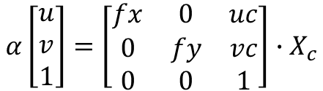




First evaluate intrinsic matrix.
Assume no extrinsic and distortion
board
image
$$α\left[\begin{matrix}u \\ v \\ 1\end{matrix}\right]=\left[\begin{matrix}fx & 0 & uc \\ 0 & fy & vc \\ 0 & 0 & 1\end{matrix}\right]∙X_{c}$$
$$X_{c}$$
$$θ$$
$$f$$
$$Z$$
$$θ≈0.9$$
Closed-form solution
Least Squares Method---reprojection error
Error value: 1100 for 3380 points
Similar solution for extrinsic matrix and distortion
Notes:
假定没有外参和畸变,给出内参的一个封闭解，最小二乘法，最小化重投影误差。
把Xc当作世界坐标，两点间的物理距离不知道，但手册中给了theta角。因为使用的小孔成像原理，勾股定理求Xc长度。
内参优化后，同理代入求畸变系数，外参。最后再用求出的外参去优化内参，重复到稳定。

Slide 16
03
Experiment & Result

Slide 17
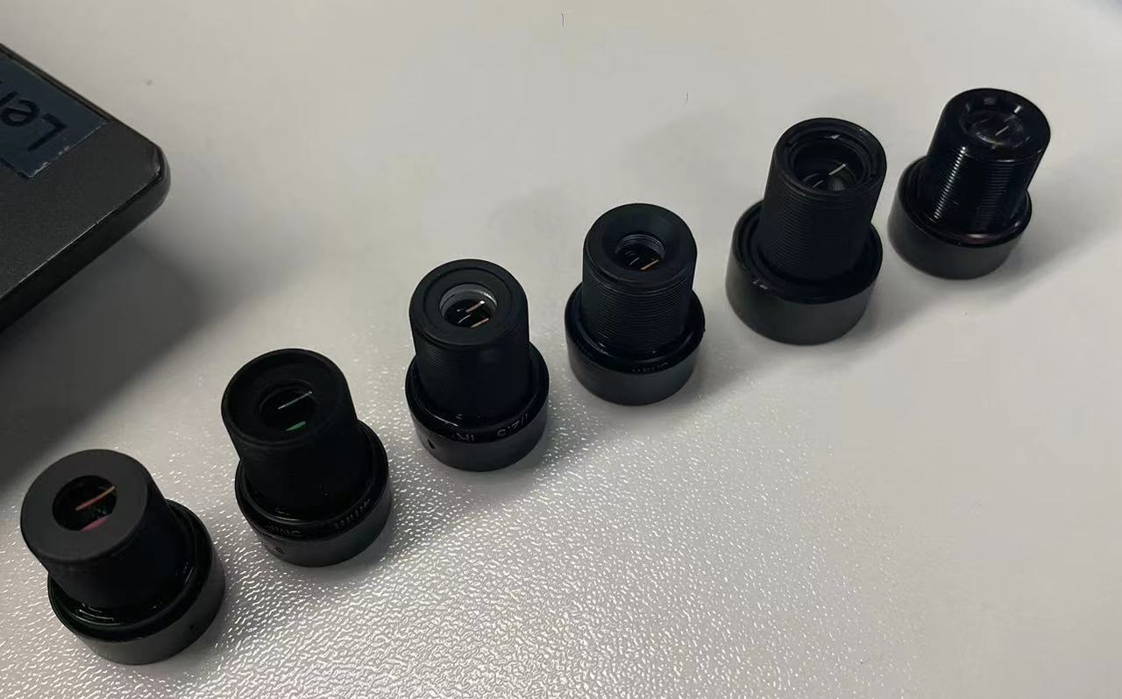
Experiment lens with different focal length
3.6mm
4mm
6mm
8mm

Slide 18
Parameters : Change R
Parameters for different focal length:
8mm
R = 22
Min_distance = 14
Max_distance = 23
Theshold_value = 19
6mm
R = 15
Min_distance = 10
Max_distance = 16
Theshold_value = 55
4mm
R = 11
Min_distance = 7
Max_distance = 12
Theshold_value = 25
3.6mm
R = 8.4
Min_distance = 5
Max_distance = 10
Theshold_value = 25
root

Slide 19
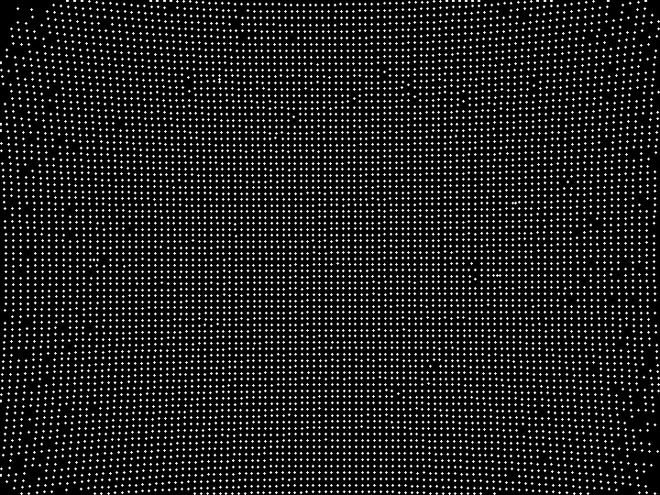
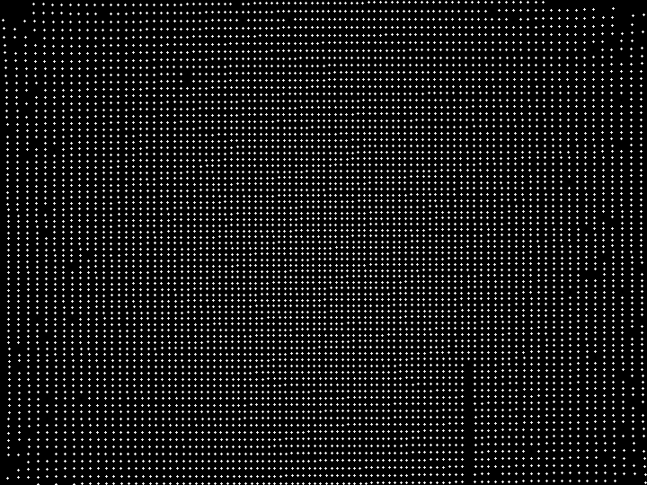
Sample results
3.6mm
Images without undistortion
Images after undistortion

Slide 20
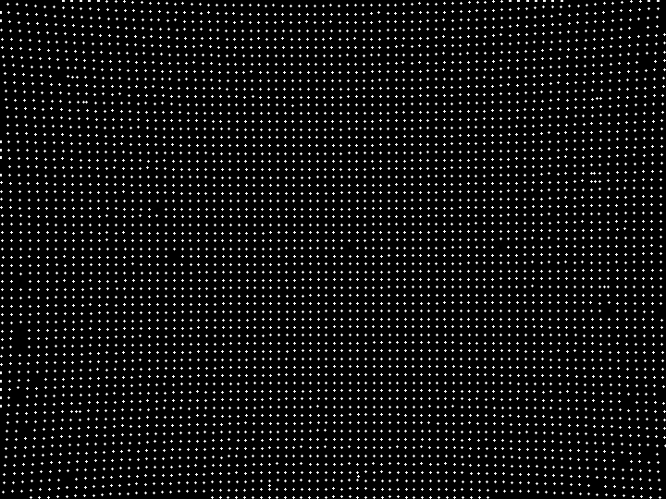
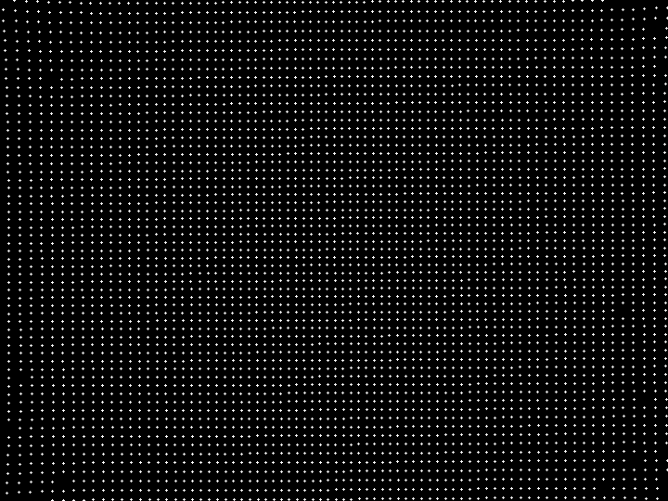
Sample results
4mm
Images without undistortion
Images after undistortion
Notes:
imageJ查看对比

Slide 21
04
Demo

Slide 22
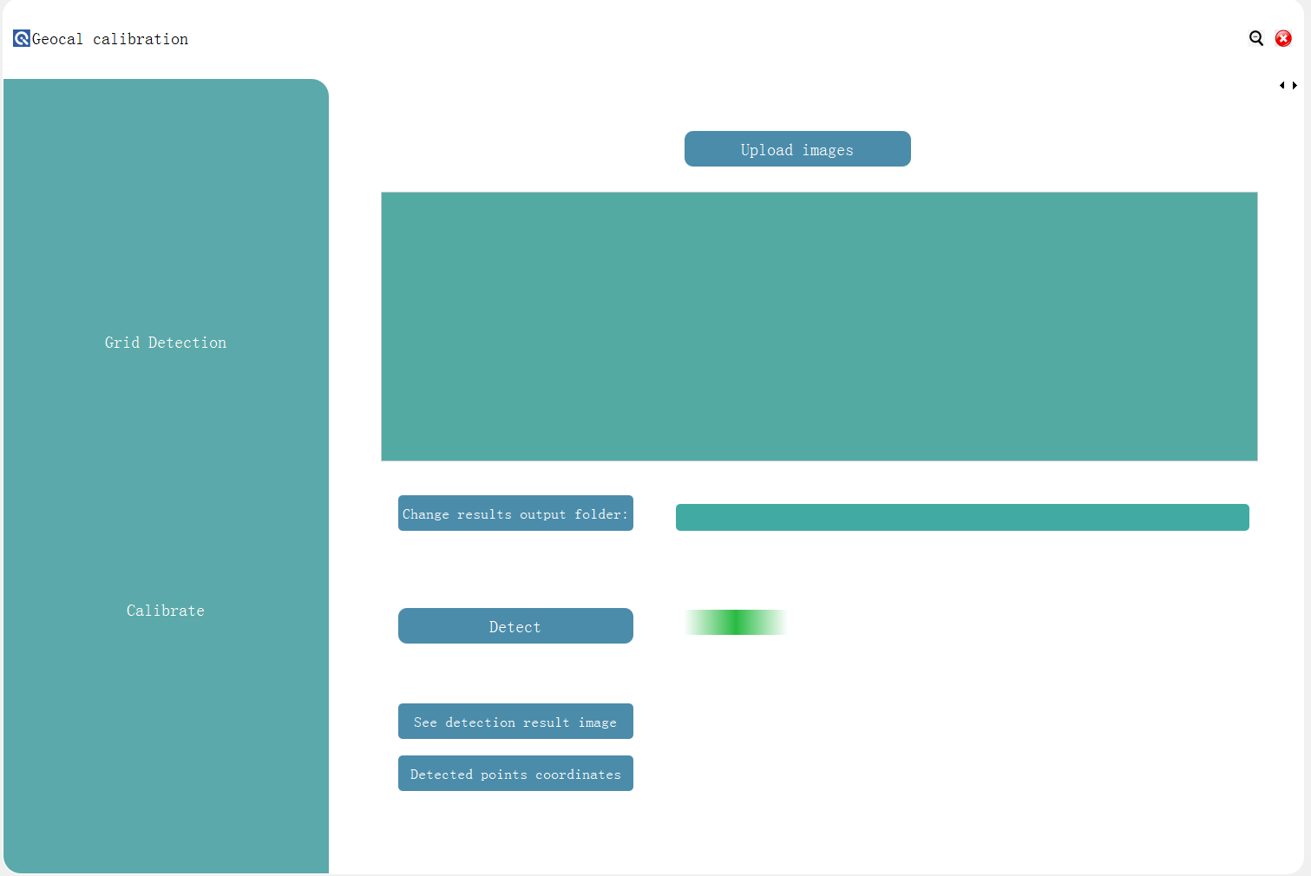
UI page 1
Two pages
Output folder
See results

Slide 23
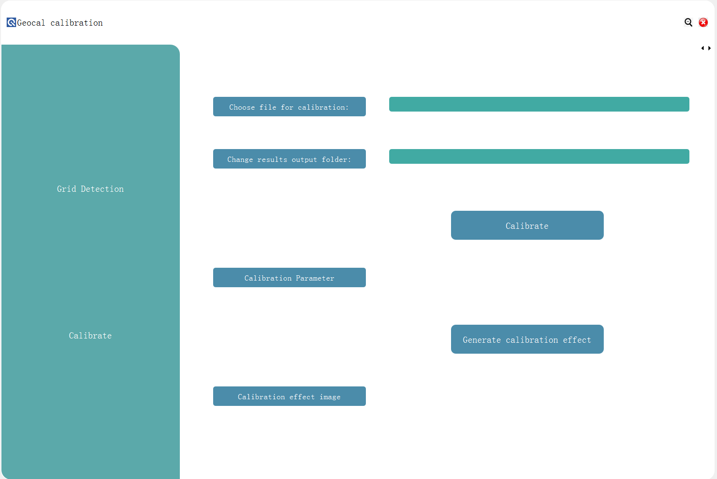
UI page 2
Final coordinates txt file from last step
See results
Run ui_manage.py

Slide 24
05
Future

Slide 25
Shortages of the project
Larger FOV
Did not test a camera with larger FOV
Slow(3 -5 mins)
Try different library may significantly increase the speed.
Optimize algorithm logic is another way.
Angle change from inside to outside
Change theta according to layer the point is in
User friendly

Slide 26
Thanks for helps!

