Slide 1
Text Categorization
Student: Melemciuc Marius-Constantin

Slide 2
Problem
Classify documents on topics/domains
Dataset Reuters-21578
21578 Docs
20856 Train Docs
722 Test Docs
Take the 10 most popular topics
For every topic T_{i}, 0 < i < 10
Train
Train document D_{k1} has type T or non-T, but not both
Now we have the trained model
Test
Classify test document D_{k2} as T or non-T, based on the training model
After Test we obtain
Precision - ability of the classifier not to label as positive a sample that is negative
Recall - ability of the classifier to find all the positive samples
F1 - harmonic mean of the Precision and Recall

Slide 3
Test Example
Document Labels
grain
non-grain
Train Docs
583 grain
20273 non-grain
Test Docs
45 grain
677 non-grain

Slide 4
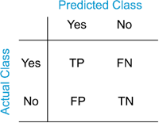
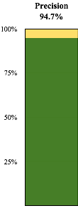
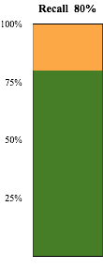
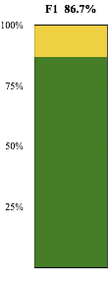
Confusion Matrix
36 | 2
9 | 675

Slide 5
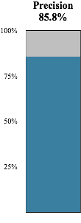
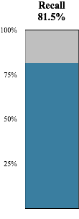
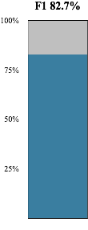
Tests Average
Using
Remove stopwords
Stemming

Slide 6
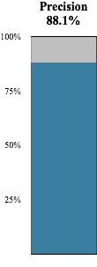
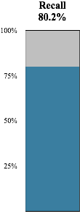

Using
Remove stopwords

Slide 7

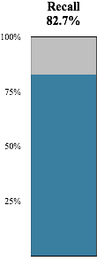

Without
Remove stopwords
Stemming

Slide 8
A = with remove stopwords, B = with stemming
Classifier | Obs | Precision | Recall | F1
SVM | AB | 0.858 | 0.815 | 0.827
 | A | 0.881 | 0.800 | 0.828
 | - | 0.868 | 0.827 | 0.838
Naive-Bayes | AB | 0.791 | 0.780 | 0.781
 | A | 0.779 | 0.785 | 0.776
 | - | 0.771 | 0.786 | 0.771
Perceptron | AB | 0.716 | 0.848 | 0.764
 | A | 0.752 | 0.868 | 0.795
 | - | 0.678 | 0.895 | 0.746

