Slide 1
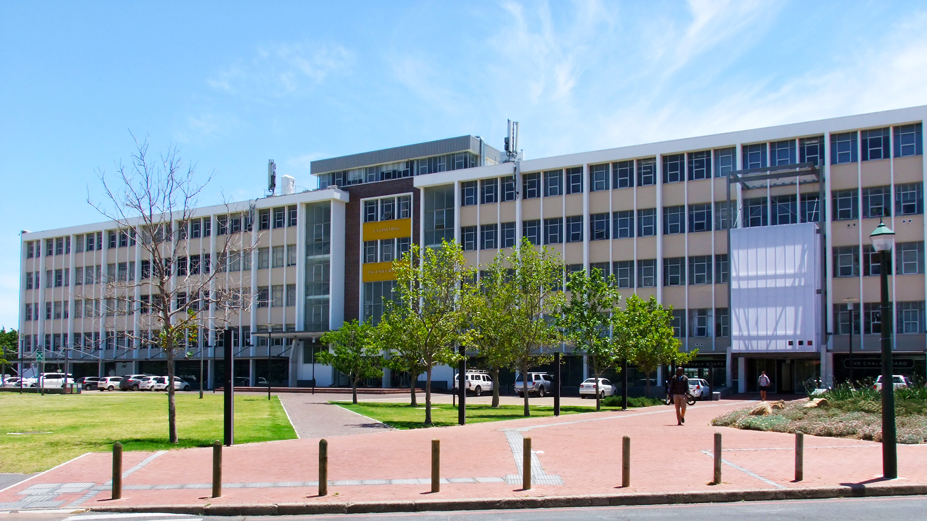
COOPERATIVE COLLISION AVOIDANCE USING HORIZONTAL MANOEUVRES
Photo by Stefan Els
Notes:
Good morning and Adrian Stark.
A progress presentation on my final-year project…
Traditional cooperative collision avoidance systems are reactive.
Typically results in follow-on accidents due to the avoiding actions.
So we need predictive avoidance and that is what this project is trying to create.

Slide 2
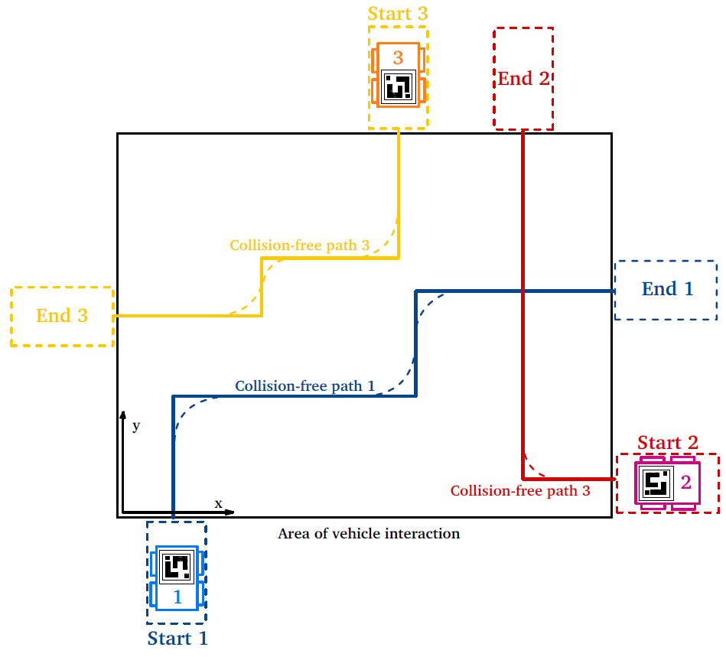
The Problem Statement
Design a route planner for generating the collision-free paths.
Create a MATLAB/Simulink model of robots to test the control system.
Practically demonstrate it with scale robots.
Constraints:
  Centralised computation
  Vehicles can only move in the horizontal plane and constantly moving forward.
  No obstacles present.
  Collisions will occur the defined area.
Notes:
Broken up into 3 parts.
Route planner:
Considers pose and vehicle dynamics to generate paths
Model and test system in MATLAB.
Demonstrate it.
Constraints:
- Computation doesn’t happen onboard robot.
Horizontal plane and moving forward.
Paths to area and outside are not concerned.
NO OBSTACLES

Slide 3
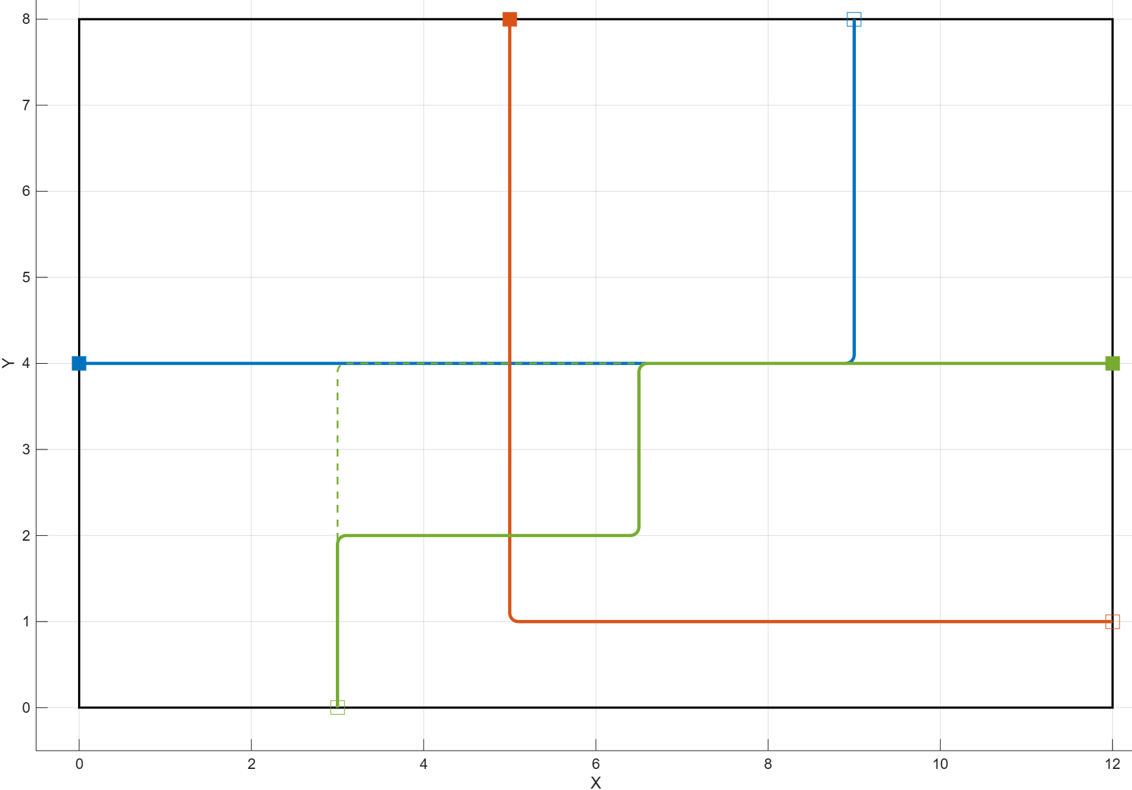
Route planning
Centralised A* Search
Started with prioritised searches & RRT
4-connected grid
Optimisations
  Centralised
  Heuristic adjustment – precalculated distances
Minimum safe distance
Outputted as grid coordinates
Notes:
ARTIFICIAL POTENTIAL FIELDS and RECIPROCAL VELOCITY OBSTACLES but quickly found out that they were too complex.
Prioritised searches: LIMITED with no easy priority.
RRT: complex paths that are difficult to control
2. 4-connected grid: INEFFECIENCIES.
3. Instead of 3 branches per node, it creates 9.
Choses shortest sum of all paths.
4. Not Manhattan as it can result in being left on the edge facing the wrong way.
5. Drops routes much longer than budget, and tests moves for each robot first and if negative, doesn’t test them again. Very important for a 9 branch tree.
6. Minimum safe distance allows of inaccuracies in the vehicles following of the path.
4

Slide 4
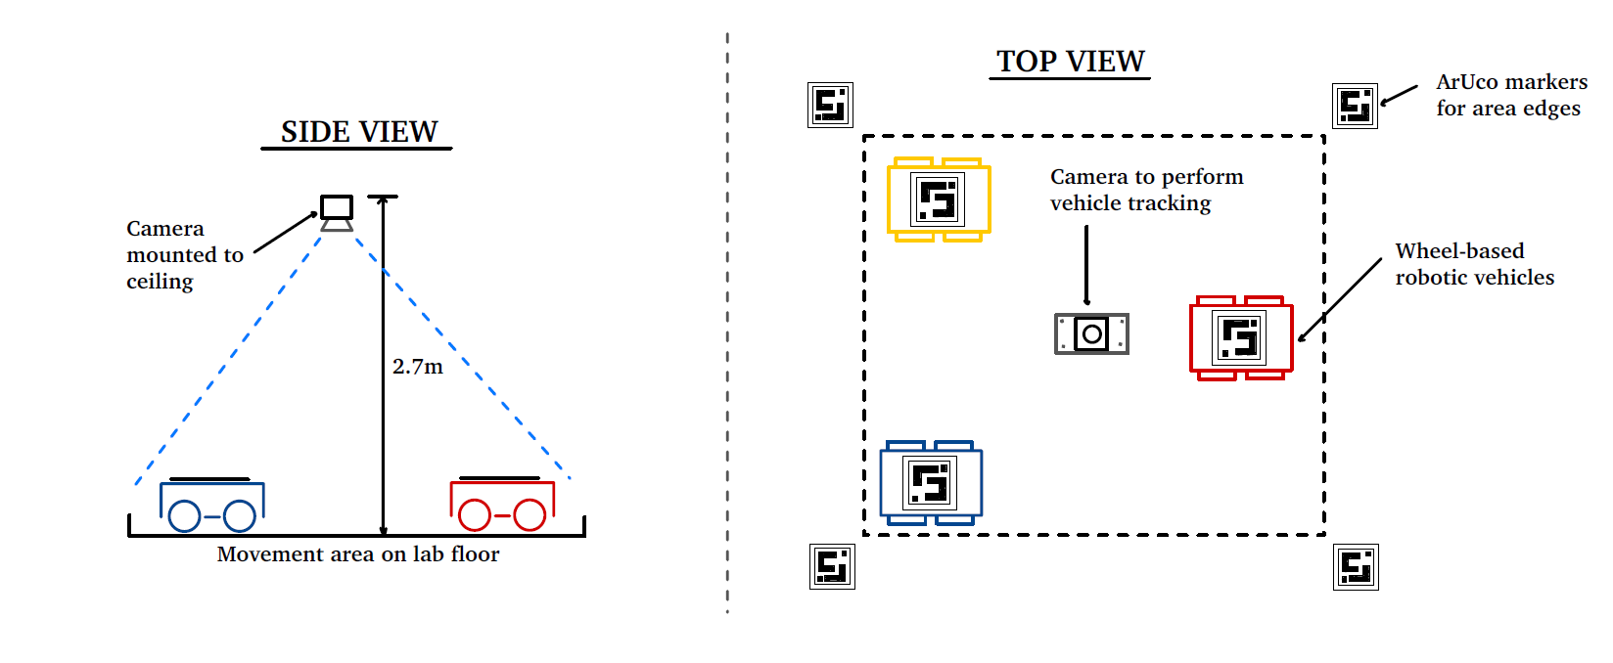
Hardware selection
Demonstration components
Cost was a major consideration.
Basic robotics kit with most components.
Bluetooth receivers for communication of commands.
ArUco markers were chosen for accuracy.
  Sufficiently accurate with well-sized markers.
  Lots of support and drivers available.
  Implementation required large FOV camera to give large movement area.
Notes:
Cost.
Bluetooth commands and wheel encoders for speed controllers.
ArUco:
Accurate if size right
Support
Large FOV camera
INSTEAD OF MOTION CAPTURE
Laptop:
- Calculate paths
- Send necessary commands in the form of voltages or omegas

Slide 5
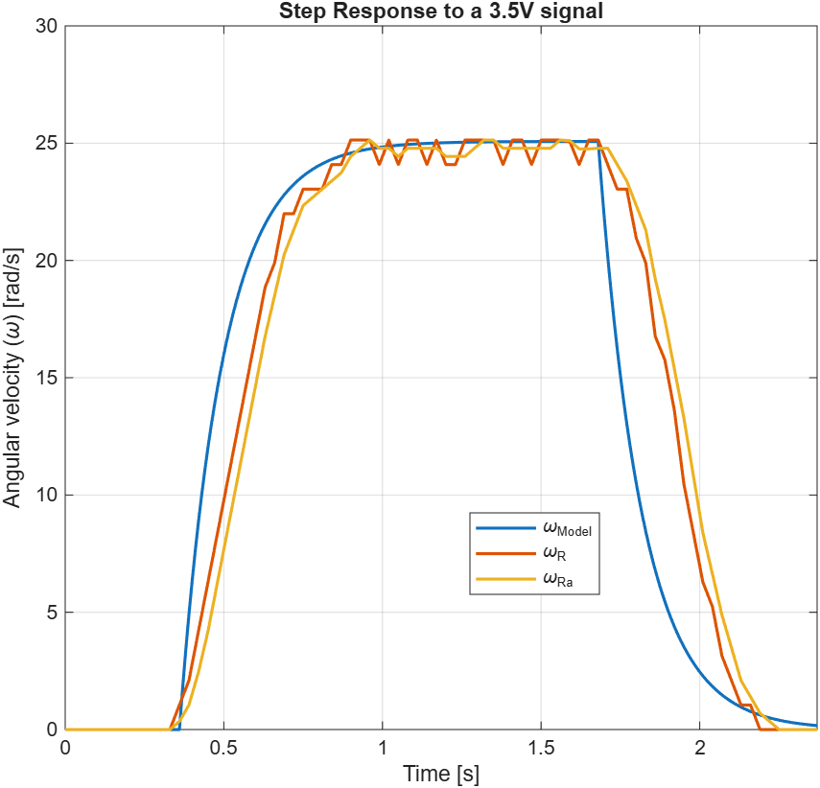
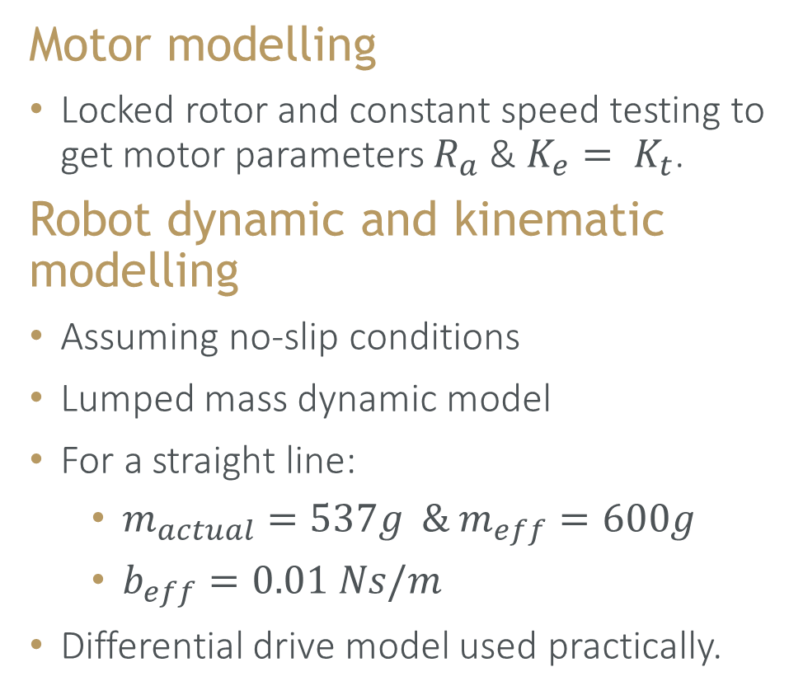
Robot modelling
Motor modelling
Locked rotor and constant speed testing to get motor parameters $R_{a}$ & $K_{e}= K_{t}$.
Robot dynamic and kinematic modelling
Assuming no-slip conditions
Lumped mass dynamic model
For a straight line:
  $m_{actual}=537g \& m_{eff}=600g$
  $b_{eff}=0.01 Ns/m$
Differential drive model used practically.
Notes:
No data on low cost motors.
Needed to test to get armature resistance and the motor constants.
Needed for dynamic modelling.
Forward, left and right only so no-slip can be assumed.
Lumped mass model with an effective moment of inertia and viscous damping.
For straight line, J = m and also expect b to be small.

Slide 6
Safety
General safety rules
Follow all lab safety measures regarding closed shoes, long trousers and no baggy clothes.
Never work by yourself in laboratories.
Project specific safety
Needed to create 3S LiPo batteries
  Cells pose a fire hazard if shorted during assembly.
  Tape any open conductors.
  Work in a clear workspace as best to let potential fire burn.
  Make use of lab’s e-waste bin if something were to go wrong.

Slide 7
Work to be done
1. Trajectory controller implementation
Plan to implement a Pure Pursuit controller.
On track to be finished by mid-next week.
2. Discretize the models and controllers and implement into demonstration
Bluetooth implementation is mostly done.
Implement ArUco marker tracking.
Validate and test demonstration results.
Notes:
Pure pursuit: Easy to implement, and will not result in maximum turn rate as soon as a corner is seen due to look ahead.

Slide 8
Conclusion
Project aims to create a CCA route planner and demonstrate it.
Centralised A* Search planning was chosen and executed.
Cost-effective hardware was chosen and then modelled.
All relevant safety precautions have been taken.
The route planner and robot modelling are complete, still need to complete the controllers and implement them into the demonstration.
On track to finish in time for the submission deadline.

Slide 9
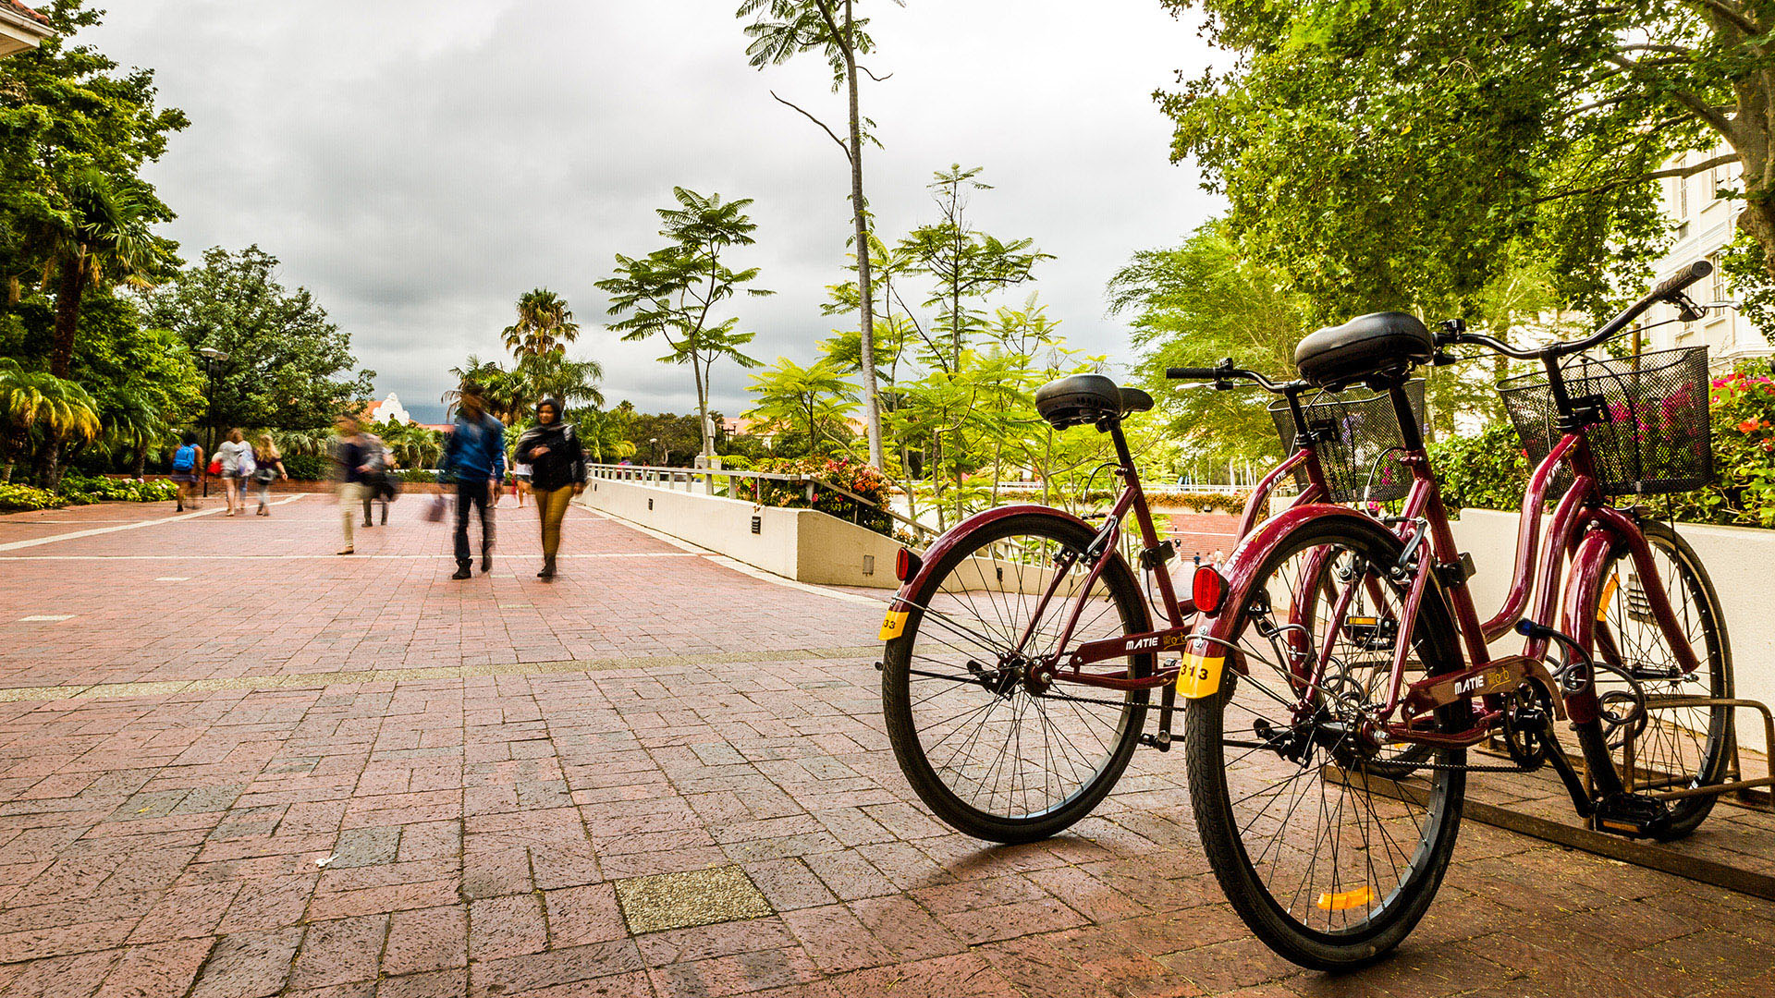
Thank you
Enkosi
Dankie
Photo by Stefan Els
Notes:
Thank you very much for your time.

Slide 10
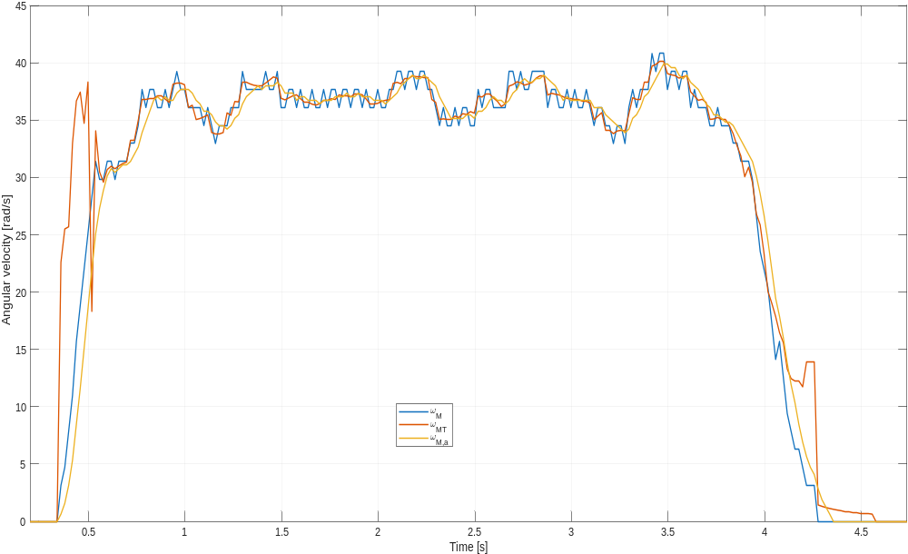
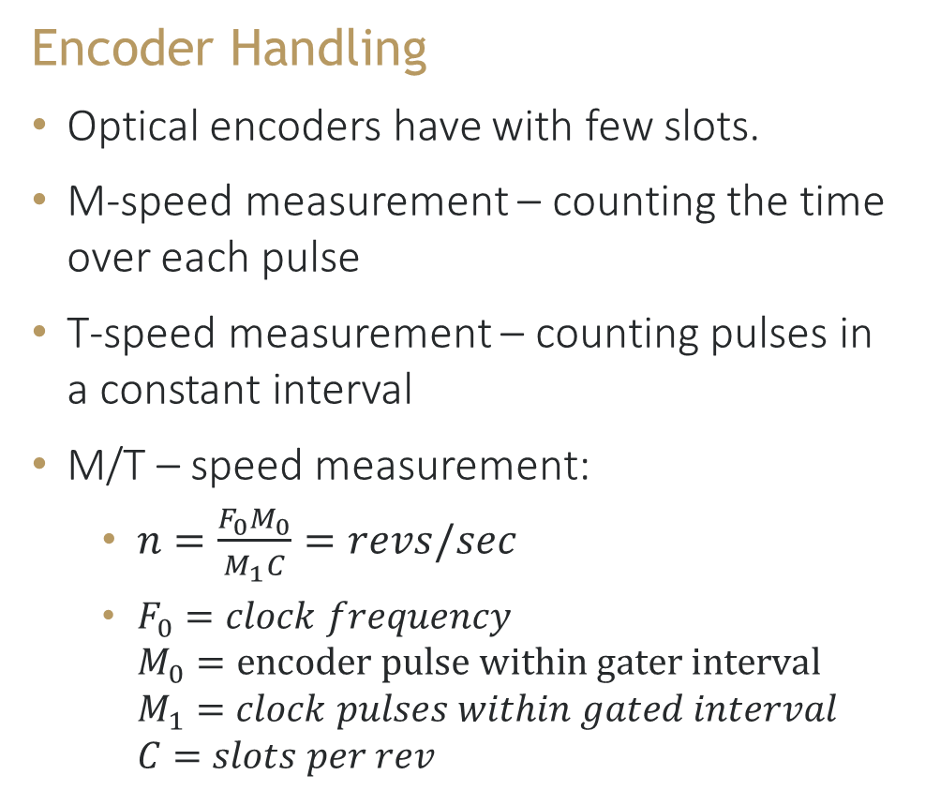
Robot modelling
Encoder Handling
Optical encoders have with few slots.
M-speed measurement – counting the time over each pulse
T-speed measurement – counting pulses in a constant interval
M/T – speed measurement:
  $n=\frac{F_{0}M_{0}}{M_{1}C}=revs/sec$
  $F_{0}=clock frequency$
  $M_{0}=encoder pulse within gater interval$ $M_{1}=clock pulses within gated interval$
  $C=slots per rev$
Notes:
M works very well if you have lots of slots.
T fails to deal with the transient very well.

Slide 11
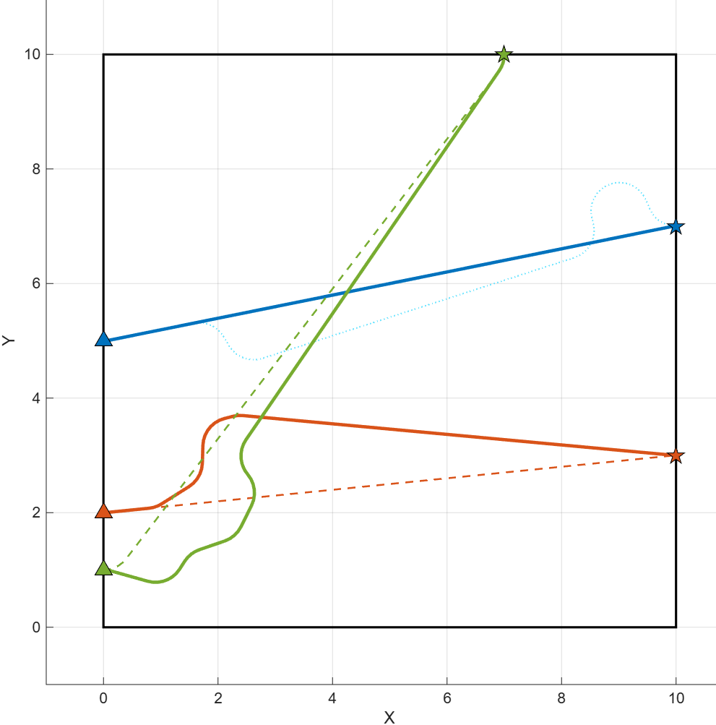
Extra slides for clarification
RRT

Slide 12
Extra slides for clarification
Setup

Slide 13
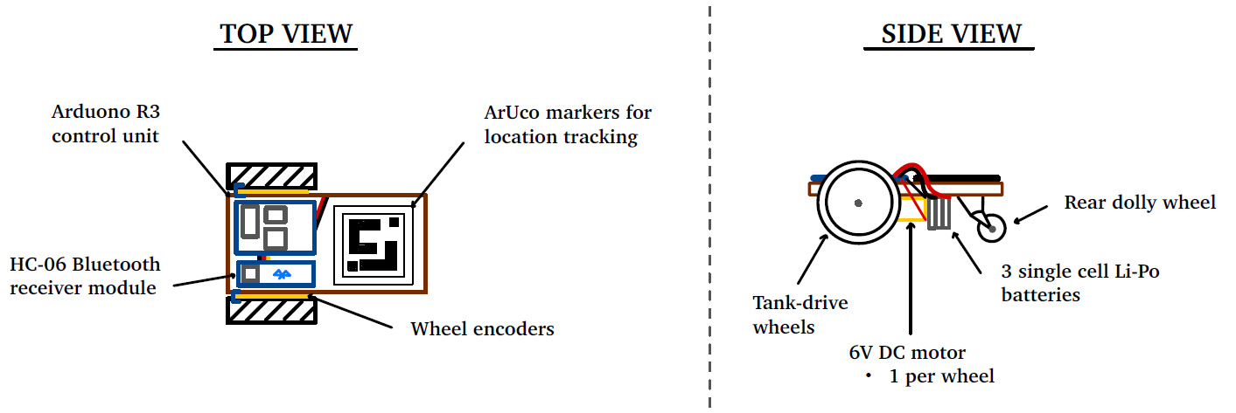
Extra slides for clarification
Setup

Slide 14
Extra slides for clarification
Dynamics modelling

Slide 15
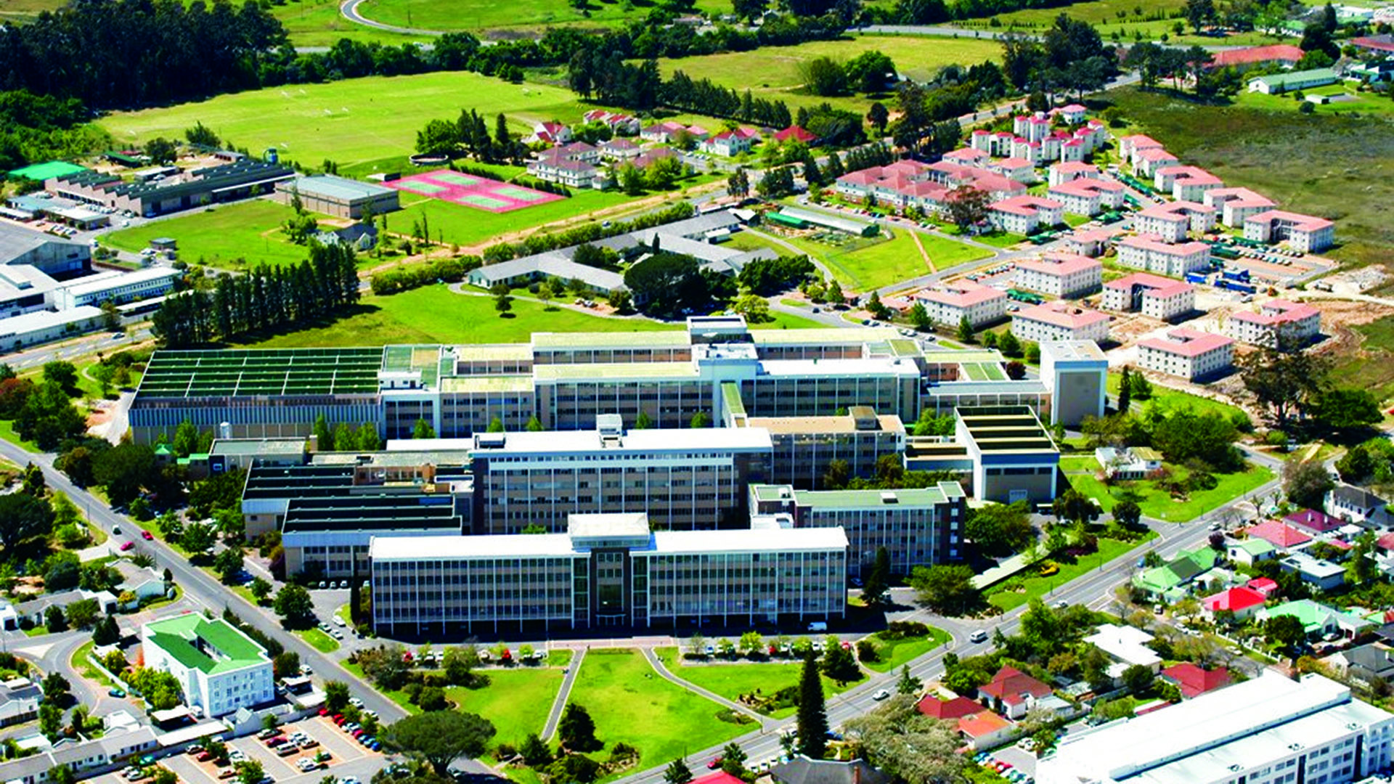
Partner logo
Partner logo
PRESENTATION TITLE
Date
Photo by Stefan Els
Notes:
Co-branded Cover Slide Option
Replace the background image:
Right-click on the slide, then choose Format Background and select Picture or texture fill. Select a new picture of your choice.
Remember to add an image attribution for e.g., Photo by Stefan Els.

Slide 17
A* Search with Priority
Rapidly Expanding Random Trees
A* Search with no priority

