Slide 1
UNIFIED CIVIL ENGINEERING COMPUTATION TOOL (UCECT)
Name: K. Kiranmai
Roll No: 25A31A0117

Slide 2
REQUIREMENTS:
Software Requirements
C Compiler (GCC / Turbo C)
Notepad / VS Code / Any IDE
Hardware Requirements
RAM: 512 GB or more
Operating System: Windows / Linux
Hard Disk: 20 GB

Slide 3
INTRODUCTION:
The Unified Civil Engineering Computation Tool (UCECT) is a C-based software application designed to perform multiple civil engineering calculations in a single platform. Civil engineering students and professionals often need to perform repetitive calculations using different methods and tools. UCECT overcomes this problem by integrating important calculations into one menu-driven program. The tool includes modules for Stopping Sight Distance, Soil Bearing Capacity checking, and Water Tank Volume calculation. It accepts user inputs, processes them using standard engineering formulas, and displays accurate results. This project helps bridge the gap between theoretical knowledge and practical civil engineering applications.

Slide 4
ALGORITHM:
Stopping Sight Distance (SSD)
Step 1: Start.
Step 2: Read input: Ask user to enter speed V in km/h.
Step 3: Read input: Ask user to enter reaction time t in seconds (typical 2.5 s if unknown).
Step 4: Read input: Ask user to enter coefficient of friction f (dimensionless).
Step 5:Read input: Ask user to enter grade G as a decimal (e.g., +0.02 for +2% uphill, −0.03 for −3% downhill).
Step 6: Validate inputs: Ensure V ≥ 0, t > 0, f > 0. If invalid show error and stop.
Step 7: Compute lag (thinking) distance LD:
LD = 0.278 × V × t.
Step 8: Compute braking denominator:
denom = 254 × (f + G).
If denom ≤ 0, show error (unsafe/invalid friction+grade) and stop.

Slide 5
Step 9: Compute braking distance BD:
BD = (V × V) / denom.
Step 10: Compute SSD:
SSD = LD + BD.
Step 11: Output: Display LD, BD, SSD with units (meters).
Step 12: End.
Soil Bearing Capacity Checker — Step-wise
Step 1: Start.
Step 2: Read input: Ask user to enter applied total vertical load P in kN.
Step 3: Read input: Ask user to enter footing area A in m².
Step 4: Validate inputs: Ensure P ≥ 0 and A > 0. If invalid show error and stop.
Step 5: Compute ultimate bearing pressure q = P / A (kN/m²).
Step 6: Apply factor of safety (optional): If user supplies FS (typical 2.5–3), compute allowable / safe bearing capacity SBC = q / FS. If no FS, assume SBC = q and note it is unfactored.

Slide 6
Step 7: Classify soil (example thresholds):
If SBC ≤ 100 kN/m² → “Weak soil”
If 100 < SBC ≤ 200 kN/m² → “Medium strength”
If SBC > 200 kN/m² → “Strong soil”
(Mention these are example thresholds — user may change them.)
Step 8: Output: Display q, SBC (if FS used), and classification. Include units (kN/m²).
Step 9: End.
Water Tank Volume Calculator — Step-wise (Menu + two shapes)
Step 1: Start.
Step 2: Display menu:
1. Rectangular tank
2. Cylindrical tank
Step 3: Read input: User selects choice (1 or 2).

Slide 7
Step 4:Validate choice: If invalid show error and return to menu or stop.
If choice = 1 (Rectangular):
5. Read length L (m).
6. Read width W (m).
7. Read height H (m).
8. Validate L>0, W>0, H>0 — if not, show error and stop.
9. Compute Volume V = L × W × H (m³).
10. Optionally compute litres = V × 1000.
11. Display V (m³) and litres.
12. End.
If choice = 2 (Cylindrical):

Slide 8
5. Read radius r (m) or diameter d (m). If diameter given, set r = d/2.
6. Read height h (m).
7. Validate r>0 and h>0 — if not, show error and stop.
8. Compute Volume V = π × r² × h (use π = 3.14159265).
9. Optionally compute litres = V × 1000.
10. Display V (m³) and litres.
11. End.

Slide 9
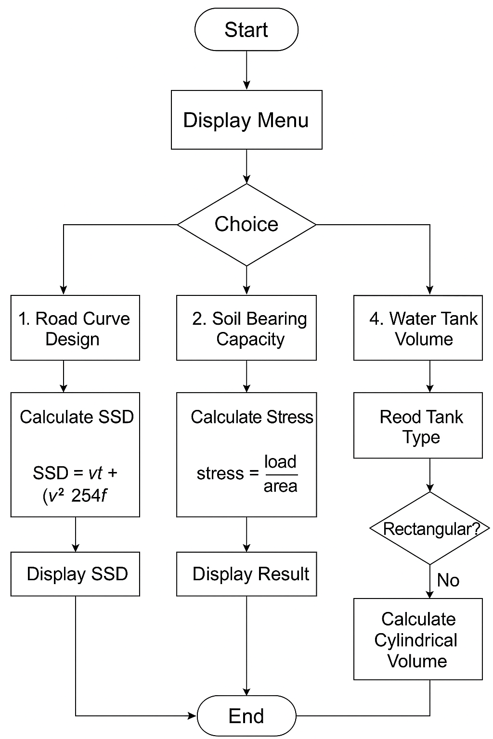
FLOWCHART:

Slide 10
MODULES for the Project:
1. Stopping Sight Distance (SSD).
2. Soil Bearing Capacity Checker
3. Water Tank Volume Calculator.

Slide 11
Road Curve Design – Stopping Sight Distance (SSD)
Module 1: Input Module
Design speed
Brake reaction time
Coefficient of friction
Gradient
Module 2: SSD Calculation Module
Perception–reaction distance
Braking distance
Total Stopping Sight Distance (SSD)
Module 3: Output Module
Reaction distance
Braking distance
Final SSD result
Safe/unsafe indication for road design

Slide 12
Soil Bearing Capacity Checker
Module 1: Input Module
Soil type
Cohesion (c)
Angle of internal friction (ϕ)
Unit weight (γ)
Foundation width (B)
Foundation depth (D)
Module 2: Bearing Capacity Calculation Module
Terzaghi’s formula
Calculates ultimate bearing capacity
Calculates net and safe bearing capacity (using FOS)
Module 3: Output Module
Ultimate bearing capacity
Net SBC
Safe SBC
Suitable foundation recommendation

Slide 13
Water Tank Volume Calculator
Module 1: Input Module
Select tank type (rectangular/cylindrical)
Rectangular: Length, Width, Height
Cylindrical: Radius, Height
Module 2: Volume Calculation Module
Volume in m³
Converts to litres
Module 3: Output Module
Volume in cubic meters
Volume in litres

Slide 14
MODULE WISE LOGIC:
1. The program uses a menu-driven approach implemented inside an infinite while loop.
2. A main control module displays the menu and accepts the user’s choice.
3. The switch-case structure integrates all computation modules in a single program.
4. Case 1 integrates the SSD module, which calculates the Stopping Sight Distance based on user inputs.

Slide 15
MODULE WISE LOGIC:
5. Case 2 integrates the Soil Bearing Capacity module, which checks whether the foundation is safe or unsafe.
6. Case 3 integrates the Water Tank Volume module, which calculates the volume of rectangular or cylindrical tanks.
7. Each module performs its calculation independently using local variables.
8. After execution of any module, control returns to the main menu automatically.
9. Case 4 acts as the exit module, terminating the program safely.

Slide 16
MODULE INTEGRATION(CODE):
#include <stdio.h>
int main()
int choice; // menu choice
while (1) // infinite loop to repeat menu until exit
{
printf("\n==== MAIN MENU ====\n");
printf("1. Road Curve Design – Stopping Sight Distance (SSD)\n");
printf("2. Soil Bearing Capacity Checker\n");
printf("3. Water Tank Volume Calculator\n");
printf("4. Exit\n");
printf("Enter your choice: ");
scanf("%d", &choice);

Slide 17
switch (choice)
{
// -------------------- SSD PROGRAM --------------------
case 1:
{
float v, t, f, SSD;
printf("\n=== Road Curve Design – Stopping Sight Distance (SSD) ===\n");
printf("Enter speed of vehicle (km/hr): ");
scanf("%f", &v);
printf("Enter reaction time (sec): ");
scanf("%f", &t);
printf("Enter coefficient of friction: ");
scanf("%f", &f);

Slide 18
SSD = (v * t) + ((v * v) / (254 * f));
printf("\nStopping Sight Distance (SSD) = %.2f meters\n", SSD);
break;
}
// -------------------- SOIL BEARING CAPACITY PROGRAM --------------------
case 2:
{
float load, area, SBC, stress;
printf("\n=== Soil Bearing Capacity Checker ===\n");
printf("Enter load on foundation (kN): ");
scanf("%f", &load);
printf("Enter area of foundation (sq.m): ");
scanf("%f", &area);
printf("Enter safe bearing capacity of soil (kN/sq.m): ");
scanf("%f", &SBC);

Slide 19
stress = load / area;
printf("\nApplied Stress = %.2f kN/m2\n", stress);
if (stress <= SBC)
printf("Result: SAFE — Soil can bear the load.\n");
else
printf("Result: NOT SAFE — Increase foundation size.\n");
break;
}
// -------------------- WATER TANK VOLUME PROGRAM --------------------
case 3:
{
int tankType;
float length, width, height, radius, volume;
printf("\n=== Water Tank Volume Calculator ===\n");
printf("1. Rectangular Tank\n");
printf("2. Cylindrical Tank\n");

Slide 20
printf("Enter type: ");
scanf("%d", &tankType);
if (tankType == 1) {
printf("Enter length (m): ");
scanf("%f", &length);
printf("Enter width (m): ");
scanf("%f", &width);
printf("Enter height (m): ");
scanf("%f", &height);
volume = length * width * height;
printf("\nVolume of Rectangular Tank = %.2f cubic meters\n", volume);
}
else if (tankType == 2) {
printf("Enter radius (m): ");
scanf("%f", &radius);

Slide 21
printf("Enter height (m): ");
scanf("%f", &height);
volume = 3.1416 * radius * radius * height;
printf("\nVolume of Cylindrical Tank = %.2f cubic meters\n", volume);
}
else {
printf("Invalid tank type!\n");
}
break;
}
// -------------------- EXIT --------------------

Slide 22
case 4:
printf("\nExiting program...\n");
return 0; // stop entire program
default:
printf("\nInvalid choice! Try again.\n");
}
printf("\nPress Enter to return to Main Menu...");
getchar(); // to consume leftover newline
getchar(); // wait for user
}
return 0;
}

Slide 23
SAMPLE OUTPUT:
1. Road Curve Design – Stopping Sight Distance (SSD)
2. Soil Bearing Capacity Checker
3. Water Tank Volume Calculator
4. Exit
Enter your choice: 1
=== Road Curve Design – Stopping Sight Distance (SSD) ===
Enter speed of vehicle (km/hr): 80
Enter reaction time (sec): 5
Enter coefficient of friction: 10
Stopping Sight Distance (SSD) = 402.52 meters
Press Enter to return to Main Menu…

Slide 24
CONCLUSION:
The Unified Civil Engineering Computation Tool (UCECT) integrates important civil engineering calculations into a single C-based application. It helps users easily perform Stopping Sight Distance, Soil Bearing Capacity, and Water Tank Volume calculations. The menu-driven approach makes the program simple and user-friendly. Accurate input handling and validation ensure reliable results. The modular structure improves clarity and allows easy modification or expansion in the future. UCECT bridges the gap between theoretical knowledge and practical engineering applications. It runs on basic hardware and standard C programming tools. Overall, the project is a useful learning and computation tool for civil engineering students.

