Slide 1
PROJECT-1
HOSPITAL PATIENT MANAGEMENT SYSTEM

Slide 2

What is it?
It is a digital version of a patient’s paper chart.
It serves as a central repository for everything related to a patient's health journey.
It allows authorized users to access data instantly and securely from different departments.

Slide 3

A Hospital Patient Record System (HPRS) is a digital software platform used by healthcare facilities to electronically store, manage, and retrieve patient health information. It replaces traditional paper files with a centralized, secure database.
It is often referred to technically as an EHR (Electronic Health Record) or EMR (Electronic Medical Record).

Slide 4

Why do hospitals invest in this system instead of using paper files?
Data Centralization: It brings together scattered information into one single screen.
Patient Safety (Critical): The system can automatically alert doctors if a prescribed medicine will react dangerously with another medicine the patient is taking.
Legibility: It eliminates errors caused by unclear handwriting on paper prescriptions.
Data Security: Digital records can be encrypted, password-protected, and backed up to the cloud, unlike paper records which can be lost to fire, water, or theft.
Speed: In an emergency, a doctor can pull up a patient's blood group and allergies in seconds, rather than waiting for a clerk to find a physical file.

Slide 5

The main idea of hospital patient record system are:
1. Digitization
2. Centralization (One Patient, One Record).
3. Unique Identification.
4. Instant Accessibility.
5. Interconnectivity.
6. Clinical Safety.
7. Data Security.

Slide 7
THE CONCEPT OF USER-DEFINED DATA TYPES (STRUCT)
Standard C data types (int, float, char) are insufficient for complex data. An integer can store a heartbeat, but it cannot store a "Patient."
Theory: The struct keyword allows you to create a Composite Data Type.
In your code: struct Patient is not a variable itself; it is a blueprint (or template).
When you write struct Patient p1; inside main(), you are telling the compiler: "Reserve a block of memory large enough to hold all the fields defined in the Patient blueprint."

Slide 8
Nested Structures(Composition)
This is the most advanced concept in the snippet. You will notice struct Date Address and then used inside struct Patient. are defined outside
Theory: This is called Composition (a "Has-A" relationship).
A Patient has a Name (string).A Patient has a Date of Birth (struct).
Why we do it: It promotes Reusability. If you later build a struct Doctor or Appointment, you can reuse the same struct Date without rewriting the day, month, and year logic.

Slide 9
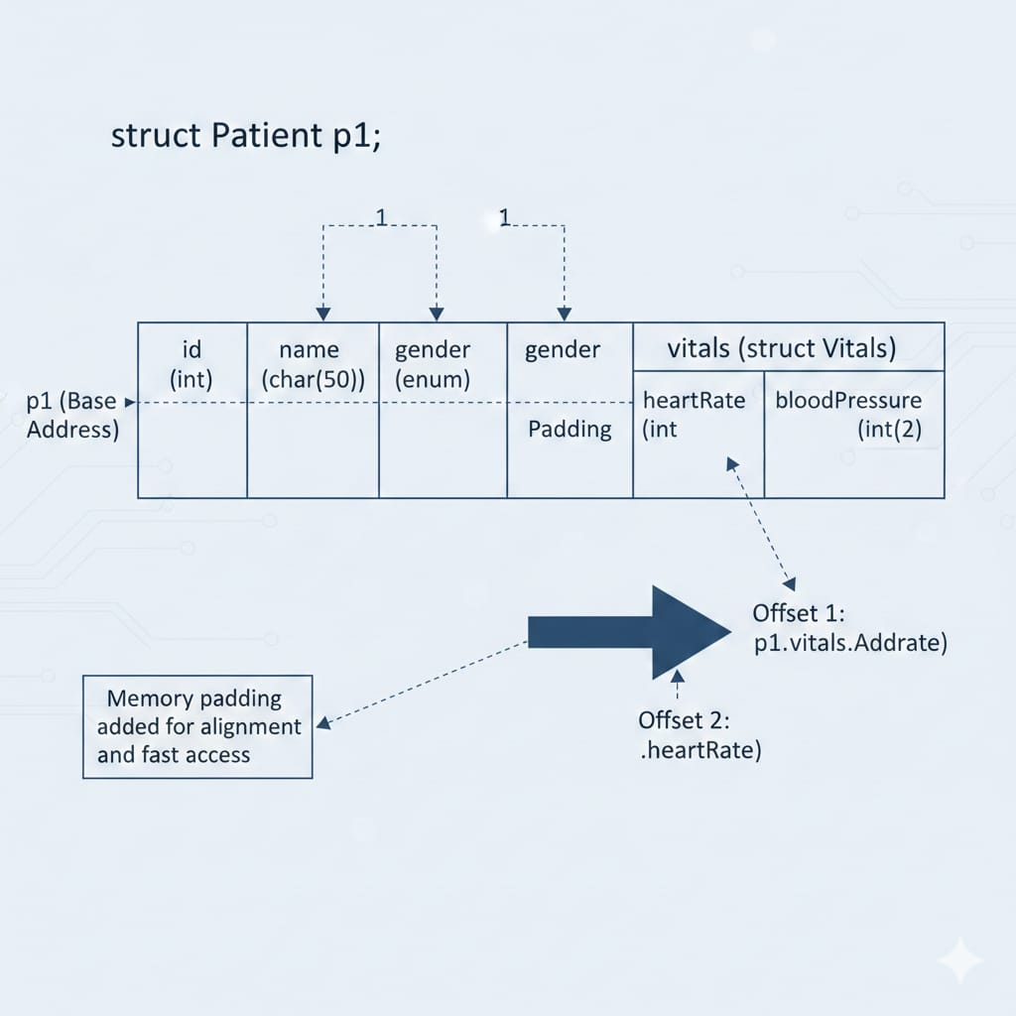
Memory Layout & Padding
When struct Patient p1; is declared, a single continuous block of memory is allocated.
All members (id → name → gender → vitals → etc.) are stored one after another in this block.
The dot operator (.) works like an offset finder.
For p1.vitals.heartRate, the compiler does:
Start at the base address of p1.
Move to the vitals sub-structure inside p1.
Move further to the heart Rate variable inside vitals.
Memory padding may be added by the compiler to maintain alignment and fast access.

Slide 10
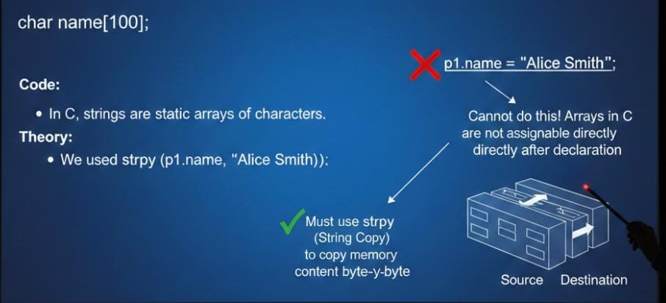
STRING HANDLING IN STRUCTURES
Code: char name[100];
Theory: In C, strings are static arrays of characters.
We used strcpy (p1.name, "Alice Smith"); . You cannot do 1.name = "Alice Smith"; because arrays in C are not assignable
via the = operator after declaration. You must copy the memory content byte-by-byte, which is what strcpy (String Copy) does.

Slide 11
PASSING STRUCTURES TO FUNCTIONS
Code: void display Patient(struct Patient p)
Theory: This uses Pass-by-Value.
When you call display Patient (p1), the program creates a copy of the entire p1 structure and hands it to the function.
Implication: If the function modifies p, it changes the copy, not the original p1 in main
Performance Note: For very large structures (e.g., if a patient had a massive MRI image buffer), passing by value is slow because it copies too much data. In professional systems, we pass by Reference (using Pointers) to avoid this overhead.

Slide 12
THANK YOU
TEAM MEMBERS:
ADABALA ANJALI-25A31A04J4
AKELLA AKSHAYA-25A31A04J5
ANGADI BHAGYA SWAMI-25A31A04M1
ARIGELA JOSHI ADITYA RAM-25A31A04M2

