Slide 1

Mastering Payro l Calculation with C Programming
Embark on a journey to understand how C programming can be leveraged to automate and streamline payroll calculations. This presentation will guide you through the fundamental concepts and practical implementation.

Slide 2




Understanding the Core Challenge: Manual Payroll
Manual Calculations
Prone to human errors, time-consuming, and inefficient for large organisations.
Paperwork s Records
Managing physical records can be cumbersome, leading to misplaced documents and audit complexities.
Compliance Risk
Keeping up with ever-changing tax laws and labour regulations is a constant challenge.

Slide 3





Why C for Payroll? A Powerful Solution
Performance
C offers high performance, crucial for processing large datasets quickly and efficiently.
System-Level Access
Its low-level capabilities allow for optimal resource management and direct hardware interaction.
Robustness
C is known for creating stable and reliable applications, essential for financial systems.
Portability
Code written in C can be easily compiled and run on various platforms with minimal modifications.

Slide 4
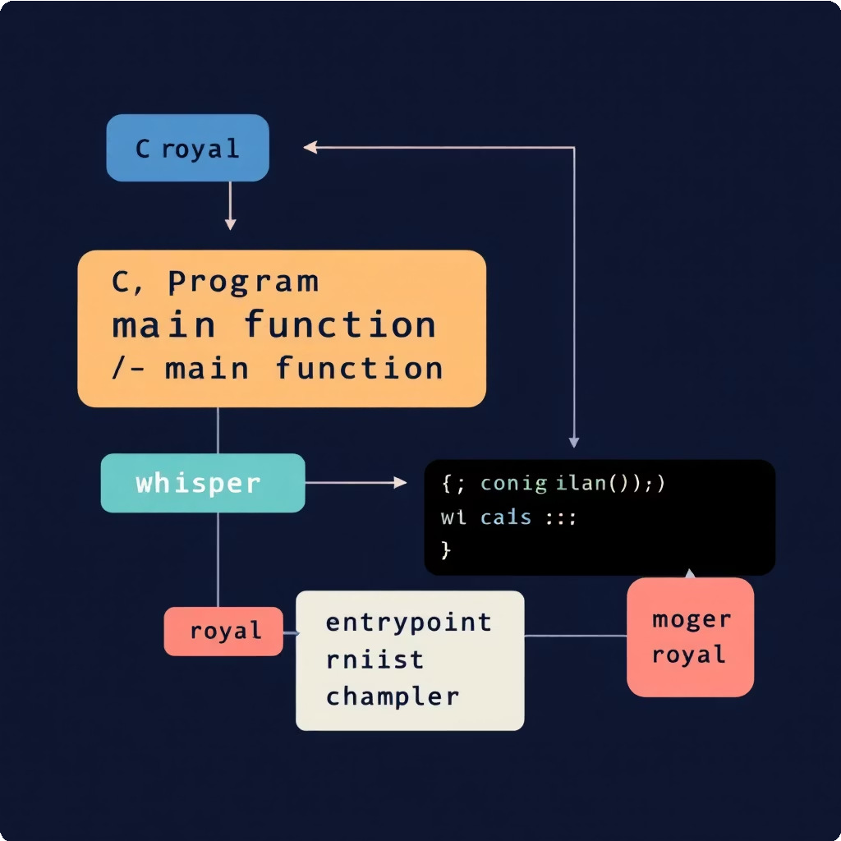



Code Breakdown: The 'main' Function
The main() function is the entry point of every C program. It's where execution begins.
#include
int main() {
char name[50], department[50]; int id;
float basic, hra, da, pf, gross, net;
Key Variables Declared
name, department: Stores employee text data.
id: Unique employee identification number.
basic: Fundamental salary component.
hra, da, pf, gross, net: Variables for various salary calculations.

Slide 5

Input Collection: Gathering Employee Data
The program interacts with the user to collect necessary employee details, which are then stored in declared variables.
01
Employee ID
Unique numeric identifier for each employee.
printf("Enter Employee ID: "); scanf("%d", &id);
02
Employee Name
Full name of the employee.
printf("Enter Employee Name: "); scanf("%s", name);
03
Department
The department the employee belongs to.
printf("Enter Department: "); scanf("%s", department);
04
Basic Salary
The base remuneration before any additions or deductions.
printf("Enter Basic Salary: "); scanf("%f", &basic);

Slide 6



Payroll Components: Dissecting Salary Calculations
A typical payroll system involves several components that make up an employee's total earnings and deductions.
Basic Salary
The foundation of the salary structure.
HRA (20%)
House Rent Allowance, calculated as 20% of Basic Salary.
PF (8%)
Provident Fund, a mandatory deduction
of 8% from Basic Salary.
DA (10%)
Dearness Allowance, calculated as 10% of Basic Salary.

Slide 7
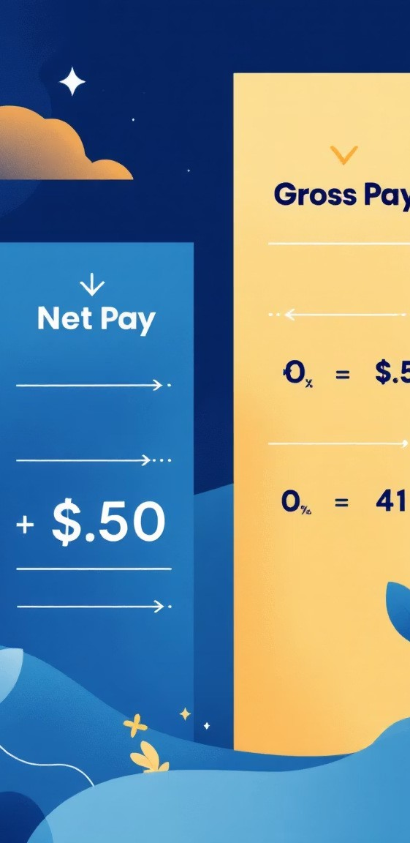
The Calculation Logic: Gross and Net Salary
Once the individual components are determined, the program calculates the gross and net salaries.
Gross Salary
This is the total salary earned by an employee before any deductions. It includes Basic, HRA, and DA.
Net Salary
Take-home pay after PF
Basic Salary
Core pay component
PF Deduction
Provident fund contribution
Gross and Net Salary
HRA
Housing allowance
gross = basic + hra + da;
Gross Salary
Total before deductions
DA
Dearness allowance
Net Salary
The final amount an employee takes home after all deductions, like Provident Fund, are subtracted from the gross salary.
net = gross - pf;

Slide 8
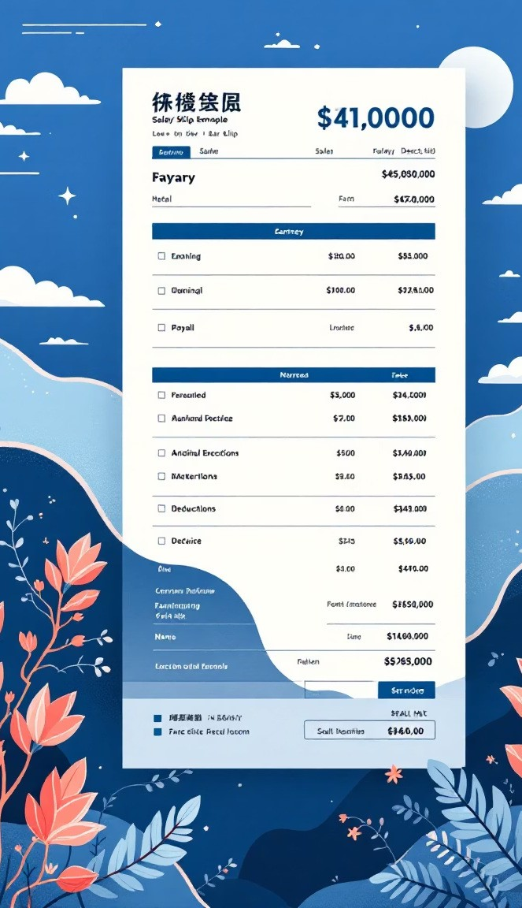
Outputting the Salary Slip: Clarity s Detail
The program then neatly formats and prints the employee's salary slip, ensuring all details are clearly presented.
printf("\n \n");
printf(" EMPLOYEE SALARY SLIP\n");
printf(" \n");
printf("Employee ID : %d\n", id); printf("Employee Name : %s\n", name); printf("Department : %s\n", department); printf(" \n");
printf("Basic Salary : %.2f\n", basic); printf("HRA (20%%) : %.2f\n", hra);
printf("DA (10%%) : %.2f\n", da); printf("PF Deduction (8%%): %.2f\n", pf); printf(" \n");
printf("Gross Salary : %.2f\n", gross); printf("Net Salary : %.2f\n", net);
printf(" \n");

Slide 9

Enhancing the Code: Future Possibilities
Database Integration
Store employee data and salary records in a database for better management and retrieval.
User Interface
Develop a graphical user interface (GUI) for easier interaction and improved user experience.
Tax Calculations
Incorporate more complex tax deductions and local tax laws.
Report Generation
Add functionalities to generate detailed reports for auditing and financial analysis.

Slide 10

Key Takeaways: Your C Payroll Journey
Foundational Logic
Understood the basic structure and variable declarations in C programming for payroll.
Practical Application
Learned to implement input, calculation, and output for a simple payroll system.
Growth Potential
Identified areas for expansion and improvement in the payroll application.
This foundational knowledge in C programming for payroll opens doors to more complex and robust financial applications. Keep exploring and coding!

