Slide 1
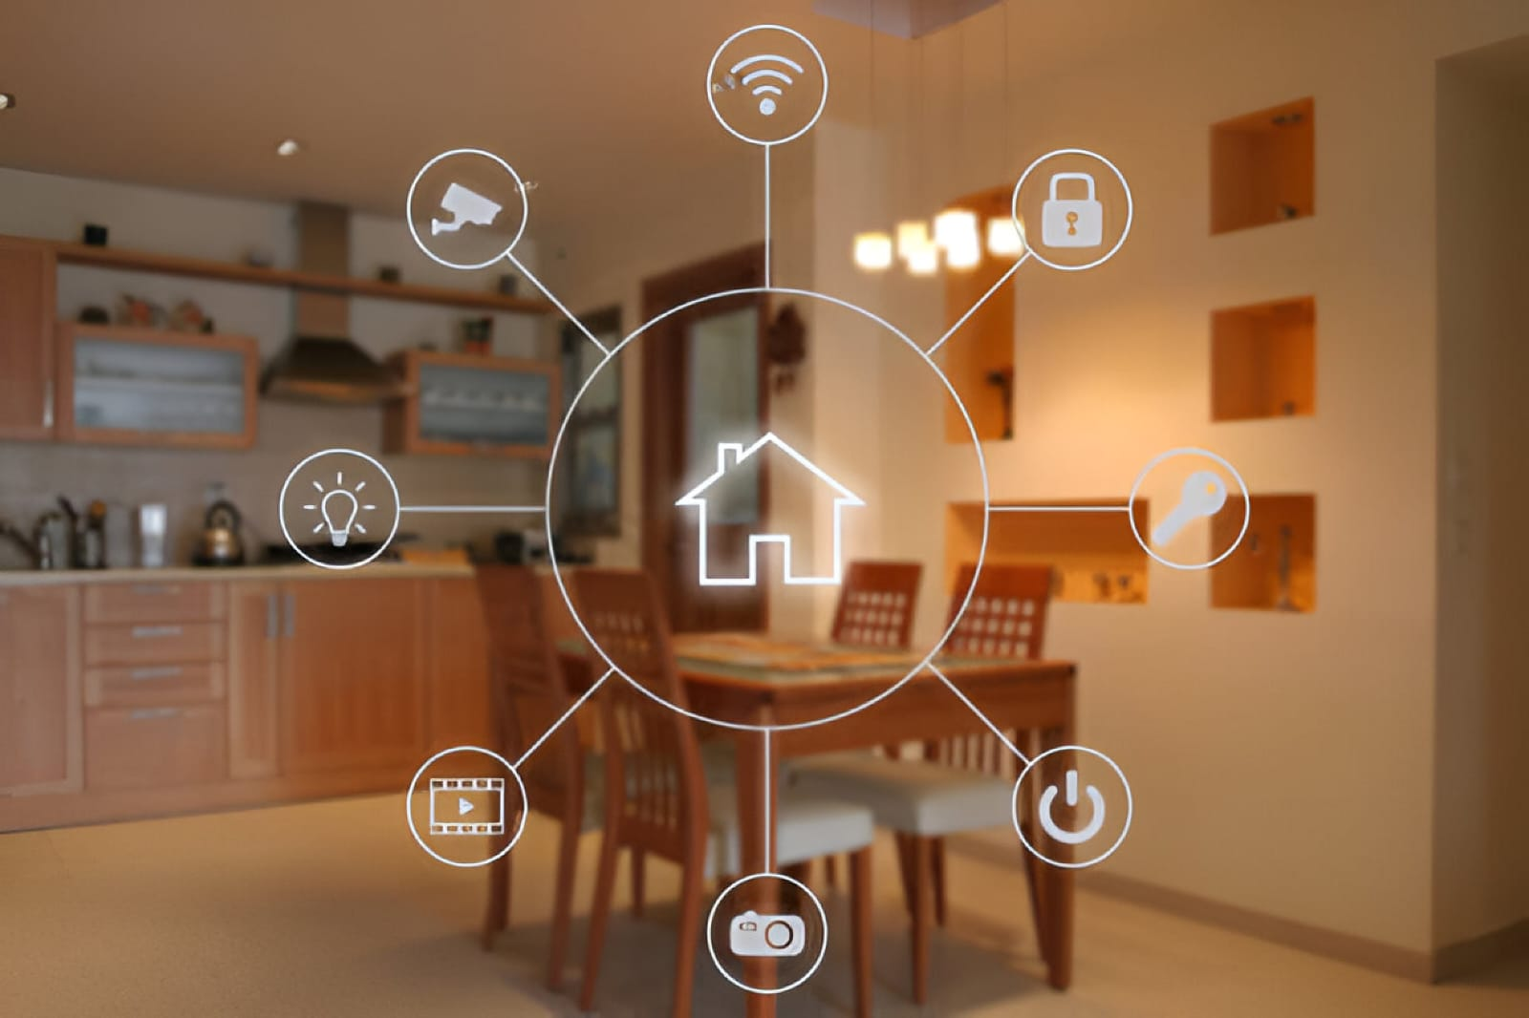

Slide 2
B
A
C
D
Displays energy consumption
Measures electricity usage in Real time
Helps reduce power wastage
Accessed virtually via mobile or web

Slide 3

A
B
C
D
Measures electricity usage in Real time
Displays energy consumption
Helps reduce power wastage
Accessed virtually via mobile or web

Slide 4
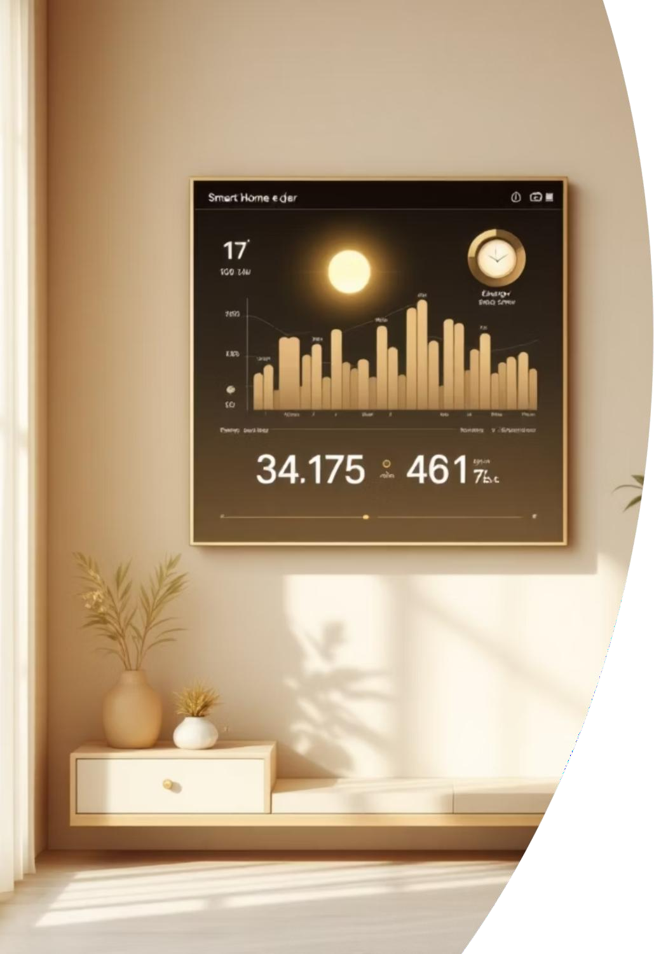
Smart Home Energy Monitor
Programming-based Energy Monitoring System
A computational solution for tracking and optimizing household electricity consumption through automated data analysis and intelligent recommendations.

Slide 5
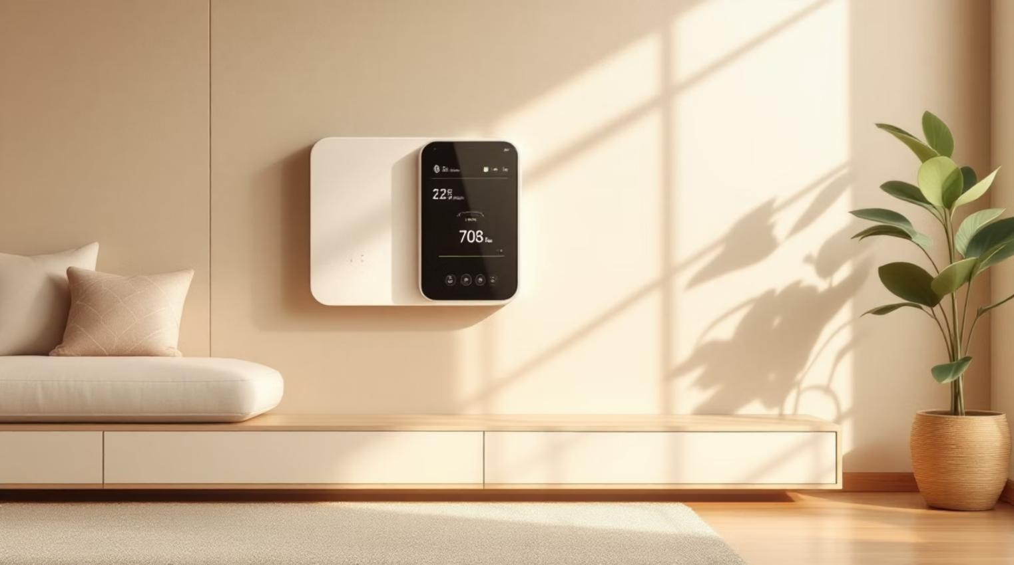
What is a Smart Home Energy Monitor?
Energy Monitoring System
A Smart Home Energy Monitor is a computational system that tracks electricity consumption patterns across household appliances. It processes usage data to provide insights into energy expenditure and identifies optimization opportunities.
Real-time tracking of appliance power
usage
Automated cost calculation based on tariff rates
Data-driven recommendations for
efficiency

Slide 6






Why Energy Monitoring Matters
Financial Savings
Understanding consumption patterns helps identify wastage and reduce electricity bills significantly.
Environmental Impact
Lower energy consumption reduces carbon footprint and supports sustainable living practices.
Consumer Awareness
Provides visibility into which appliances consume most power, enabling informed decisions.

Slide 7
Project Overview
How the System Works
Data Input
Reads appliance usage data from structured file
Processing
Calculates energy consumption and costs
Analysis
Identifies high-usage appliances
Recommendations
Suggests optimization strategies
The program processes appliance-level energy data stored in a file, performs calculations to determine total consumption and associated costs, then analyzes patterns to suggest reduction strategies.

Slide 8
Project Objectives
01
Monitor Energy Usage
Track power consumption across all household appliances with detailed logging
03
Identify High-Consumption Appliances
Flag devices that consume excessive power and contribute most
to bills
02
Calculate Consumption & Cost
Determine total energy usage in kilowatt-hours and associated monetary expenses
04
Reduce Energy Wastage
Provide actionable recommendations to minimize unnecessary
consumption

Slide 9
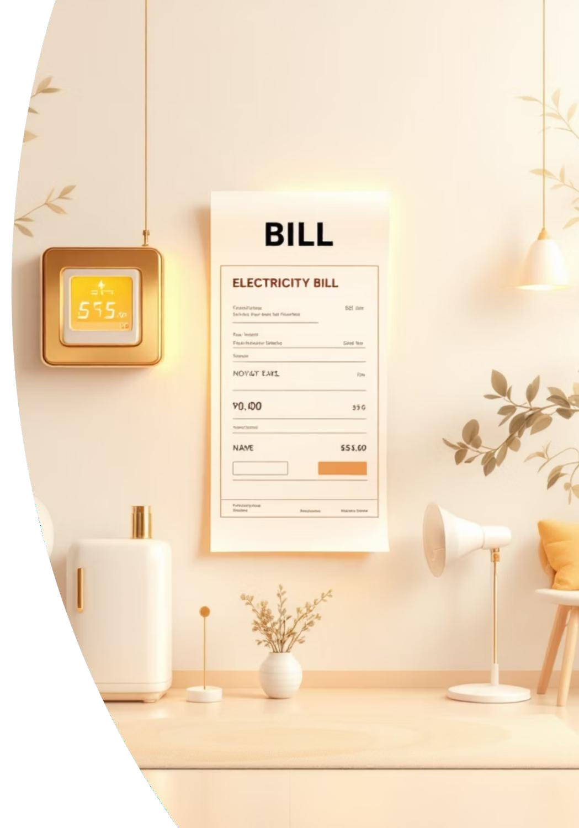
Problem Statement
Lack of Appliance-Level Awareness
Consumers don't know which devices consume most electricity, making optimization difficult.
Escalating Electricity Bills
Without monitoring, households face continuously rising costs without understanding causes.
Absence of Simple Monitoring
Existing solutions are complex or expensive, preventing widespread adoption by average users.

Slide 10


Methodology & Working
Output Stage
Displays total energy consumed, estimated cost, sorted list of appliances by usage, and reduction suggestions
Processing Stage
Calculates energy consumption: (Power × Duration) ÷ 1000 = kWh. Sums total consumption and multiplies by tariff rate for cost
Input Stage
Program reads structured file containing appliance names, power ratings (watts), and usage duration (hours)

Slide 11


Technologies Used
Programming Language
Data Structures or C for implementing core logic and calculations
Data Processing
Sorting algorithms and comparative analysis for usage patterns
File Handling
Reads and processes data from text or CSV files
Mathematical Logic
Energy calculations and cost estimations based on tariff rates

Slide 12
Results & Output
156
kWh Consumed
Total monthly energy usage across all appliances
₹1,872
Estimated Cost
Based on ₹12 per kWh tariff rate
3
High-Usage Appliances
Air conditioner, water heater, and refrigerator identified
Sample Output Analysis
The system processes appliance data and generates comprehensive reports showing consumption patterns. High-usage devices are highlighted, and reduction strategies are suggested based on usage patterns and power ratings.

Slide 13
Advantages, Conclusion & Future Scope
Key Advantages
Easy Implementation
Simple file-based input requires minimal setup
Cost-Effective
No additional hardware needed for basic functionality
Energy Savings
Identifies wastage and suggests optimization
Financial Benefits
Reduces electricity bills through informed usage
Improved Awareness
Provides clear visibility into consumption patterns
Future Enhancements
Real-Time IoT Integration
Connect with smart plugs for live monitoring
Cloud Storage
Store historical data for trend analysis
Mobile Application
Remote access and notifications on mobile devices
AI-Powered Insights
Machine learning for predictive recommendations

