Slide 1
Banking System Simulation
Mini Project Presentation
C++ Programming

Slide 2
Abstract
This project simulates a simple banking system using C++.
Users can deposit, withdraw, and check account balance.
The system demonstrates object-oriented programming concepts.

Slide 3
Introduction
Banking systems are essential for secure financial transactions.
This project is implemented using C++ language.
It provides a menu-driven interface for banking operations.

Slide 4
Objectives
To understand basic banking operations.
To implement classes and objects in C++.
To simulate real-world banking functionalities.

Slide 5
Requirements
Software: C++ Compiler, VS Code / CodeBlocks
Hardware: Minimum 4GB RAM, Processor
Operating System: Windows/Linux

Slide 6
Algorithm
Start the program
Create bank account
Display menu options
Perform deposit/withdraw/check balance
Exit the system

Slide 7
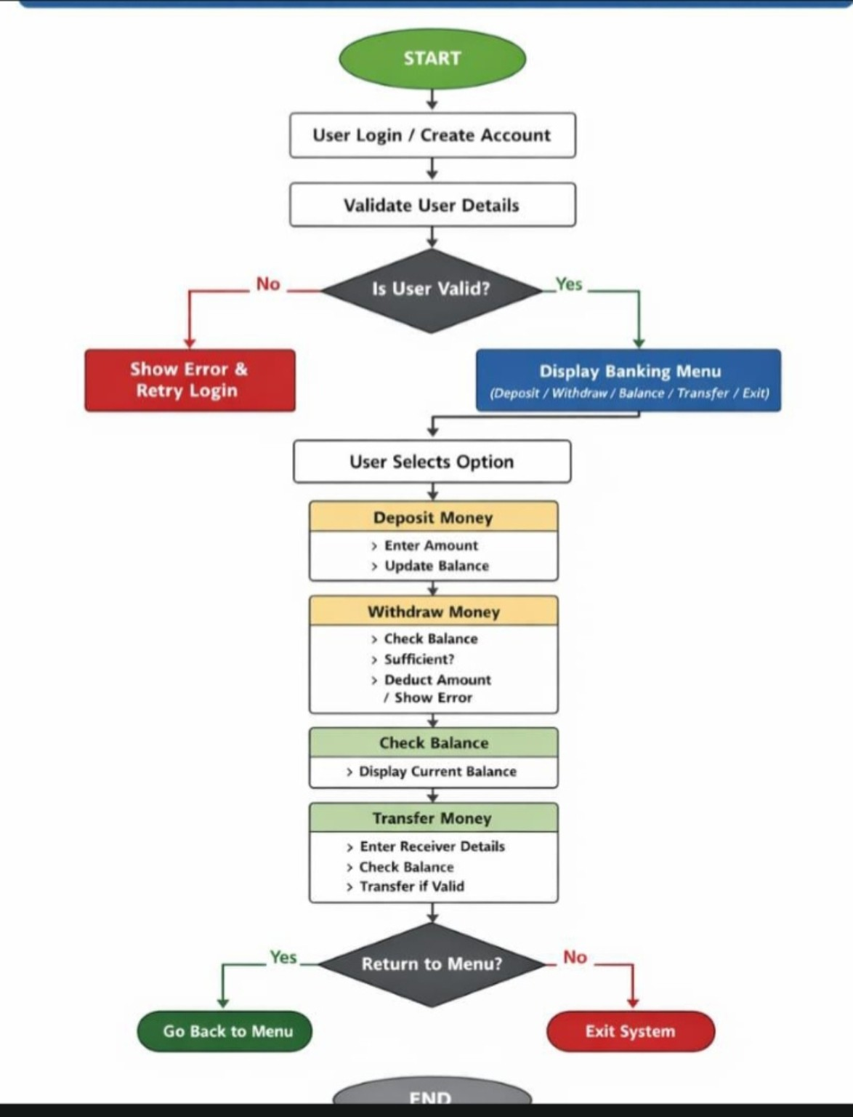
Banking System Flowchart
• The banking system starts by creating an account for the customer.
• Users can deposit money, withdraw funds, and check account balance securely.
• The flowchart clearly explains the sequence of operations performed in the system.
This flowchart explains the complete banking process including account creation, deposits, withdrawals, balance checking, and exit operations.

Slide 8
Methodology
User enters account holder name.
Bank account object is created.
Menu-driven operations are executed.
Balance is updated dynamically.

Slide 9
Project Implementation
Class: BankAccount
Functions: deposit(), withdraw(), checkBalance()
Loop and switch-case used for menu handling.

Slide 10
Results
The system successfully performs banking operations.
It prevents invalid transactions.
Displays updated balance after every operation.

Slide 11
Future Scope
Add login authentication.
Store account details in database.
Implement online transaction features.

Slide 12
Conclusion & References
The project demonstrates a simple banking system simulation.
References: C++ Documentation, GeeksforGeeks, TutorialsPoint

