Slide 1
Password Strength Checker

Slide 2

Introduction: The Escalating Need for Robust Password Security
As digital interactions increase exponentially, password security has become paramount. Every day, millions of accounts face threats from sophisticated cyberattacks. Traditional password practices no longer suffice in today's threat landscape.
With over 80% of data breaches involving compromised credentials, organisations and individuals urgently need intelligent solutions that balance security with usability.

Slide 3
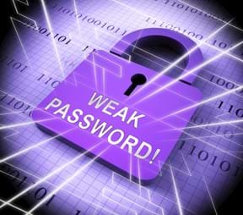

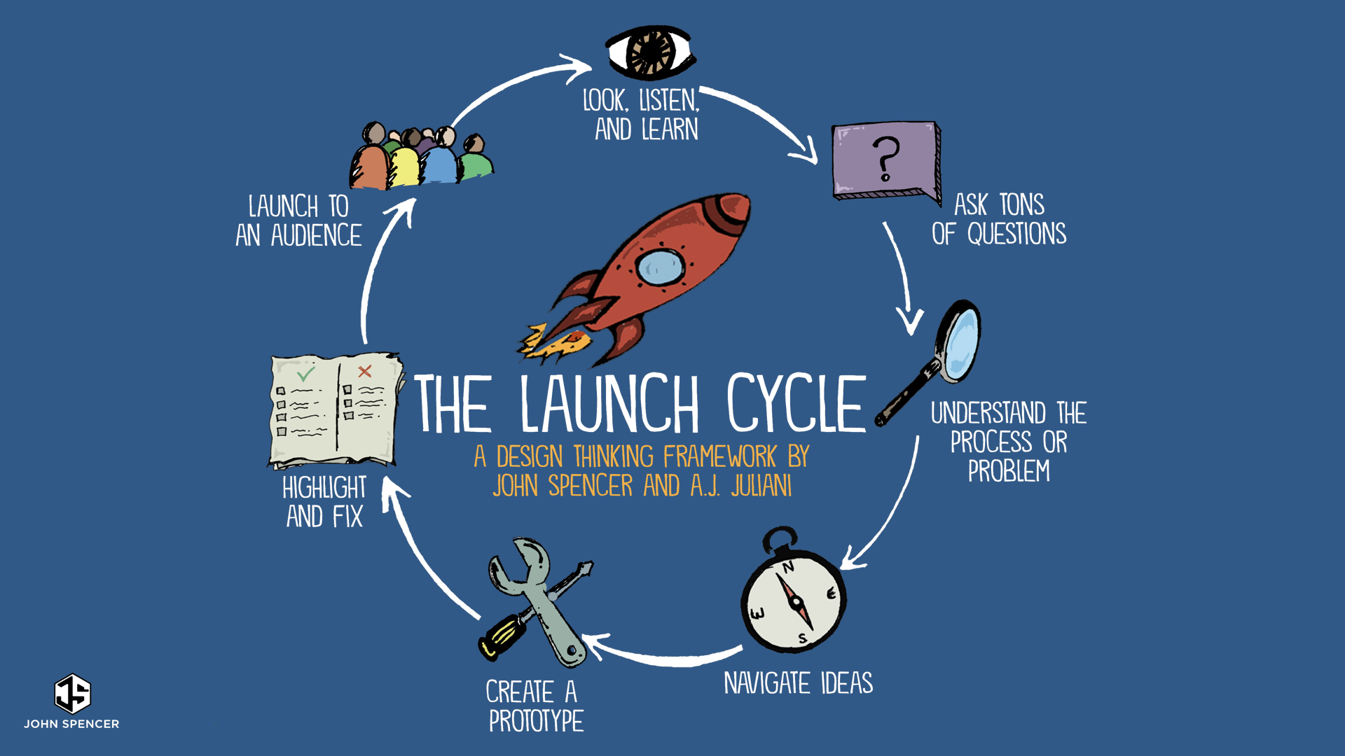

Current Challenges: Weak Passwords, Data Breaches, and User Fatigue
Weak Password Practices
Escalating Data Breaches
User Fatigue
Users often choose easily guessable passwords like 'password123' or reuse the same credentials across multiple sites, creating security vulnerabilities.
Organisations face an average of 270 data breaches annually, with weak passwords being the primary entry point for malicious actors.
Managing numerous complex passwords leads to frustration, resulting in insecure practices like writing passwords on sticky notes or reusing them across platforms.

Slide 4
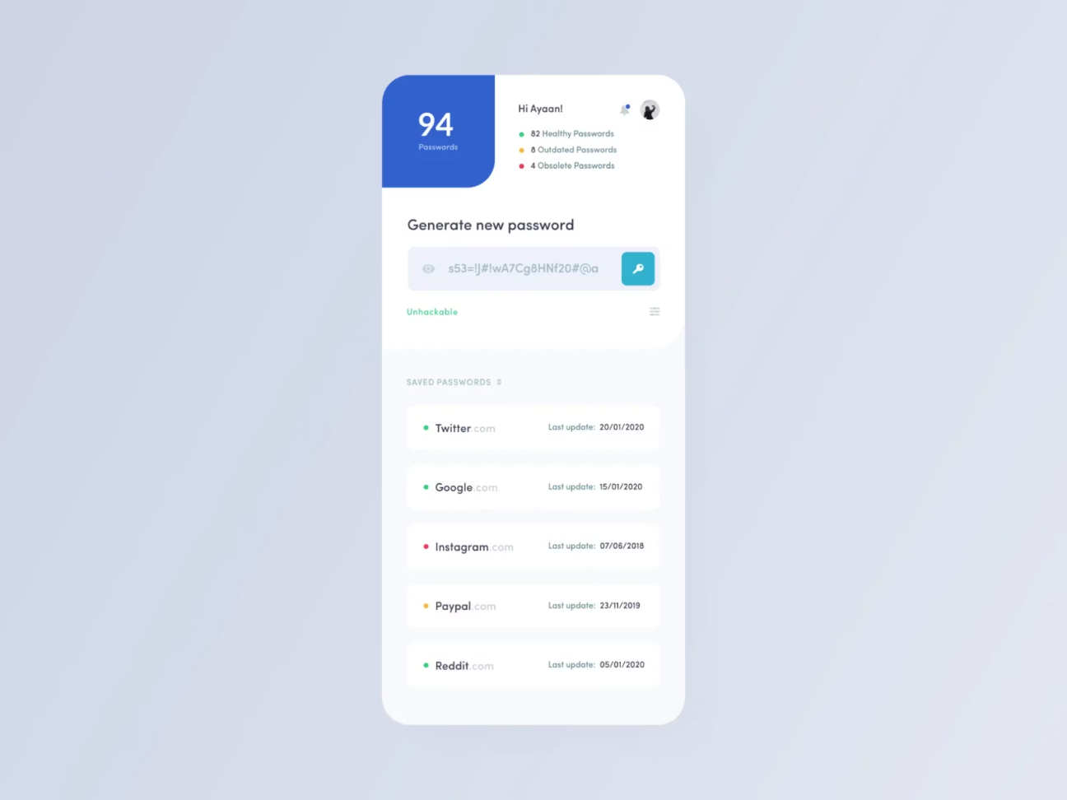
Our Solution: A Smart, Intuitive Password Strength Manager
Introducing an intelligent password strength manager that transforms how users create and manage secure credentials. Our solution combines cutting-edge cryptography with user-friendly design to eliminate security compromises.
The system analyses password patterns in real-time, provides instant feedback, and suggests optimised alternatives without burdening users. It seamlessly integrates with existing authentication systems whilst maintaining enterprise-grade security standards.

Slide 5


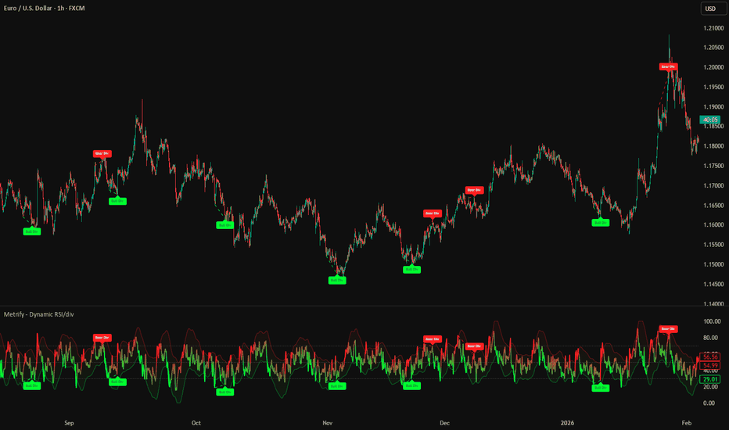
Key Features: Real-Time Feedback, Strength Indicators, and Generation Tools
Real-Time Feedback
Visual Strength Indicators
Smart Generation Tools
Instant analysis as users type, displaying security metrics and identifying patterns that attackers might exploit.
Creates cryptographically secure passwords with user-defined parameters, ensuring optimal security without memorisation burden.
Colour-coded bars and scores that clearly communicate password robustness at a glance, from red (weak) to green (excellent).

Slide 6
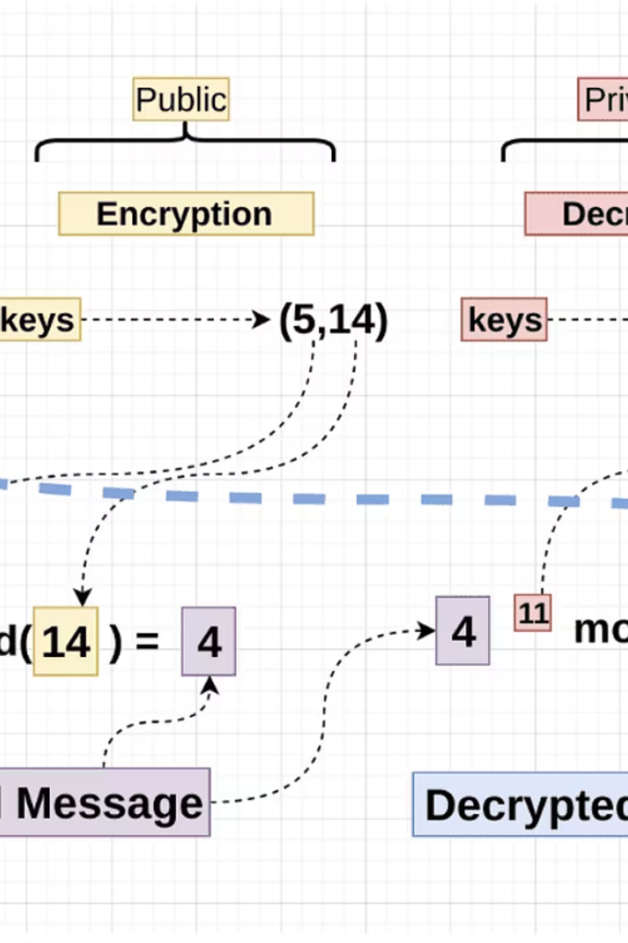




How It Works: Behind the Scenes of Our Algorithms and Analytics
Input Analysis
Scans password for dictionary words, patterns, and common substitutions
Entropy Calculation
Measures randomness and unpredictability using cryptographic principles
Breach Database Check
Verifies against billions of compromised credentials in real-time
Security Score
Generates comprehensive strength rating with actionable recommendations

Slide 7

User Benefits: Enhanced Security, Ease of Use, and Peace of Mind
Enhanced Security
Simplified Management
Protects against brute-force attacks, dictionary attacks, and credential stuffing with enterprise-grade cryptographic standards.
Eliminates password memorisation stress with intuitive interface and automated generation tools that work across all platforms.
Peace of Mind
Continuous monitoring alerts users of compromised credentials, ensuring prompt action before unauthorised access occurs.

Slide 8
Technical Implementation: Architecture, Chosen Technologies, and Future Scope
System Architecture
Technologies Used
Client-side encryption using Web Crypto API
RESTful API for seamless integration
Zero-knowledge architecture ensures privacy
Cloud-based breach database verification
JavaScript/TypeScript for frontend logic
Python/Node.js for backend processing
PostgreSQL for secure data storage
SHA-256 and bcrypt for hashing
Future Enhancements
Planned features include biometric authentication integration, multi-factor authentication support, and passwordless login protocols using WebAuthn standards.

Slide 9
Demo/Use Case: A Live Demonstration of the Password Strength Manager
01
02
03
User Enters Password
Instant Analysis
Visual Feedback
Types or pastes a password into the designated field
System evaluates strength within milliseconds
Displays colour-coded strength meter and detailed breakdown
04
05
Smart Suggestions
Secure Storage
Recommends stronger alternatives if needed
Encrypted storage with optional cloud sync

Slide 10
Thank You

