Slide 1
AptiDaily
C++ Core Placement Practice Engine
Daily challenges • Randomized questions • Score analytics

Slide 2
Abstract
AptiDaily is a C++-based aptitude practice engine designed to support students preparing for placement and competitive examinations. It stores questions by academic year, topic and difficulty level, along with multiple-choice options, correct answers and explanations. The system selects questions for the student's active year, avoids previously completed questions when possible, and shuffles the selection to create a daily challenge. After a quiz is submitted, AptiDaily calculates the score, updates topic-wise statistics, records daily scores and stores attempt history. A dashboard presents the total questions solved, correct answers, overall accuracy, daily challenges completed and topic-level performance. The current implementation demonstrates the core logic in a command-line program using C++ data structures and standard-library algorithms.

Slide 3
Problem Statement & Objectives
• Students need a simple, structured way to practise aptitude questions regularly.
• Manual tracking makes it difficult to review scores and identify weak topics.
• Generate a randomized daily challenge from a question bank.
• Track completed questions and topic-wise correct/total counts.
• Summarize performance using score, accuracy and daily challenge statistics.

Slide 4
System Design & Data Structures
• Question: stores year, topic, level, question text, options, answer index and explanation.
• StudentState: stores student details, topic statistics, daily scores and attempt history.
• vector<Question>: holds the question bank and quiz selections.
• unordered_set<string>: checks completed question texts efficiently on average O(1).
• unordered_map<string, TopicStats>: updates topic-level performance on average O(1).
• std::shuffle with a random engine: randomizes the candidate question order.

Slide 5
Algorithm
• Start and initialize the engine with the student's name and academic year.
• Load the question bank containing questions, options, answers and explanations.
• Filter questions matching the active year and not present in the completed-question set.
• If no eligible questions remain, use the full question bank as a fallback.
• Shuffle the candidate pool and select up to the requested number of questions.
• Display questions and collect the selected option for each question.
• On submission, compare answers, calculate score and update topic statistics and completion records.
• If mode is daily, store the score against the date; append the attempt to history.
• Calculate overall accuracy and display the dashboard; stop.

Slide 6
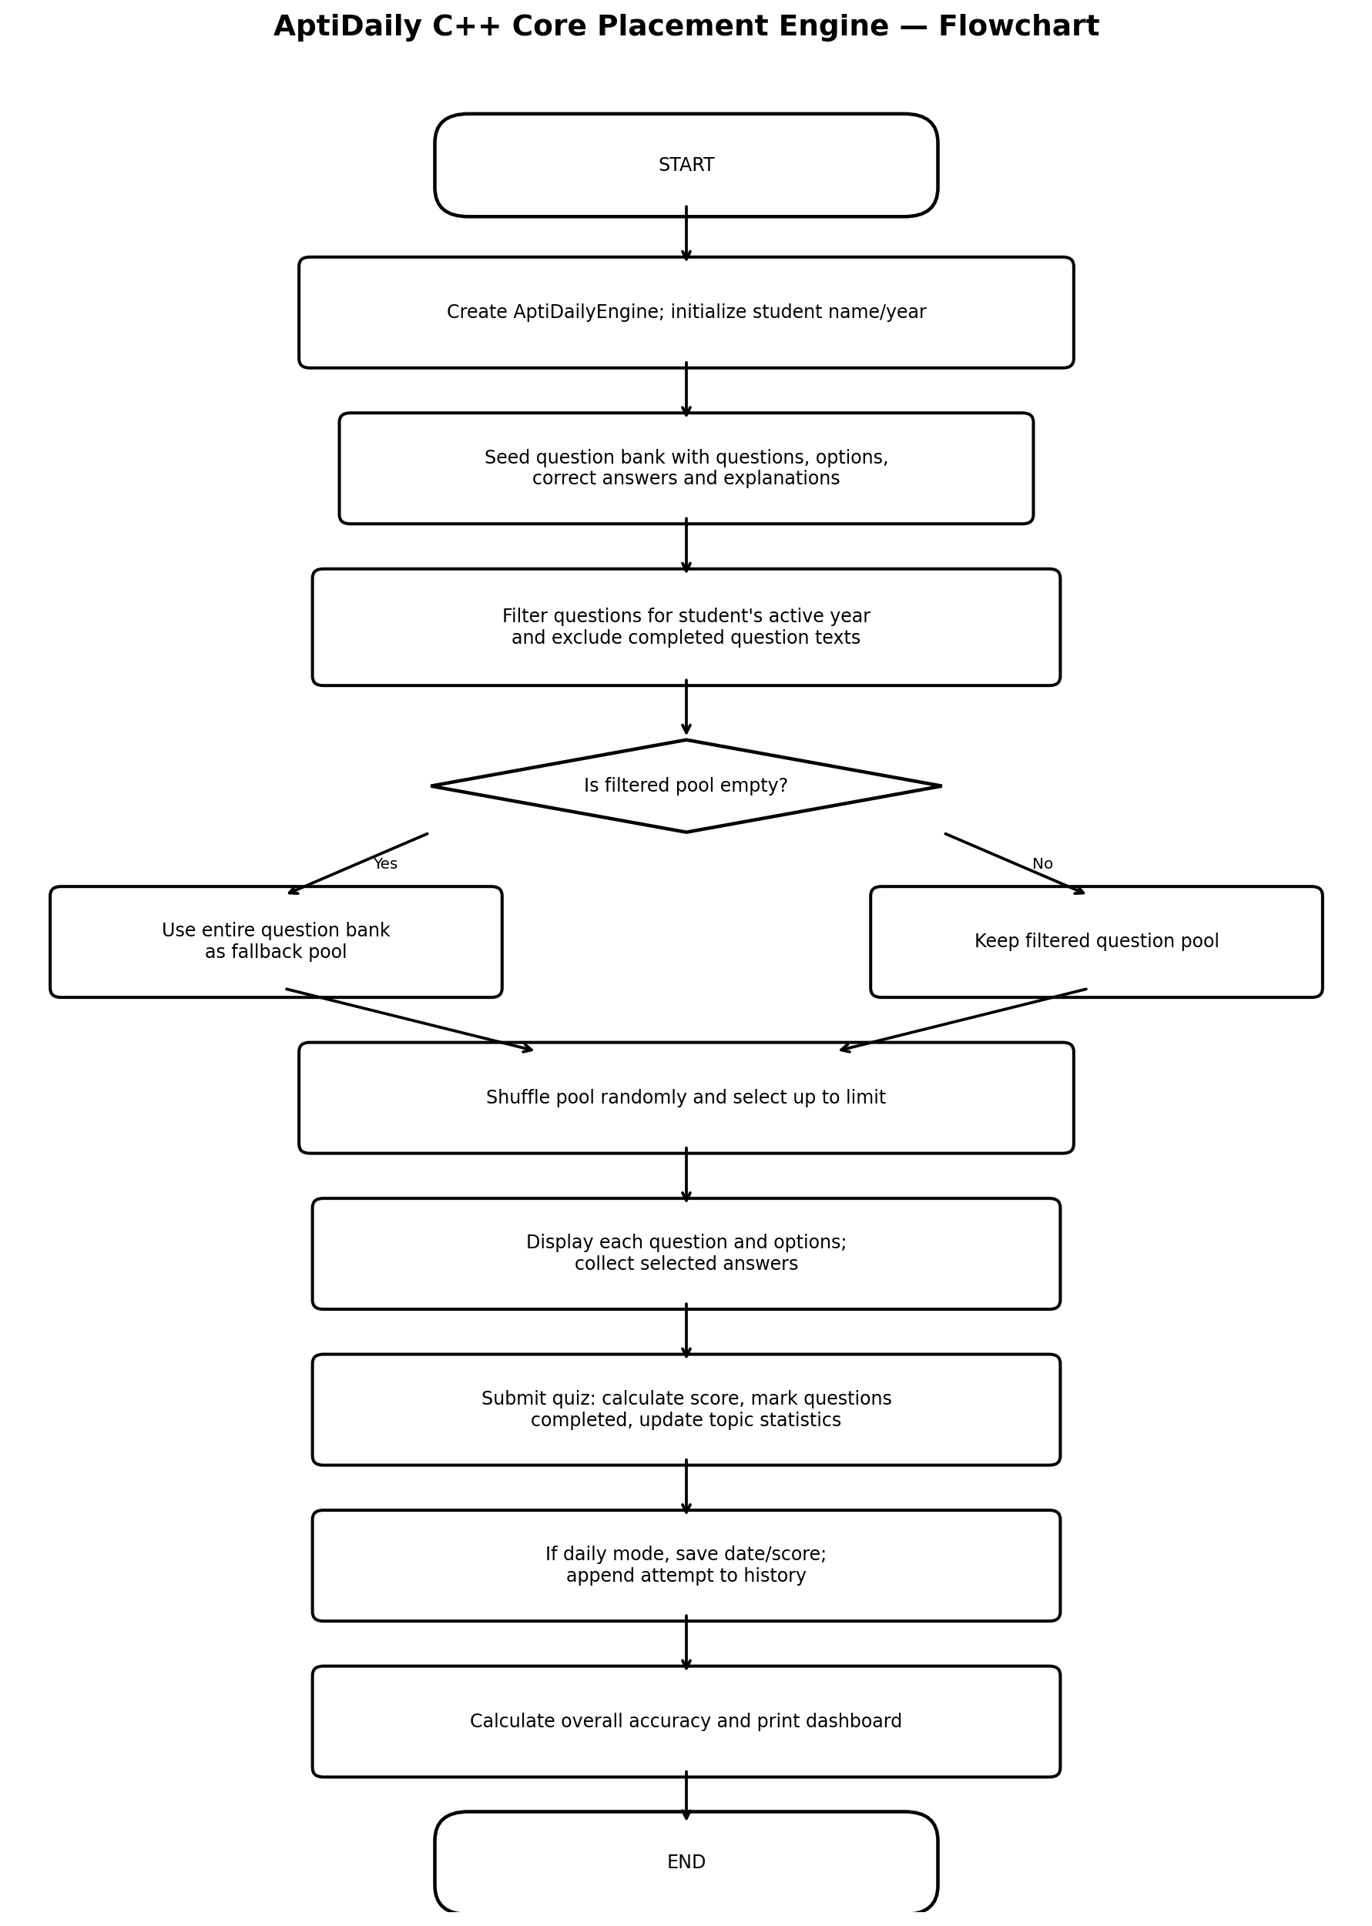
Flowchart
Process overview
Initialize → Select questions → Quiz → Evaluate → Update analytics

Slide 7
Output & Dashboard Analytics
• Displays student name and active academic year.
• Reports total questions attempted and number answered correctly.
• Computes overall accuracy as (total correct ÷ total attempted) × 100.
• Shows the number of dates logged for daily challenges.
• Lists topic-wise correct answers, total attempts and accuracy percentage.

Slide 8
Conclusion & Future Enhancements
• AptiDaily demonstrates a modular C++ workflow for question selection, quiz scoring and performance tracking.
• The use of vectors, hash maps and hash sets supports organized data handling and efficient lookups.
• Current demo uses simulated answers and keeps data in memory during execution.
• Future work: interactive answer input, persistent file/database storage, larger question bank, date automation and a graphical/web interface.

