Slide 1
80
OWNER CONTROL ROOM FOR INDIAN RETAIL
Dukan Drishti
tests passing
231
Plain answers for shop owners, with the reason attached
products in the sample shop
0
Sairam Saladi
GitHub: 25A31A05GA · dukan-drishti.vercel.app
dependencies, pure Python

Slide 2
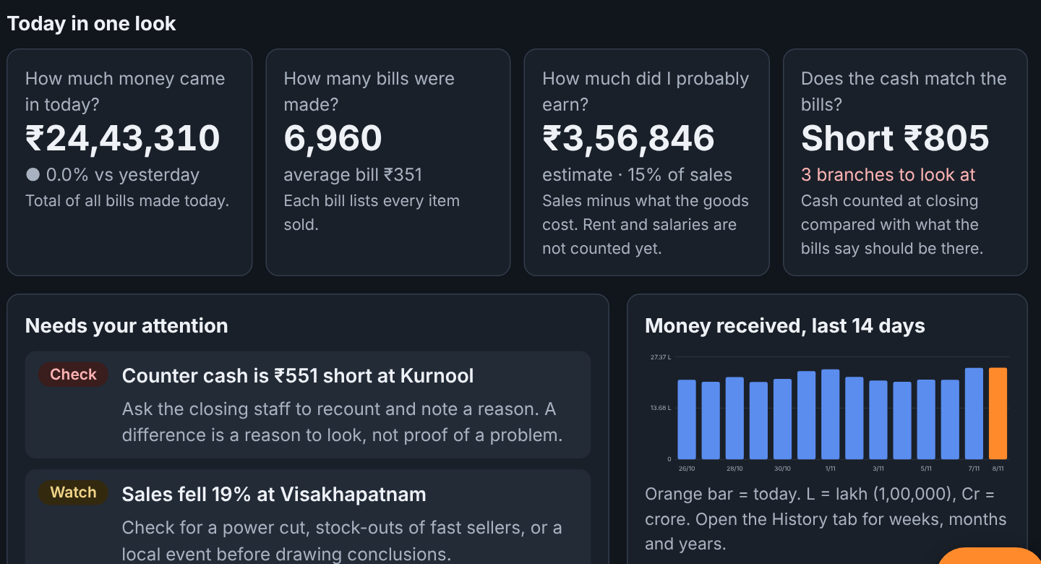
THE PROBLEM
One owner, many bills
▪ An owner cannot watch every branch
▪ Reports come late and need an accountant
▪ "Sales fell" never says why
▪ Offers, suppliers and cash feel like guesses
Screen: Today in one look
Sairam Saladi · Dukan Drishti · 2

Slide 3
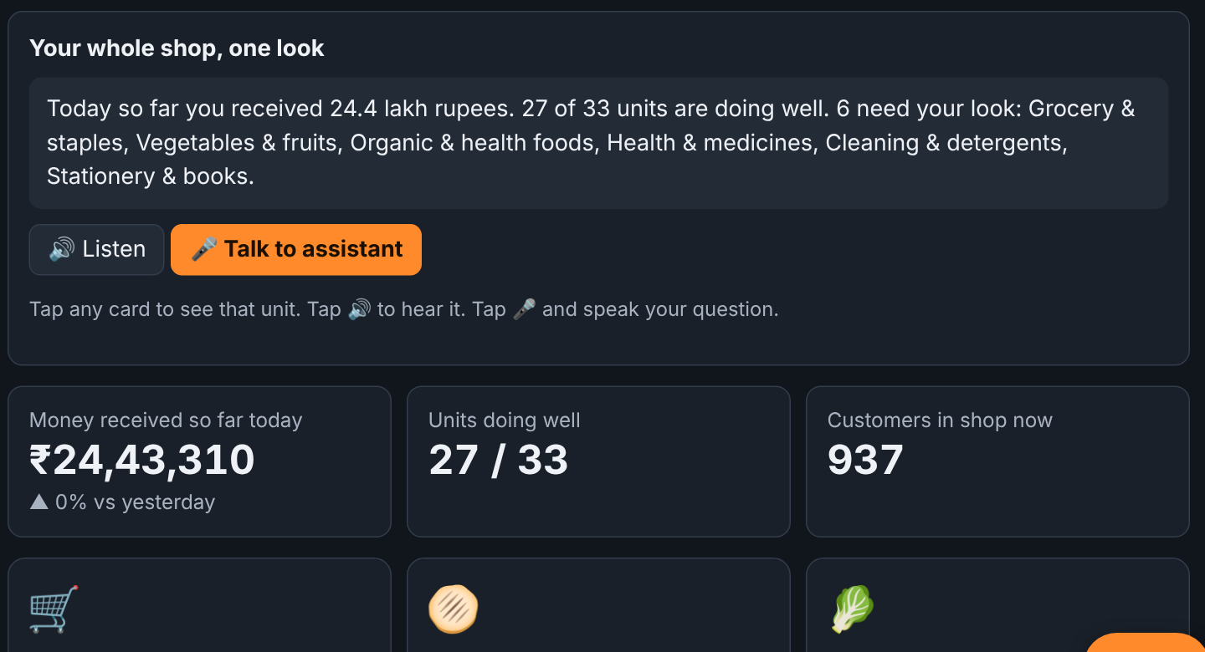
THE IDEA
Short answers, with a reason
▪ Looks at sales, stock, credit and cash
▪ Gives Good, Watch or Check
▪ Says why, and what it does NOT prove
▪ Works for a kirana or a 100-store chain
Screen: All units at a glance
Sairam Saladi · Dukan Drishti · 3

Slide 4
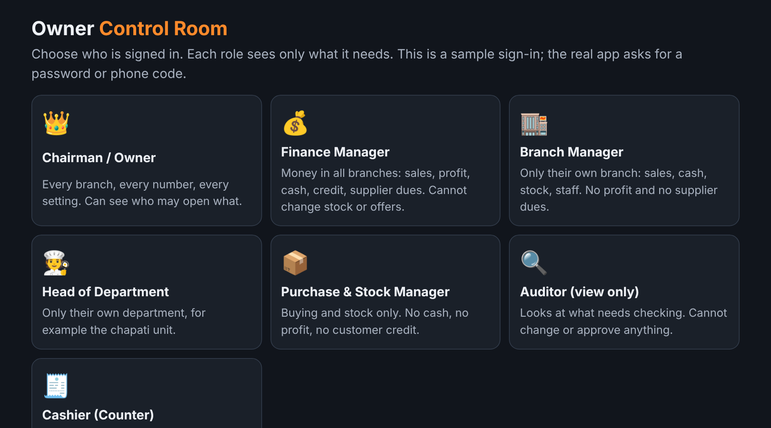
WHO SEES WHAT
Seven roles
▪ Chairman sees every number
▪ Branch manager: own branch, no supplier dues
▪ Cashier: own counter only
▪ Auditor can look, never change
Screen: Choose who is signed in
Sairam Saladi · Dukan Drishti · 4

Slide 5
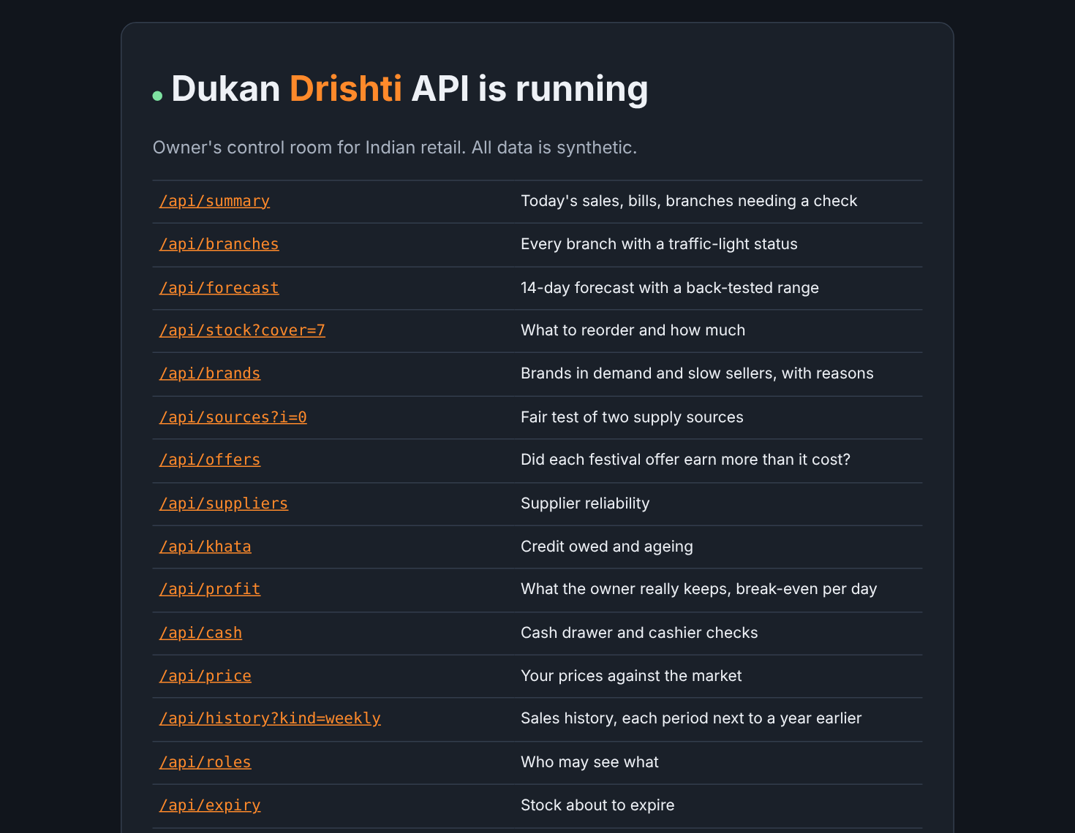
UNDER THE HOOD
Built in pure Python
▪ Nothing to install: standard library only
▪ One rule set shared with the dashboard
▪ Command line and REST API
▪ Styled page for browsers, JSON for programs
Screen: The API home page
Sairam Saladi · Dukan Drishti · 5

Slide 6
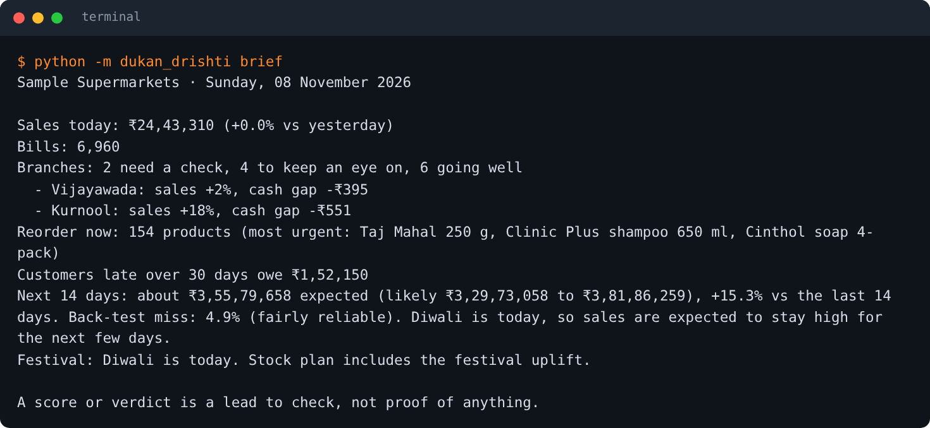
EVERY MORNING
The 30-second brief
▪ Sales today and change vs yesterday
▪ Branches that need a check
▪ Products to reorder first
▪ Late credit and the next 14 days
Screen: python -m dukan_drishti brief
Sairam Saladi · Dukan Drishti · 6

Slide 7
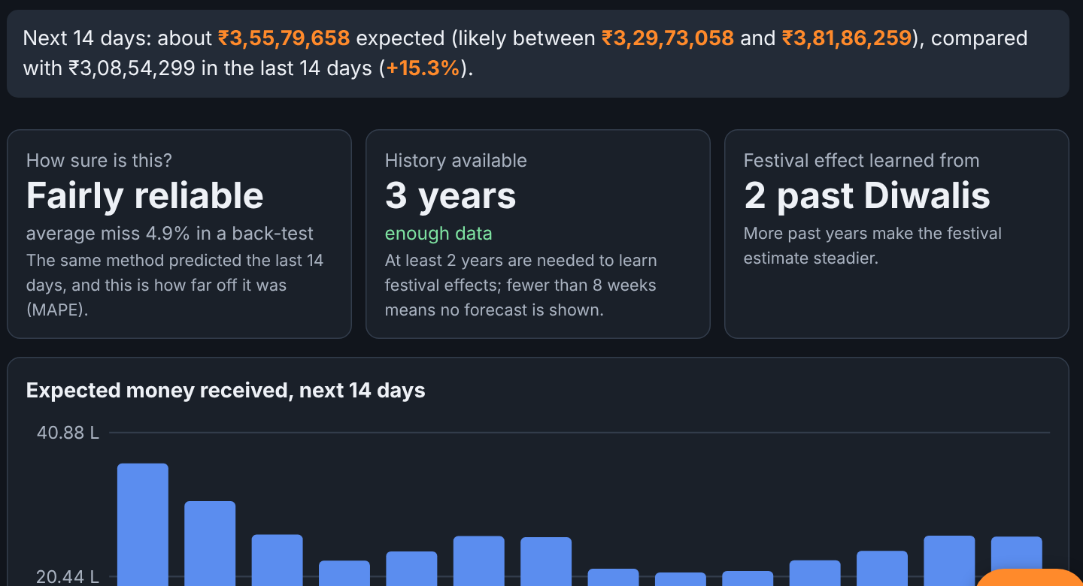
FORECAST
It shows its own error
▪ Predicts 14 days with a likely range
▪ Tested on the last 14 days
▪ No forecast with under 8 weeks of data
▪ Small shop? Labelled "rough guide"
6.2%
6.0%
12.3%
12 stores miss
chain miss
one kirana
Screen: 14-day forecast
Sairam Saladi · Dukan Drishti · 7

Slide 8
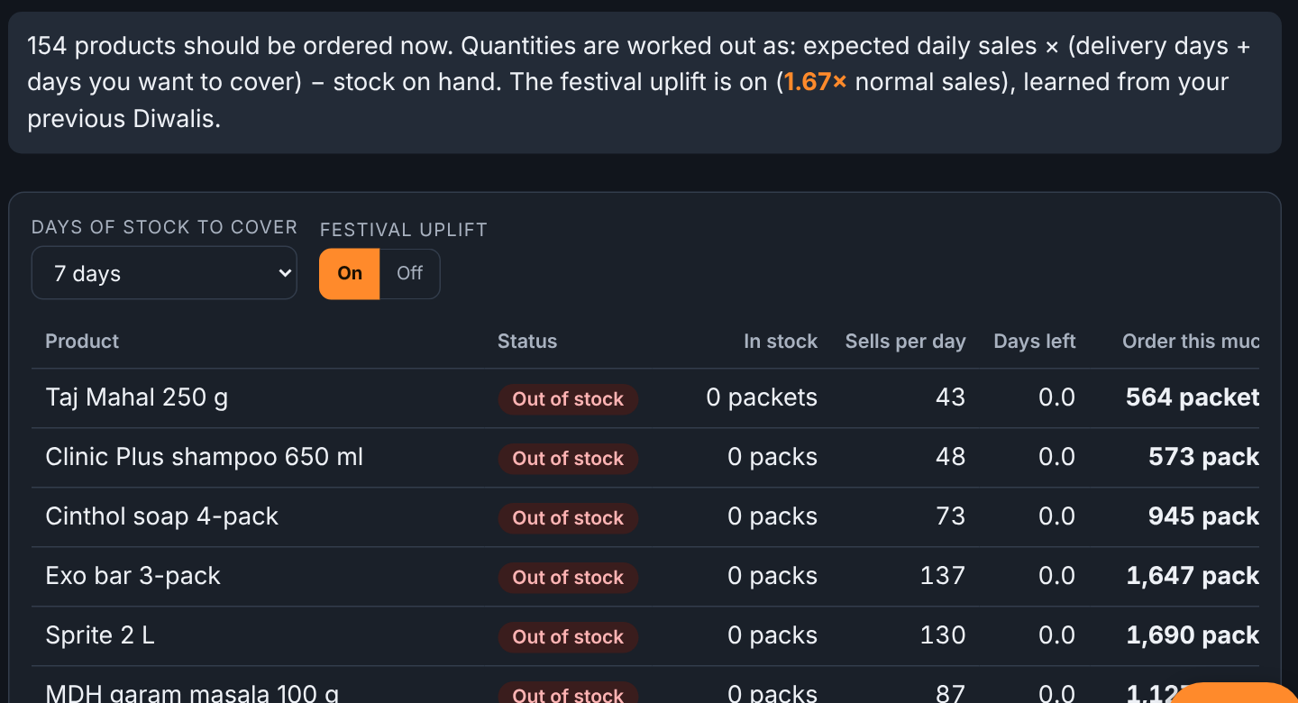
STOCK
What to order, and how much
▪ Daily sales × (delivery + cover) − stock
▪ Diwali uplift of about 1.67×
▪ 154 of 231 products flagged on Diwali
▪ Horlicks: 1 packet left, order 1,965
Screen: Stock and reorder
Sairam Saladi · Dukan Drishti · 8

Slide 9
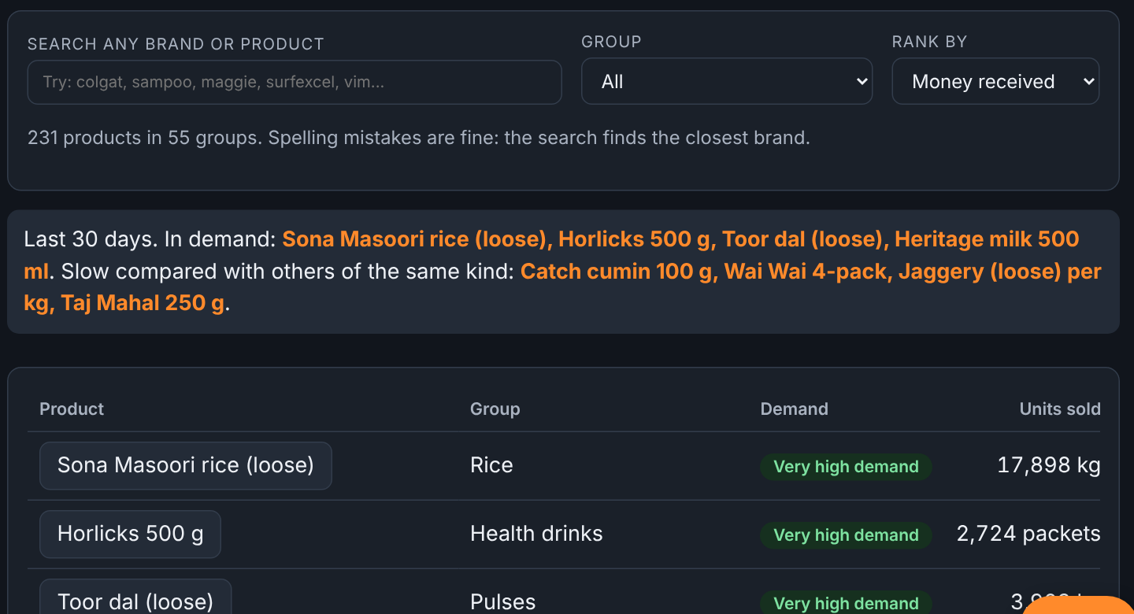
BRANDS
Which brand sells, and why
▪ Verdict plus the reasons
▪ Price gap, stock-outs, offer days
▪ Slow does not mean bad
▪ Compared inside its own group
Screen: Brands and products
Sairam Saladi · Dukan Drishti · 9

Slide 10
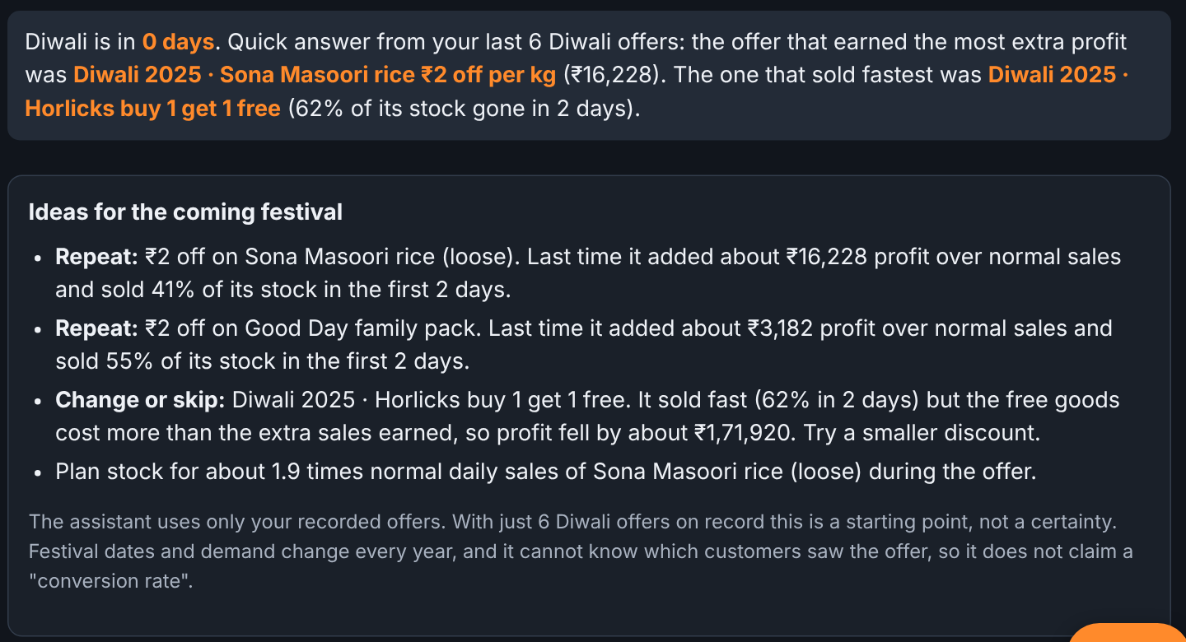
CASE STUDY
The offer that lost money
▪ Diwali 2025, Horlicks buy 1 get 1
▪ Sold about 1,017 extra packets
▪ Free packets cost ₹1,77,640
▪ "Sold out" is not "earned money"
1,017
₹1.78 L
−₹1.72 L
extra packets
free goods
net profit
Screen: Offers and festivals
Sairam Saladi · Dukan Drishti · 10

Slide 11
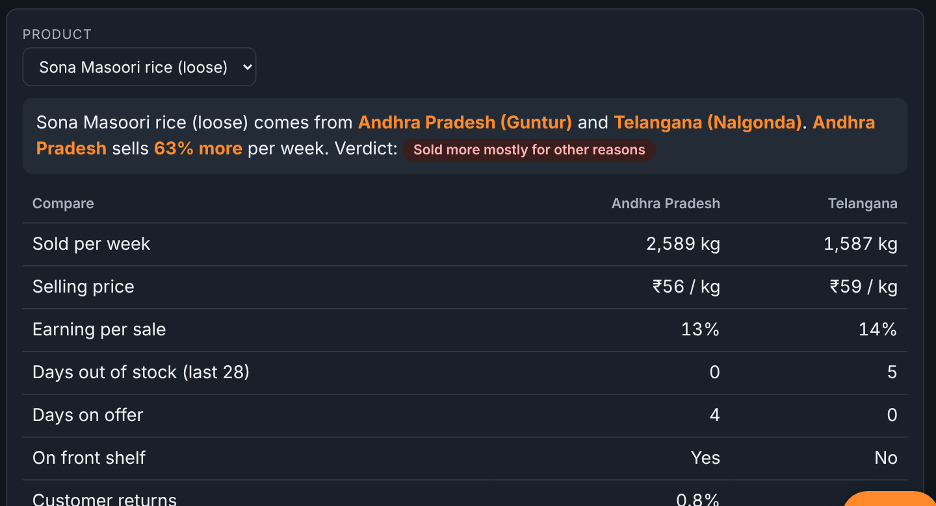
FAIR TEST
Better rice, or just cheaper?
▪ Andhra rice sells 63% more
▪ But it is 5% cheaper
▪ And the other was out of stock
▪ Verdict: other reasons, not proof
Screen: Regional source test
Sairam Saladi · Dukan Drishti · 11

Slide 12
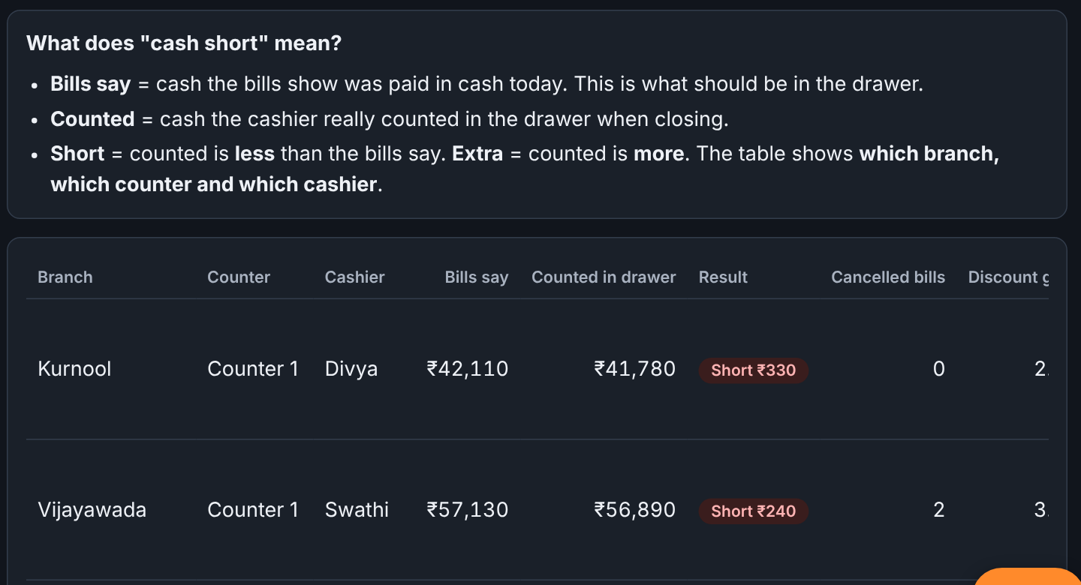
CASH
The drawer that is short
▪ Kurnool, Counter 1: short ₹330
▪ Shows branch, counter, cashier
▪ May mean change error or a cancelled bill
▪ A lead to check, never blame
Screen: Cashiers and cash
Sairam Saladi · Dukan Drishti · 12

Slide 13
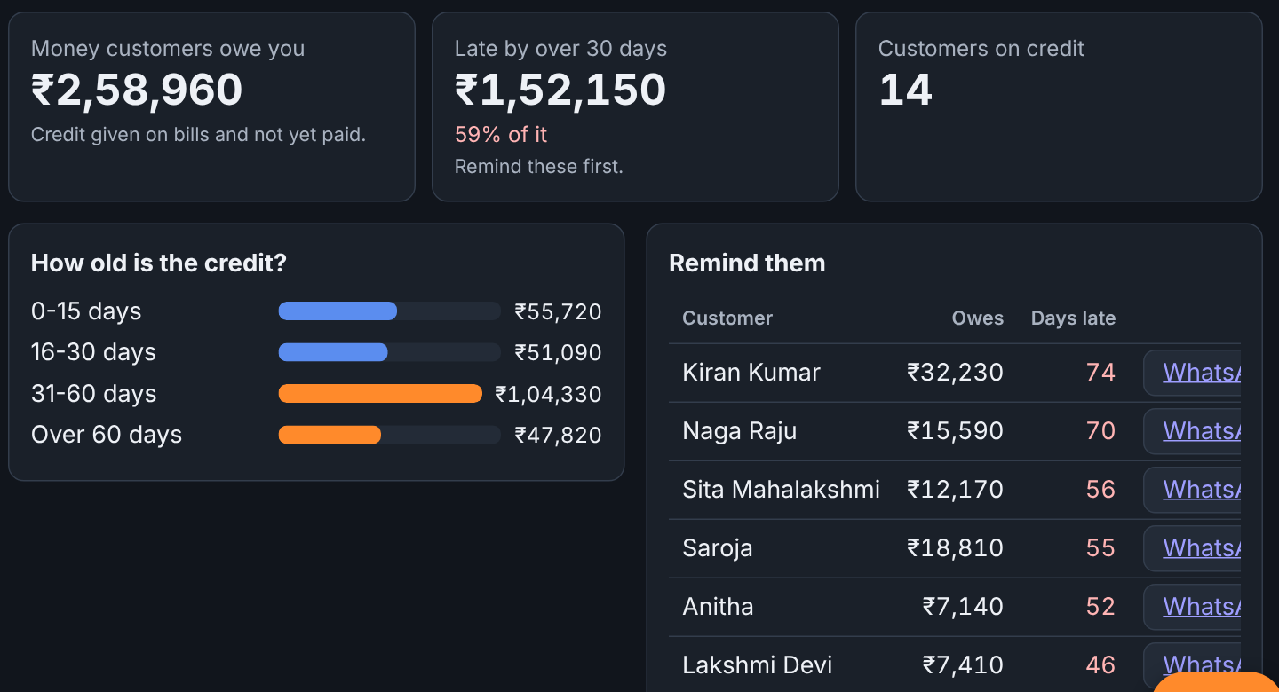
CREDIT
Who owes the shop
▪ ₹2,58,960 owed by 14 customers
▪ 59% is over 30 days late
▪ Oldest first
▪ Ready WhatsApp reminder
₹2.59 L
59%
14
owed
over 30 days
customers
Screen: Credit (khata)
Sairam Saladi · Dukan Drishti · 13

Slide 14
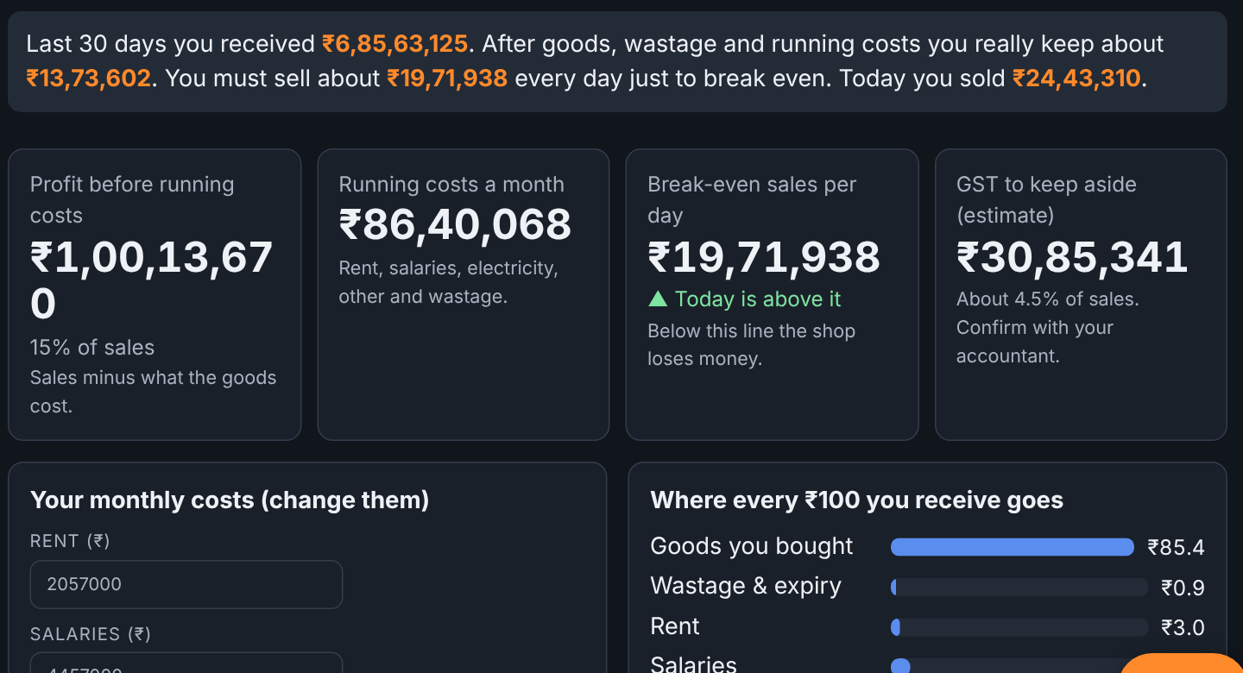
PROFIT
What the owner really keeps
▪ About ₹13.7 lakh kept in 30 days
▪ Break-even ₹19.7 lakh a day
▪ GST to set aside: ₹30.9 lakh
▪ Today is above break-even
Screen: Profit and costs
Sairam Saladi · Dukan Drishti · 14

Slide 15
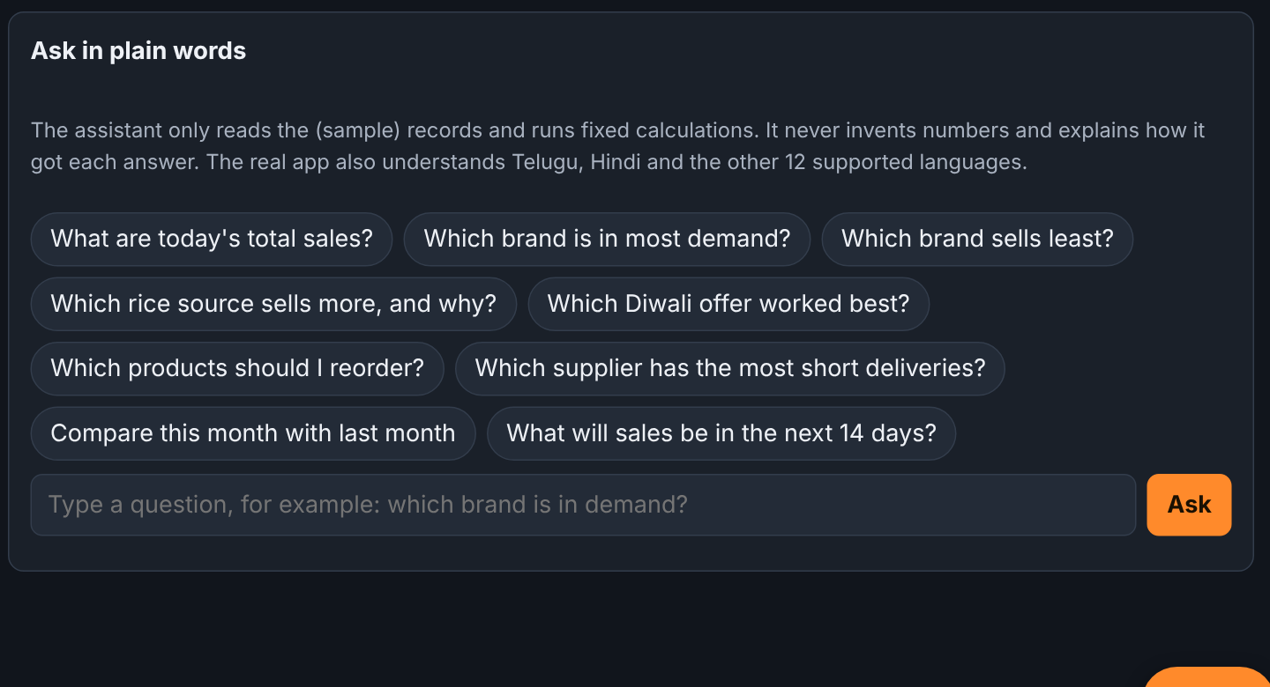
ASK
Plain words, typo friendly
▪ Ask "which brand sells least"
▪ Finds "horlix" as Horlicks
▪ Right product in top 3: 95.3%
▪ Random letters wrongly matched: 1.25%
Screen: Ask the assistant
Sairam Saladi · Dukan Drishti · 15

Slide 16
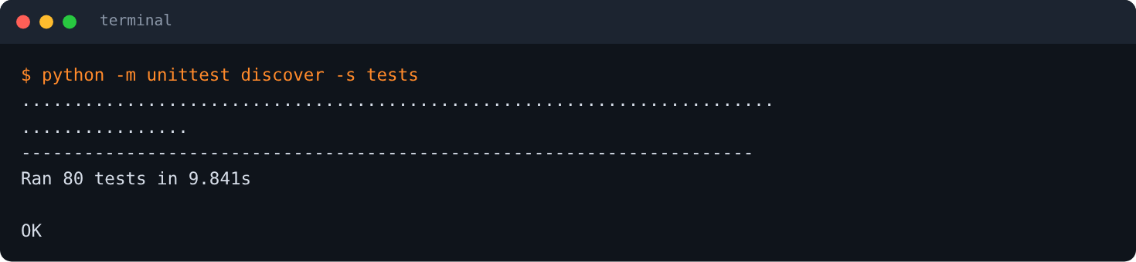
PROOF
How I know it is right
▪ Python compared with the dashboard's own JavaScript
▪ Matches to 12 decimals
▪ Screens match what the dashboard prints
▪ 80 tests, about 10 seconds
Screen: 80 tests, all passing
Sairam Saladi · Dukan Drishti · 16

Slide 17
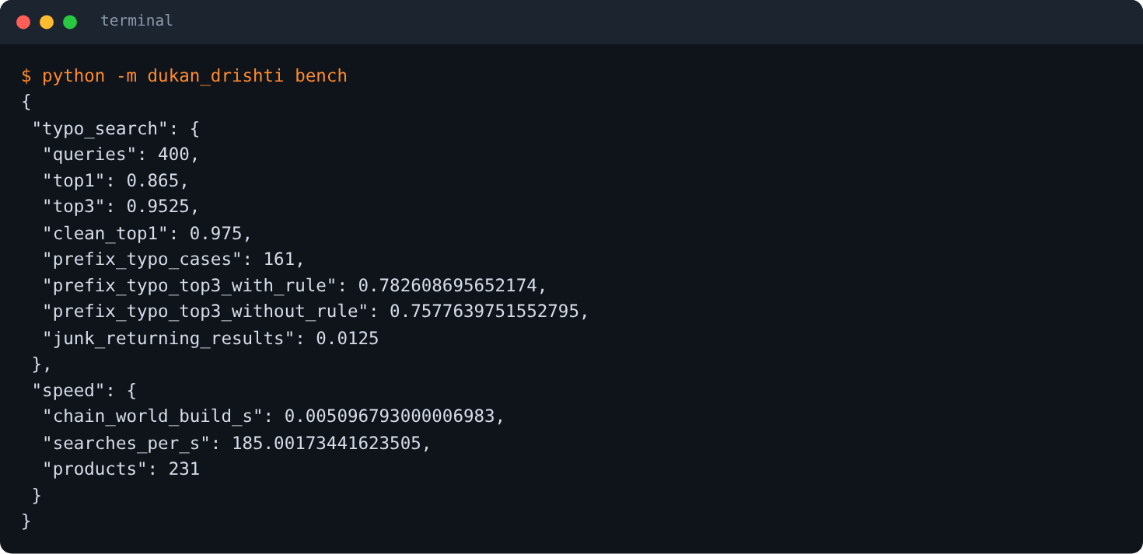
HONESTY
What went wrong
▪ Dashboard has 231 products, not 18
▪ My first search fix cut accuracy to 77.3%
▪ Re-ran the test, fixed it, back to 86.5%
▪ I corrected my own wrong claim
Screen: python -m dukan_drishti bench
Sairam Saladi · Dukan Drishti · 17

Slide 18
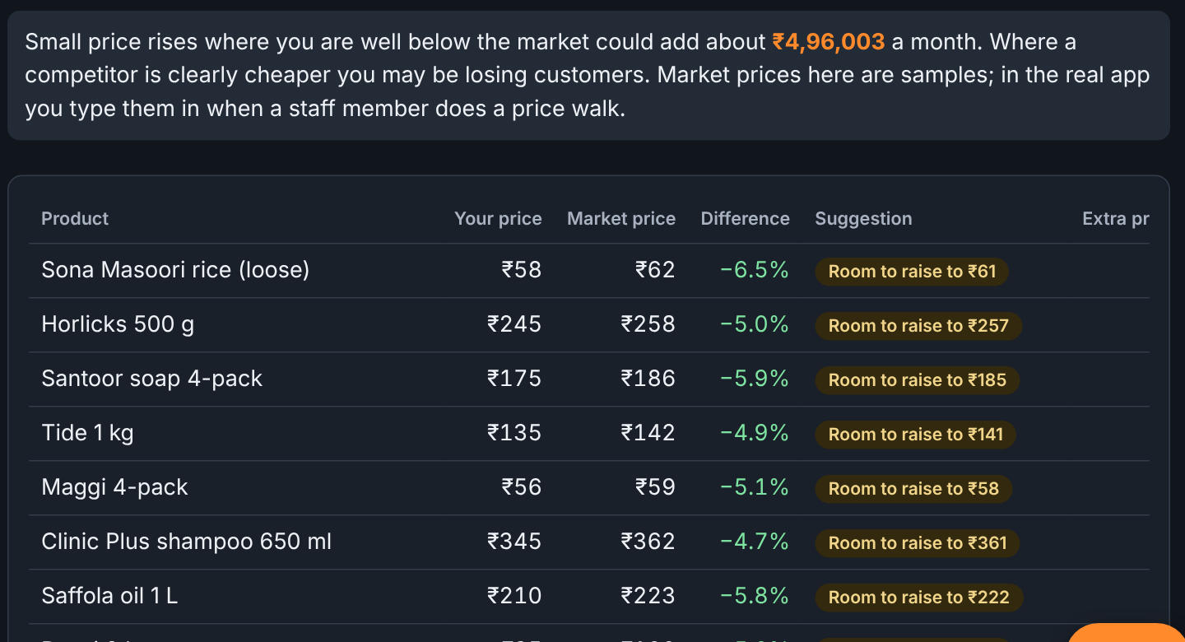
CASE STUDY
Room to raise a price
▪ Sona Masoori: ₹58 vs market ₹62
▪ You are 6.5% below the market
▪ Raise to ₹61: about ₹53,694 a month
▪ Raise ₹1 first, then watch
Screen: Price watch
Sairam Saladi · Dukan Drishti · 18

Slide 19
LIMITS AND NEXT
Said out loud
Limits
Next
▪ Sample data only
▪ Not tested on a real shop
▪ No login or database yet
▪ Import real bills from CSV
▪ SQLite storage
▪ Telugu and Hindi in Python
▪ WhatsApp morning brief
Sairam Saladi · Dukan Drishti · 19

Slide 20
Thank you
Sairam Saladi
GitHub: 25A31A05GA
Live: dukan-drishti.vercel.app
Email: [add your email] LinkedIn: [add your link]

