Slide 1
EXPENSE TRACKER
Presented By:
Your Name

Slide 2
ABSTRACT
Expense Tracker is a simple C++ programming project used to maintain daily expense records digitally. The system allows users to add expenses, view expenses, calculate total expenses, add income, and calculate savings.

Slide 3
INTRODUCTION
Expense Tracker is developed using C++ programming language to help users manage expenses efficiently. The system stores expense details digitally and calculates total expenses and savings automatically.

Slide 4
OBJECTIVES
• Maintain expense records
• Calculate total expenses
• Add income details
• Calculate savings
• Reduce manual calculations

Slide 5
ALGORITHM
1. Start program
2. Display menu
3. Add/view expenses
4. Add income
5. Calculate savings
6. Exit program

Slide 6
FLOWCHART
Start
↓
Display Menu
↓
Enter Choice
↓
Add/View Expenses
↓
Calculate Savings
↓
Stop

Slide 7
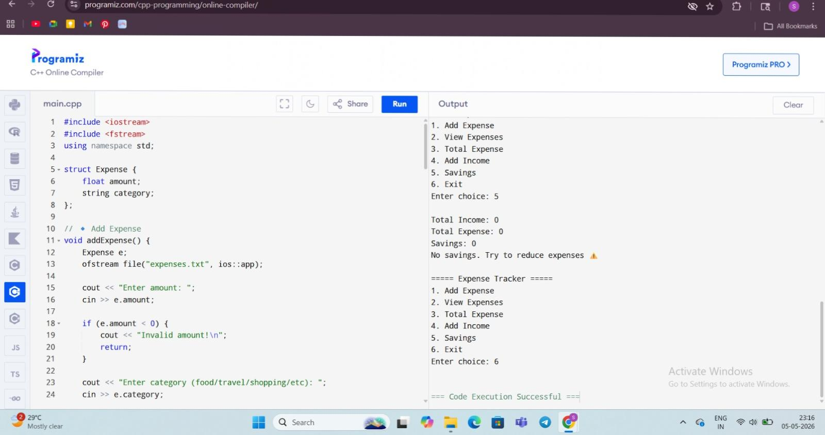
RESULT
Paste screenshots of:
• Main Menu
• Add Expense
• View Expenses
• Savings Calculation

Slide 8
ADVANTAGES
• Easy to use
• Saves time
• User-friendly
• Calculates savings automatically

Slide 9
CONCLUSION
The Expense Tracker project successfully manages expense and income records efficiently using C++ programming concepts.

Slide 10
FUTURE WORK
In future, this project can be improved by adding database connectivity and graphical user interface features.

