Slide 1
LIBRARY MANAGEMENT SYSTEM
Presented By:
Your Name

Slide 2
ABSTRACT
The Library Management System is developed using C programming language to manage library records digitally. It helps in adding and displaying books easily.

Slide 3
INTRODUCTION
This project simplifies library record management using C programming. It reduces manual work and stores book details digitally.

Slide 4
OBJECTIVES
• Maintain records digitally
• Reduce manual work
• Add and display books
• Easy to use system

Slide 5
ALGORITHM
1. Start program
2. Display menu
3. Read choice
4. Add/display books
5. Exit program

Slide 6
FLOWCHART
Start
↓
Display Menu
↓
Enter Choice
↓
Perform Operation
↓
Stop

Slide 7
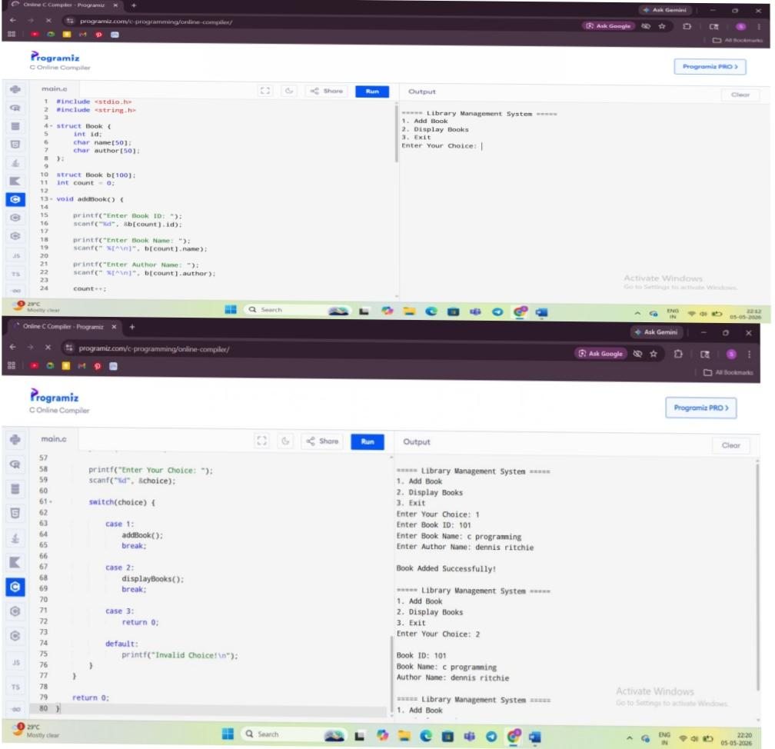
RESULT
Paste your program screenshots here.

Slide 8
CONCLUSION
The Library Management System manages library records efficiently and demonstrates practical implementation of C programming concepts.

