Slide 1
C++ PROJECT
BANKING
SYSTEM
A Console-Based Banking Application using Object-Oriented C++
Department of Computer Science | Dev-C++ 5.11 | GitHub Version Control | 2025–2026

Slide 2
01 | ABSTRACT
Overview This project presents a console-based Banking System built in C++ using Object-Oriented Programming (OOP). It simulates real banking operations and is version-controlled on GitHub. Core Focus The system is structured around four classes — Account, User, Bank, and main() — each with a distinct responsibility. STL vectors handle dynamic in-memory data storage. Key Concepts Encapsulation, modular design, dynamic memory, and input validation are the core engineering principles demonstrated.
C++
Language
Dev-C++
IDE
OOP
Paradigm
GitHub
Version Control
Banking System — C++ Project Report

Slide 3
02 | INTRODUCTION
A Banking System is a critical software application that manages financial data, ensures transaction integrity, and provides secure access to user accounts. This C++ project demonstrates these concepts in a simulated console environment.
01
OOP Design
02
Core Features
03
GitHub Workflow
Apply classes, encapsulation & dynamic memory management in C++.
Deposit, Withdraw, Transfer & Transaction History operations.
Feature-branch strategy, Pull Requests & clean commit history.
Technologies Used:
C++
Dev-C++ 5.11
STL Vectors
GitHub
OOP Classes
g++ Compiler

Slide 4
03 | ALGORITHM
Register
Login
Deposit
Input username & password
Check if username exists
If not → Create User + Account
Assign account number (1001+)
Save to users list
Input username & password
Loop through all users
Match both credentials
On success → load Banking Menu
On fail → show error
Input amount
Check amount > 0
balance += amount
Save to transaction history
Print confirmation
Withdraw
Transfer
Exit
Input amount
Check amount > 0
Check amount <= balance
balance -= amount
Save to history
Input receiver acc + amount
Search receiver in users[]
Verify sender balance
Sender withdraw, receiver deposit
Update both histories
User selects Exit
Loop ends
Delete all User pointers
Free allocated memory
Program terminates

Slide 5
04 | FLOWCHART
START / main()
Create Bank Object
Register
Main Menu Choice?
Exit
Create User
+ Account
Login
Banking Menu
Balance
Deposit
Withdraw
Transfer
History
← All operations update Account & Transaction History →
Logout / END

Slide 6
05 | METHODOLOGY
01
02
03
04
05
Requirements
Analysis
System
Design
Implementation
Version Control
Testing
Identified functional & non-functional requirements: login, transactions, validation, modularity.
Designed 4 OOP classes: Account, User, Bank, main(). Each with a single clear responsibility.
Coded in C++ with .h/.cpp separation. Used STL vectors for dynamic storage and new/delete for memory.
Managed on GitHub with feature branches. Each feature had its own branch, PR, and merge to main.
Manual testing in Dev-C++ 5.11. Verified all edge cases: invalid input, zero amounts, insufficient balance.
Git Workflow: git checkout -b feature/X → git commit → git push → Pull Request → Merge to main

Slide 7
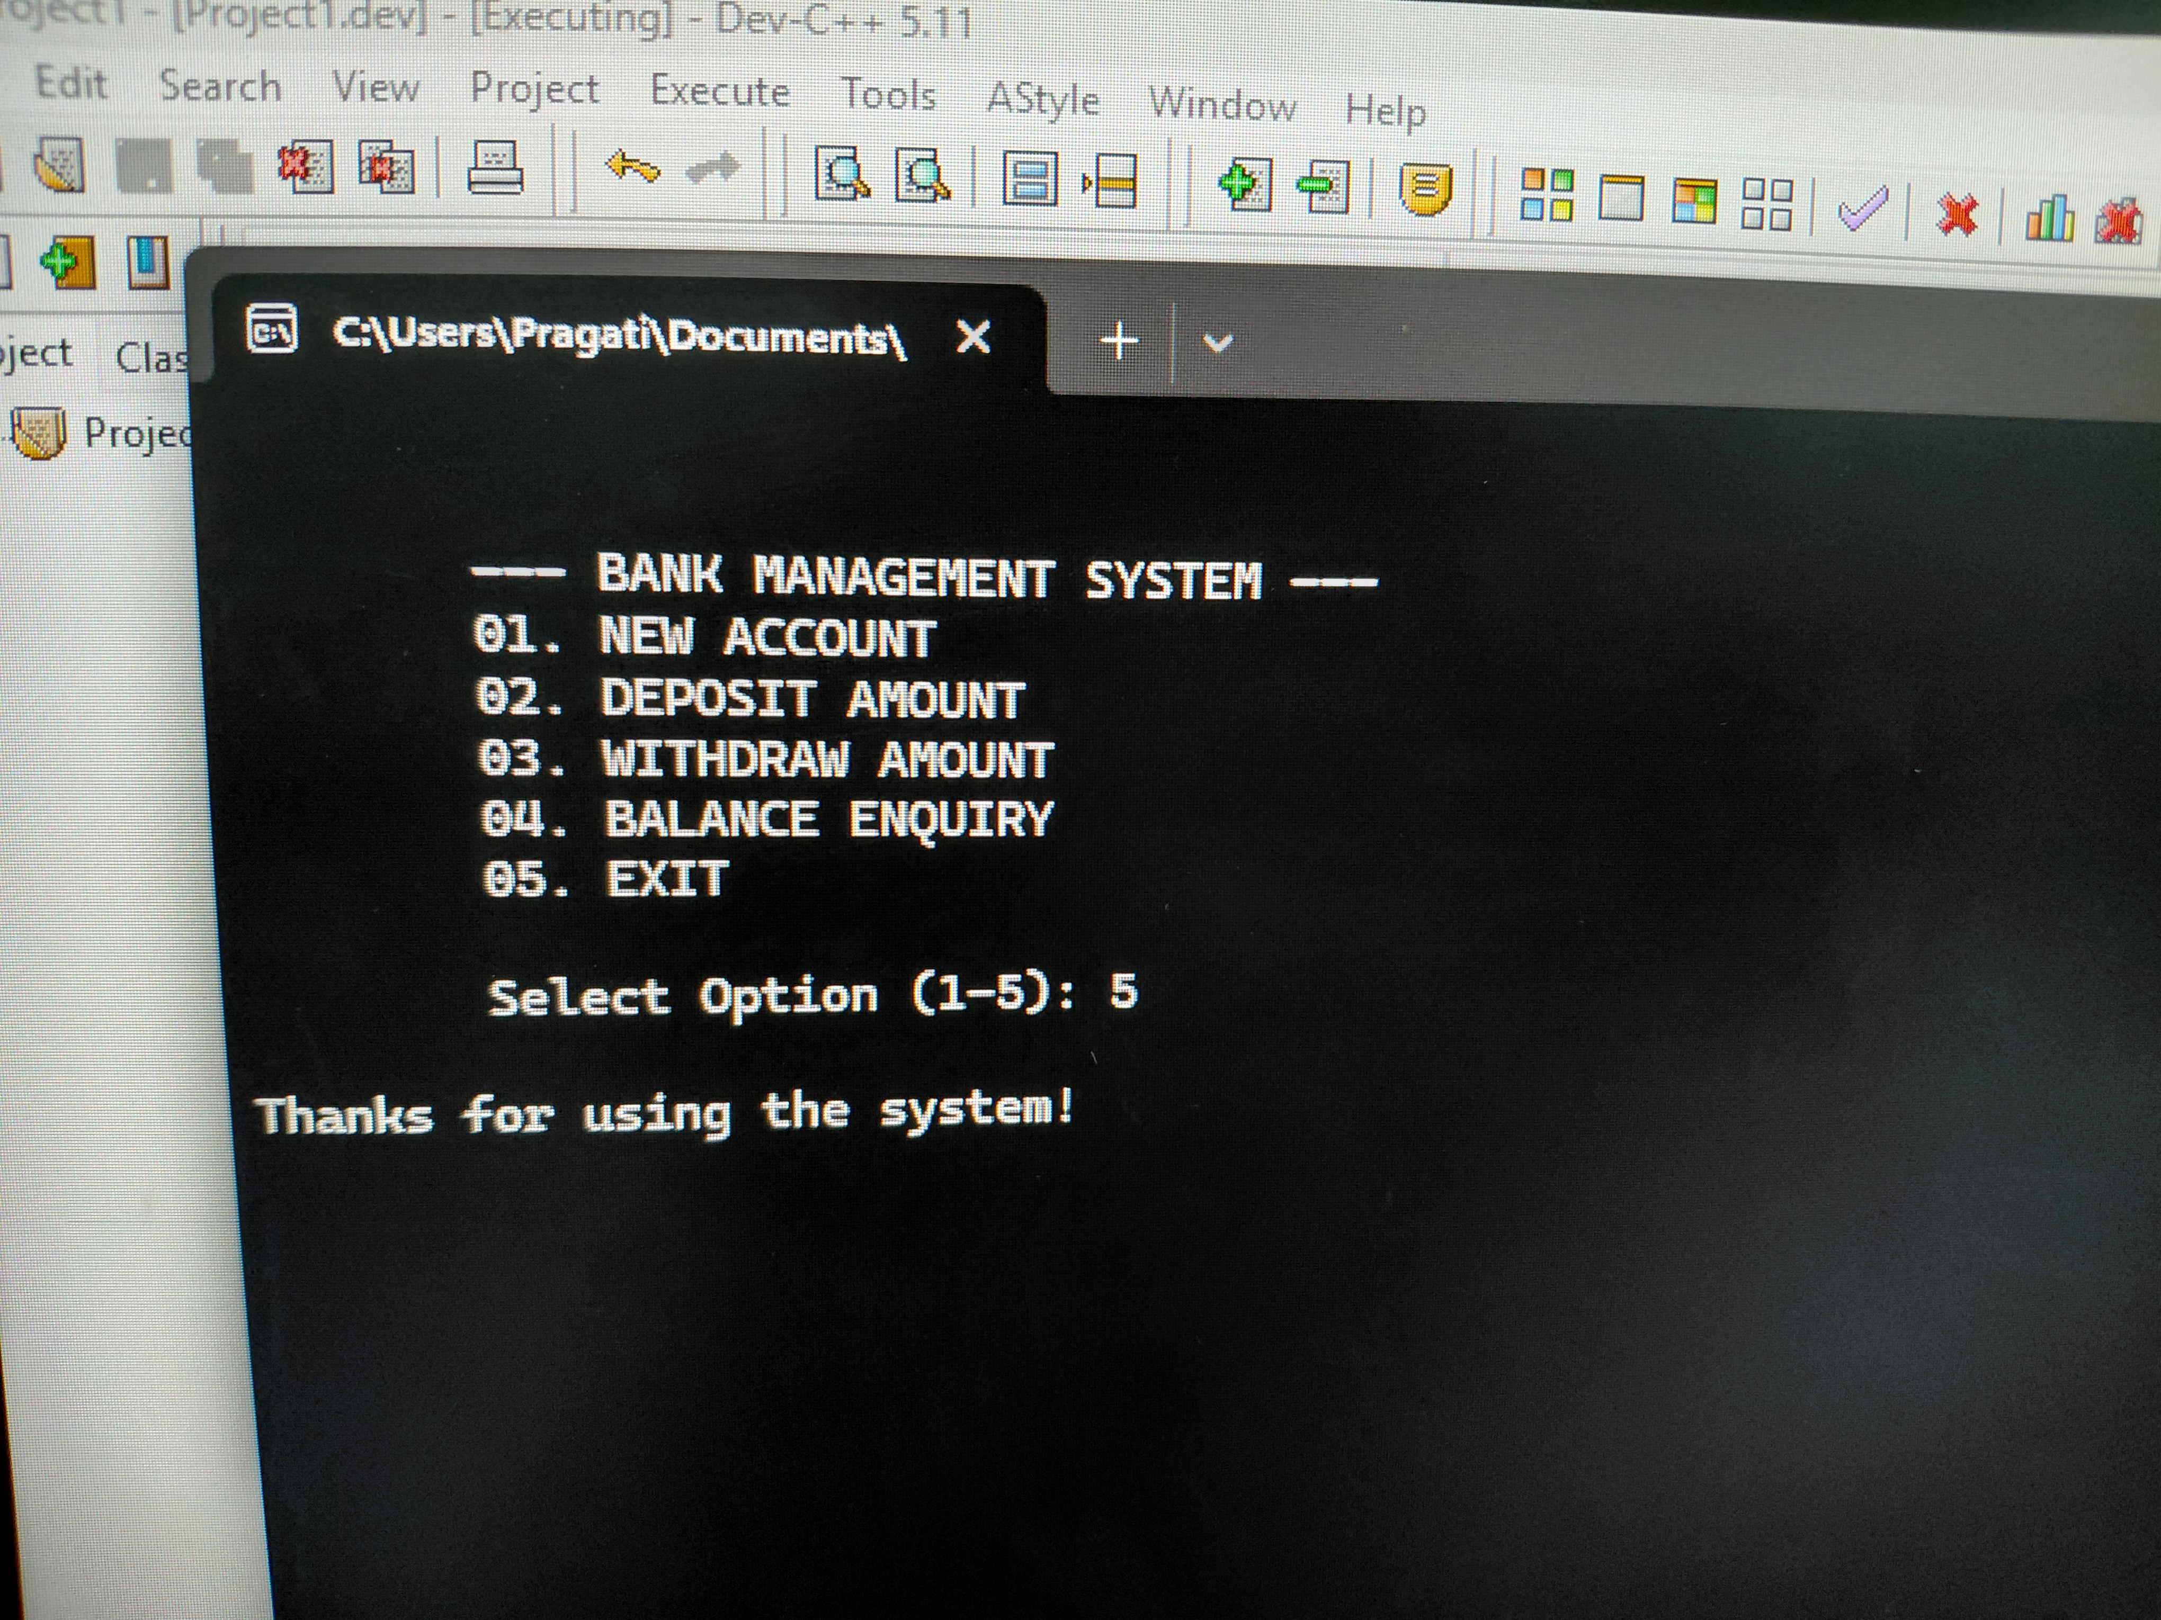
06 | RESULT
Test Results
Feature | Status
New Account | ✔ PASS
Login / Auth | ✔ PASS
Deposit | ✔ PASS
Withdraw | ✔ PASS
Balance Enquiry | ✔ PASS
Exit Gracefully | ✔ PASS
Fig 1: Bank Management System running in Dev-C++ 5.11
🎯 ALL TESTS PASSED — 6 / 6

Slide 8
07 | CONCLUSION
The Banking System project successfully demonstrates how OOP principles can be applied to model a real-world domain in C++. Each class serves a distinct role: Account manages balances & history User handles credentials & ownership Bank orchestrates all operations main() is the minimal entry point All 6 features passed testing. The project is fully managed on GitHub using a clean feature-branch workflow.
✔
OOP Applied
✔
6 Features Built
✔
All Tests Passed
✔
GitHub Managed
This project provides a strong foundation for future development into a production-grade banking application.

Slide 9
08 | FUTURE WORK
💾 File Storage
HIGH
🔒 Password Hashing
HIGH
🖥 GUI Interface
MEDIUM
Save data between sessions using file I/O or SQLite database.
Encrypt passwords using SHA-256 or bcrypt for security.
Replace console with Qt or web-based front-end.
💳 Account Types
MEDIUM
🏦 Loan Module
LOW
🌐 REST API Layer
LOW
Add savings, checking, and fixed deposit account types.
Implement loan application and repayment tracking.
Expose banking operations via API for mobile or web clients.

Slide 10
THANK YOU
Banking System — C++ Project
Language: C++ IDE: Dev-C++ 5.11 Version Control: GitHub
Department of Computer Science | 2025–2026
Questions & Discussion

